Slide 1
Elektronisk bestillingsverktøy
Basware Purchase Management ; PM
Varemottak – mine anmodninger

Slide 2
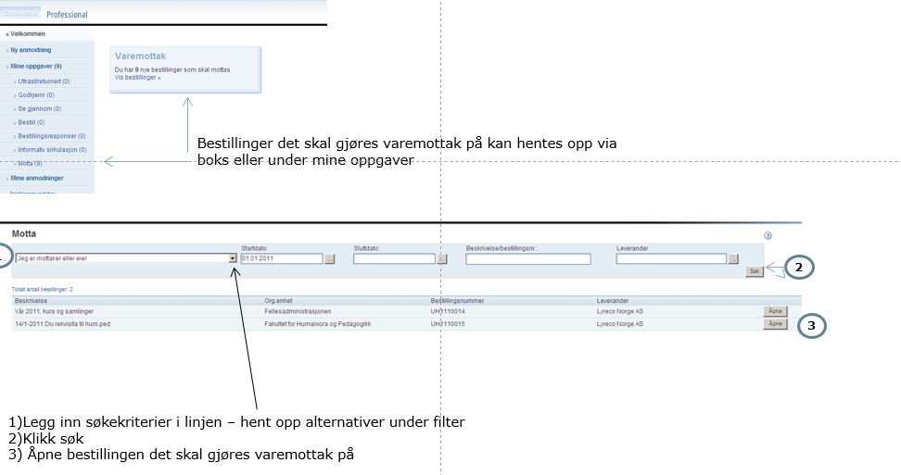
Varemottak

Slide 3
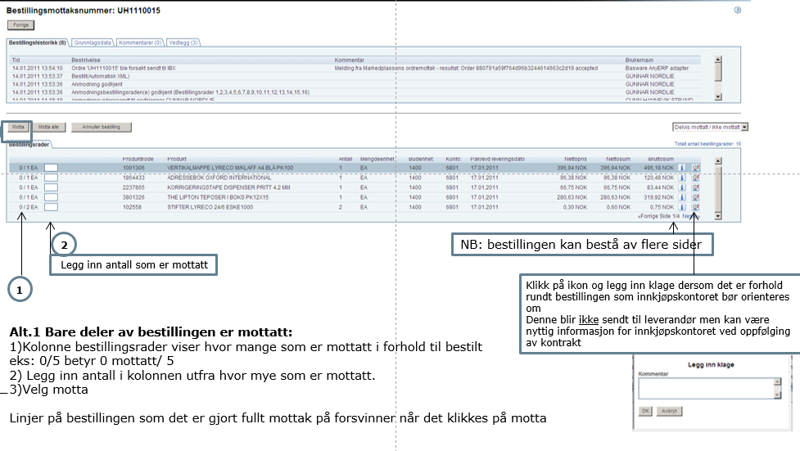
Varemottak forts.

Slide 4
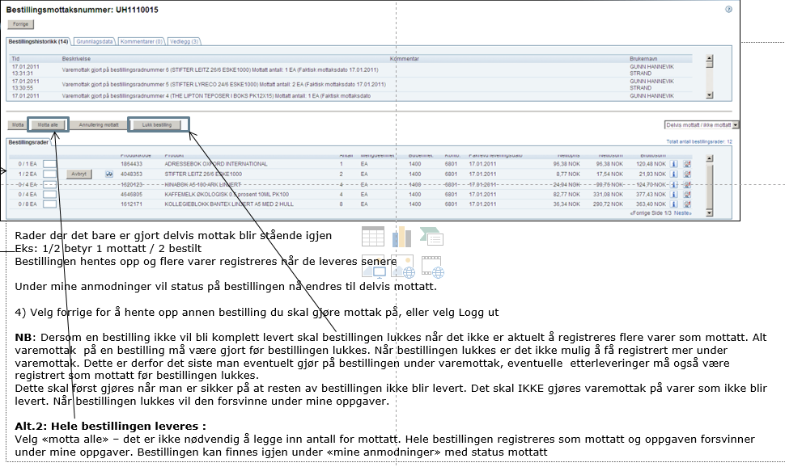
Varemottak forts.

Slide 5
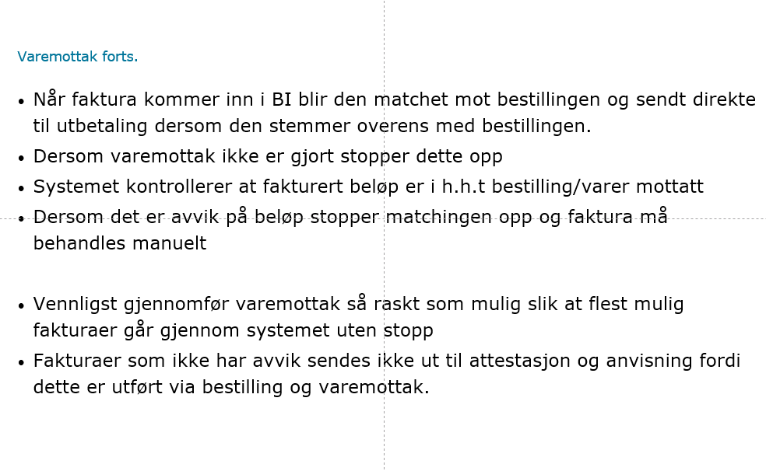
Varemottak fortsetter

Slide 6
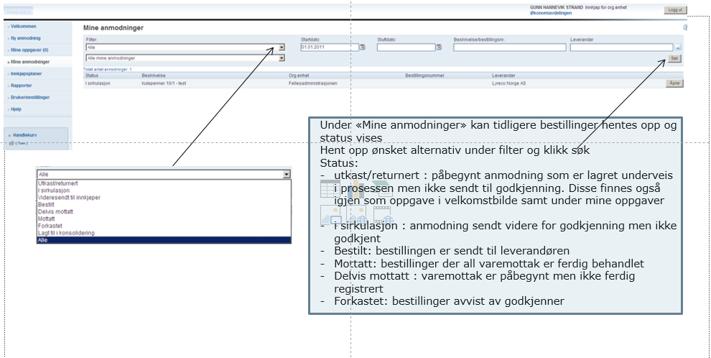
Mine anmodninger

Slide 7
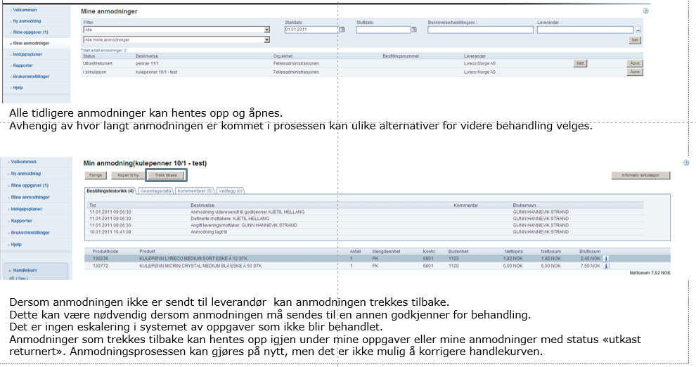
Mine anmodninger forts.

Slide 8
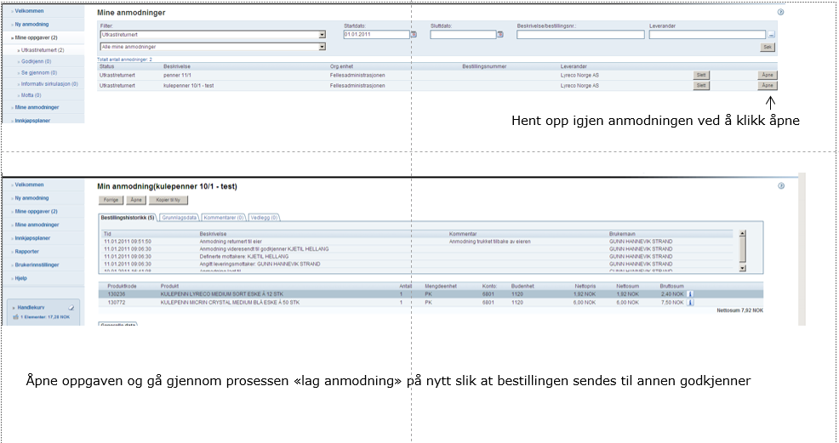
Mine anmodninger forts.

