Slide 1
Exams
Rules and regulations
Practical details
Electronic exam in WISEflow
Tips and advice
Tatiana Pozolotina
Section for exams
Welcome to the information meeting about exams!

Slide 2
Important information
It is your own responsiblility to familiarize yourself with NHH’s examination information and regulations.
General information for students
Regulations about examinations for full-time study programmes at NHH
Course descriptions
Informational videos:
  Home exams
  School exams

Slide 3

Withdrawal deadline
Deadline for withdrawal – three weeks before the first exam/ or exam part in the course (details in Studentweb)
Withdraw before withdrawal deadline!
A no-show at an exam counts as an examination attempt, but does not appear on your transcript

Slide 4

Examination attemps
Two examination attempts per course
If you want to leave the examination room during a school exam without submitting your paper you have to sign a withdrawal form before you leave your desk
This will count as an examination attempt unless you provide a medical certificate.

Slide 5
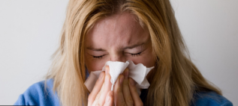
Illness before the exam
Doctor's notice must be submitted at the latest the first business day after the exam
Submit an Online form (if you have a Norwegian Bank-ID)
Or send to exams@nhh.no (if you don't have a Bank-ID)
The medical certificate must be dated before or on the exam date, and be signed and stamped
With valid documentation you will not use an exam attempt

Slide 6

Illness during the exam
Contact the invigilator to withdraw from the examination.
  NB! The withdrawal form must be filled in.
You must then immediately see a doctor.
If you get sick during home exam, do not submit your paper/ blank paper in WISEflow, everything submitted in WISEflow will be send for assessment regardless of the doctor’s notice.

Slide 7

Re-sit exam
Bachelor: written individual exams in mandatory courses are normally held every semester
Master: exams are held only in the semester the course is taught
Prerequisite: passed compulsory activity
Compulsory activities:
can only be passed in the semester the course is taught.
valid in the following semesters unless otherwise specified in the course description or until the requirements for passing are changed

Slide 8
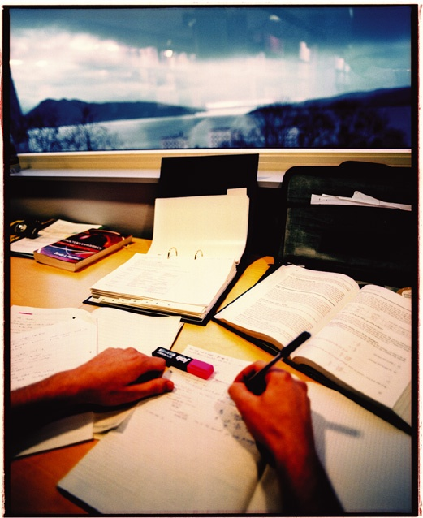
Re-sit examination
You will be tested in accordance with the most recent curriculum taught, and changes may be made to the content, curriculum and form of assessment, and course requirement.
The best result will appear in your transcript
You can still re-sit an exam after your
exchange has ended, if you still have
valid attempts left in the course.
You will need help signing up for it, so please send an e-mail to exchange@nhh.no

Slide 9
Cheating
Cheating is a violation of the regulations and the University and University Colleges Act.
It may result in you being banned from NHH and all Norwegian universities and university colleges for up to two semesters, in addition to having your grade annulled.
It is your responsibility as a student to familiarize yourself with the regulations regarding cheating. Ignorance of the regulations is no excuse.
More information: Information about cheating

Slide 10
Cheating at school exams
Illegal support materials:
Syllabus or other academic literature if not specified by course responsible
Calculator types that are not allowed
«Cheat notes»: notes in the books that are not allowed
«Cheat sheets»
Cell phones, watches or other support materials not specified
All communication with other participants during the exam will be regarded as an attempt to cheat.

Slide 11
Permitted support materials
You can only have food, drinks, ID and permitted support materials on your desk
The information about permitted support materials is
provided by the lecturer on Canvas
on the front page of the examination question paper
Copies and loose sheets are not permitted unless otherwise stated
Permitted support materials cannot be borrowed from other participants
Remember to turn off your cell phone
NB! Watches are not allowed

Slide 12
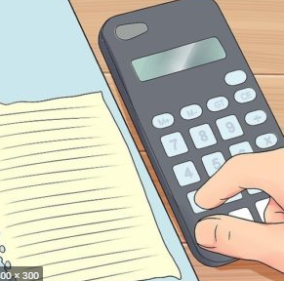
Calculator
If a calculator is permitted, any calculator, with the exception of calculators with wireless communication options may be used.
  You must be able to show that the memory is empty before the exam start
  User manuals are not permitted

Slide 13
Dictionary
One bilingual dictionary may be used, unless the course description states otherwise.
Electronic dictionaries are not permitted.
Economic or legal dictionaries are not permitted.
For examination in language and law, own rules may apply - see course description.
No references are permitted in dictionaries.

Slide 14
Cheating at home exams, compulsory activities and other written submissions
The following will be treated as an attempt to cheat:
All citing without referencing, including your own previously submitted work
Cooperating with other participants/groups
Putting your name on a group paper if you did not contribute
All submitted papers are checked for plagiarism in Canvas and WISEflow.
Make sure you reference your paper properly
Ask the Library
PhD on Track – a useful resource for master students
For referencing: sokogskriv.no/en/

Slide 15
Special examination arrangements
A student with medical conditions that give disadvantages in an exam setting may apply for special examination arrangements
Both acute and chronic conditions.
For more information and application form, please refer to: Link
Application deadlines
September 1st for Autumn semester
February 1st for Spring semester
Acute applications are processed continuously
  Application due to seasonal allergies are only assessed as an acute illness.
Documents must be attached.
Notes:
If you have some condition that may give you a disadvantage you may request special arrangements. Dyslexia, severe allergies, tendinosis or similar
If something occurs right before the examination we may also accommodate. Extra time, writing on PC, standing desk. Contact us, we will guide you.
Must be documented by a doctors note.
Ekstra tid, ekstra hviletid, PC for dyslektikere, spesielle stoler ved ryggplager

Slide 16
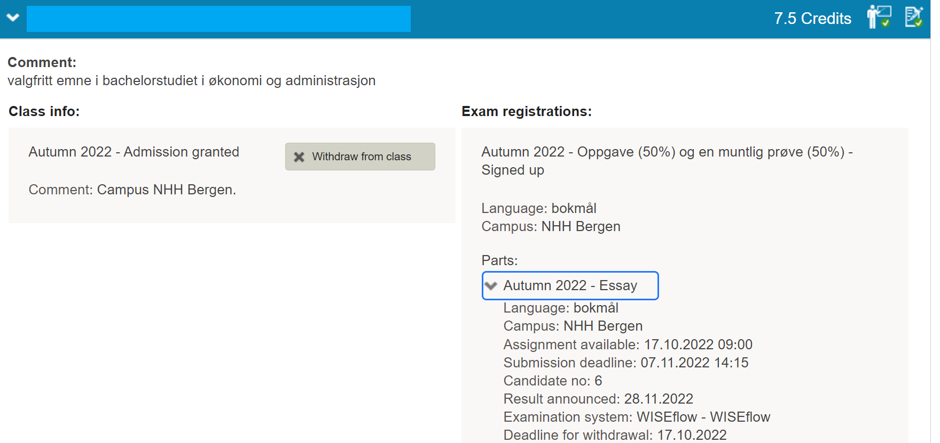
Before the exams
Exam dates: Timetables
Studentweb: Information about electronic exams, dates, examination rooms, candidate number (different for every exam) : Upcoming events
Notes:
Eksamensplanen ligger på nett. Studentsider –venstremenyen.
Kandidatnummer og sted kommer opp under «Kommende hendelser» med en gang du logger deg inn. => Sjekk dette på forhånd for å unngå unødig stress på eksamensdagen
Også info om hvert fag under «Aktive emner» i StudentWeb.

Slide 17

The day of the exam
You must meet at least 30 minutes before the examination starts (normally 8:30)
You can only have your own laptop, charger, ID, food and drink, and permitted support materials on your desk
Electronic exam: You have to log in to WISEflow and open the correct flow at least 15 minutes before the exam starts
Invigilator will check your ID and get your signature after the exam start
Breaks: Get in touch with the invigilator
  You cannot leave the examination room before 1 hour after the exam start
NB! In case of late arrival at the exam you may be denied participation
Notes:
Kandidaten skal kun ta med mat, drikke og tillatte hjelpemidler til pulten. Yttertøy, sekker, vesker, notater og lignende må plasseres på anvist sted. Mobiltelefon, klokker, og annet elektronisk utstyr må være avslått og pakket bort. PC-etui må også legges vekk

Slide 18
ID
  Valid ID with a photo must be on your desk during the exam (ex. passport, driver's license).
  ID on a mobile phone is not valid!
ID KORT
Jule Nisse
født: 24.12.1900
Notes:
Passport

Slide 19

During the exam
Read the exam questions carefully before you start answering
Use your time wisely
Try to keep a neat layout
Remember that all questions must be answered, unless otherwise stated.

Slide 20

Show consideration for others!
  Do not eat crispbread / strong smelling food (like mackerel in tomato and salami)
  Do not use perfume / aftershave
  Show consideration when leaving the examination room, there can be students with extra time still working

Slide 21
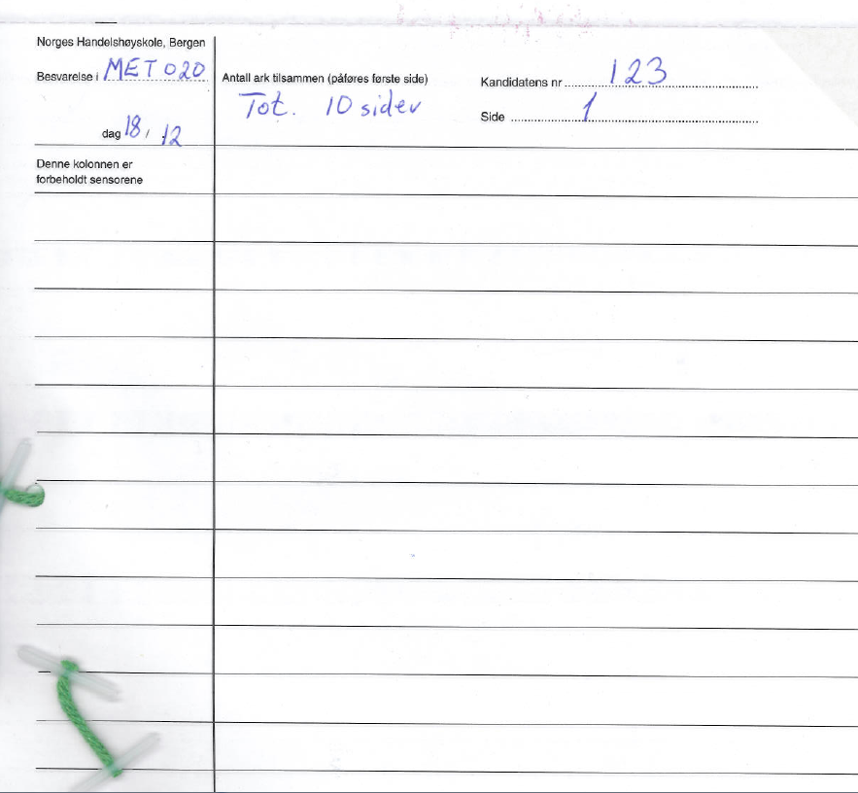
School exam on paper
Notes:
Candidate number registered on all pages
The examination sheet must also be marked with:
Course code
Date
All pages must be numbered, and the total number of pages must be stated on the first page
Exam sheet with 2 carbon copies - blue/black ballpoint pen must be used (not a felt-tip pen) - remember not to put the sheets on top of each other....!
15 extra minutes to prepare the papers for submission, in addition to the set exam time.
The sheets are divided into 3 sets, 2 are stapled together and handed in,
one set is retained

Slide 22

Grades
Published on StudentWeb
3 weeks after the exam. Some courses have a prolonged assessment deadline.
Grade statistics are published on StudentWeb for all exams

Slide 23
Grades
Grading scale: A-F (pass/ fail in some courses).
Grades cannot be converted to a different scale
If the assessment form consists of several parts: sub-grades are combined into aggregate grades (normally part grades are provided as well)
Re-sit exams do not form the basis for conversion to scholarships in Lånekassen
NB! You can receive a loan from Lånekassen for max.8 years
Notes:
Du kan få støtte fra Lånekassen i opptil åtte år, men du kan ikke være forsinket med mer enn 60 studiepoeng.

Slide 24

Grade explanation and grade appeal
NB! Check the assessor guide/ solution guide published in Canvas before asking for a grade explanation or sending a grade appeal!
Grade explanation
Grade explanation request is sent in WISEflow.
Only one group member should ask for an explanation, and then forward the explanation to the other group members.
The examiner can choose to give an explanation orally or in writing.
Deadline to request a grade explanation: One week from when the grades are published.
Deadline to give a grade explanation is two weeks from the date the explanation request is sent.

Slide 25

Grade appeal
IF you have a Norwegian BANK-ID
Fill in and submit the form here
IF you do not have a Norwegian BANK-ID:
Fill in the form
Sign the form and send to exams@nhh.no
The deadline for appeal is three weeks from the date the results are published, or the grade explanation received.
NB! Group-based assessment form: Can appeal individually.
If several in a group wish to appeal, they must fill in an appeal form individually
Oral exams cannot be appealed.

Slide 26
Grade appeal
Answer papers are sent to the appeal committee six weeks from the original grade publication date.
The grading deadline for the new committee is three weeks after receiving the answer papers.
We cannot speed up the process to accommodate individual needs
Blind appeal grading
The new grade after the appeal
NB! The new grade can stay the same, be lower or higher than the original grade
The new grade after the appeal is final and cannot be further appealed.

Slide 27
WISEflow for participants
Introduction course

Slide 28


Types of FLOWs
School exam
  FLOWlock – with a WORD-like text editor
  FLOWmulti – an interactive school exam

Slide 29


Types of FLOWs
Home exam
  FLOWassign – uploading of a PDF-file and appendices if allowed
  FLOWhandin – uploading of different types of files

Slide 30

Types of FLOWs
Assessment and grade explanation flow
  FLOWattend – assessment registration for handwritten and
  oral exams, portfolio grades

Slide 31
Before the exam
Log in with Microsoft log in
2. Download lockdown browser (school exams)
3. Use guides and practice in demo flows
4. Check the PC, mouse, keyboard, WEB camera
5. Read information emails about exams
6. Come to the drop-in on November 8th if you have any questions (12:00-14:00 in AUD F)

Slide 32
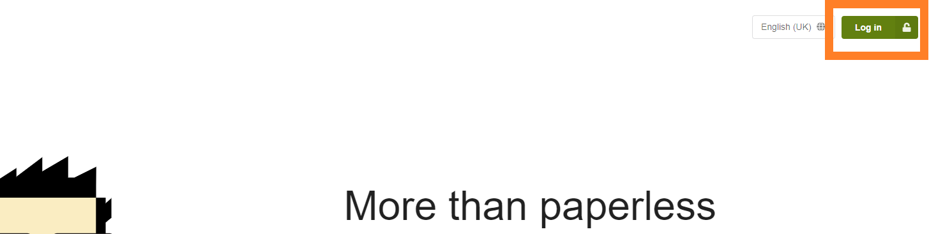
Logging in
Browsers: Google Chrome, Firefox
Go to https://europe.wiseflow.net

Slide 33
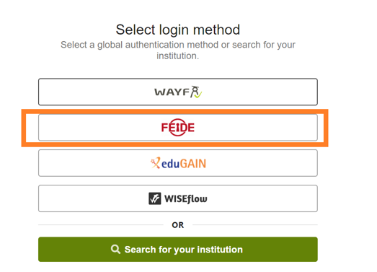
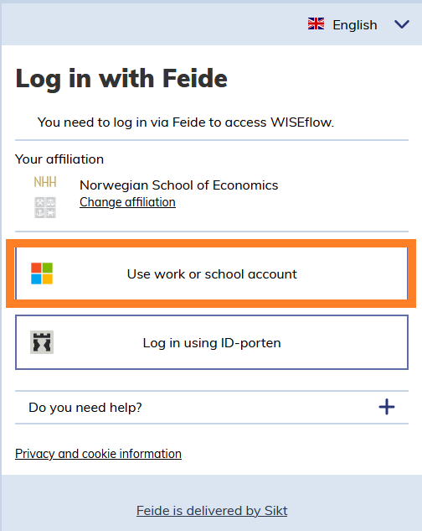
Logging in
Select FEIDE as an authentification method
Click on Use work or school account
Make sure that NHH is set as your
affiliation

Slide 34
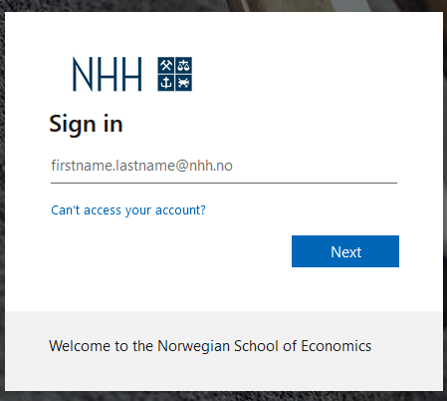
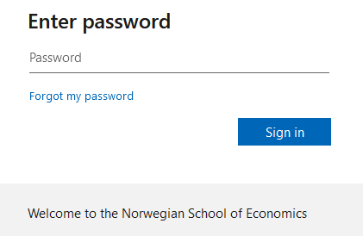
Logging in with FEIDE
Sign in with your student e-mail address
Use your FEIDE-password

Slide 35
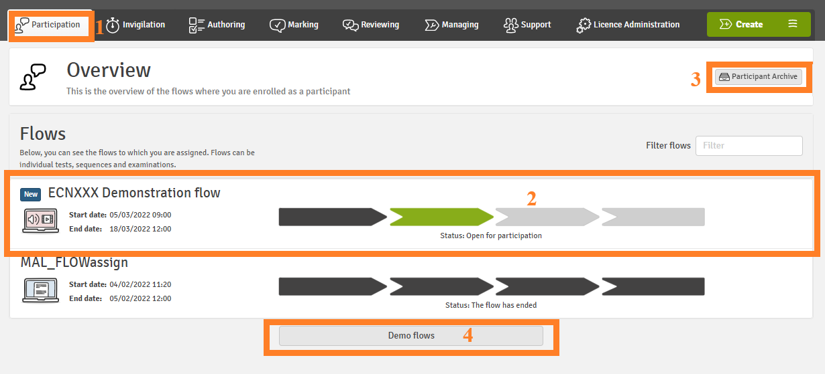
Participant
Notes:
Participation tab> to choose the participant role
Green: flows open for participation
Find old archived flows
Practice in demo flows

Slide 36
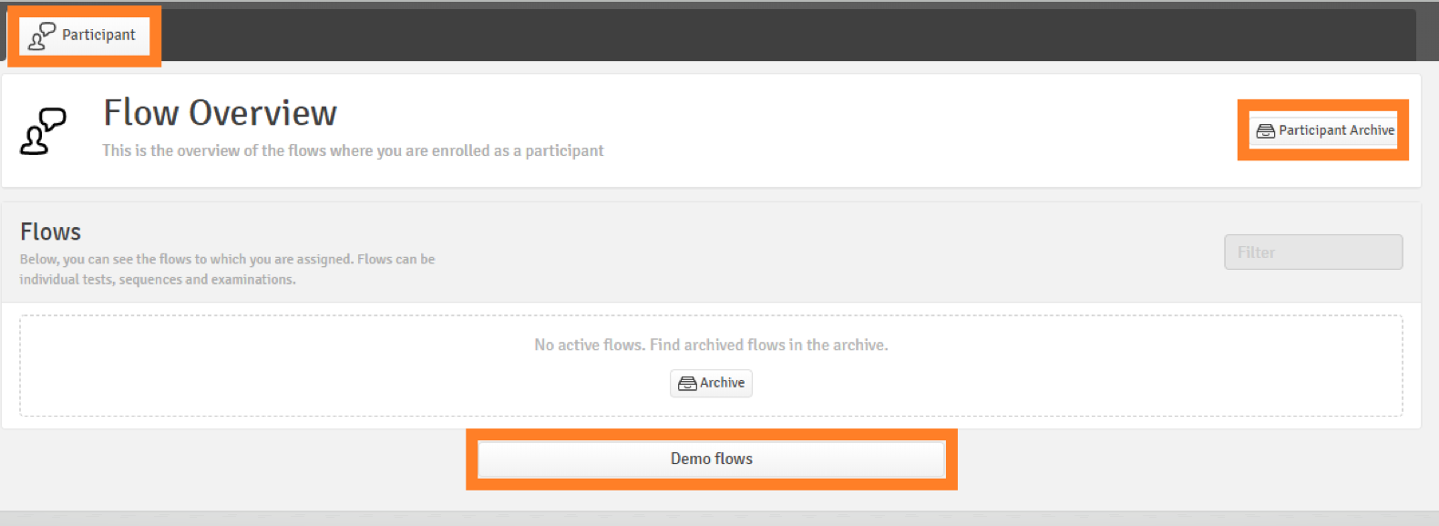
3. Use guides and practice in demo flows
You should also try out some features
by checking demo flows
Notes:
As usual, you have access to the web cam and drawing tool in the appendix manager on FLOWlock exams. It is now possible to crop, rotate and adjust brightness of the images. From this semester you also have access to the code editor in the appendix manager which enables you to write mathematical formulas with the help of LaTeX. We advise you to test out the tools in the appendix manager in the demo flows in WISEflow before your exams.

Slide 37
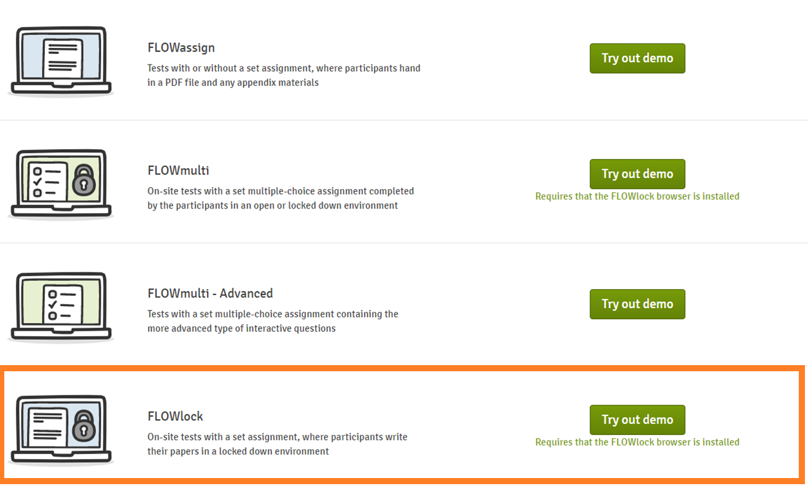

Slide 38
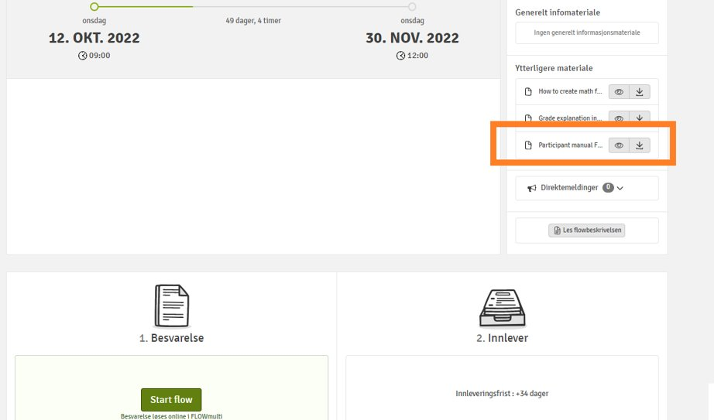
3. Where can I find manuals for exams?
Detailed manual is available in the exam flow (activated approx. 1 week before the exam)

Slide 39
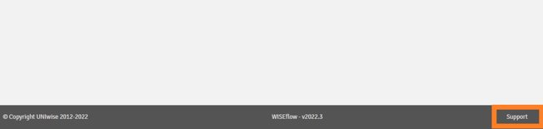
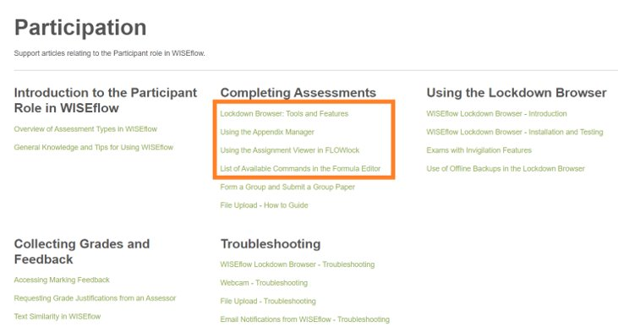
3. Where can I find manuals for exams?
2. Manuals from the WISEflow supplier UNIwise can be found under Support

Slide 40
3. Where can I find information/ manuals for exams?
3. Information on NHH website
School exam: https://www.nhh.no/en/for-students/examinations/electronic-school-exam/
Home exam: https://www.nhh.no/en/for-students/examinations/home-exams-and-assignments/

Slide 41
Laptop requirements
We have a limited number of laptops for emergency needs only. These are reserved for those who experience problems with their own PC on the day of the exam.
REGULATIONS FOR FULL-TIME STUDY PROGRAMMES AT THE NORWEGIAN SCHOOL OF ECONOMICS (NHH), Section 1-7 Laptop computers:
Students at NHH must have access to their own laptop computers in connection with teaching and assessment. Requirements apply in relation to equipment and software
Test your webcam in the demoflows
Notes:
If the quality is bad we advise you to buy an external webcam with a cable

Slide 42
4. Check the PC, mouse, keyboard, WEB camera
PC: lockdown browser installed, you have administrator access to your PC, deacticate automatic Windows updates
Test in the demo flow that the WEB camera takes legible pictures
Allowed to use a wired mouse, keyboard, external webcamera
No cordless equipment is allowed
External monitor is not allowed
Notes:
If the quality is bad we advise you to buy an external webcam with a cable

Slide 43
Home exam
The most of home exams are in FLOWassign: you should convert your main document into a PDF. Practice on converting files into a PDF format before the exam!
Appendices, if allowed, can be submitted in
various formats.
15 minutes extra for uploading the paper.
NB! Bigger files (e.g., videos) can take longer to upload.
Make sure you have an alternative internet source

Slide 44
Home exam
Requirements on the maximum length of answers must be followed
The answer paper should be uploaded in a .pdf format in WISEflow. If not stated otherwise by the lecturer.
The candidate number(s) should be provided on the first page.
Find your candidate number on StudentWeb
Deadline is final!!!

Slide 45
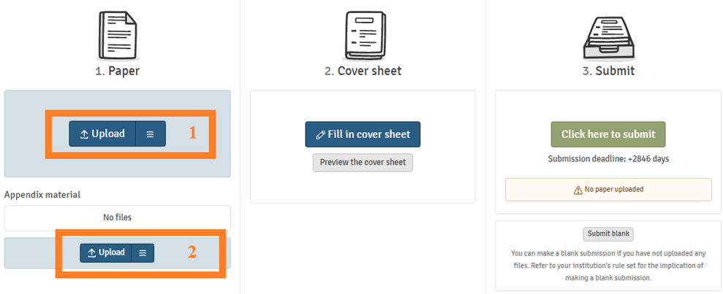
Uploading and submitting your answer paper
Uploading main file in a PDF format (1) and appendices (if allowed) in any formats (2)

Slide 46
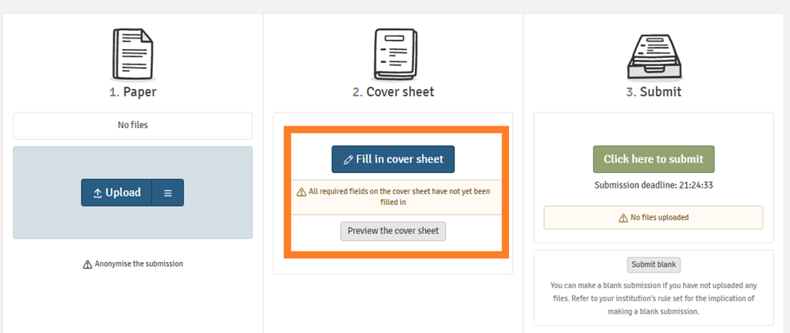
Uploading and submitting your answer paper
If you are required to fill in the cover sheet, you will not be able to proceed to submitting your paper before filling it in.

Slide 47
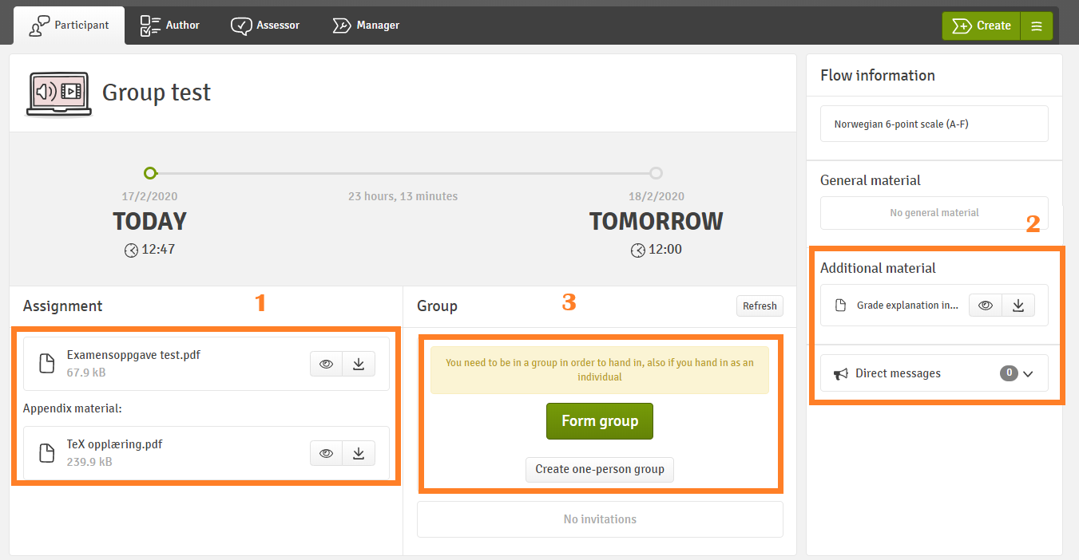
Group exam
NB! You must create a group before you can upload the paper
If you are submitting individually, create a one-person group

Slide 48
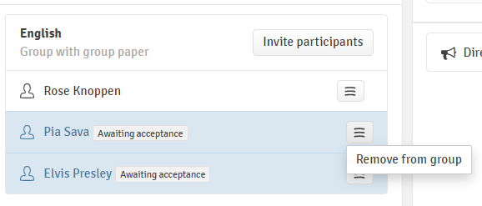
Group exam
NB! All the invited group members must accept/ reject the group invitation before you can submit the paper. Make sure you create groups well in advance of the submission deadline.
You can also remove the members from the group.
After you have accepted the invitation, you have the same rights as the person who created the group.
One group member submits the paper for the whole group. Each group member can see the submitted paper.

Slide 49
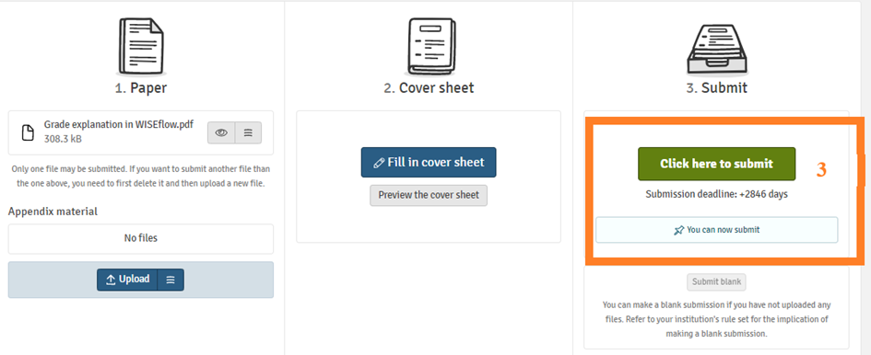
Uploading and submitting your answer paper
Press Click here to submit (3) button to submit your paper.

Slide 50
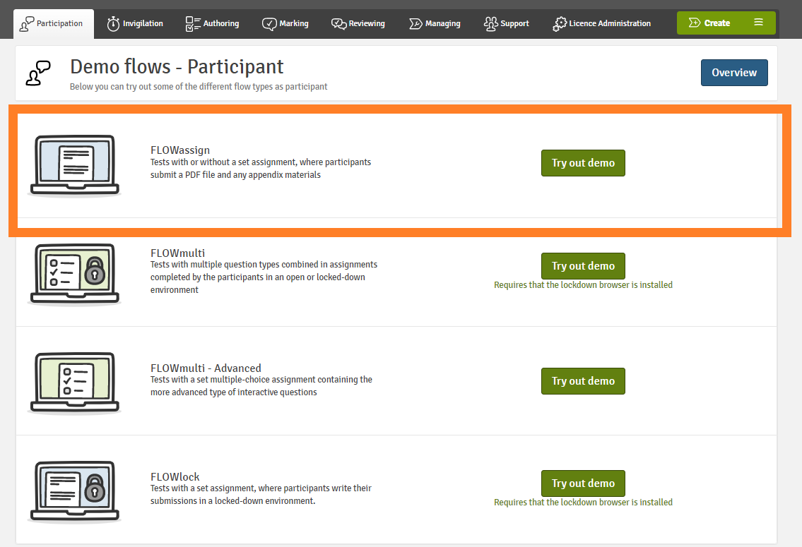
Home exam
Try FLOWassign demo flow

Slide 51
If you experience technical problems with submission
Send your paper in the right format to the Exam Office (exams@nhh.no) before the deadline.
If the file is too large to be sent by email, use File sender: https://filesender.sikt.no/(FEIDE login).
NB! The links to cloud storage are not accepted.
NB! Submissions are not accepted after the deadline.
Deadline is final!!!

Slide 52
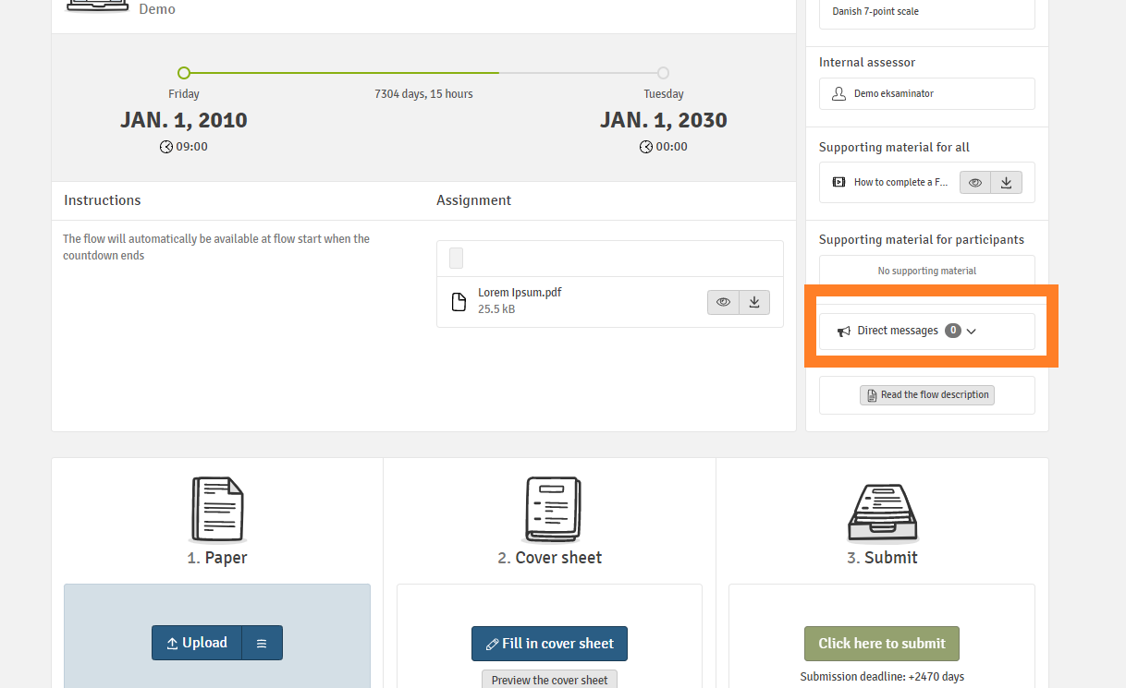
If you experience technical problems with submission
The link to Filesender and other important information about problems with submission will appear in a direct message sent 1 hour before the submission deadline on each home exam

Slide 53
If you experience technical problems with submission
NB! Problems with internet connection is not a valid excuse for late submission
It is important that you use a stable internet connection when submitting your exam. We also recommend that you have an alternative Internet connection available in case there is a problem with your network. A good alternative is to use your phone as a WIFI hotspot.

Slide 54
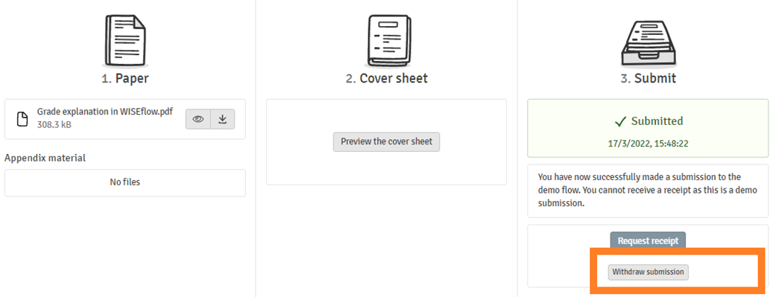







Home exam
You can withdraw your paper before the deadline and submit another paper
Notes:
Skriv om filfjerning

Slide 55
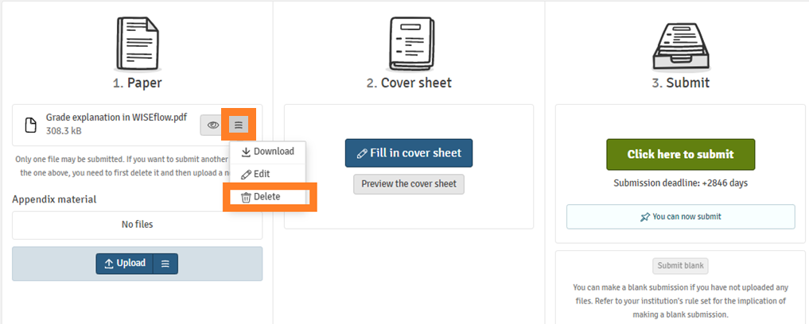





Home exam
NB! Remember to delete old files before uploading new files that will replace them and then press submit. When you press Click here to submit, everything that is uploaded in the flow will be sent for grading.
Notes:
Skriv om filfjerning

Slide 56
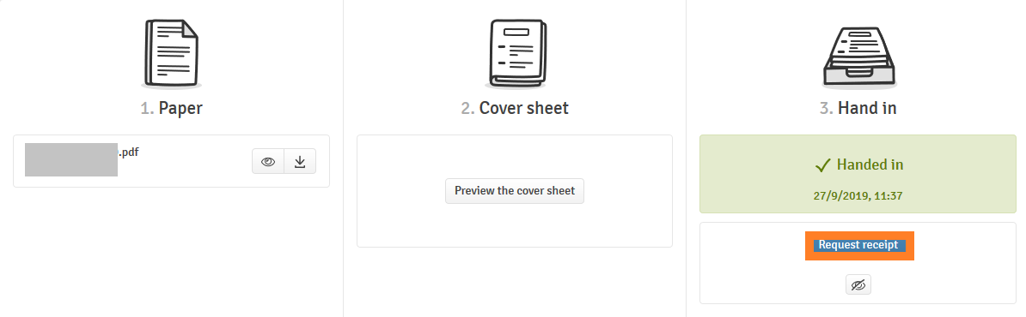
Exam in WISEflow
Remember to request the receipt:

Slide 57
School exam
Exams with LOCKdown browser: FLOWlock and FLOWmulti
Device monitor exams

Slide 58
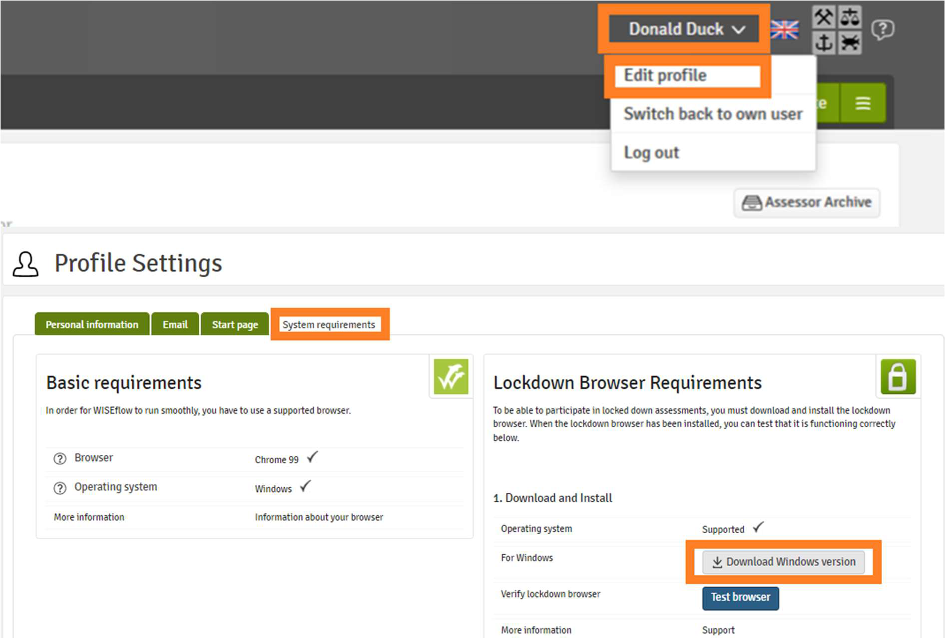
Download lockdown browser for school exams
You must download the latest version of lockdown browser before every examination period (is already available this semester):
Click on your name in the upper right corner and select Edit profile.
Click System requirements.
Make sure that all points are ticked off .
Download the latest version of the lockdown browser.
NB! You won't be compensated for the time used to download and install lockdown browser on the exam. Technical invigilators will prioritize other issues.
Notes:
As usual, you have access to the web cam and drawing tool in the appendix manager on FLOWlock exams. It is now possible to crop, rotate and adjust brightness of the images. From this semester you also have access to the code editor in the appendix manager which enables you to write mathematical formulas with the help of LaTeX. We advise you to test out the tools in the appendix manager in the demo flows in WISEflow before your exams.

Slide 59
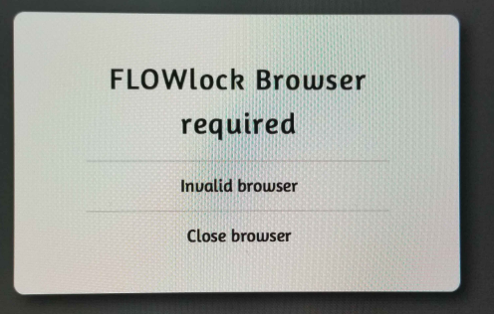

Slide 60
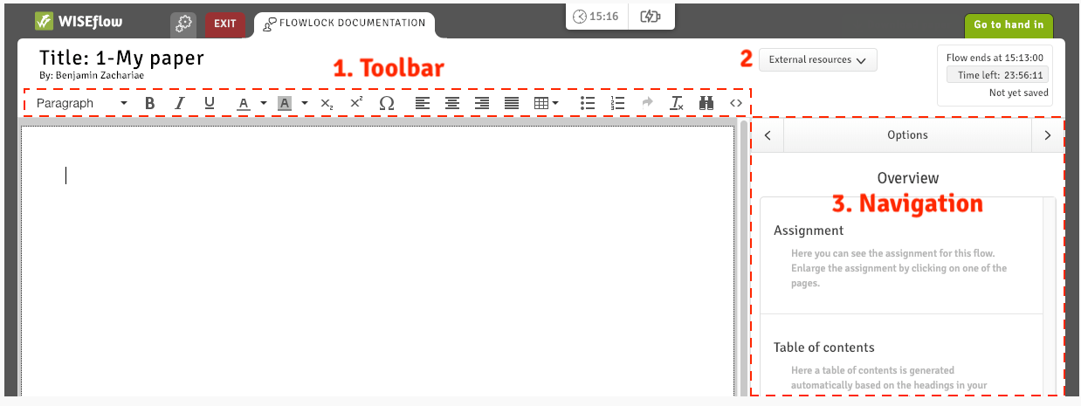
FLOWlock
A WORD-like text editor
NB! Your answer paper will be converted to a PDF-file, there can be margin width
discrepancies, thus some words can be moved to a new line.
If the alignment is important (e.g., accounting), create a table!

Slide 61
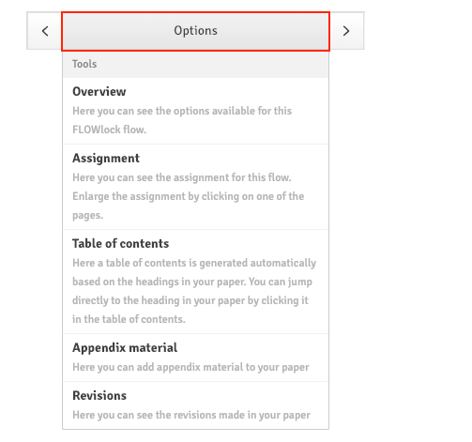
Navigation

Slide 62
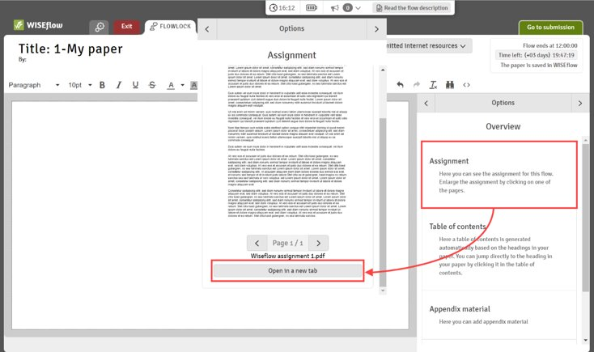
Navigation: Assignment
You can open the exam assignment in its own tab

Slide 63
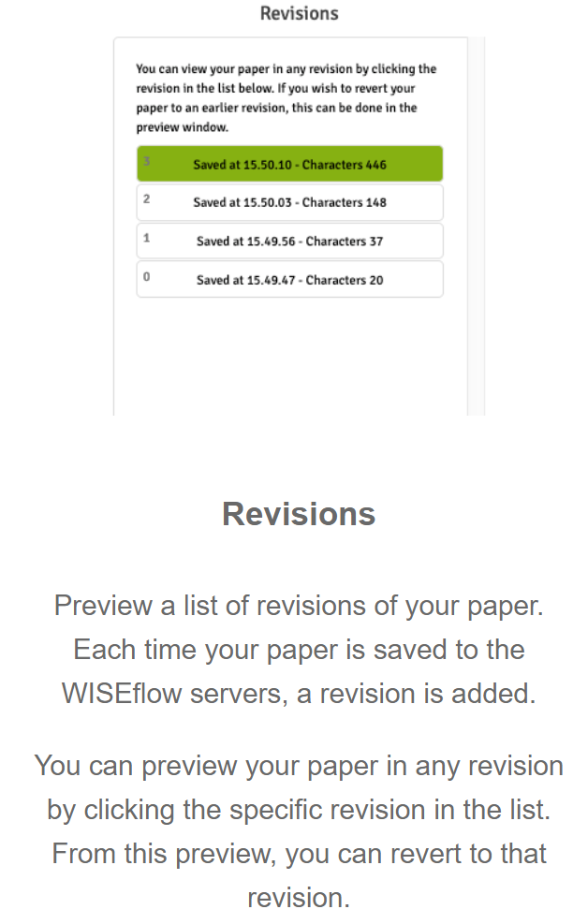
Revisions

Slide 64
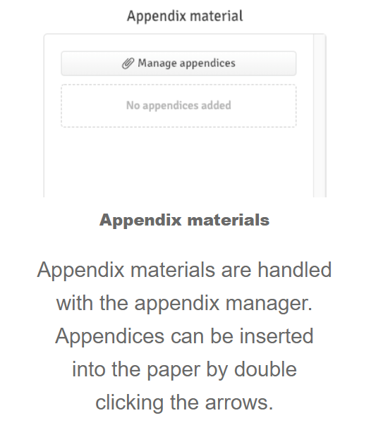
Appendix manager

Slide 65
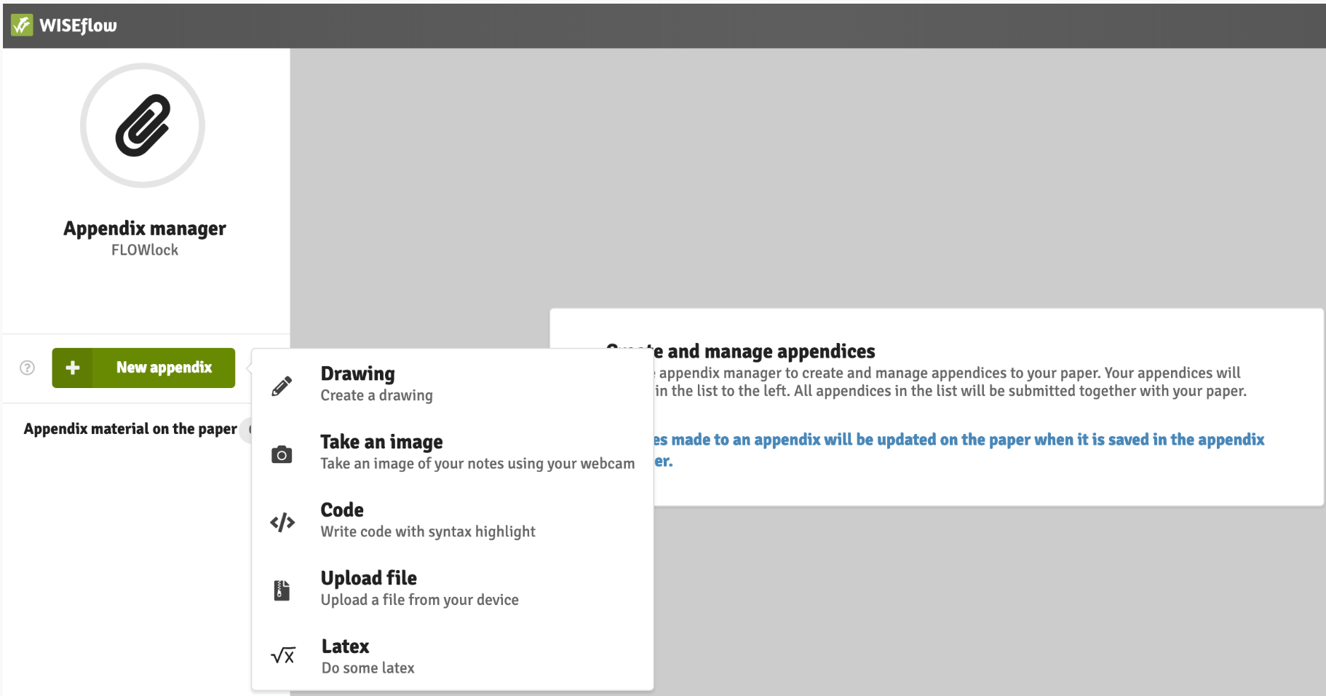
Appendix manager

Slide 66
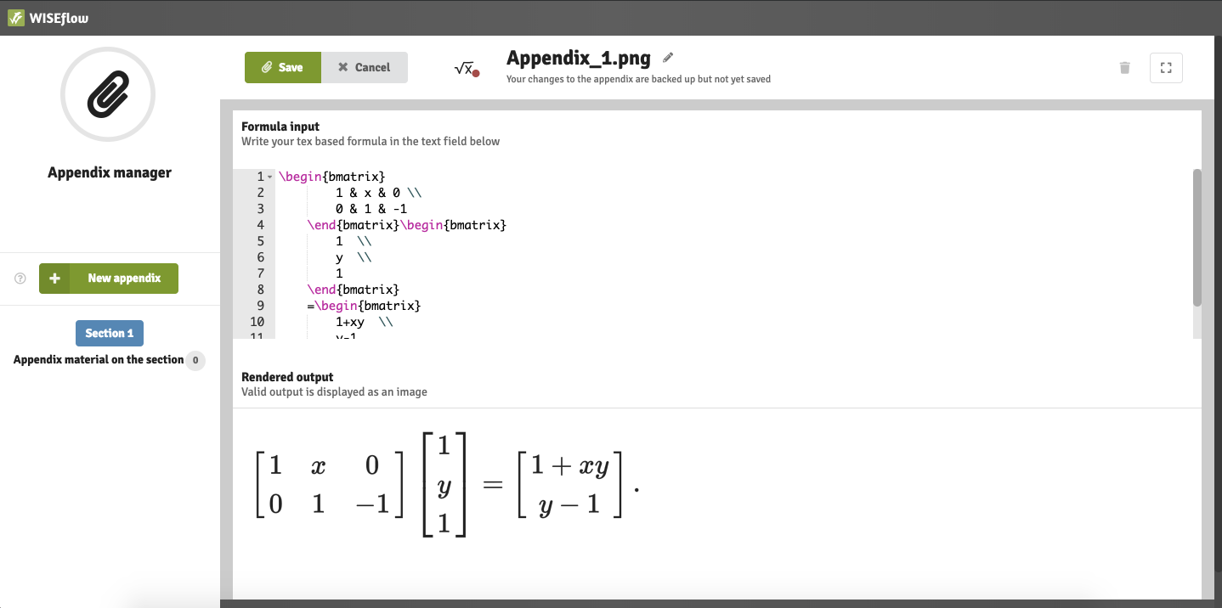
Formula editor

Slide 67
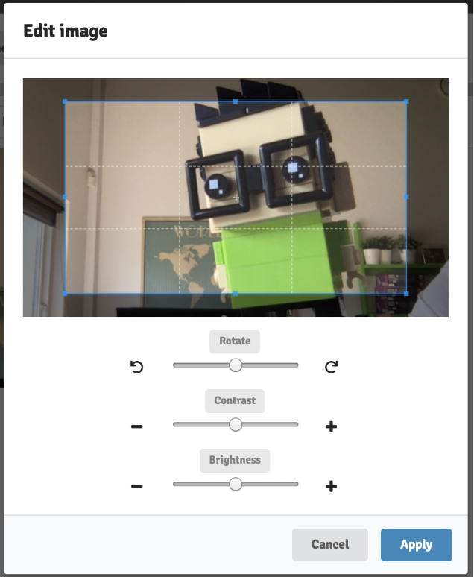
WEBCAM
Use a special sheet for taking pictures handed out by invigilators
You can edit Webcam pictures.

Slide 68
Appendix manager

Slide 69
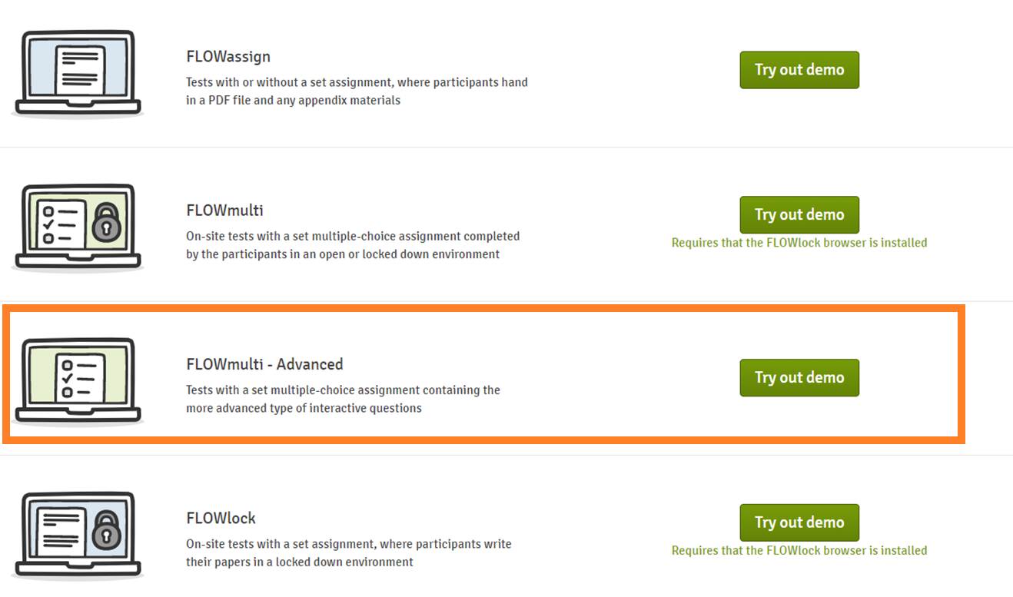
FLOWmulti: the interactive exam

Slide 70
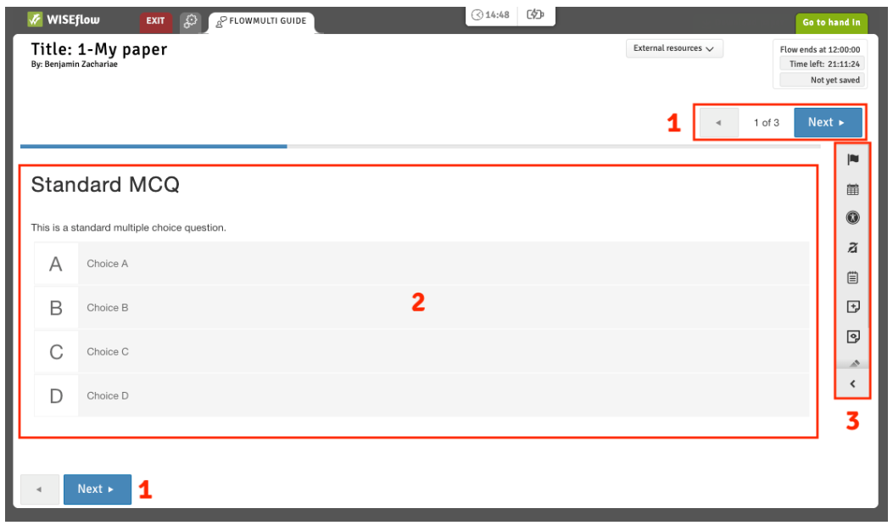
FLOWmulti: the interactive exam
1. Navigate between sections of the questionnaire.
2. The current section is situated here. A section can have multiple questions.
3. Annotation and overview tools for FLOWmulti.

Slide 71
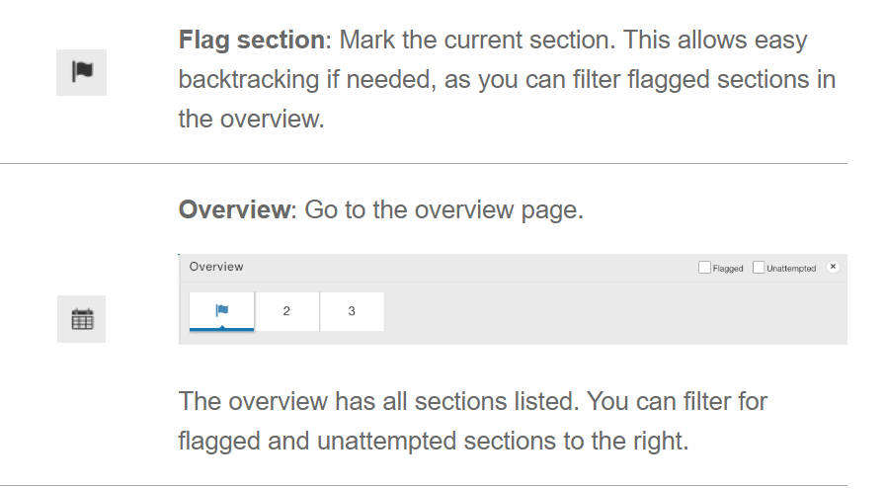
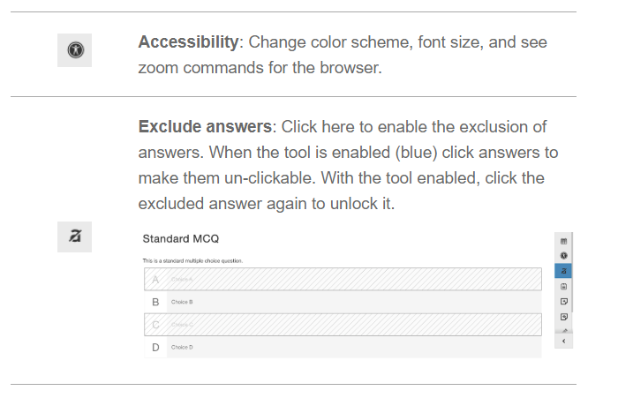
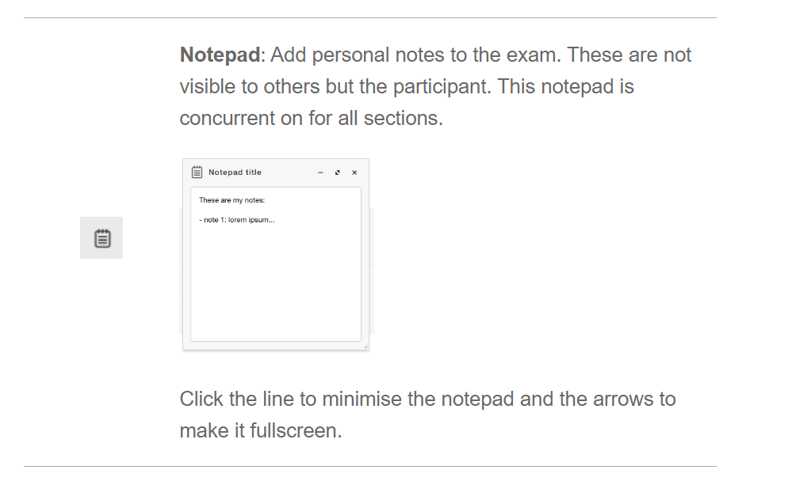
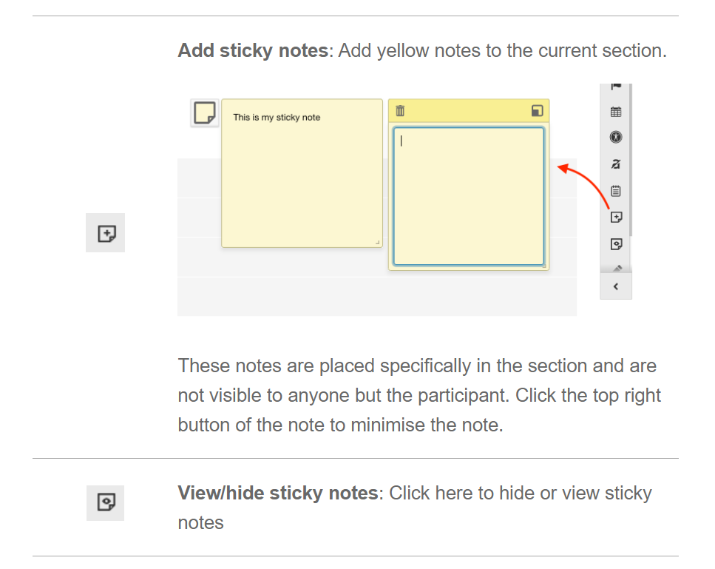
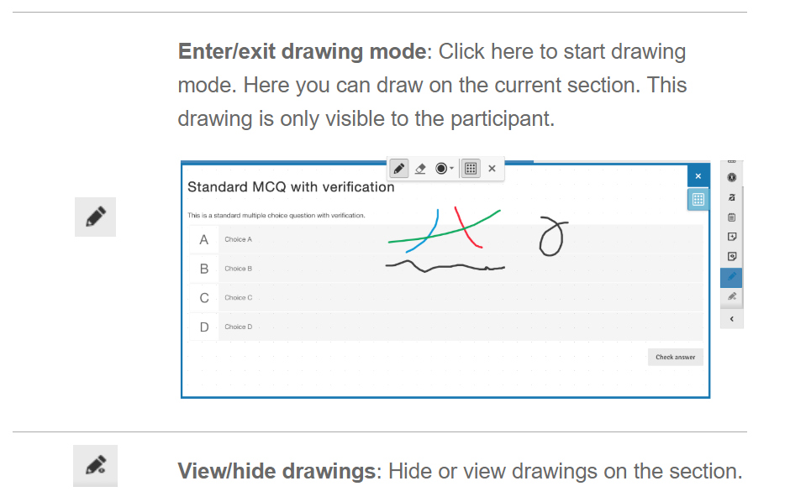
Annotation tools: changes visible only to you

Slide 72
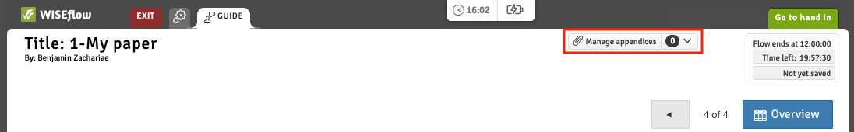
Appendix manager
For specific question types you can add appendices to the section. Click the "Manage appendices" to open the Appendix manager in a new tab.

Slide 73
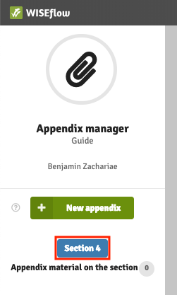
Appendix manager
The appendix manager shows you which section is open.

Slide 74
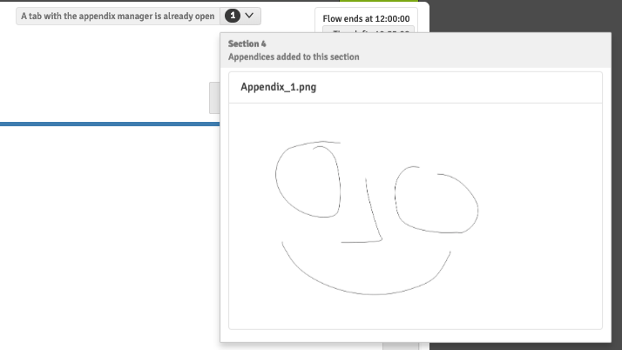
Appendix manager
You can preview appendices for the section in the dropdown to the right of the manage appendices button.

Slide 75
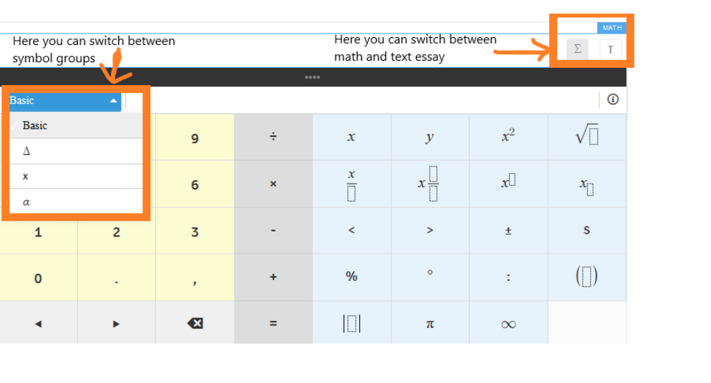
Math essay in FLOWmulti
NB! Remember to switch between text and math!

Slide 76
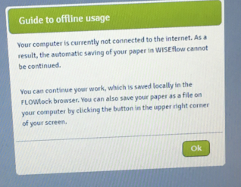
School exam
Do not be worried if you get this message during the exam: press Ok and continue working

Slide 77
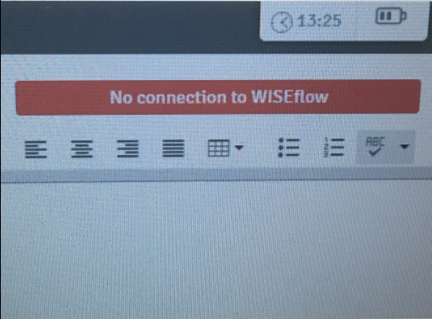
School exam
You can monitor your connection status on the top of the browser: if you are not connected to the internet for over 5 minutes, please, contact a technical invigilator. NB! Do not refresh the browser while offline.

Slide 78
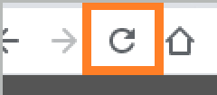
School exam
If you are online, but are experiencing other issues, for example, the extra time is not showing, refresh the browser. If the problem persists, take contact with a technical invigilator

Slide 79

Direct messages
Important information and instructions
Pop up automatically
Can be found on the top of the page

Slide 80
Submitting and exiting lockdown browser
You can hand in or exit without handing in (an invigilator will have to enter the password)

Slide 81
Exams in Device monitor
Device monitor takes pictures of your screen continuously
Technical invigilators and exam administration can see the print screens during and after the exam.

Slide 82

Exams with Device monitor
Install Device monitor (manual sent in email and in the flow)
Start Device monitor before the exam
Device monitor should be on until you submit
Before the exam: save the file with your answer paper on your computer’s hard disk. Remember the location and file name.
Make sure that the name cannot be confused with other file names.
Save the file frequently during the exam

Slide 83

Practical assignments
Complete the flow "Important information about exams and cheating autumn 2023" (it is a FLOWmulti exam).
Download and install the lockdown browser
Open the demo FLOWlock
  Create a table
  Take a picture with your webcam and insert it in the paper

Slide 84
Drop in for help with WISEflow:
November 8th, 12:100 – 14:00 in AUD F

Slide 85
Thank you for attention

