Slide 1
Exams
Rules and regulations
Practical details
Electronic exam in WISEflow
Tips and advice
Tatiana Pozolotina
Section for exams
Welcome to the information meeting about exams!

Slide 2
Important information
It is your own responsiblility to familiarize yourself with NHH’s examination information and regulations.
General information for students
Regulations about examinations for full-time study programmes at NHH
Course descriptions
Informational videos:
  Home exams
  School exams

Slide 3

Registration and withdrawal deadline
Deadline for confirming your study plan/semester registration in Studentweb
September 1st for Autumn semester
February 1st for Spring semester
It is your own responsibility to make sure that your study plan is registered correctly within the deadline
Deadline for withdrawal – three weeks before the first exam/ or exam part in the course (details in Studentweb)
Withdraw before withdrawal deadline!
A no-show at an exam counts as an examination attempt, but does not appear on your transcript

Slide 4

Examination attemps
Two examination attempts per course, MRR-courses: 3 attempts
If you want to leave the examination room during a school exam without submitting your paper you have to sign a withdrawal form before you leave your desk
This will count as an examination attempt unless you provide a medical certificate.

Slide 5
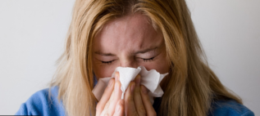
Illness before the exam
Doctor's notice must be submitted at the latest the first business day after the exam
Submit an Online form (if you have a Norwegian Bank-ID)
Or send to exams@nhh.no (if you don't have a Bank-ID)
The medical certificate must be dated before or on the exam date, and be signed and stamped
With valid documentation you will not use an exam attempt

Slide 6

Illness during the exam
Contact the invigilator to withdraw from the examination.
  NB! The withdrawal form must be filled in.
You must then immediately see a doctor.
If you get sick during home exam, do not submit your paper/ blank paper in WISEflow, everything submitted in WISEflow will be send for assessment regardless of the doctor’s notice.

Slide 7

Re-sit examination
Bachelor: written individual exams in mandatory courses are normally held every semester
Master: exams are held only in the semester the course is taught
Prerequisite: passed compulsory activity
Compulsory activities:
can only be passed in the semester the course is taught.
valid in the following semesters unless otherwise specified in the course description or until the requirements for passing are changed

Slide 8
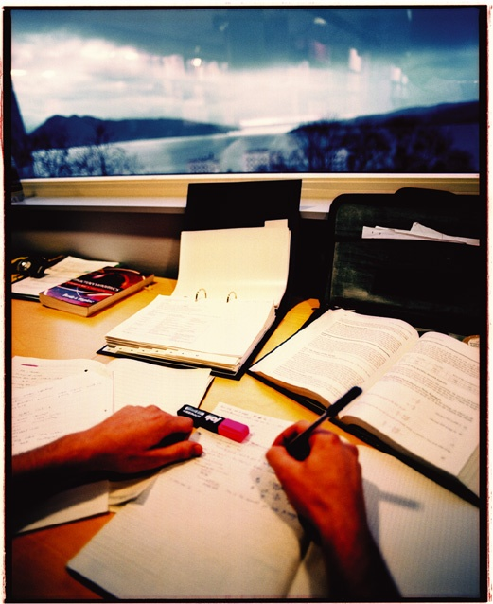
Re-sit examination
You will be tested in accordance with the most recent curriculum taught, and changes may be made to the content, curriculum and form of assessment, and course requirement.
The best result will appear in your transcript

Slide 9
Cheating
Cheating is a violation of the regulations and the University and University Colleges Act.
It may result in you being barred from NHH or all Norwegian universities and university colleges for up to two semesters, in addition to having your grade annulled
It is your responsibility as a student to familiarize yourself with the regulations regarding cheating. Ignorance of the regulations is no excuse.
More information: Information about cheating

Slide 10
Cheating at school exams
Illegal support materials:
Syllabus or other academic literature if not specified by course responsible
Calculator types that are not allowed
«Cheat notes»« or notes in the books that are allowed,
«Cheat sheets»
Cell phones, watches or other support materials not spesified
All communication with other participants during the exam will be regarded as an attempt to cheat.

Slide 11
Cheating at home exams, cumpulsory activities and other written submissions
The following will be treated as an attempt to cheat:
All citing without referencing, including your own previously submitted work
Cooperating with other participants/groups
Putting your name on a group paper if you did not contribute
All submitted papers are checked for plagiarism in Canvas and WISEflow.
Make sure you reference your paper properly
Ask the Library
PhD on Track – a useful resource for master students
For referencing: sokogskriv.no/en/

Slide 12
Special examination arrangements
A student with medical conditions that give disadvantages in an exam setting may apply for special examination arrangements
Both acute and chronic conditions.
For more information and application form, please refer to: Link
Application deadlines
September 1st for Autumn semester
February 1st for Spring semester
  Application due to seasonal allergies are only assessed as an acute illness.
You can apply for leave of absence in case of long-term illness, pregnancy, summons to Military Service in the course of your studies. Documents must be attached.
Notes:
If you have some condition that may give you a disadvantage you may request special arrangements. Dyslexia, severe allergies, tendinosis or similar
If something occurs right before the examination we may also accommodate. Extra time, writing on PC, standing desk. Contact us, we will guide you.
Must be documented by a doctors note.
Ekstra tid, ekstra hviletid, PC for dyslektikere, spesielle stoler ved ryggplager

Slide 13
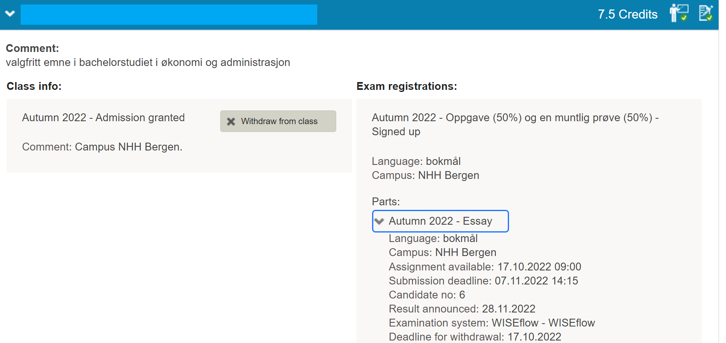
Before the exams
Exam dates: Timetables
Studentweb: Information about electronic exams, dates, examination rooms, candidate number (different for every exam) : Upcoming events
Notes:
Eksamensplanen ligger på nett. Studentsider –venstremenyen.
Kandidatnummer og sted kommer opp under «Kommende hendelser» med en gang du logger deg inn. => Sjekk dette på forhånd for å unngå unødig stress på eksamensdagen
Også info om hvert fag under «Aktive emner» i StudentWeb.

Slide 14
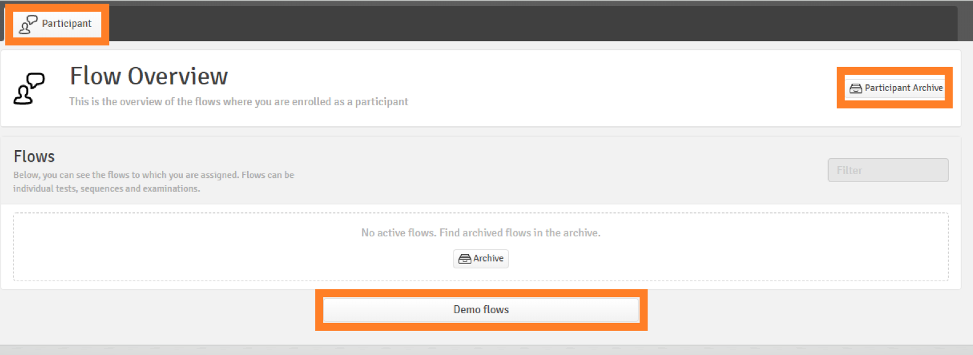
Preparation before electronic school exams
You must download the latest version of FLOWlock browser before every examination period
You should also try out some features by clicking Start FLOWlock and demo flows
Notes:
As usual, you have access to the web cam and drawing tool in the appendix manager on FLOWlock exams. It is now possible to crop, rotate and adjust brightness of the images. From this semester you also have access to the code editor in the appendix manager which enables you to write mathematical formulas with the help of LaTeX. We advise you to test out the tools in the appendix manager in the demo flows in WISEflow before your exams.

Slide 15
Laptop requirements
We have a limited number of laptops for emergency needs only. These are reserved for those who experience problems with their own PC on the day of the exam.
REGULATIONS FOR FULL-TIME STUDY PROGRAMMES AT THE NORWEGIAN SCHOOL OF ECONOMICS (NHH), Section 1-7 Laptop computers:
Students at NHH must have access to their own laptop computers in connection with teaching and assessment. Requirements apply in relation to equipment and software
Test your webcam in the demoflows
Notes:
If the quality is bad we advise you to buy an external webcam with a cable

Slide 16

The day of the exam
You must meet at least 30 minutes before the examination starts (normally 8:30)
You can only have your own laptop, charger, ID, food and drink, and permitted support materials on your desk
Electronic exam: You have to log in to WISEflow and open the correct flow at least 15 minutes before the exam starts
Invigilator will check your ID and get your signature after the exam start
Breaks: Get in touch with the invigilator
  You can not leave the examination room before 1 hour after the exam start
NB! In case of late arrival at the exam you may be denied participation
Notes:
Kandidaten skal kun ta med mat, drikke og tillatte hjelpemidler til pulten. Yttertøy, sekker, vesker, notater og lignende må plasseres på anvist sted. Mobiltelefon, klokker, og annet elektronisk utstyr må være avslått og pakket bort. PC-etui må også legges vekk

Slide 17
ID
  Valid ID with a photo must be on your desk during the exam (ex. passport, driver's license).
  ID on a mobile phone is not valid!
ID KORT
Jule Nisse
født: 24.12.1900
Notes:
Passport

Slide 18
Permitted support materials
You can only have food, drinks, ID and permitted support materials on your desk
The information about permitted support materials is
provided by the lecturer on Canvas
on the front page of the examination question paper
Copies and loose sheets are not permitted unless otherwise stated
Permitted support materials cannot be borrowed from other participants
Remember to turn off your cell phone
NB! Watches are not allowed

Slide 19
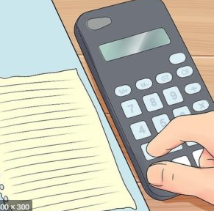
Calculator
If a calculator is permitted, any calculator, with the exception of calculators with wireless communication options may be used.
  You should be able to show that the memory is empty before the exam start
  User manuals are not permitted

Slide 20
Dictionary
One bilingual dictionary may be used, unless the course description states otherwise.
Electronic dictionaries are not permitted.
Economic or legal dictionaries are not permitted.
For examination in language and law, own rules may apply - see course description.
No references are permitted in dictionaries.

Slide 21

During the exam
Read the exam questions carefully before you start answering
Use your time wisely
Try to keep a neat layout
Remember that all questions must be answered, unless otherwise stated.

Slide 22

Show consideration for others!
  Do not eat crispbread / strong smelling food (like mackerel in tomato and salami)
  Do not use perfume / aftershave
  Show consideration when leaving the examination room, there can be students with extra time still working

Slide 23
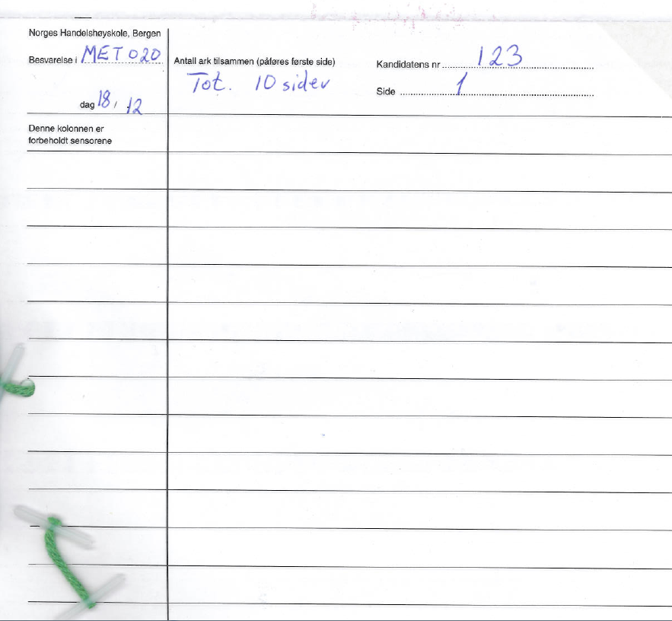
School exam on paper
Notes:
Candidate number registered on all pages
The examination sheet must also be marked with:
Course code
Date
All pages must be numbered, and the total number of pages must be stated on the first page
Exam sheet with 2 carbon copies - blue/black ballpoint pen must be used (not a felt-tip pen) - remember not to put the sheets on top of each other....!
15 extra minutes to prepare the papers for submission, in addition to the set exam time.
The sheets are divided into 3 sets, 2 are stapled together and handed in,
one set is retained

Slide 24
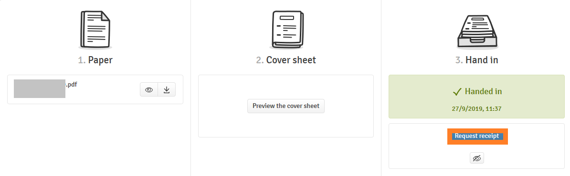
Exam in WISEflow
Remember to request the receipt:

Slide 25
Home exam
Requirements on the maximum length of answers must be followed
The answer paper should be uploaded in a .pdf format in WISEflow. If not stated otherwise by the lecturer.
The candidate number(s) should be provided on the first page.
Find your candidate number on StudentWeb
Deadline is final!!!

Slide 26

Grades
Announced on StudentWeb
Published 3 weeks after the exam. Some courses have a prolonged assessment deadline.
Grade statistics are published on StudentWeb for all exams

Slide 27
Grades
Grading scale: A-F (pass/ fail in some courses)
If the assessment form consists of several parts: sub-grades are combined into aggregate grades (normally part grades are provided as well)
Re-sit exams do not form the basis for conversion to scholarships in Lånekassen
NB! You can receive a loan from Lånekassen for max.8 years
Notes:
Du kan få støtte fra Lånekassen i opptil åtte år, men du kan ikke være forsinket med mer enn 60 studiepoeng.

Slide 28

Grade explanation and grade appeal
NB! Check the assessor guide/ solution guide published in Canvas before asking for a grade explanation or sending a grade appeal!
Grade explanation
Grade explanation request is sent in WISEflow.
Only one group member should ask for an explanation, and then forward the explanation to the other group members.
The examiner can choose to give an explanation orally or in writing.
Deadline to request a grade explanation: One week from when the grades are published
Deadline to give a grade explanation is two weeks from the date the explanation request is sent.

Slide 29

Grade appeal
IF you have a Norwegian BANK-ID
Fill in and submit the form here
IF you do not have a Norwegian BANK-ID:
Fill in the form
Sign the form and send to exams@nhh.no
The deadline for appeal is three weeks from the date the results are published, or the grade explanation received.
NB! Group-based assessment form: Can appeal individually.
If several in a group wish to appeal, they must fill in an appeal form individually

Slide 30
Grade appeal
Answer papers are sent to the appeal committee six weeks from the original grade publication date.
The grading deadline for the new committee is three weeks after receiving the answer papers.
Blind appeal grading
The new grade after the appeal
NB! The new grade can stay the same, be lower or higher than the original grade
The new grade after the appeal is final and cannot be further appealed.

Slide 31
WISEflow for participants
Introduction course

Slide 32
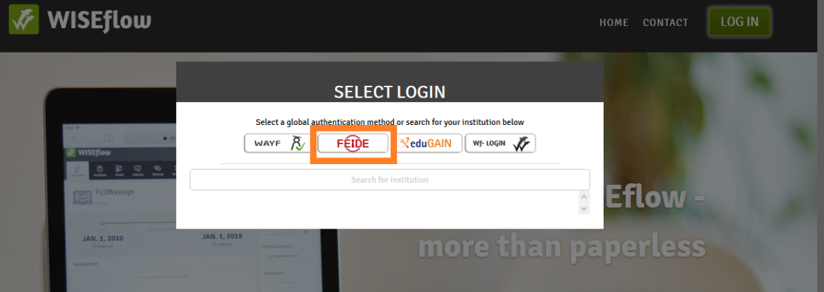
Logging in
Browsers: Google Chrome, Firefox
Go to https://europe.wiseflow.net
Log in using FEIDE (student number + password).

Slide 33


Types of FLOWs
School exam
  FLOWlock – with a WORD-like text editor
  FLOWmulti – an interactive school exam

Slide 34


Types of FLOWs
Home exam
  FLOWassign – uploading of a PDF-file and appendices if allowed
  FLOWhandin – uploading of different types of files

Slide 35

Types of FLOWs
Assessment and grade explanation flow
  FLOWattend – assessment registration for handwritten and
  oral exams, portfolio grades

Slide 36
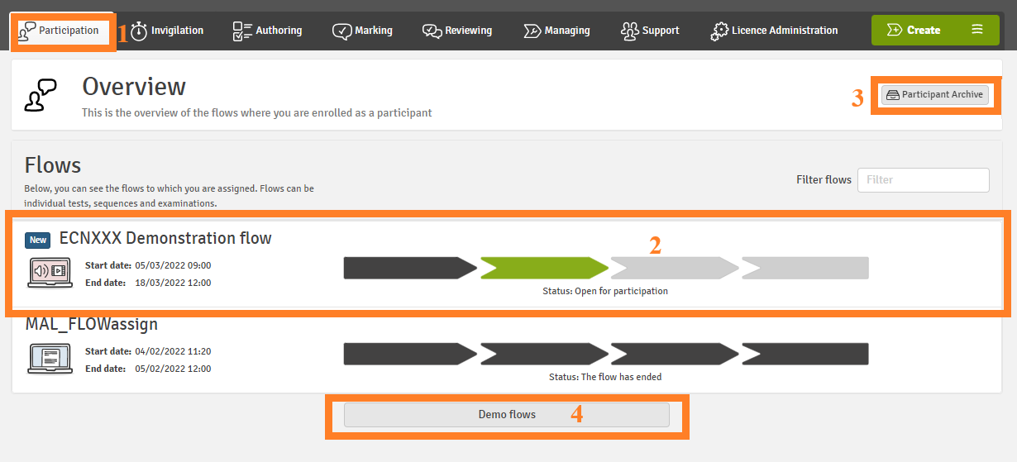
Participant
Notes:
Participation tab> to choose the participant role
Green: flows open for participation
Find old archived flows
Practice in demo flows

Slide 37
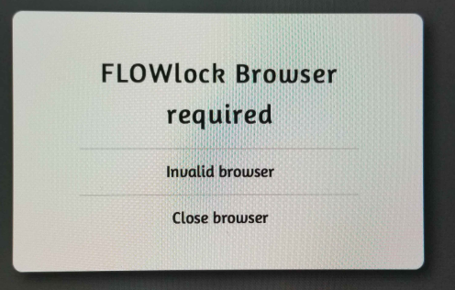

Slide 38
School exam
Download a new version of the FLOWlock browser (is already available this semester):
Log into WISEflow
Click on your name in the upper right corner and select Edit profile.
Click System requirements.
Make sure that all points are ticked off .
Download the latest version of the FLOWlock browser.

Slide 39
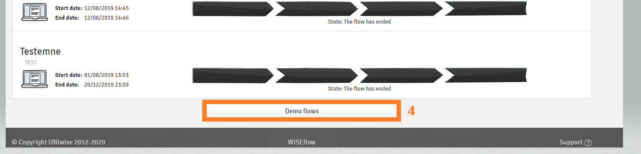
Practicing before exams

Slide 40
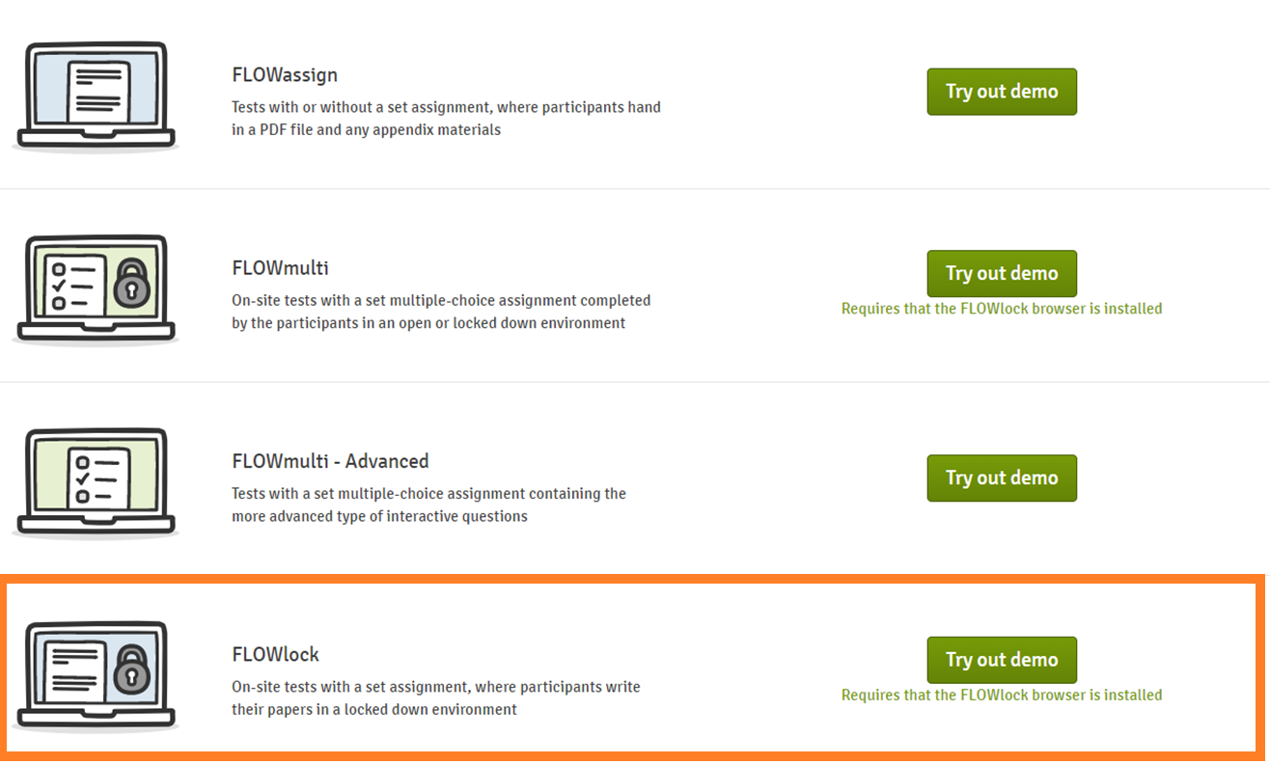

Slide 41
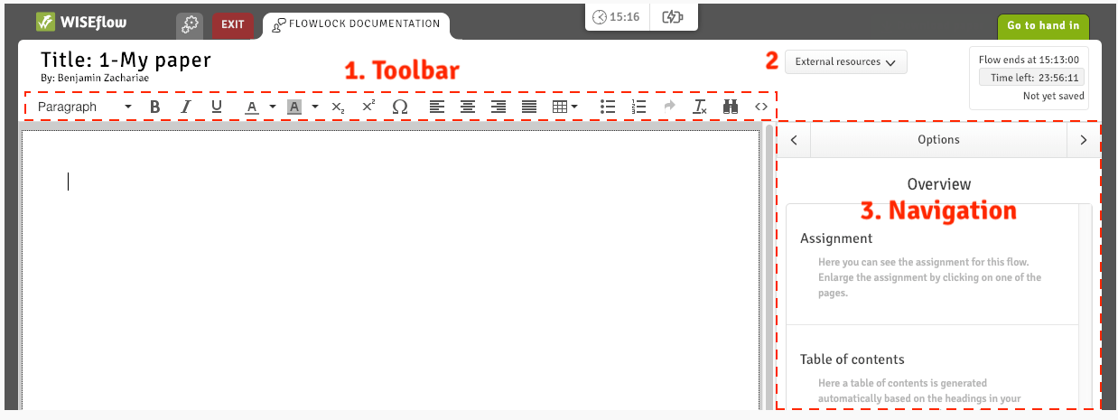
FLOWlock
A WORD-like text editor
NB! Your answer paper will be converted to a PDF-file, there can be margin width
discrepancies, thus some words can be moved to a new line.
If the alignment is important (e.g., accounting), create a table!

Slide 42
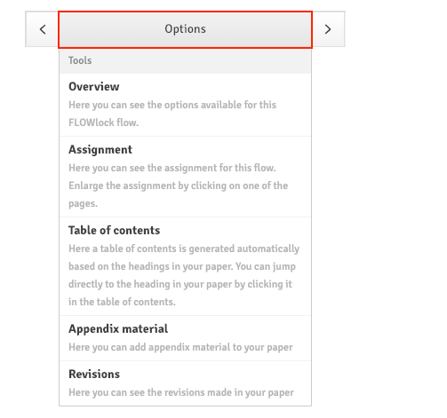
Navigation

Slide 43
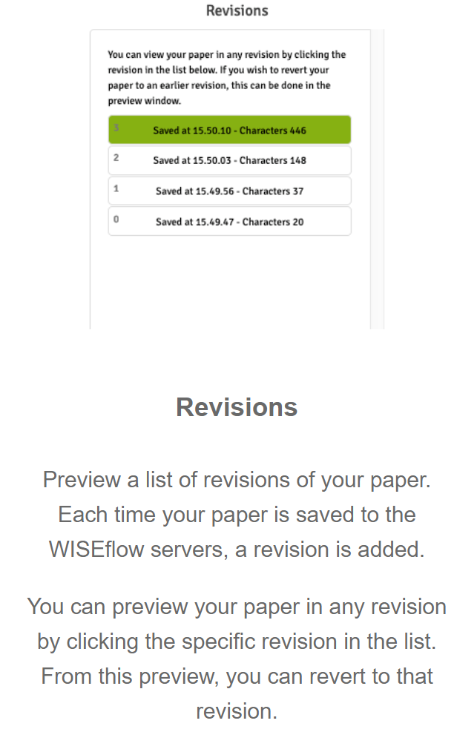
Revisions

Slide 44
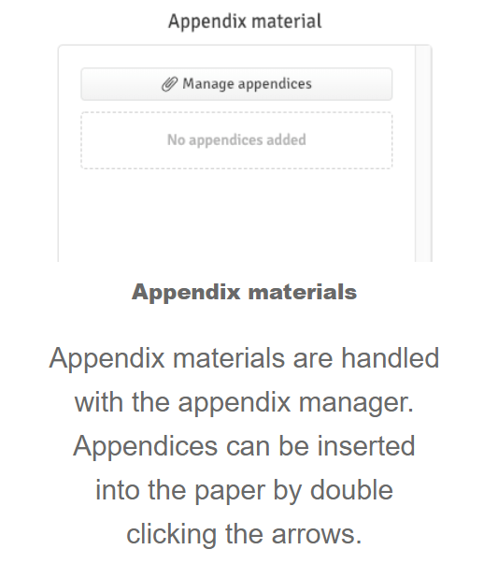
Appendix manager

Slide 45
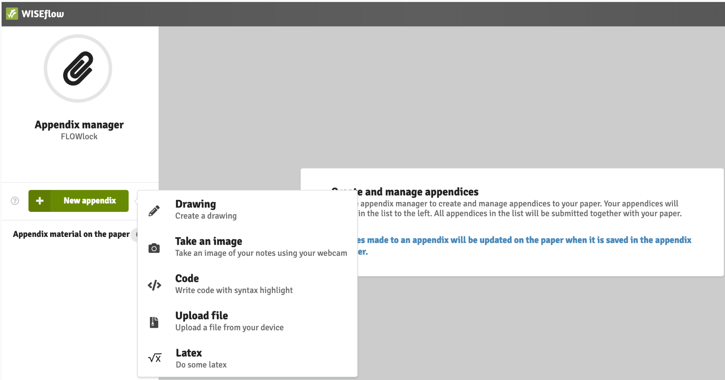
Appendix manager

Slide 46
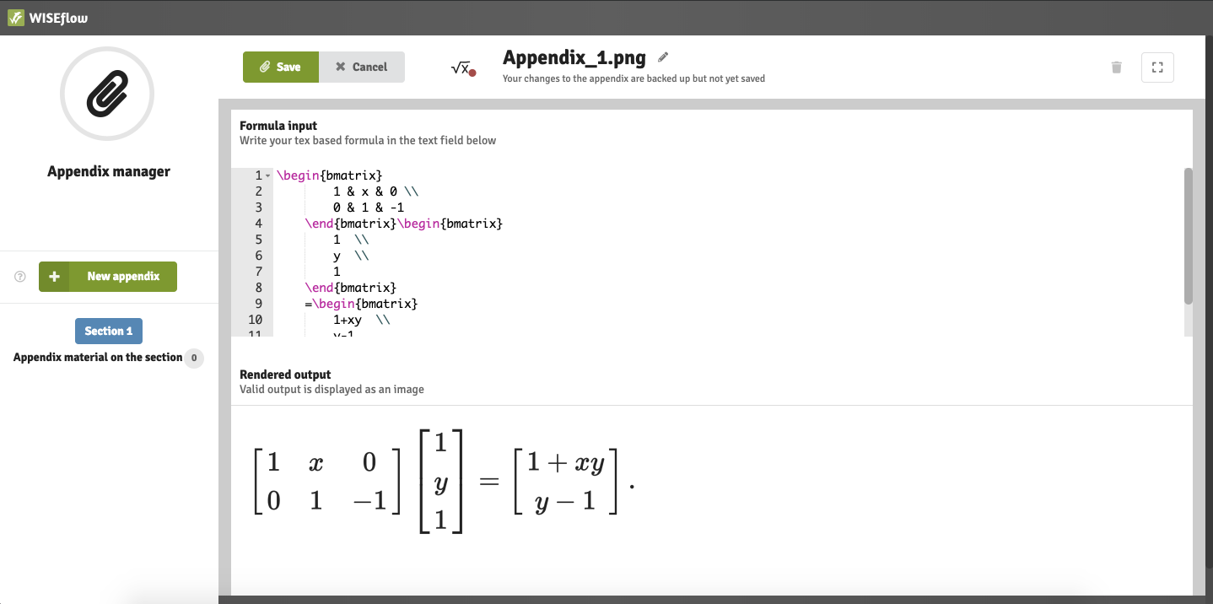
Formula editor

Slide 47
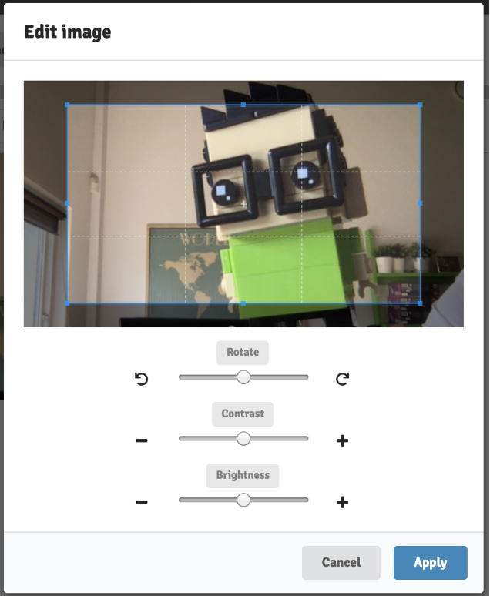
WEBCAM
You can edit Webcam pictures

Slide 48
Appendix manager

Slide 49
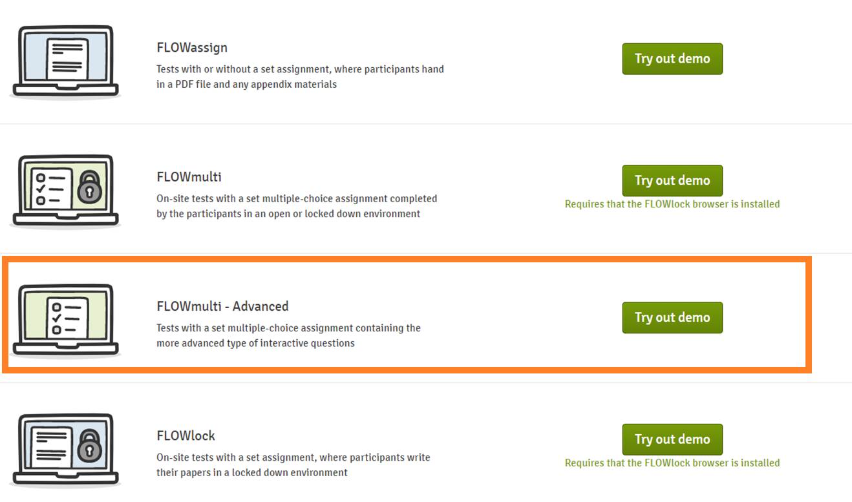
FLOWmulti: the interactive exam

Slide 50
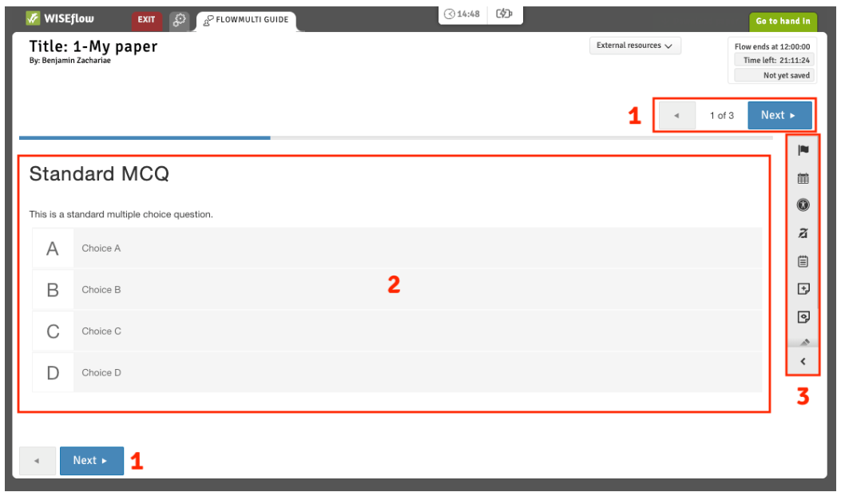
FLOWmulti: the interactive exam
1. Navigate between sections of the questionnaire.
2. The current section is situated here. A section can have multiple questions.
3. Annotation and overview tools for FLOWmulti.

Slide 51
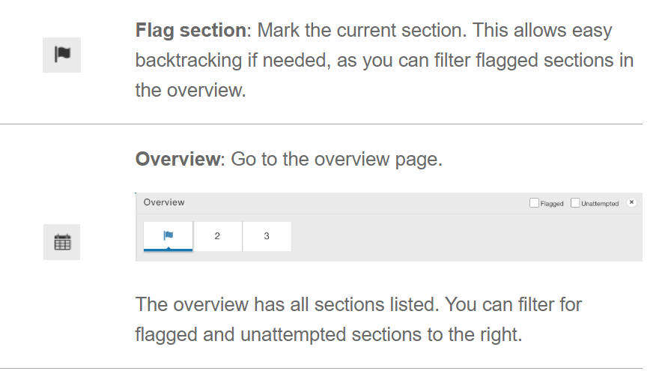
Annotation tools: changes visible only to you

Slide 52
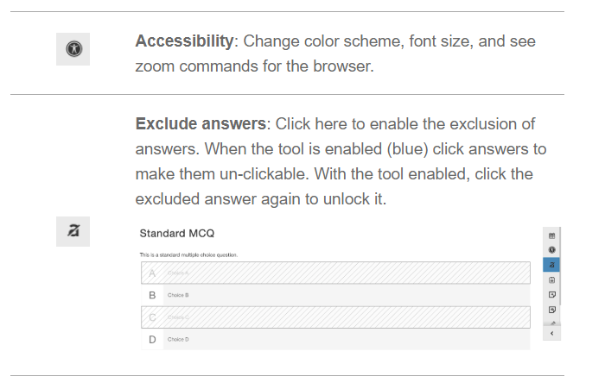
Annotation tools: changes visible only to you

Slide 53
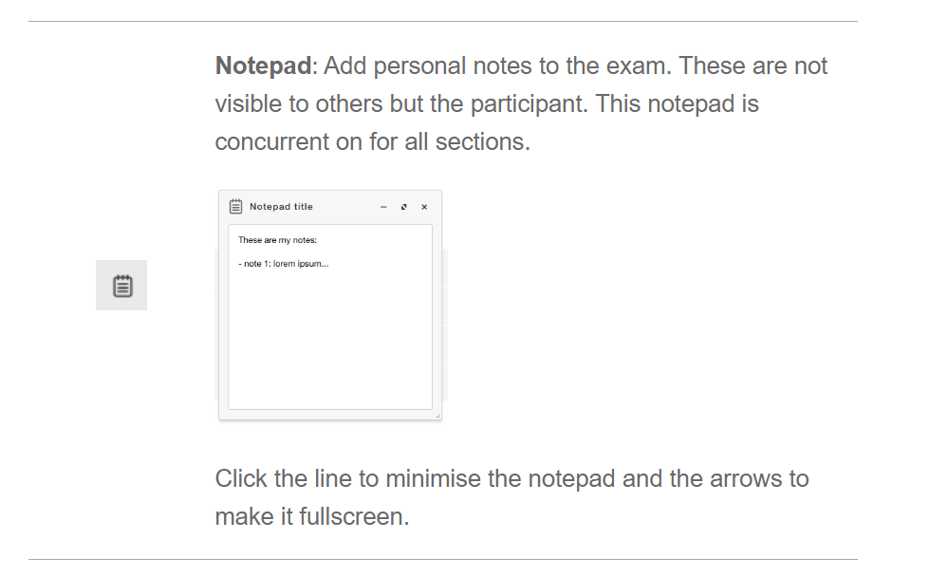
Annotation tools: changes visible only to you

Slide 54
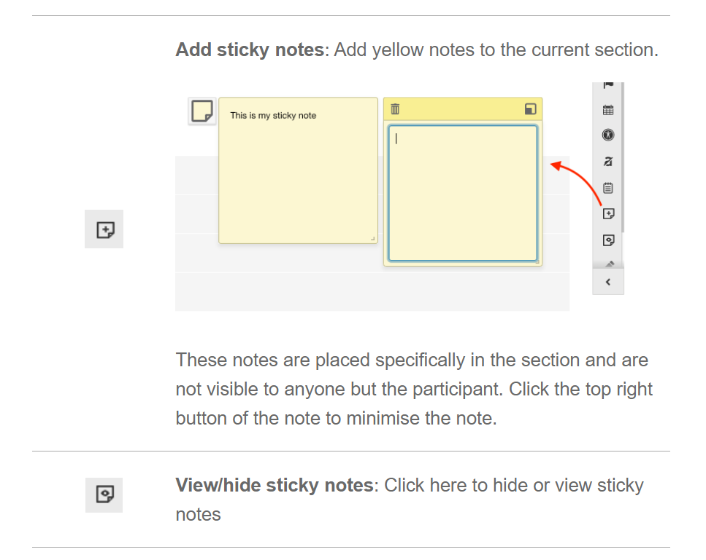
Annotation tools: changes visible only to you

Slide 55
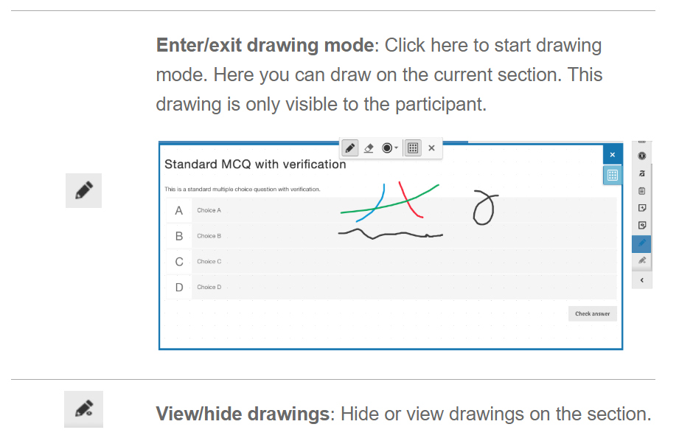
Annotation tools: changes visible only to you

Slide 56
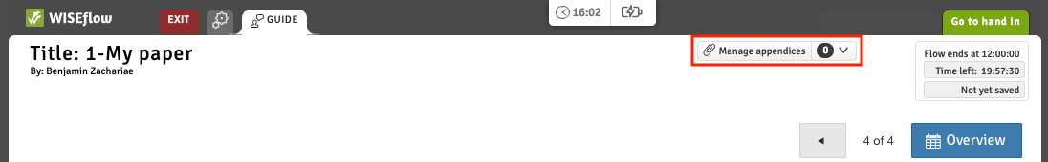
Appendix manager
For specific question types you can add appendices to the section. Click the "Manage appendices" to open the Appendix manager in a new tab.

Slide 57
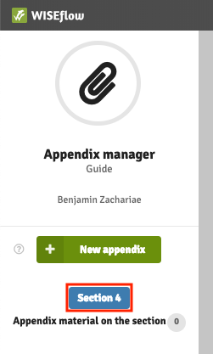
Appendix manager
The appendix manager shows you which section is open.

Slide 58
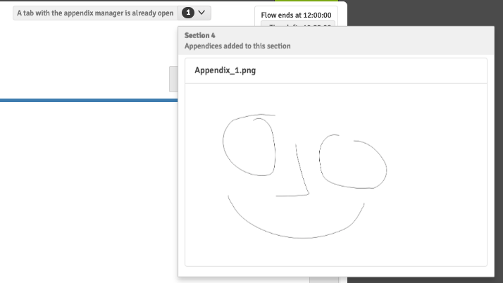
Appendix manager
You can preview appendices for the section in the dropdown to the right of the manage appendices button.

Slide 59
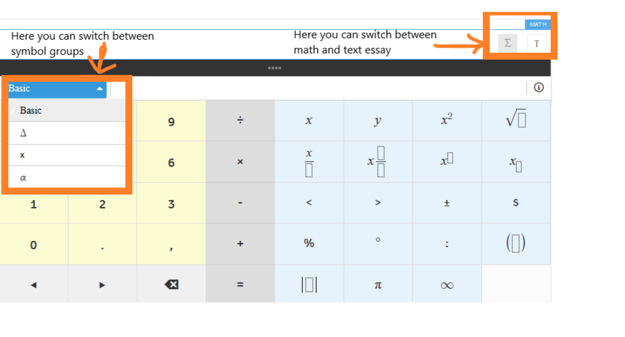
Math essay in FLOWmulti
NB! Remember to switch between text and math!

Slide 60
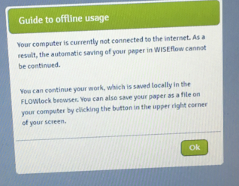
School exam
Do not be worried if you get this message during the exam: press Ok and continue working

Slide 61
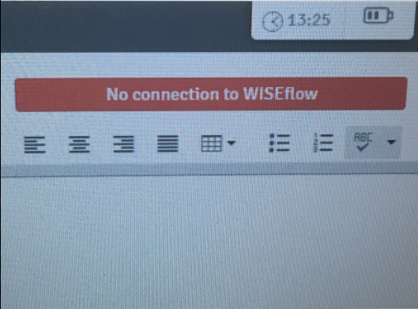
School exam
You can monitor your connection status on the top of the browser: if you are not connected to the internet for over 5 minutes, please, contact a technical invigilator. NB! Do not refresh the browser while offline.

Slide 62

School exam
If you are online, but are experiencing other issues, for example, the extra time is not showing, refresh the browser. If the problem persists, take contact with a technical invigilator

Slide 63
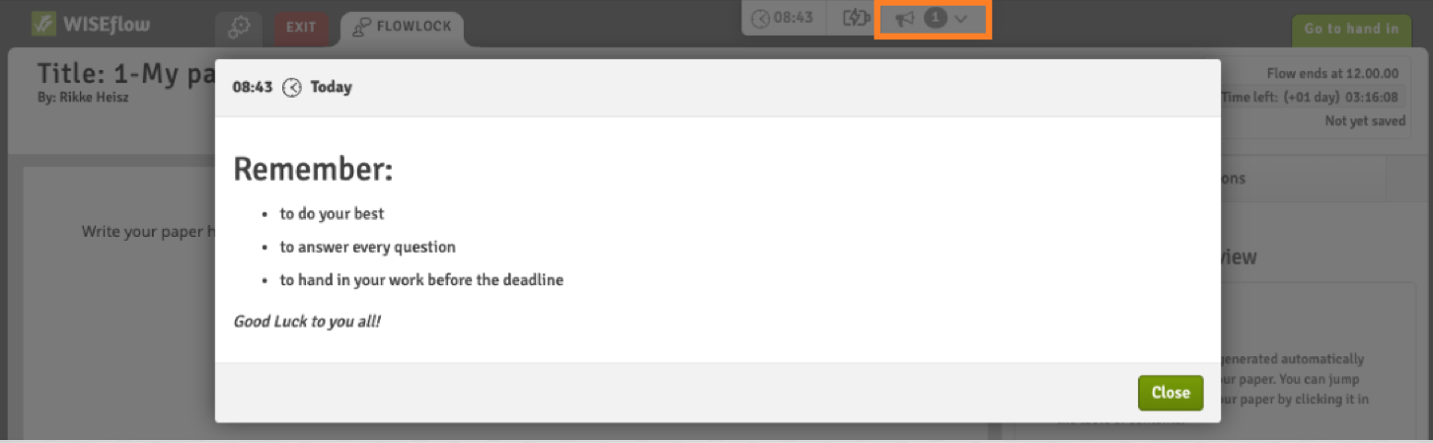
Direct messages
Important information and instructions
Pop up automatically
Can be found on the top of the page

Slide 64
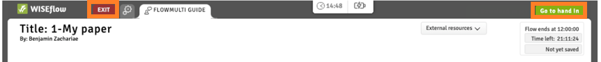
School exam
You can hand in or exit without handing in (an invigilator will have to enter the password)

Slide 65
Home exam
The most of home exams are in FLOWassign: you should convert your main document into a PDF
The appendices, if allowed, can be submitted in
various formats.
NB! The papers are not accepted after the deadline.
15 minutes extra for uploading the paper.
NB! Bigger files (e.g., videos) can take more time to upload.
If you experience technical problems with submission, send your paper to the Exam Office (exams@nhh.no) before the deadline.

Slide 66
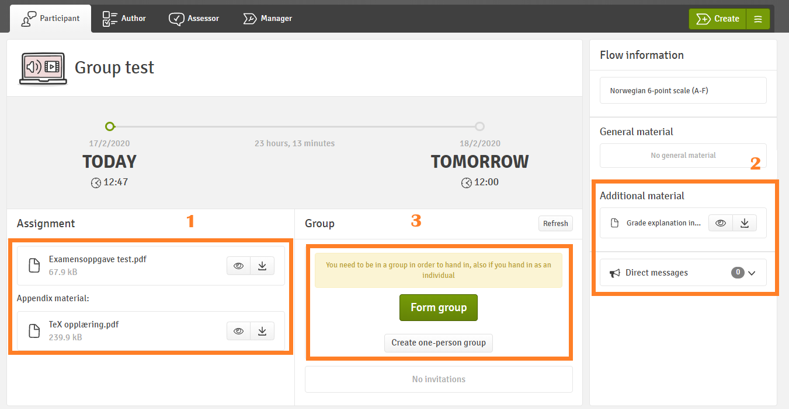
Group exam
NB! You must create a group before you can upload the paper
If you are submitting individually, create a one-person group

Slide 67
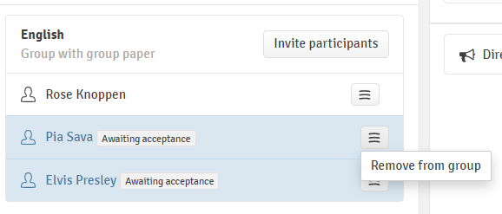
Group exam
NB! All the invited group members must accept/ reject the group invitation before you can submit the paper. Make sure you create the groups long before the submission deadline.
You can also remove the members from the group.
After you have accepted the invitation, you have the same rights as the person who created the group.
One group member submits the paper for the whole group. Each group member can see the submitted paper.

Slide 68
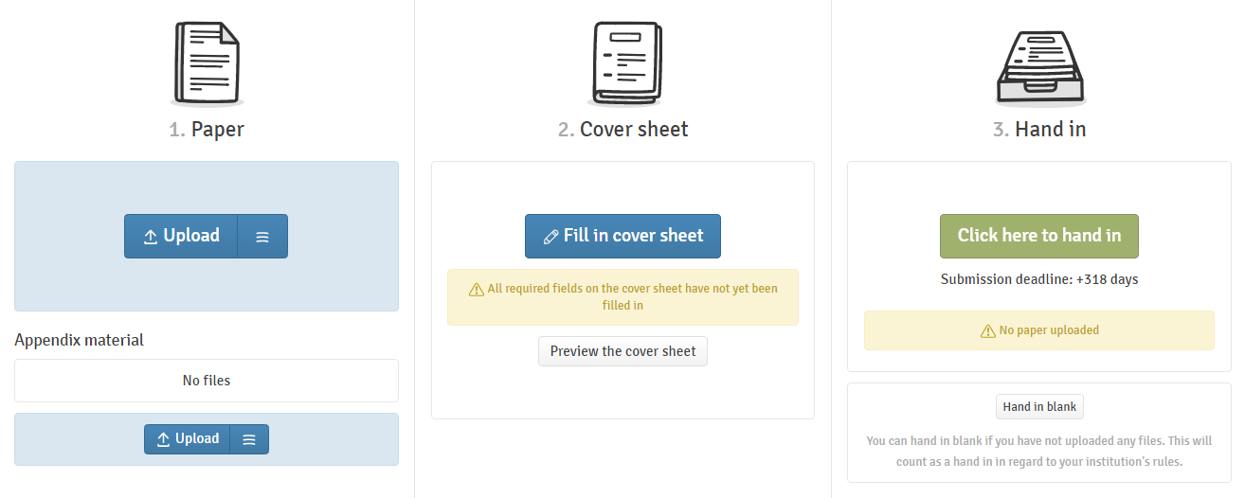
Home exam
If you are required to fill in the cover sheet, you will not be able to proceed to submitting your paper before filling it in.

Slide 69
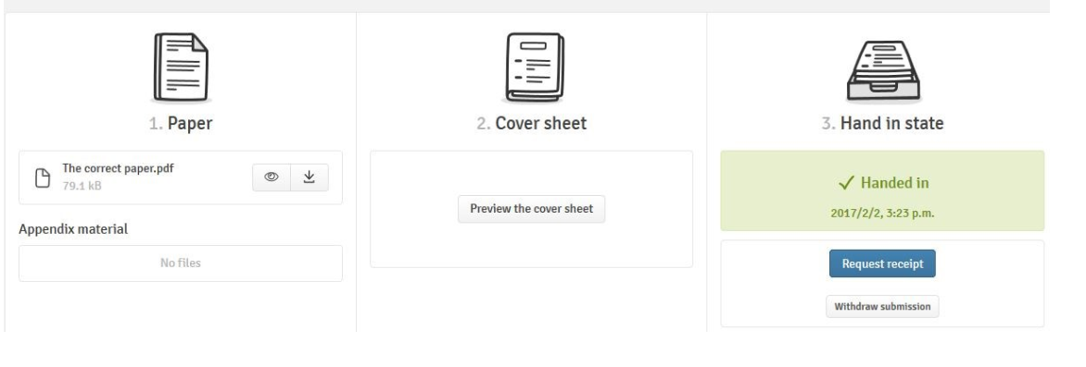
Home exam
You can withdraw your paper before the deadline and submit another paper

Slide 70
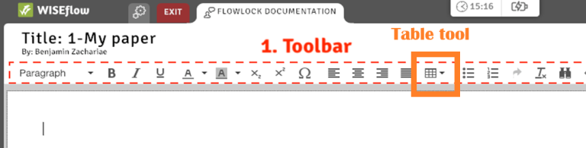
Practical assignments
Complete the flow "Important information about exams and cheating autumn 2022"
Download and install the FLOWlock browser
Open the demo FLOWlock
  Create a table
  Take a picture with your webcam and insert it in the paper
Open the demo FLOWmulti – Advanced
  Go to page 8 (math essay). Practice to switch between math and text, write some text and math formulas
Drop in for help with WISEflow:
Thursday 3rd of November, 14:15 – 15:15 in LAB1

Slide 71
Thank you for attention

