Slide 1
Enhancing Understanding of Audit Data Analytics Decisions Via A Hands-On Case Solution In R
Thomas E. McKee, Ph.D. , CPA, CMA, CIA
Professor - Medical University of South Carolina
Professor II- Norwegian School of Economics (NHH)
Session 1:13, Thursday, June 7th, 1:00 p.m. 100 minute presentation

Slide 2
Background
For the past three decades I have lectured in graduate auditing courses (part-time or full-time [Fulbright Scholar] ) at Norwegian School of Economics [NHH]
October 2017-I was asked to teach part of new NHH graduate class “Digital Auditing” which was first offered March 2018
I was asked to focus on linking data analytics with auditing decisions

Slide 3
TOPICS
Based on my prior published research, my data analytic topics were auditing and
  Cluster analysis
  Decision trees
  Regression
  Neural Networks
  Self-Organizing Maps (SOMs)

Slide 4
Neural Networks & SOMs
Neural networks and SOMs were not initially part of the topics I was asked to lecture on.
I have worked with neural networks for several decades,.e.g.
  McKee, T.E. 1990. “Evaluation of Enterprise Continuity Status Via Neural Networks.” Abstracts of The Thirteenth Annual Congress of The European Accounting Association, P. 72.
I added the two topics to my lectures due to my belief that students need a deeper understanding of feature extraction and convolutional neural networks as a basis for understanding “deep learning” possibilities, e.g. Machine vision

Slide 5
Programming In R
Course coordinator and other course instructors decided on R language for this course
My prior programming experience:
  Assembly
  Fortran
  Basic
  Cobol
  Visual Basic
  C ++
Never previously programmed in R !!!

Slide 6
Why R?
Open source language developed in mid-1990’s from more archaic S language developed in mid-1970’s at Bell Labs
Free
Good visualizations
8700+ third party packages
Rstudio is nice interface
Data must fit in RAM so limited to 50% of RAM data sizes unless workarounds:
  Chunk data in partitions for hard drive storage/multiple processors
  Run R in Cloud on Apache Hadoop ecosystem

Slide 7
Instructional Approach
Student hands-on emphasis!
Task-Centered
  Progression through increasingly complex tasks
    E.g. Basic cluster to SOM
    E.g. Regression to Neural Networks
Demonstration
  Guide learners through skill by having them execute same R code as instructor
Activation
  Build on prior knowledge gained from previous instructors who taught
    R
    Cluster, Decision Tree, Regression

Slide 8
Implementation
Preferred a single data set which could be used for all 5 techniques
Advantages
  Less time required for basic data familiarity analysis
  Deeper understanding of data
  Comparison relative performance of techniques
PROBLEM !
  Could not locate suitable data set which was not overly complex and would not consume too much class time with setup

Slide 9
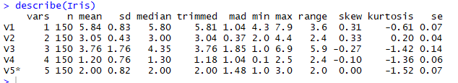
IRIS Data As Precursor To Synthetic Data
install.packages(psych)
library("psych")
describe(Iris)

Slide 10
Synthetic Data Set As Solution
The creation of case data for either type of case creation, real entity or fictitious entity, is called creating “synthetic data.”
Synthetic data is defined in Wikipedia as "any production data applicable to a given situation that are not obtained by direct measurement." [https://en.wikipedia.org/wiki/Synthetic_data]
Case written up for real company “QB House” , but data was synthetic.

Slide 12
We will do an in-class hands-on walkthrough of all four analysis techniques using R Studio!

Slide 13
Generate 30,000 Data Items In 3 Subsets then Bind Together Into Single File Named “QB1”
set.seed(2000)
x1<-rnorm(10000,5,1) # Wait Time 5,6,7
x2<-rnorm(10000,10,1) #Chair time10,12,14
x3<-rnorm(10000,9,.25) #Revenue per visit 9,10,11
x4<-rnorm(10000,4.5,.25) #labor cost per visit 4.5,6.0,7.7
x5<-rnorm(10000,1,0) #country/location 1,2,3,
dataframe1<-data.frame(WaitT=x1,ChairT=x2,Revenue=x3,LaborC=x4,Country=x5)
x12<-rnorm(10000,6,1)
x22<-rnorm(10000,12,2)
x32<-rnorm(10000,10,.25)
x42<-rnorm(10000,6,.25)
x52<-rnorm(10000,2,0)
dataframe2<-data.frame(WaitT=x12,ChairT=x22,Revenue=x32,LaborC=x42,Country=x52)
x13<-rnorm(10000,7,1)
x23<-rnorm(10000,14,3)
x33<-rnorm(10000,11,.25)
x43<-rnorm(10000,7.7,.25)
x53<-rnorm(10000,3,0)
dataframe3<-data.frame(WaitT=x13,ChairT=x23,Revenue=x33,LaborC=x43,Country=x53)
QB1<-rbind(dataframe1,dataframe2,dataframe3)
str(QB1)
summary(QB1)

Slide 14
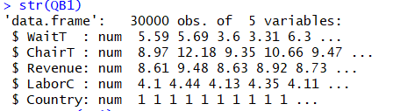
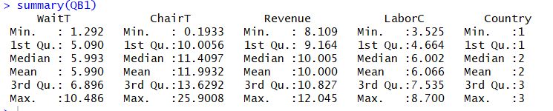
Examining File Generated

Slide 15
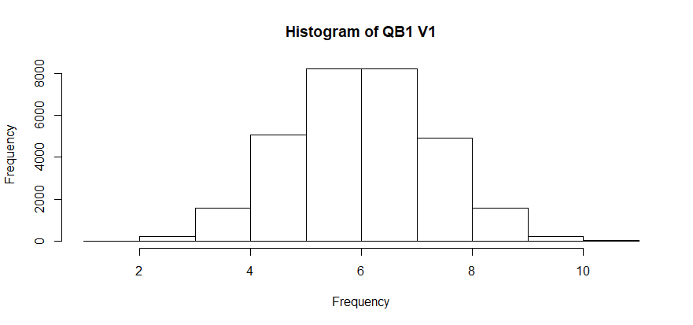
Histogram V1
>hist(QB1$WaitT,breaks=10,main="Histogram of QB1 V1",xlab="Frequency")

Slide 16


Correlations

Slide 17
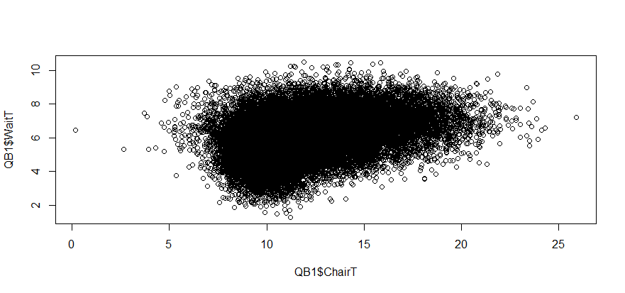
Plots

Slide 18
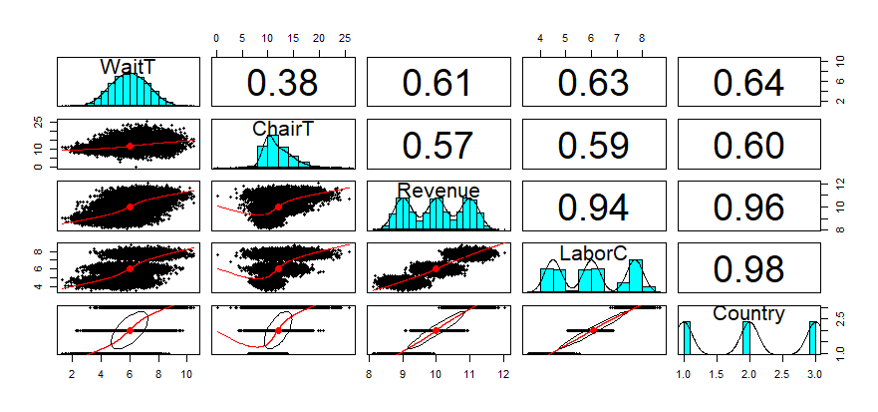
Broad Data Overview
> install.packages("psych")

Slide 19
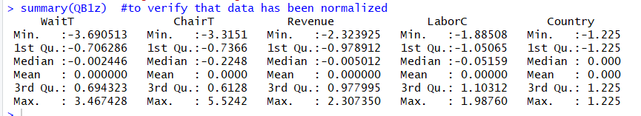
Cluster Analysis Scaled Data
>install.packages("gmodels")
>library(gmodels)
>install.packages("ggplot2")
>library(plyr)
>library("ggplot2")
>install.packages("C50")
>library(C50)
[Note: dropped data column 5 for students’ actual cluster analysis via following command >qb1<-QB1[,-c(5)]
>QB1z<-as.data.frame(lapply(QB1,scale))
  #normalizes data into data frame
>summary(QB1z)
  #to verify that data has been normalized

Slide 20
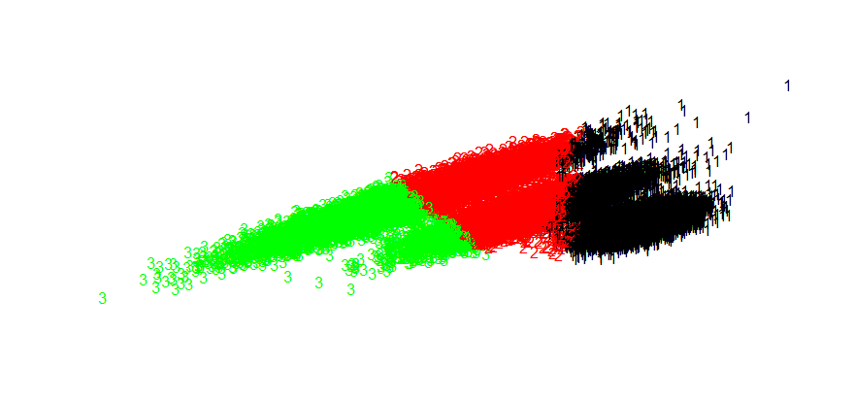
Cluster Visualization- Non-Normalized Data
dat<-QB1[,-5]
clus<-kmeans(dat,centers=3)
plotcluster(dat,clus$cluster,color=TRUE,shade=TRUE,labels=2,lines=0)

Slide 21
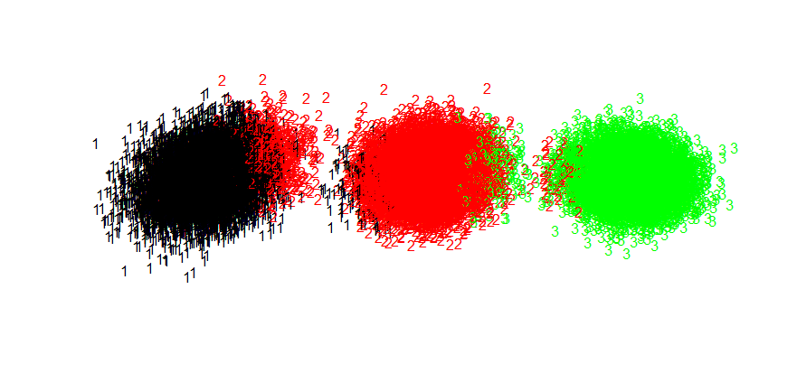
Cluster Visualization- Normalized Data
dat<-QB1z[,-5]
clus<-kmeans(dat,centers=3)
plotcluster(dat,clus$cluster,color=TRUE,shade=TRUE,labels=2,lines=0)

Slide 22
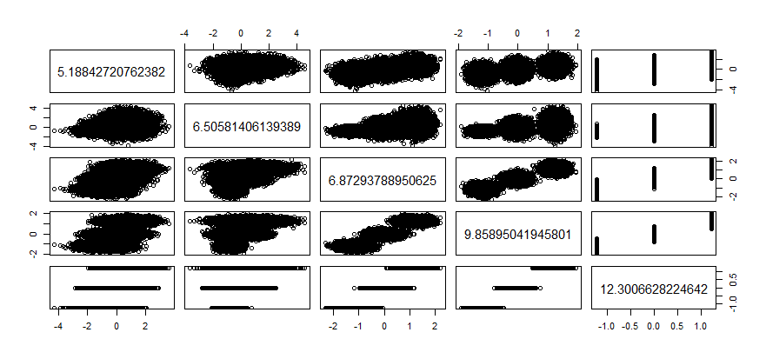
Cluster Analysis Un-Scaled Data
>plot(QB1z,clus$centers)

Slide 23
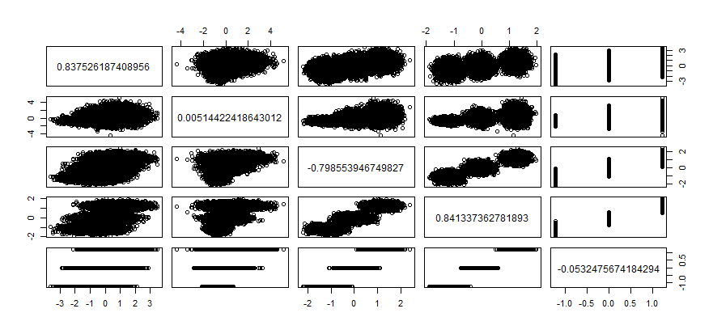
Cluster Analysis Un-Scaled Data
>plot(QB1z,clus$centers)

Slide 24
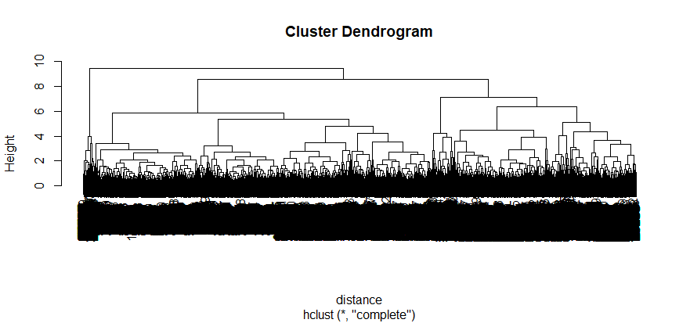
Dendrogram
distance<-dist(QB1z)
  #computes Euclidean distance measure
hc<-hclust(distance)
  #computes hierarchial cluster based on distance
plot(hc)
  # plots dendogram

Slide 25
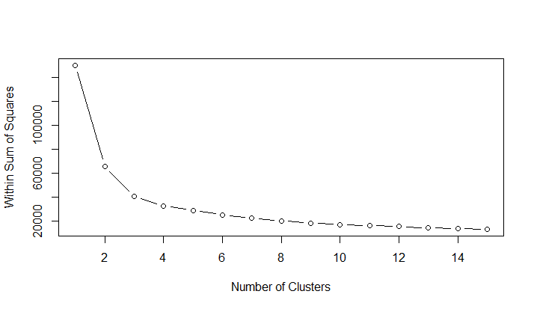
Cluster Scree Plot Scaled Data
wss<-numeric (15)
  # vector varies from 1 to 15
for (k in 1:15) wss[k]<-sum(kmeans(QB1z,centers=k,nstart=25)$withinss)
  #repeat kmeans 25 times and store values wss vector
plot(1:15,wss,type="b",xlab="Number of Clusters",ylab="Within Sum of Squares")
Within-Group Heterogeneity Based on K Clusters

Slide 26
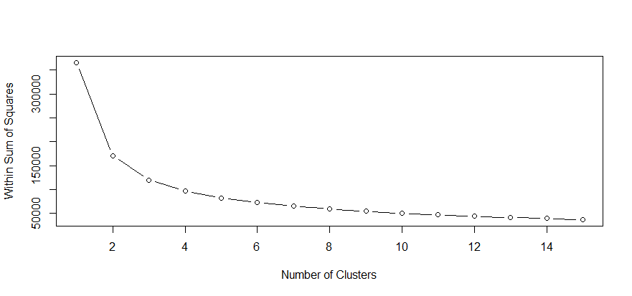
Cluster Scree Plot Original Data wss<-numeric (15)
# vector varies from 1 to 15 for (k in 1:15) wss[k]<-sum(kmeans(QB1,centers=k,nstart=25)$withinss) #repeat kmeans 25 times and store values wss vector plot(1:15,wss,type="b",xlab="Number of Clusters",ylab="Within Sum of Squares")

Slide 27
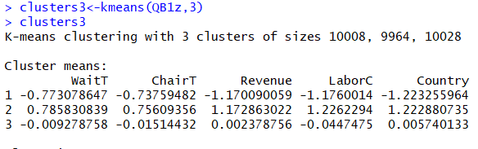

K Means

Slide 28
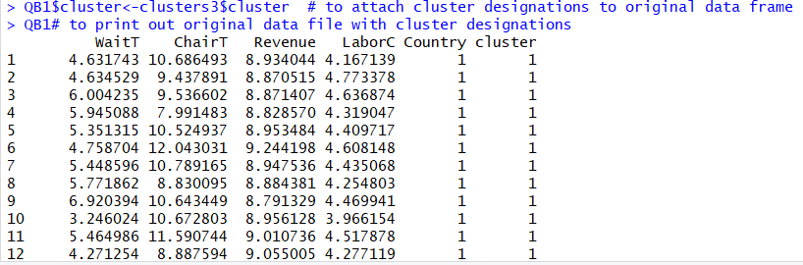

Examining Actual Data In Clusters
>QB1$cluster<-clusters3$cluster
  # to attach cluster designations to original data frame
>QB1
  # to print out original data file with cluster designations

Slide 29
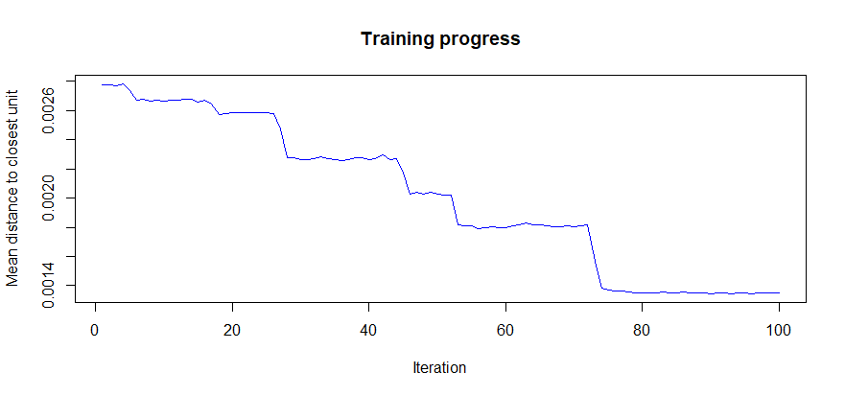
Self Organizing Maps
>install.packages("kohonen")
>library("kohonen")
>som_scaled=scale(QB1[,1:5])
>som.grid=somgrid(xdim=6,ydim=6,topo="hexagonal")
>som_model=som(som_scaled,grid=som.grid,rlen=100,alpha=c(0.05,0.01))
>plot(som_model,type="changes",col="blue")
  # to graph training progress of model

Slide 30
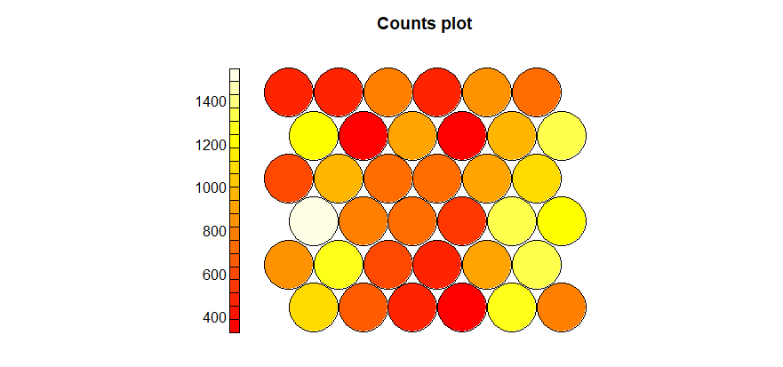
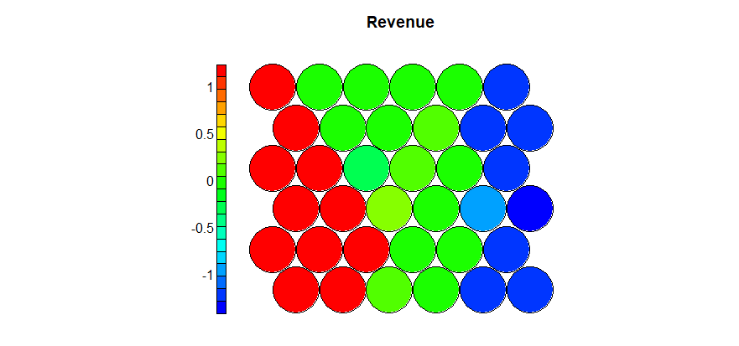
SOM
plot(som_model,type="count")
coolBlueHotRed<-function(n,alpha=1){rainbow(n,end=4/6,alpha=alpha)[n:1]}
plot(som_model,type="property",property=getCodes(som_model)[,3],main=colnames(getCodes(som_model))[3],palette.name=coolBlueHotRed)
Previous is heatmap for variable X3 Revenue
You can also do clustering on the SOM

Slide 31
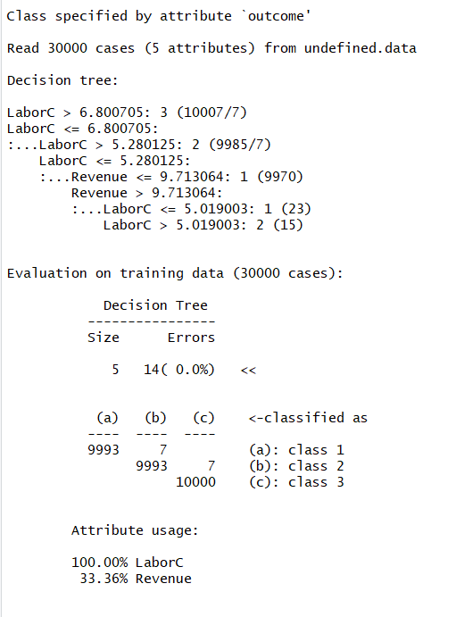
C5 Decision Tree
QB1$x5<-as.factor(QB1$x5)
  #to convert x5 to factor so it can be decision variable
c5<-C5.0(x=QB1[,-5],y=QB1$x5) # removes x5 from x data set and uses x5 as y variable
summary(c5)
Note: 14 misclassifications

Slide 32
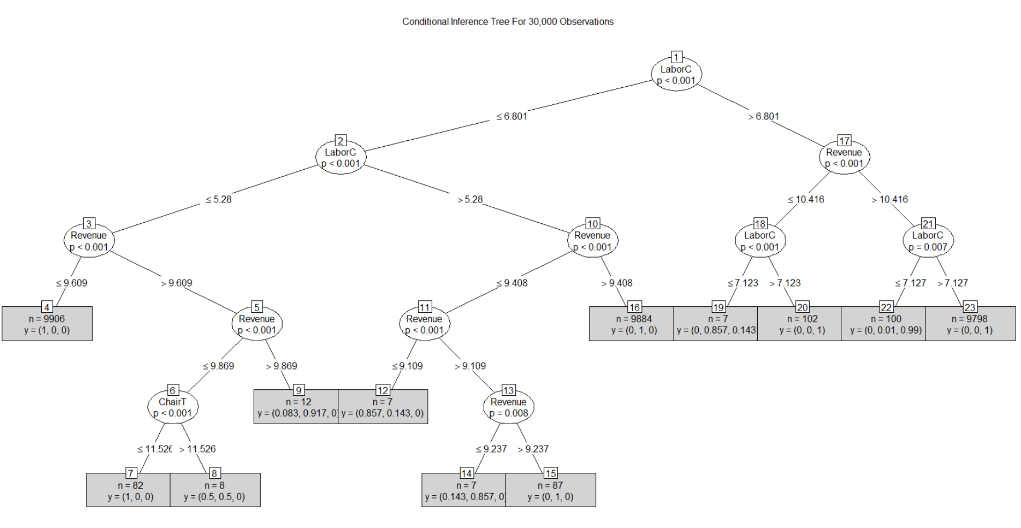
Conditional Inference Tree
(Use statistical stopping rules so pruning not generally required)
install.packages("party")
library(party)
nparatree<-ctree(Country~WaitT+ChairT+Revenue+LaborC, data=QB1)
plot(nparatree,type="simple",main="Conditional Inference Tree For 30,000 Observations")
Note: Documentation in R is dense but I think bottom numbers are interpreted as % in 3 possible classes. Using % < .5 we might interpret this to mean that (1+1+3+9+2+3 or 19 total misclassifications.

Slide 33
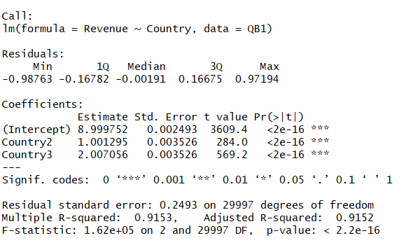
Regression
regmodel1<-lm(x3~x5,data=QB1)
summary(regmodel1)

Slide 34
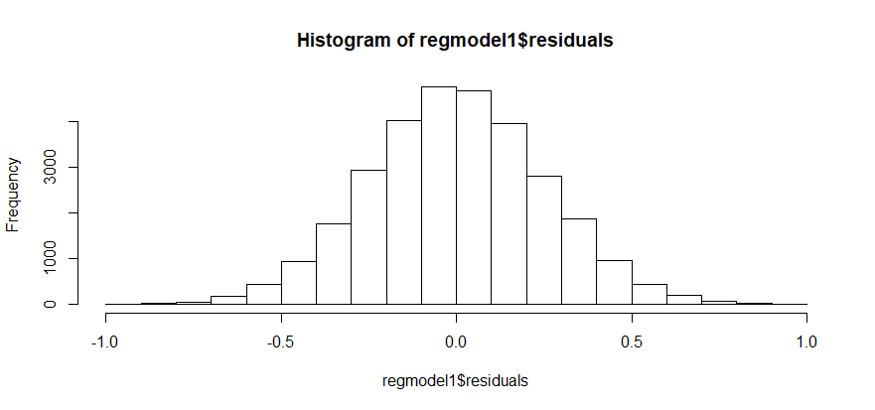
Residuals
hist(regmodel1$residuals)

Slide 35
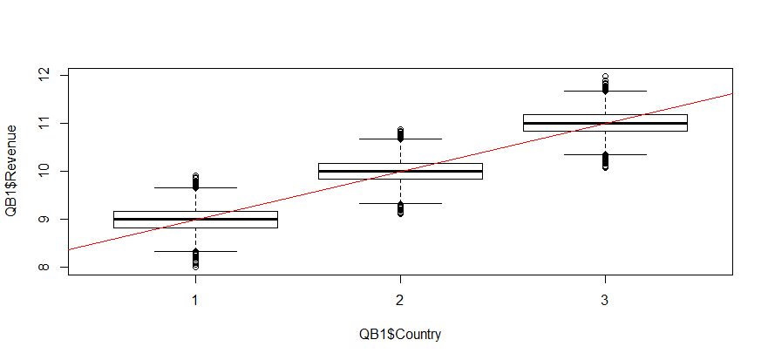
Regression Graph
(Y=revenue, X=location)
plot(QB1$Revenue~QB1$Country)
abline(a=7.997,b=1.002,col="red")

Slide 36
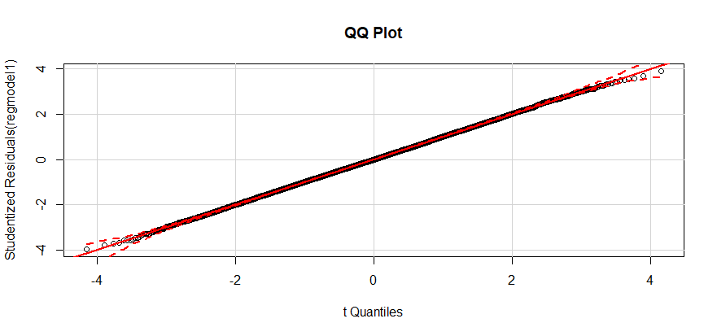

QQ Plot of Residuals &
Durbin Watson for Autocorrelation
install.packages("car")
library(car)
qqPlot(regmodel1,main="QQ Plot")
DW value of 2 indicates no autocorrelation.

Slide 37


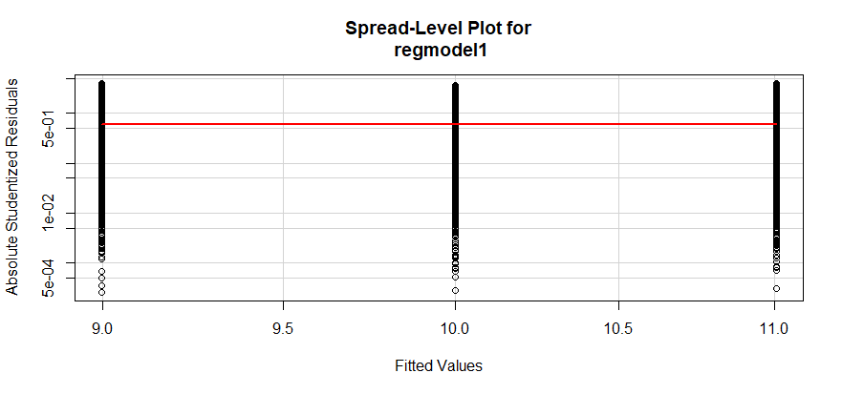
Non-Constant Variance Test For Heteroscedasticity
&
Spread Level Plot
> ncvTest(regmodel1)
P > .05 suggests heteroscedasticity present
Flat line suggests no change in spread or variance

Slide 38
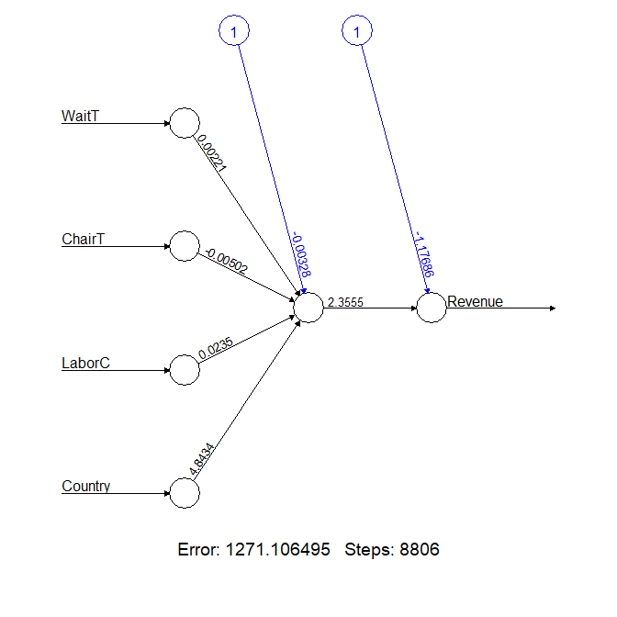
Neural Network
install.packages("neuralnet")
library(neuralnet)
netmodel1<-neuralnet(Revenue~WaitT+ChairT+LaborC+Country,data=QB1z)
plot(netmodel1)

Slide 39
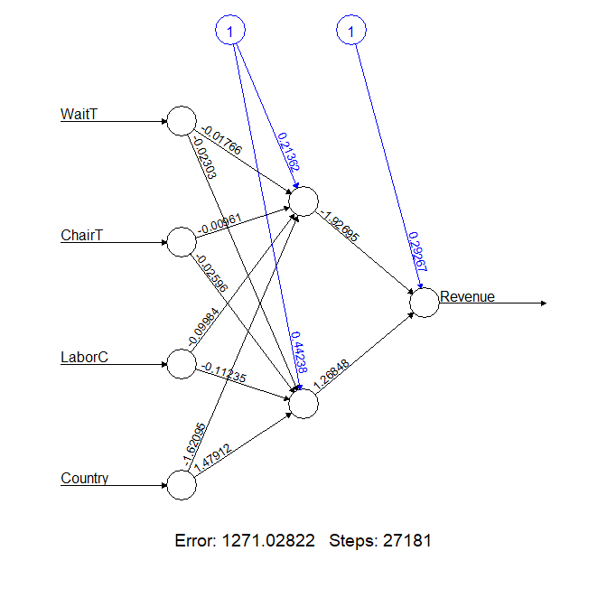
Increasing Hidden Layer
Revenue~WaitT+ChairT+LaborC+Country
>netmodel2<->neuralnet(Revenue~WaitT+ChairT+LaborC+Country,data=QB1z,hidden=2)# computational time 5+ minutes! > plot(netmodel2)
>
Note the increase in steps from 8806 to 827181 by adding 2nd node in hidden

Slide 40
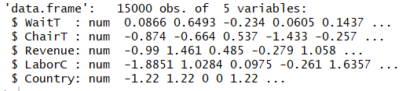
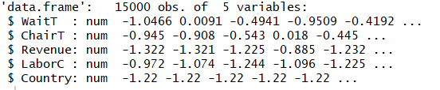
Training vs Testing Samples
>set.seed (2000)
>train_sample<-sample(30000,15000)
  #randomly selected 15000 items
>QB1z_train<-QB1z[train_sample,]
  #15000 random items in training sample
Str(QB1z_train)
>QB1z_test<-QB1z[-train_sample,]
  #negative sign provides other half of sample
Str(QB1z_test)
  netmodel3<-neuralnet(Revenue~WaitT+ChairT+LaborC+Country,data=QB1z_train)
  netmodel3results<-compute(netmodel3,QB1z_test[1:4])
  predictedclass<-netmodel3results$net.result
  cor(predictedclass,QB1z_test$Revenue)
  [1,] 0.916022679
#92% correlation of neural net model predictions of revenue with actual revenues.

Slide 41
Saving File and Importing File From Internet
Setwd(“C:/Documents and Settings/Data”)
  #sets working directory
>write.csv(QB1z, file="QB1z.csv", row.names=FALSE)
  #writes to working directory
    (file is in documents folder if working directory not previously set)
download.file("https://archive.ics.uci.edu/ml/machine-learning-databases/iris/iris.data", "iris", "wininet", quiet = FALSE, mode = "w")
  # This downloads the Iris data file

Slide 42
Case Study #1
-- After Class Lecture Coverage
Case about U.S. storage company with 1,531 locations in 5 districts and 306,000 rental units.
Calls to hotline indicate possibility of two types of fraud:
  Revenue diversion
  Payroll diversion
Students assigned to perform cluster analysis and decision tree analysis of yearly data by location
  Gross revenue
  Location
  Units
  OccMonths
  AdBudget
  EqFTEmployees
Both types of fraud were seeded into data but each fraud was committed in a different district.
Students were able to find frauds

Slide 43
Case Study#2– After Class Lecture Coverage
Company is public utility
Students tasked with performing substantive analytical review of revenue using regression with minimum R square of 80% and meeting all regression assumptions.
Materiality threshold of $1,750,000
Tolerable error is $3,500,000 based on other testing results:
  + Compliance testing
  Confirmations
  Planned testing of outliers
36 months of data for revenue and production variables
Students were able to construct appropriate model and identify two months in year under audit which were not supported by 95% confidence bounds

Slide 44
Case Study # 3 – After Class Lecture Coverage
Students provided article which had qualitative data including task outcome
Students tasks:
  Decision tree
  Code data into numeric format
  Develop C5.0 decision tree from data
  Predict outcomes
  Compare predictions to actual outcomes
  Compute accuracy levels
  Write out rules in If-Then format
  Neural network
  Develop neural network from data
  Use neural network to predict outcomes
  Compare predictions to actual outcomes
  Compute accuracy level
  Regression
  Develop regression equation
  Predict results
  Compare to actual outcomes
  Compute accuracy levels
Class discussion of following issues:
  Which technique is best for problem? Why?
  What would be involved in deploying model?
  What audit activities could be automated via a similar decision model?

Slide 45
Students Takeaways
Testing options are only limited by your imagination
  Gap analysis
  Duplicate analysis
  Limit tests (above limit, by person, by location)
  Intensity tests (most used, least used)
  Outliers
  Anomalies
  Control exceptions
  Fraud
Cluster analysis/ SOM (identify interesting subsamples)
  By location
  By year/age
  By size
  By person/source/customer
Decision trees/Regression/Neural Networks
  Predict revenue/costs
  Predict labor hours
  Predict loan losses/bad debts
You have to identify task and desired outcome before selecting appropriate tool from your toolbox!

Slide 46
Professor Takeaways
Much more work than I thought due to my inefficiencies in learning R
Next year I will develop a more realistic data set for lecture demonstrations
Overall, I found it to be a very intellectually stimulating experience!

Slide 47
Resources
AICPA. 2017. Audit Guide-Analytical Procedures
AICPA. 2017. Guide To Audit Data Analytics.
B. Baesens. 2014. Analytics In A Big Data World. Wiley.
Beysolow II, T. 2017. Introduction To Deep Learning Using R. Apress.
EMC Educational Services. 2015. Data Science & Big Data Analytics. Wiley.
Foreman, J. 2014. Data Smart-Using Data Science To Transform Information Into Insight. Wiley
James, G., D. Witten, T. Hasties, and R. Tibshirani. 2013. An Introduction To Statistical Learning With Applications In R. Springer.
Knaflic, C.N.. 2015. Storytelling with data. Wiley.
Lantz, B. 2015. Machine Learning With R. 2nd edition. Packt Publishing.
Leskovec, J., A. Rajaraman, and J.D. Ullman. 2014. Mining of massive data sets. Online book used in 3 courses at Stanford University.
McKee, T. 1988. “Does Your Practice Have A Place For An Expert System?”. The CPA Journal. Vol. 58, No. 1, pp. 114-118.
McKee, T. 1989. Modern Analytical Auditing: Practical Guidance For Auditors and Accountants, Quorum Books,
McKee,T. 1995. “Predicting Bankruptcy Via Induction.” Journal of Information Technology. Vol. 10, pp. 26-36.
Milligan, J.N. 2016 . Learning Tableau 10. Second edition. Packt Publishing.
Tabachnick, B. and L. S. Fidell. 2007. Using Multivariate Statistics. 5th edition. Pearson Publishing
Thiprungsri,S. and M.A. Vasarhelyi. 2011. “Cluster Analysis For Anomaly Detection in Accounting Data: An Audit Approach.” Int. J. of Digital Accounting Research, Vol. 11, pp. 69-84.
Templ, M. 2016. Simulation for Data Science With R. Packt Publishing.
Walkowiak, S. 2016. Big Data Analytics With R. Packt Publishing.

