Slide 1
Creating Synthetic Data Files Via R Language-A Tutorial With Hands-on Application
Thomas E. McKee, Ph.D. , CPA, CMA, CIA
Professor - Medical University of South Carolina
Professor II- Norwegian School of Economics (NHH)
Session 4:03 , 8:00 a.m., Tuesday June 5th
50 minute presentation

Slide 2
Background
For the past three decades I have lectured in graduate auditing courses (part-time or full-time [Fulbright Scholar] ) at Norwegian School of Economics [NHH]
October 2017-I was asked to teach part of new NHH graduate class “Digital Auditing” which was first offered March 2018
I was asked to focus on linking data analytics with auditing decisions

Slide 3
TOPICS
Based on my prior published research, my data analytic topics were auditing and
  Cluster analysis
  Decision trees
  Regression
  Neural Networks
  Self-Organizing Maps (SOMs)

Slide 4
Neural Networks & SOMs
Neural networks and SOMs were not initially part of the topics I was asked to lecture on.
I have worked with neural networks for several decades,.e.g.
  McKee, T.E. 1990. “Evaluation of Enterprise Continuity Status Via Neural Networks.” Abstracts of The Thirteenth Annual Congress of The European Accounting Association, P. 72.
I added the two topics to my lectures due to my belief that students need a deeper understanding of feature extraction and neural networks as a basis for understanding multi-layer Perceptrons “deep learning” possibilities, e.g. Machine vision

Slide 5
Programming In R
Course coordinator and other course instructors decided on R language for course
My prior programming experience:
  Assembly
  Fortran
  Basic
  Cobol
  Visual Basic
  C ++
Never previously programmed in R !!! Required:
  Time
  Patience
  Practice
  Varied Exercises

Slide 6
Why R?
Open source language developed in mid-1990’s from more archaic S language developed in mid-1970’s at Bell Labs
Free
Good visualizations
8700+ third party packages
R studio is nice interface
Data must fit in RAM so limited to 50% of RAM data sizes unless workarounds:
  Chunk data in partitions for hard drive storage/multiple processors
  Run R in Cloud on Apache Hadoop ecosystem

Slide 7
Instructional Approach
Student hands-on emphasis
Task-Centered
  Progression through increasingly complex tasks
    E.g. Basic cluster to SOM
    E.g. Regression to Neural Networks
Demonstration
  Guide learners through skill by having them execute same R code as instructor
Activation
  Build on prior knowledge gained from previous instructors who taught
    R
    Cluster, Decision Tree, Regression

Slide 8
Implementation
Desired a single data set which could be used for all 5 techniques
Advantages
  Less time required for basic data familiarity analysis
  Deeper understanding of data
  Comparison relative performance of techniques
PROBLEM !
  Could not locate suitable data set which was not overly complex and would not consume too much class time with setup

Slide 9
Synthetic Data Set As Solution
The creation of case data for either type of case, real entity or fictitious entity, is called creating “synthetic data.”
Synthetic data is "any production data applicable to a given situation that are not obtained by direct measurement."
  [https://en.wikipedia.org/wiki/Synthetic_data]

Slide 10
Some R Commands For Data Creation
Distributions
  Normal→ rnorm (n, mean= , std. dev=)
  Binomial → rbinom (n, size, probability)
  Uniform → runif (n, min, max)
  Beta → dbeta (x,shape1, shape2, ncp=0, log = FALSE)
  Categorical variables (10 in range 1,3) → sample (1:3,10,replace=TRUE, prob = c (3/7,1/7,3/7 )) [see p.105 Templ for discussion]

Slide 11
Basic R Commands For Data Manipulation
Join individual variables →data.frame (x1x2,…xn)
Merge data frames vertically→rbind
Truncate →x1[x1>4 & x1<8]
    Previous uses rejection method which can be computationally inefficient for small intervals. See P 117 in Temple for inversion method.
Slice() → to select 1 or more rows
Select() → to select 1 or more columns
Arrange() → to sort

Slide 12
Advanced Data Creation
Use mean and covariance matrix from original data
  P324 , Templ
Create mixture model containing good data and potential outliers by simulating both distributions separately
  P 327, Templ
Regress variable against predictors on real data set and then use model to replace variable (in a new data set) with some errors added for variable.
  P 328, Templ
R has package called “simPop” which uses advanced statistical design in simulating a population.

Slide 13
My Process To Create Data File For Class Teaching Use
Download IRIS data from web
Compute statistics on IRIS data
Create small synthetic data set that has same statistical properties
Test synthetic data set properties to validate match
Expand synthetic data set to more realistic size and adjust variable values to realistic case values for class use

Slide 14
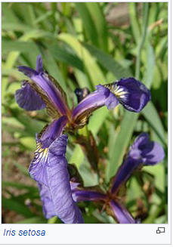
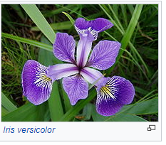
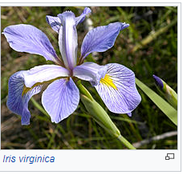
Fisher’s Iris Data
R. Fisher used data in 1936 paper but data was actually collected by E. Anderson in1935.
Typical test case for many statistical classification techniques in machine learning
The data set consists of 50 samples from each of three species of Iris (Iris setosa, Iris virginica and Iris versicolor).
Four features were measured from each sample: the length and the width of the sepals and petals, in centimetres.
Source: Wikipedia

Slide 15
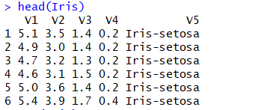
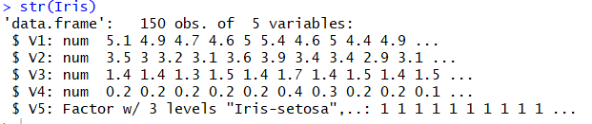
Download File
>download.file("https://archive.ics.uci.edu/ml/machine-learning-databases/iris/iris.data", "iris", "wininet", quiet = FALSE, mode = "w")
>Iris<-read.csv("C:/Users/tem21/Downloads/iris",
header=FALSE)
>head(Iris)
>str(Iris)

Slide 16
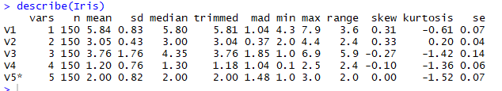
Psych Package Statistics
install.packages(psych)
library("psych")
describe(Iris)

Slide 17
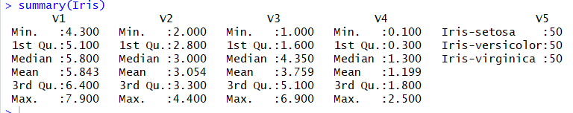


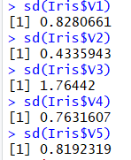
Summary Statistics
Summary (Iris)
mean(Iris$V1)
v1=Iris$v1
mean(v1)
sd(Iris.$x1)

Slide 18
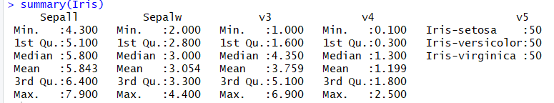
Naming Variables
names(Iris)<-c("Sepall","Sepalw","v3","v4","v5") #names the first 2 variables
summary(Iris)

Slide 19
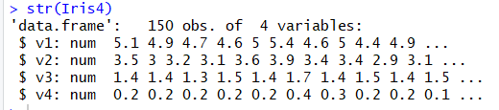
Delete column
Iris4<-Iris[,-c(5)] #concatenate command to delete column 5 from data [drops character string]
str(Iris4)

Slide 20
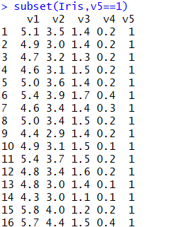
Create Subsets
names(Iris)<-c("v1","v2","v3","v4","v5") #renames the variables
Iris$v5<-as.numeric(Iris$v5) # to convert from factor to numeric
subset(Iris,v5==1)

Slide 21
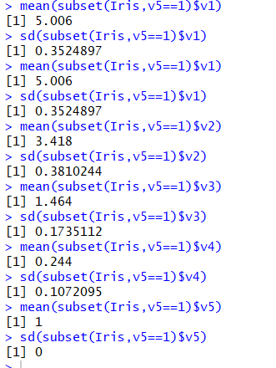
Compute Subset1 Statistics
For subset 1

Slide 22
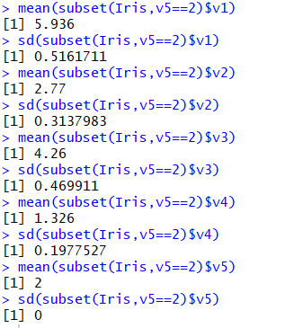
Compute Subset2 Statistics
For subset 2

Slide 23
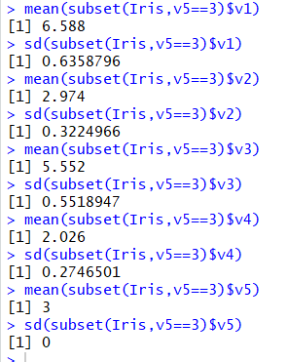
Compute Subset3 Statistics
For subset 3

Slide 24
Create New Data Set
Note: Use “set.seed (333)” or similar number to establish seed which permits reproducing same results
x1<-rnorm(10000,5.006,.3525)
x2<-rnorm(10000,3.418,.3810)
x3<-rnorm(10000,1.464,.1735)
x4<-rnorm(10000,.244,.1072)
x5<-rnorm(10000,1,0)
dataframe1<-data.frame (x1,x2,x3,x4,x5)
x1<-rnorm(10000,5.936,.5162)
x2<-rnorm(10000,2.770,.3138)
x3<-rnorm(10000,4.260,.4699)
x4<-rnorm(10000,1.326,.1978)
x5<-rnorm(10000,2,0)
dataframe2<-data.frame (x1,x2,x3,x4,x5)
x1<-rnorm(10000,6.588,.6359)
x2<-rnorm(10000,2.974,.3225)
x3<-rnorm(10000,5.552,.5519)
x4<-rnorm(10000,2.026,.2747)
x5<-rnorm(10000,3,0)
dataframe3<-data.frame (x1,x2,x3,x4,x5)
merged<-rbind(dataframe1,dataframe2,dataframe3)

Slide 25
Matching Closer To Original Data
# As you can see from previous slide, the original data set had minimums and maximums for each variable that were different from the maximum tail values from the normal distribution.
  install.packages("truncnorm")
  library(truncnorm)
  X1->rtruncnorm(10,a=4.3,b=7.9,mean=5.006,sd=.3525)
  #Previous command generates 10 normally distributed variables with a lower bound of 4.3 and an upper bound of 7.9
It is also possible to generate values using “rnorm” command and then omit those with values outside of desired interval. If you wanted 10,000 items you would have to generate approximately twice that many values to have 10,000 values which fall in the desired interval.

Slide 26
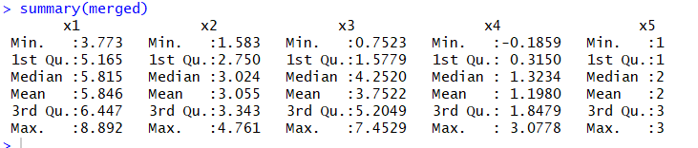
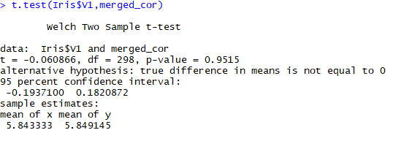

Validating Synthetic Data
Once you have created the small synthetic data file you should compare its statistical properties to the original data file to see if the properties are appropriately close.
cor_sample<-sample(30000,150)#to select random sample of 150 items from 30000
merged_cor<-merged$x1[cor_sample]
  # to select first variable from sample
P>.05 =means not significantly different

Slide 27
Expanding Data Set
After you have created small data set which is easy to visualize and test, you can create a much larger data set by simply increasing the number of items created.
I originally only created 10 items in each of the 3 subsets. After verifying it worked I increased this to 10,000 in each subset in order to end up with a data file of 30,000 items.
This is not “Big Data” but it is large enough to motivate students to run outside of Excel.
You can use write.csv() command to export file in csv format or, alternatively, use similar commands to write in Excel, tab, txt, etc. formats.

Slide 28
Creating “Story” for Data
After creating synthetic data set of 30,000 items that was close match to the original data set, the problem was what “story” to use with the data to make it a realistic class exercise.
Auditing students would not regard an Iris case as realistic.
After search a bit on the internet for interesting companies, I located QB House, and found their new business model to be interesting.
I then modified the values for the 5 variables to values I thought would work for the QB House case.

Slide 30
We will do an in-class hands-on walkthrough of all four analysis techniques using R Studio!

Slide 31
Take Aways!
R is time consuming to learn but very powerful
Formal R documentation is written for a Ph.D. in data science and is dense ( very difficult to read)
There are tons of example code on internet (beware as it may not actually run!)
It is not too hard to simulate realistic data
If you create the data via saved script, you can easily change it for other classes
I was energized to learn a new language and find classroom applications for it!

Slide 32
Do Overs!
Start with a more basic book on R and work on learning R before trying to apply it to course material
Develop case scenario first and case data second
Seed more complicated patterns, errors, anomalies in data (next class!)

Slide 33
Resources
AICPA. 2017. Audit Guide-Analytical Procedures
AICPA. 2017. Guide To Audit Data Analytics.
B. Baesens. 2014. Analytics In A Big Data World. Wiley.
Beysolow II, T. 2017. Introduction To Deep Learning Using R. Apress.
EMC Educational Services. 2015. Data Science & Big Data Analytics. Wiley.
Foreman, J. 2014. Data Smart-Using Data Science To Transform Information Into Insight. Wiley
James, G., D. Witten, T. Hasties, and R. Tibshirani. 2013. An Introduction To Statistical Learning With Applications In R. Springer.
Knaflic, C.N.. 2015. Storytelling with data. Wiley.
Lantz, B. 2015. Machine Learning With R. 2nd edition. Packt Publishing.
Leskovec, J., A. Rajaraman, and J.D. Ullman. 2014. Mining of massive data sets. Online book used in 3 courses at Stanford University.
McKee, T. 1988. “Does Your Practice Have A Place For An Expert System?”. The CPA Journal. Vol. 58, No. 1, pp. 114-118.
McKee, T. 1989. Modern Analytical Auditing: Practical Guidance For Auditors and Accountants, Quorum Books,
McKee,T. 1995. “Predicting Bankruptcy Via Induction.” Journal of Information Technology. Vol. 10, pp. 26-36.
Milligan, J.N. 2016 . Learning Tableau 10. Second edition. Packt Publishing.
Tabachnick, B. and L. S. Fidell. 2007. Using Multivariate Statistics. 5th edition. Pearson Publishing
Thiprungsri,S. and M.A. Vasarhelyi. 2011. “Cluster Analysis For Anomaly Detection in Accounting Data: An Audit Approach.” Int. J. of Digital Accounting Research, Vol. 11, pp. 69-84.
Templ, M. 2016. Simulation for Data Science With R. Packt Publishing.
Walkowiak, S. 2016. Big Data Analytics With R. Packt Publishing.

