Slide 1
Town hall meeting & summer lunch
18 september 2019

Slide 2

agenda
NHH mission
Survey on bullying and harassment
Update on cloud-services at NHH
Information from the September board meeting & events in the near future

Slide 3
NHH mission

Slide 4
WHY REVISE OUR MISSION?
To strengthen the NHH culture
Broad process involving all parts of the organization
Townhall meeting in November 2018
Mission workshop with students and employees in February 2019
Written input from all parts of the organization
Mission workshop as part of the NHH board’s annual seminar in March 2019
In the September meeting, the board decided on four short-listed candidates for our new mission statement
- Because the AACSB cares about it
“The school should review its mission statement to ensure that distinctive aspects are emphasized and highlighted in it”
Notes:
Working group: Sigrid Folkestad, Astri Kamsvåg, James Hocea + Linda N.

Slide 5
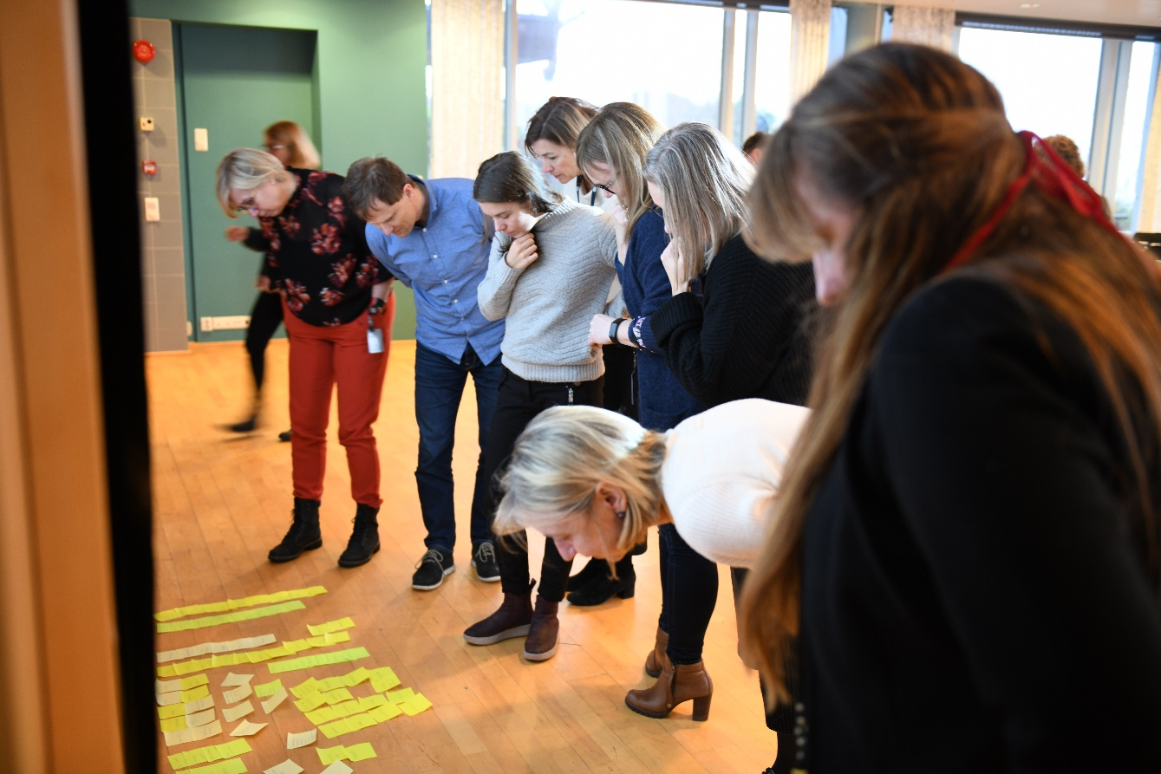
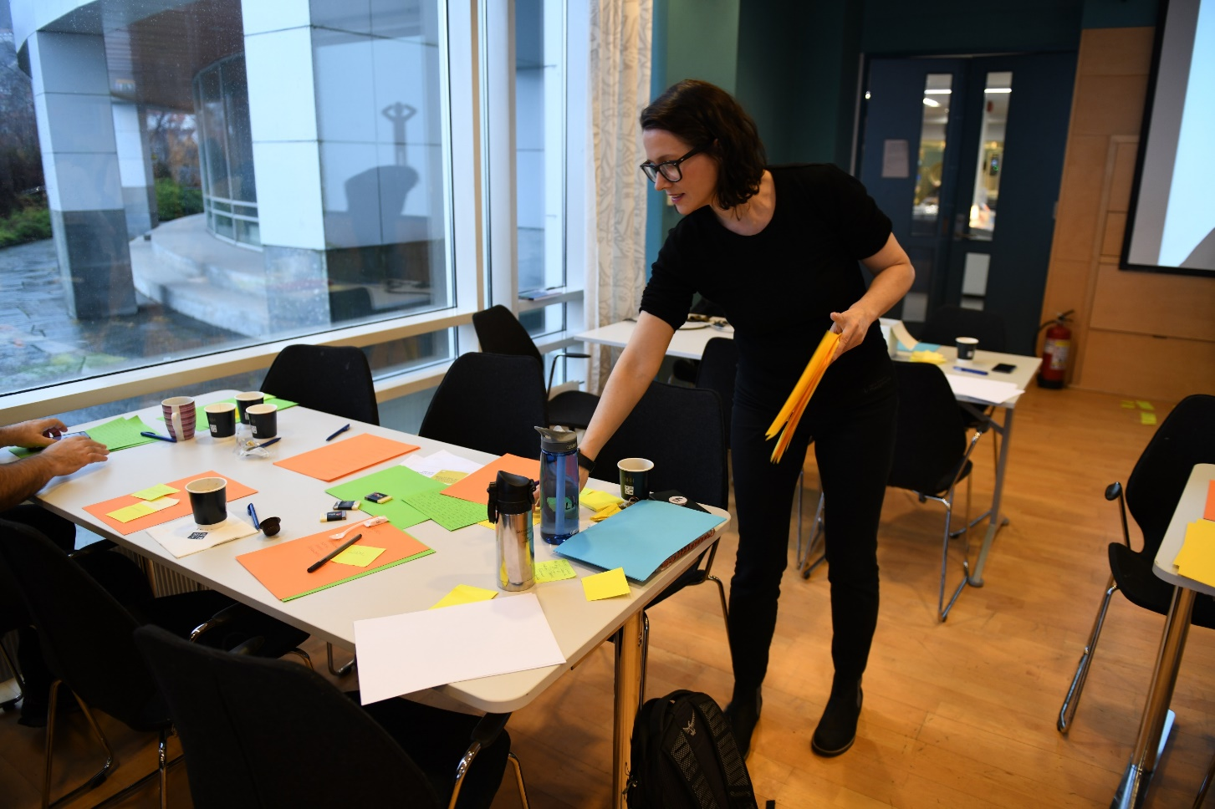
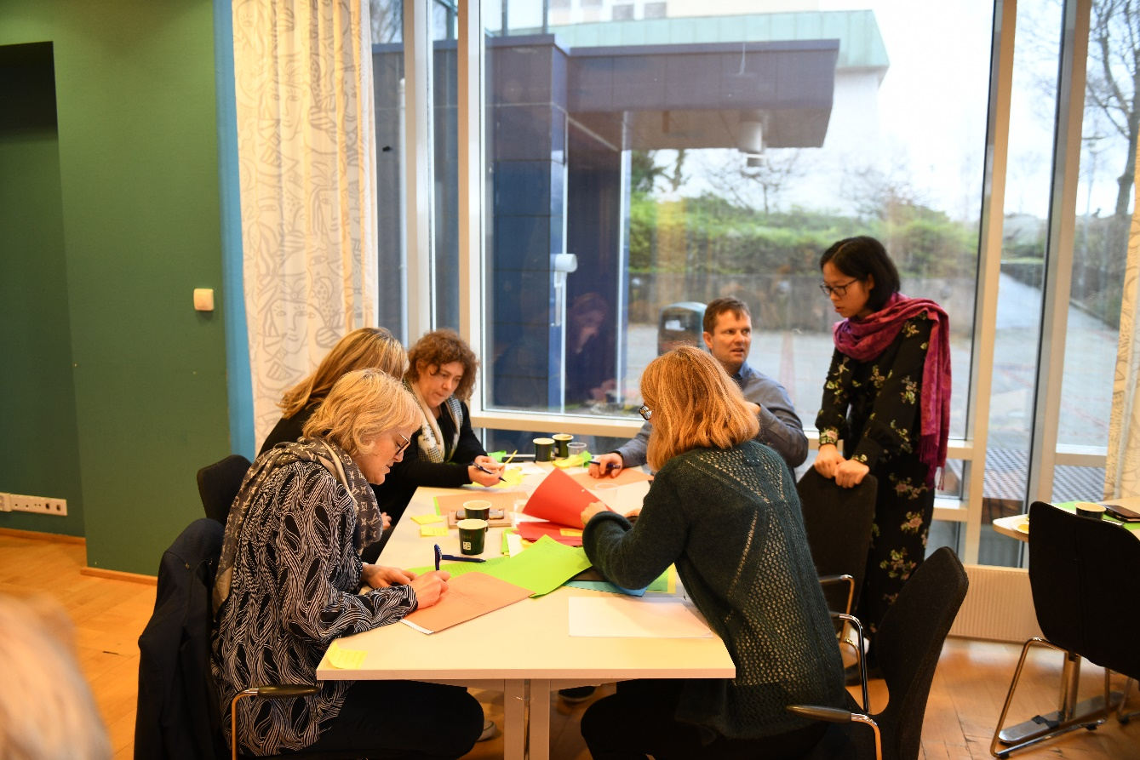
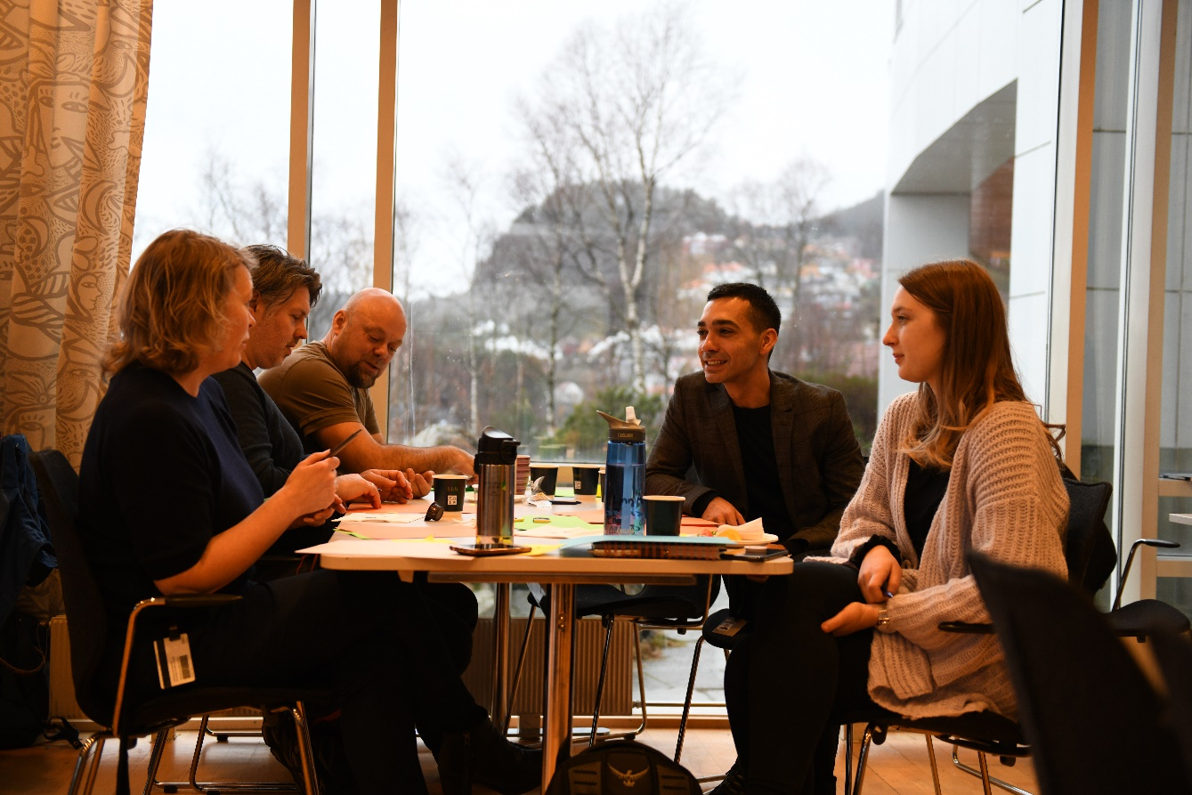
Mission workshop February 14th

Slide 6
NHH’S CURRENT MISSION STATEMENT
NHH shall be a driving force for development in business and society, and shall educate people for the purposes of value creation and sustainable development
Revise this statement – emphasize and highlight distinctive aspects

Slide 7
NEW MISSION STATEMENT – FOUR OPTIONS
English | Norsk
Together for sustainable value creation | Saman for berekraftig verdiskaping
A driving force for sustainable value creation | Ei drivkraft for berekraftig verdiskaping
Shaping knowledge for sustainable value creation | Forme kunnskap for berekraftig verdiskaping
A driving force for responsible value creation in business and society | Ei drivkraft for ansvarleg verdiskaping i næringsliv og samfunn

Slide 8


HOW TO VOTE FOR NHH’S NEW MISSION STATEMENT
There will be a news story about the new mission on Paraplyen
There, you will find a form where you can cast your vote
Deadline: Monday at 12 noon (Sept. 23)
Only one vote per person!
NHH t-shirt with new mission for everyone who votes
Note: Only an illustration

Slide 9
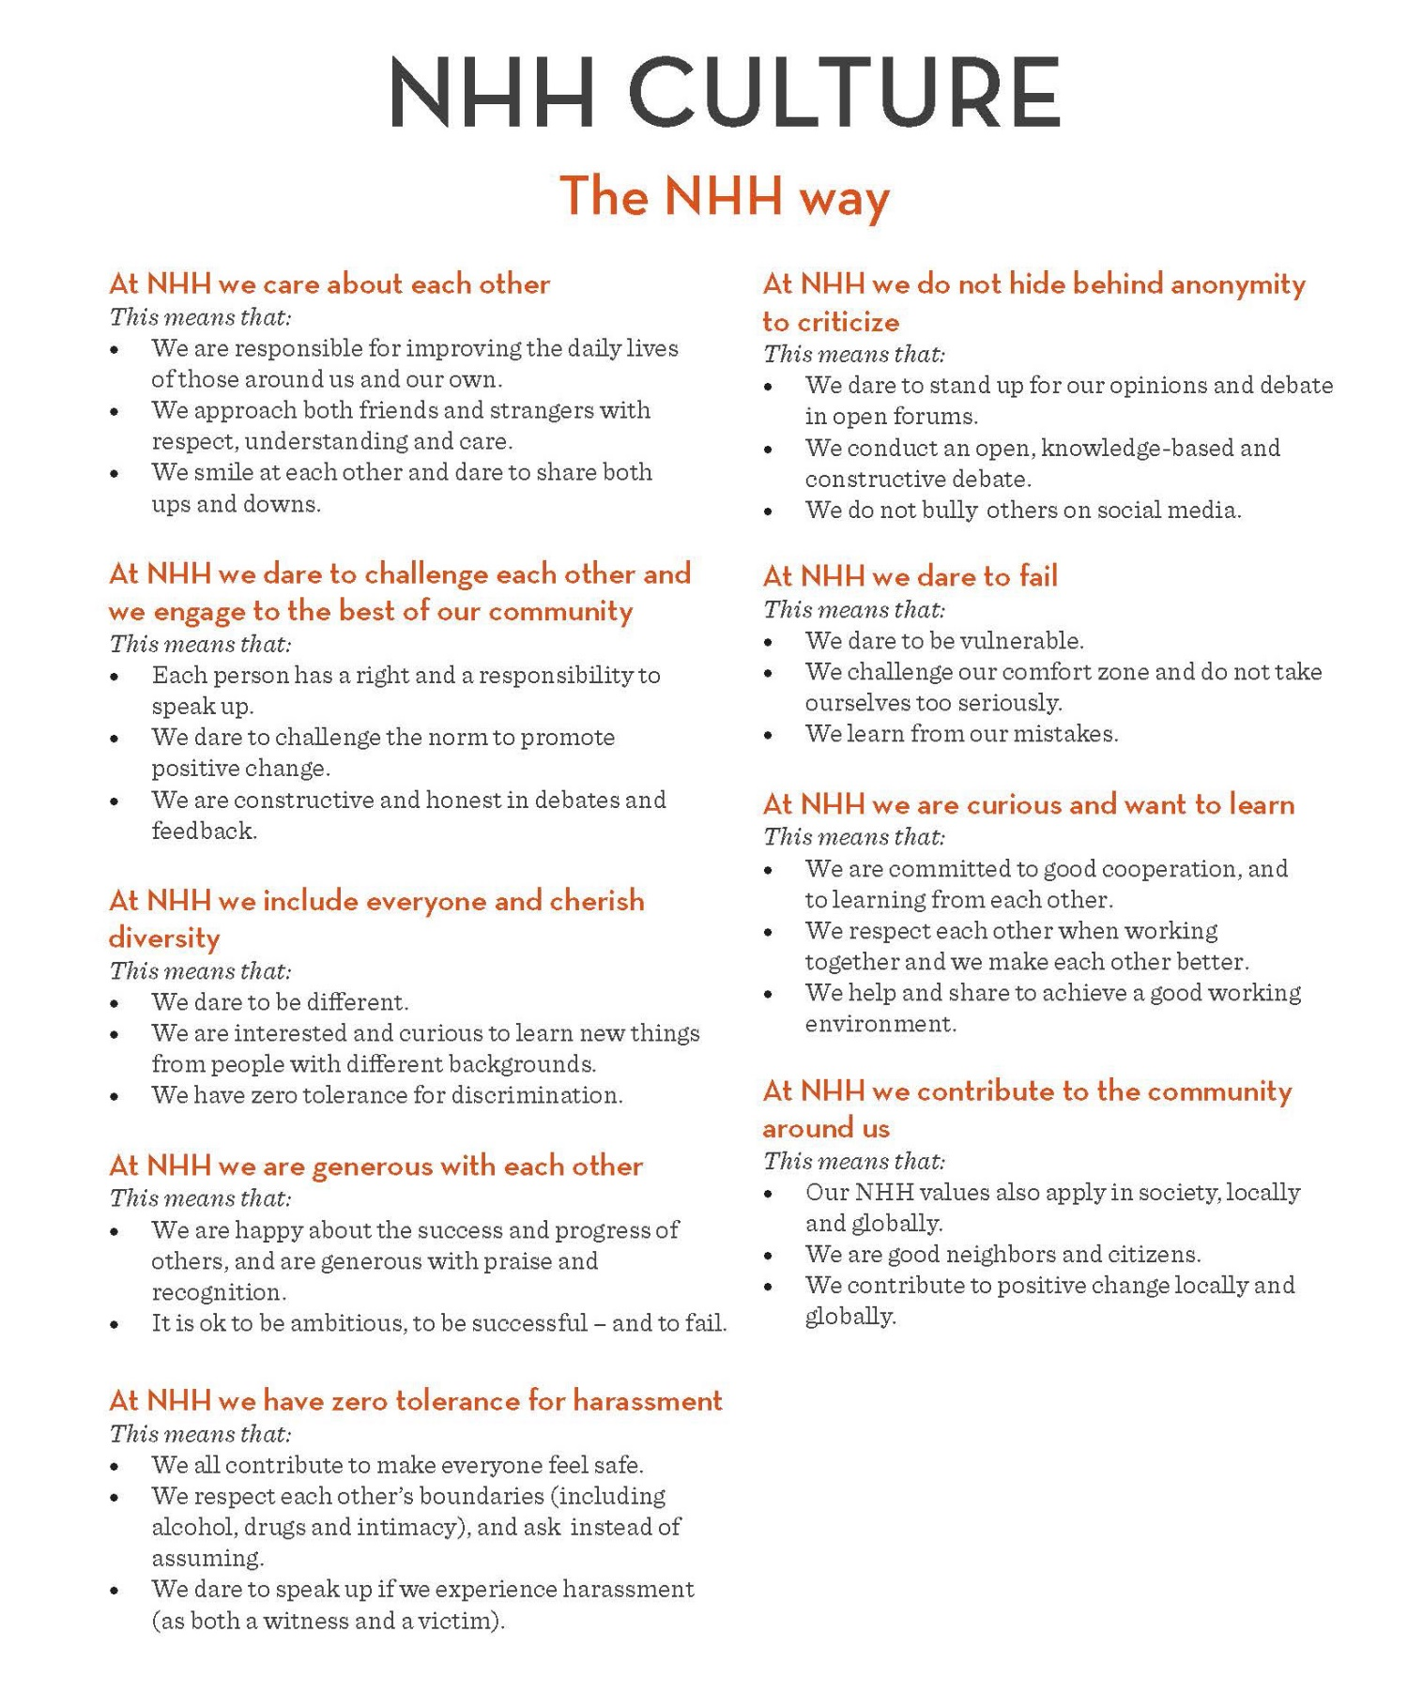

+

Slide 10
Survey on bullying and harassment

Slide 11
BULLYING AND HARASSMENT AT NHH - I
Survey of volume and frequency of bullying and harassment at the workplace,
as well as incidents of sexual harassment and sexual assault
Population survey – response rate NHH 59 % (42 %) – 229 respondents (396)
Theme 1 – Bullying and harassment
10 % (24 cases) stated that they had been subject to B&H in the past 12 months (13 %)
46 % reported that they had been subject to B&H “monthly or more often” (31 %)
Evenly divided among job categories (faculty, PhDs, admin staff) – PhDs do not stand out!
Various (unknown) reasons – but factors like gender, ethnicity and age were also reported
Mostly verbal (75 %) or non-verbal (63 %) harassment [non-verbal = ugly looks; ostracism; etc.]
50 % (12 cases) stated that their manager/leader was the responsible bully (37 %)
Theme 2 – Sexual harassment
2.3 % (5 cases) stated that they had been subject to SH in the past12 months (1.6 %)
All five cases are women sexually harassed by men – most often a peer colleague

Slide 12
BULLYING AND HARASSMENT AT NHH - II
Survey of volume and frequency of bullying and harassment at the workplace,
as well as incidents of sexual harassment and sexual assault
Population survey – response rate NHH 59 % (42 %) – 229 respondents (396)
Theme 3 – Sexual assault
No respondents stated that they had been subject to sexual assault (18 nationwide)
Theme 4 – Knowledge of and experience with the reporting system
53 % stated that they know how to find the reporting system (48 %)
5 % stated that they had reported blameworthy conditions in the past 12 months (7 %)
At NHH we have zero tolerance for harassment

Slide 13
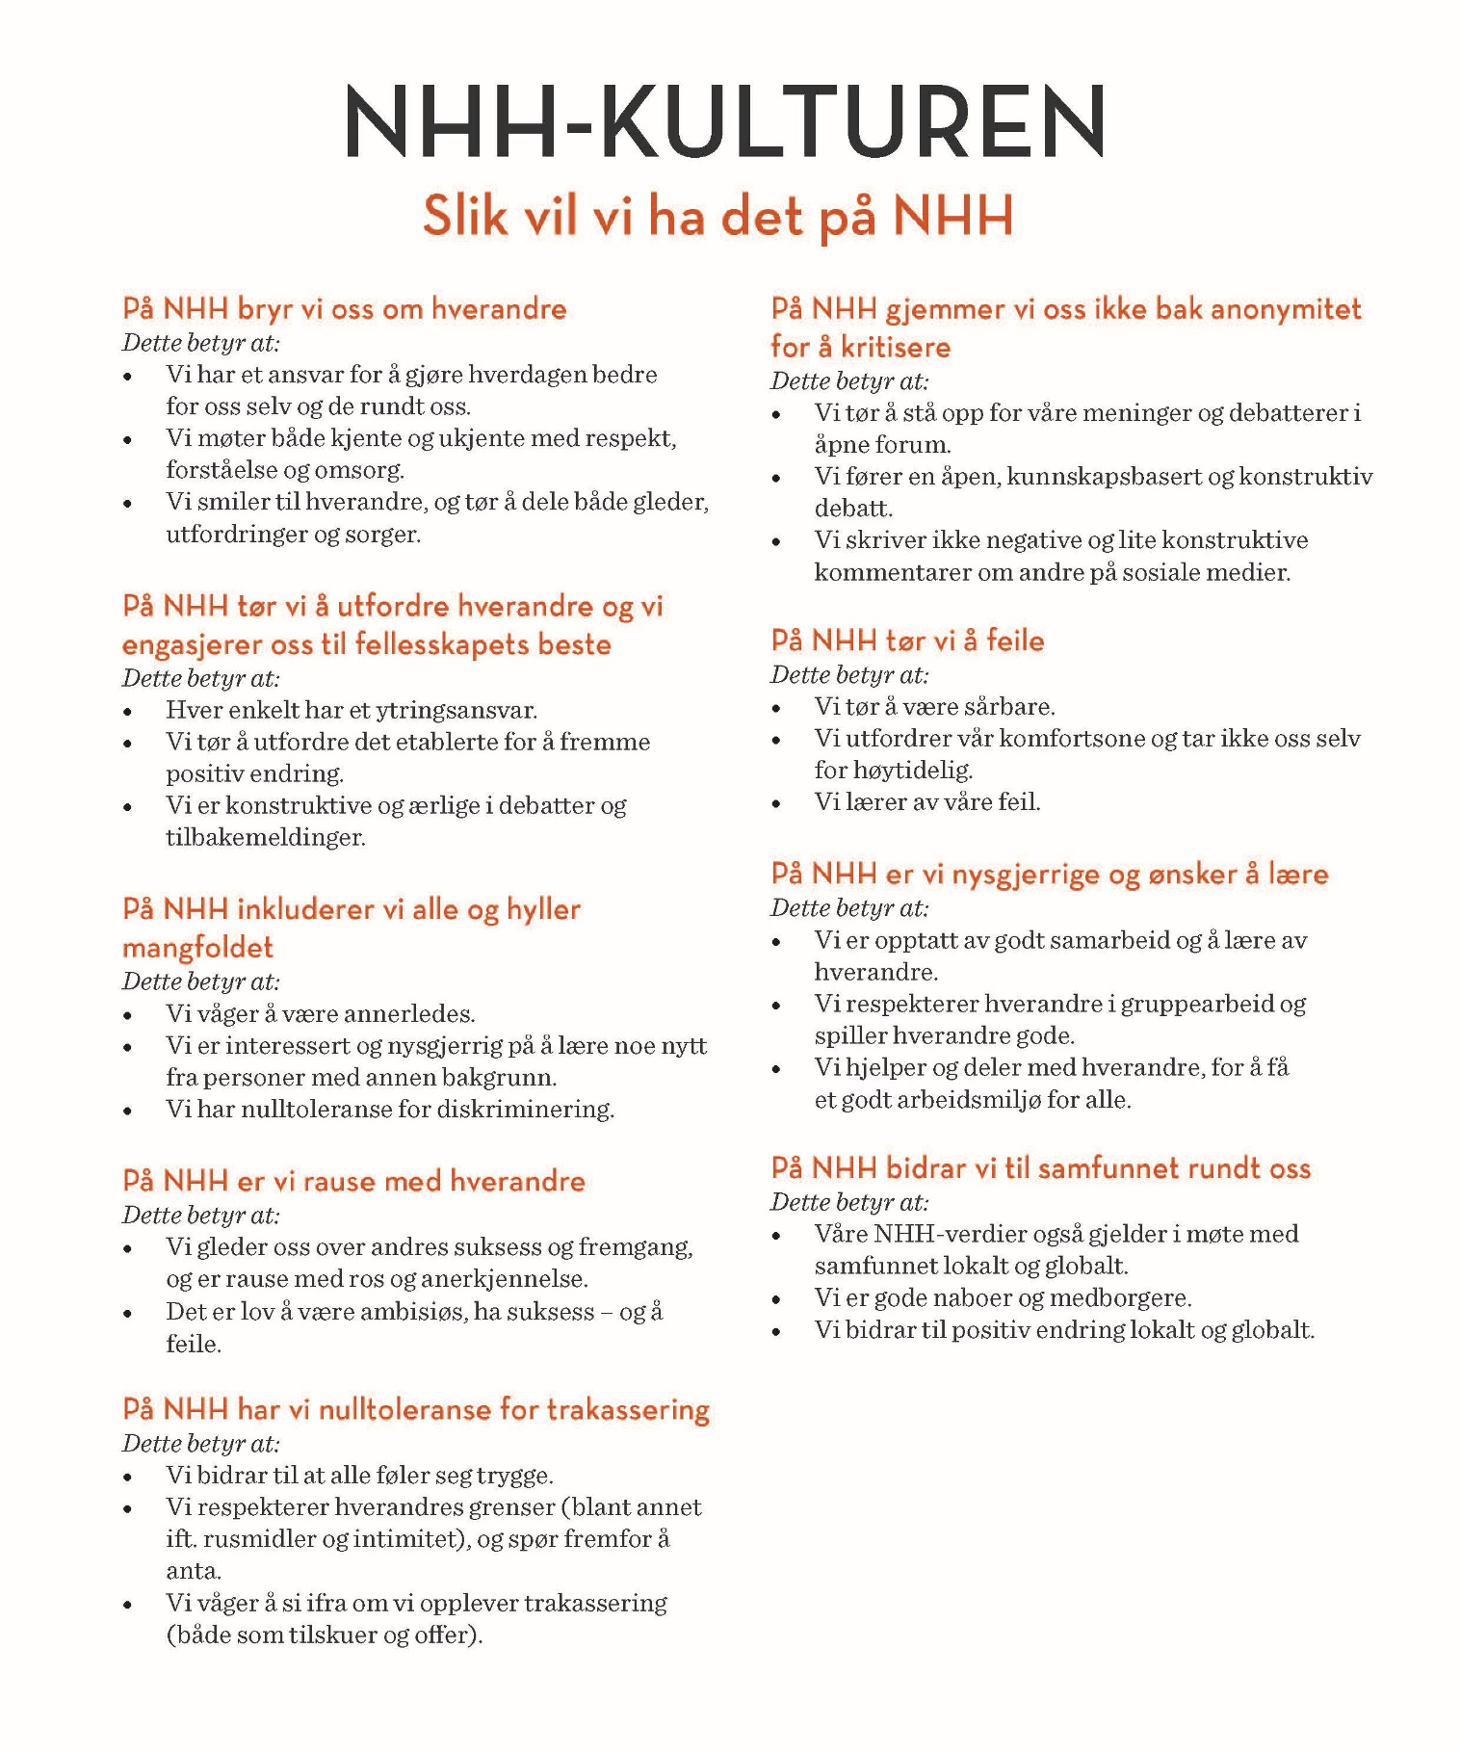

Slide 14
BULLYING AND HARASSMENT AT NHH - III
Follow-up
AMU - the Working Environment Committee is on the case (in addition to the rectors/management)
Results and reflection/discussion in relevant forums (town hall meeting(s); management meetings, board meeting; local units etc.)
This year’s safety inspection
“Hverdagsledelse” – building management skills
Strengthen the NHH CULTURE (one page) and the CODE OF CONDUCT
Continuous development of attitudes and culture
Improvement of reporting system, including availability/accessibility

Slide 15
Update on sky-services available to the nhh community

Slide 16

MICROSOFT TEAMS

Slide 17
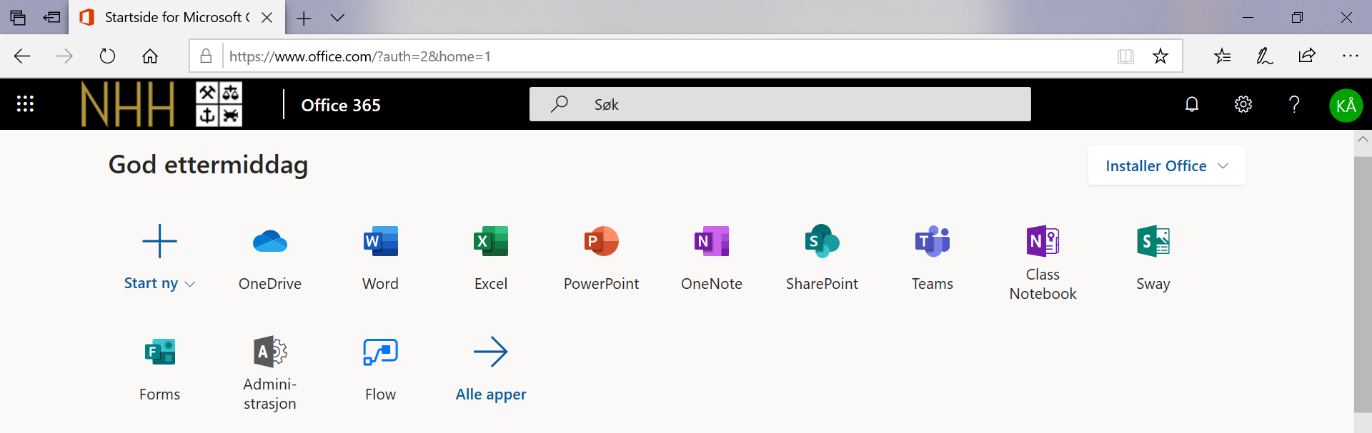
OFFICE 365 portal
Portal.nhh.no
Software Center
Google Play and Apple Store

Slide 18
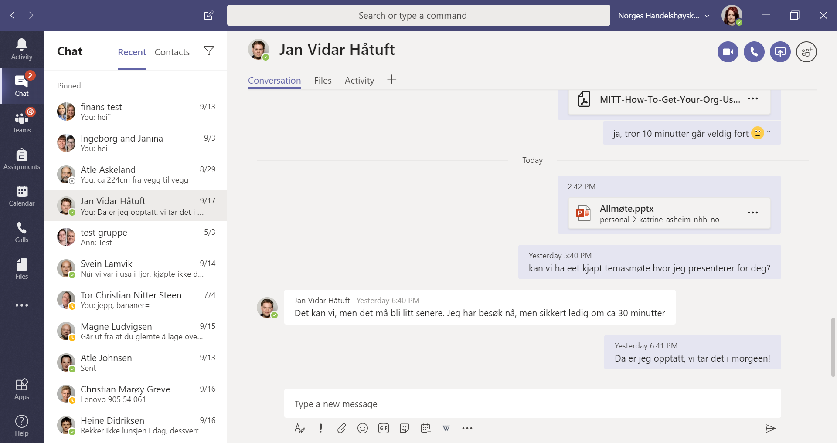
TEAMS CLIENT

Slide 19
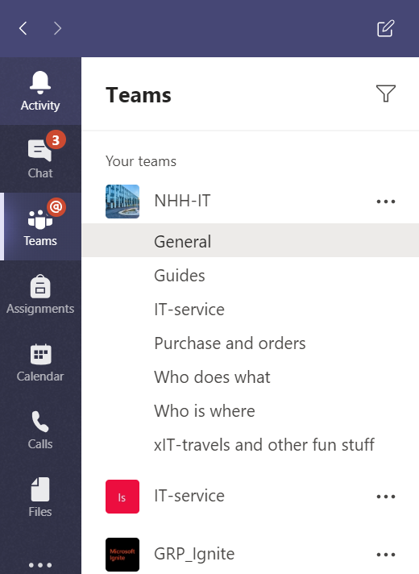
PICK A TEAM AND CHANNEL
Team
A collection og people, conversations, files and tools
Channel
A discussion in a team, dedicated to a department,
Project or topic
Conversations, meetings and work on files
together

Slide 20
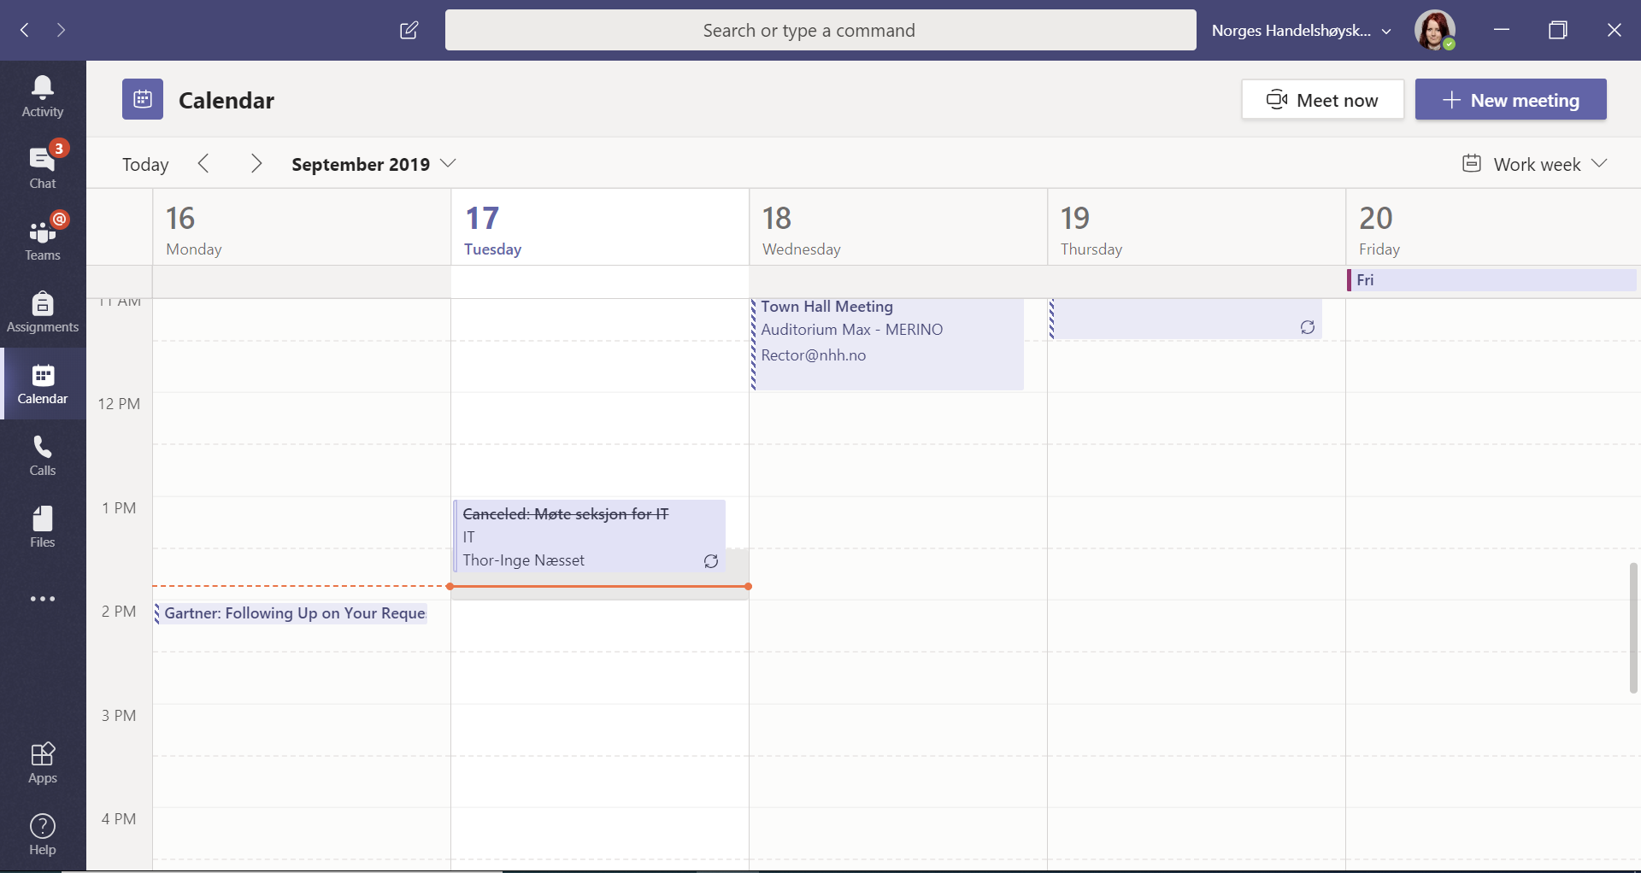
MEETINGS AND CALENDAR
Integraded with outlook
Preferred way for Video /
Audio meetings

Slide 21
ROAD AHEAD
Training
https://aka.ms/teamstraining
Courses
Technical
Shared folders will be moved to Teams
Telephony will be moved to Teams, Skype for Business will be phased out

Slide 22
Information from the September board meeting

Slide 23
SEPTEMBER NHH BOARD MEETING – some highlights
NHH mission
Report on the status for SNF
Program evaluation and action plan: Master Auditing and Accounting
Hearing – government white paper on job-relevance in higher education
First discussion on Leadership model for our departments
Towards appointed rather than elected department heads?

Slide 24
SOME BIG EVENTS IN THE NEAR FUTURE
26.09.2019: The Lemkuhl-lecture
Henrik Lie-Nielsen, gründer og investor, tema: «Apetite for deconstruction: An entrepreneur’s perspectives on career choices»
7 - 11.10.2019: International case competition
16.10.2019: Rafto Challenge with Equinor
Eldar Sætre, CEO
15.10.2019: The annual NHH alumni conference, «Fram», Clarion hotel the Hub
Nassima Dzair, Inger Stensaker ++
23.10.2019: NHH Forum with Nordic Choice Hotels
Petter Stordalen, CEO ++
06.11.2019: Conference, Anniversary of structural reforms in the electricity market
November and December:
* Workshop with Ministry of Trade, Industry and Fisheries
* Conference joint with Ministry of Finance

Slide 25
Q&A

