Slide 1
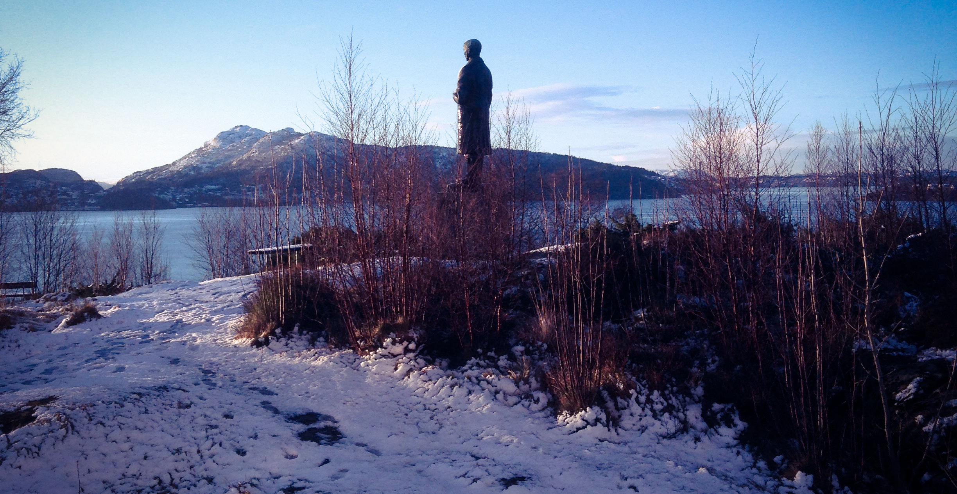
Town hall meeting
20 december 2019

Slide 2
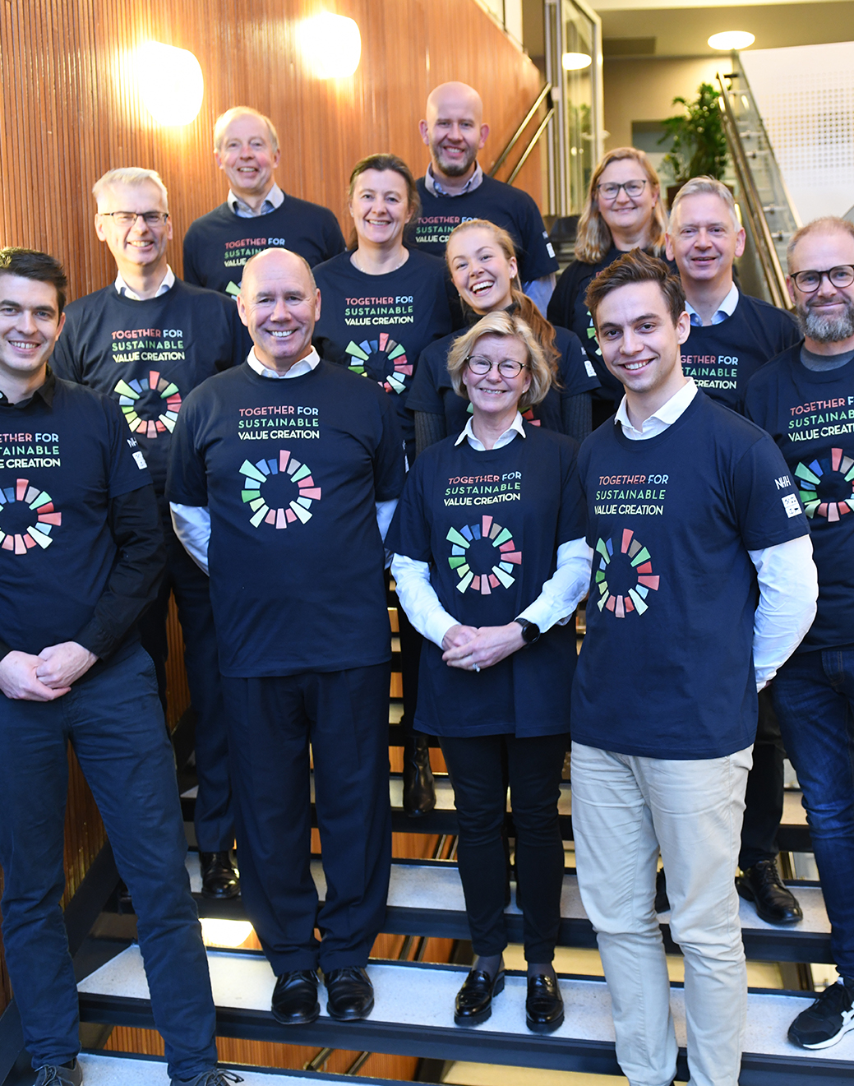
agenda
IT security – you are the most important person!
The rehabilitation process – progress report
Publication bonuses 2019
Students’ award to best lecturer in the bachelor programme

Slide 3
IT security - you are the most important person!

Slide 4

You are the most important person at NHH
Security is never better than the weakest link
More often than not that involves a human factor
That is why your awareness is so important
Notes:
You probably allready knew that
Nonetheless, it is nice to have it confirmed by someone else
KLIKK
Security is never better…. And that where we humans come in.
Unfortunately we humans tend to be more open to negotians than technical solutions.
And on some extremely rare occations we may have been known to make a mistake.
#
#

Slide 5
You are your best defense
It is much easier to target you rather than your computer or other devices.
If attackers want your password, credit card, or control of your computer
they’ll attempt to trick you into giving it to them,
often by creating a sense of urgency.
They might call you pretending to be tech support or send you emails or messages
all urging you to submit or confirm information, clicking on links, running some tools for testing etc.
By using common sense, you can stop many attacks
Notes:
#
Chances are that you are more easily persuaded than some computer software or hardware. You have feelings and desires, machines do not.
# – # – # – # - #
There are a number of threat agents out there who wants your data, wether you think the data valuable or not.
Your data and password can for instance be auctioned of to someone preparing a more sophisticated and personalized scam that you are sure to notice after it is to late.
Worth mentioning is reports of a new version of CEO fraud/Business Email Compromise, where they are after your payroll.
So instead of sending a bunch of emails, they pretend to be you and are quietly sending just one email. For example to the Office of Finance and Accounting and tell them that "you" have changed your account number.
# - #

Slide 6
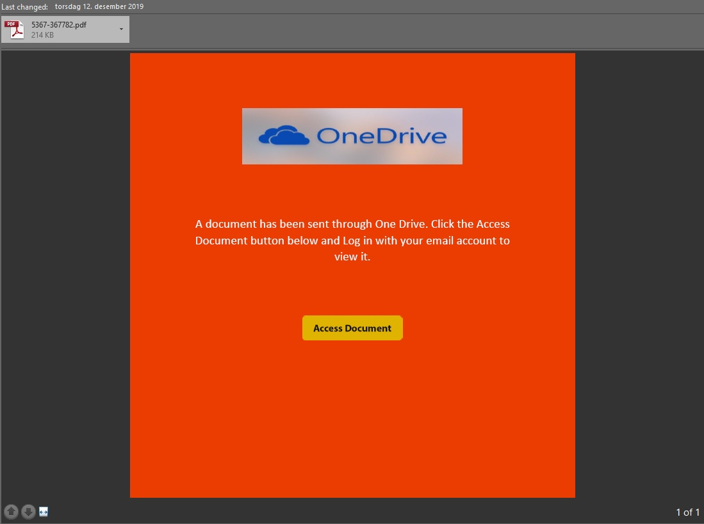
A recent example
You received an email with short heading, very little text (FYI) and an attached PDF file with a nondescriptive file name.
Opening or previewing the file you only find a link.
Clicking on the link you are led to an external resource.
Notes:
Last week we had an incident where several people received an email with an attachement.
You are highly litterate people working here, I hope you don’t forward emails to each other only writing FYI.
Of all who opend this attachment, almost 300 also clicked on the link inside the dokument.
Look at the design – a PDF file that only leads you further on?

Slide 7
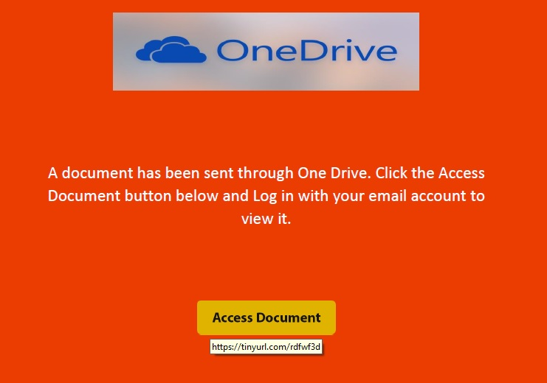
Recent example continue
Notes:
Mouse over
Again – a PDF-file that apaerantly is OneDrive – and links to a tinyURL
You have no idea where an tinyurl ends.
#

Slide 8
Passwords - The days of crazy, complex passwords are over.
Those passwords are hard to remember, difficult to type, and with today’s super-fast computers they
can be easy for a cyber attacker to crack.
When a site asks you to create a password, create a strong and unique passphrase instead.
A passphrase is a type of password that uses a series of words that is easy to remember,
such as I made this 1 myself! or These are not the droids you are looking for!
The longer your passphrase is, the stronger.
A unique passphrase means using a different one for each device or online account.
This way, if one passphrase is compromised, all of your other accounts and devices are still safe.
If available, you should also enable two-step verification (also called two-factor or multi-factor authentication).
Notes:
#
The fewer technical obstacles on route to your information, the more important is your password.
#
Make it strong – use passphrases
#
like a combination of words or a sentence you will remember
#
#
If your password is the only thing that separate others from your information, it is absolutely crucial you protect it. Do not use the same password «all over the place».
Can’t remember passwords? Write them down and keep the note in a place you trust.
#
Enable two-step verification (also called two-factor or multi-factor authentication).
Enabling two-step verification is probably the most important step you can take to protect your online accounts, and it’s much easier than you may think.

Slide 9
Messaging / Smishing attacks
This is a newer form of attempts to trick you. By now you should be familiar with the old «phone calls» or the phishing-emails.
Messaging attacks, or Smishing, are when the attackers use SMS, texting or messaging technologies when they try to trick you into doing something you should not do.
These types of attack will often feel far more informal or personal than i.e. an email will,
and this increases the chances of success in manipulating you.
In addition, these types of attacks give you far less information or clues that something is wrong.
Does this message make any sense?
Why am I receiving this message?
Notes:
#
You probaly all well aquainted with the odd phone calls (from i.e. «tech support») and phishing emails.
They probably still are anoying.
#
Smishing attacks are just the same old story, only on other plattforms.
#
Think about it. Receiving a message as SMS or in a SoMe feels far more personal than emails or an unknown voice on the phone do.
Sometimes an attack is a combination of both email and messaging attacks.
#
Have you ever tried to examine a text message on your phone? How do you do a «mouse over» a link with your finger?
#
Two important questions
#
#

Slide 10
Is this message an attack?
Is it a urgent need for you to take action and the message attempt to rush you?
Does the message in any way ask for personal information, password, account number, sensitive information?
Are you suddenly the winner of a lottery you never entered or even heard of?
Does my co-workers really write in this way and use this kind of wording, does this really sound like them?
Does the message appeals to your sense of curiosity?
Got a message that gave you a strong reaction?
Stop – calm down - think – then respond
Notes:
#
As if we weren’t pressed for time already.
#
It is you who must provide something
#
If you have problems winning lotteries you actually do enter, the same would probably apply to the ones you’ve never entered.
#
Your co-workers probaly writes in a way you like or in an irritating way you dislike, use that knowlegde.
#
Curiosity killed the cat
#
Same goes for some work relateded emails

Slide 11
Remember
that most government agencies, such as tax or law enforcement agencies,
won’t contact you via text message.
that banks, insurance companies and the likes never
ask you to submit personal information via emails or text messages, and
never ask you to login through a link in an email or message.
that if a message says there is a problem with your account, contact the company directly and
not through a link you just received.
that you are your own best defense.
Notes:
#
Be suspicious of unexpected messages asking you to either follow a link to submit information or to download/install software.
#
#
Go straight to the source.
Remember…
#

Slide 12
And that is why…
You are the most important person at NHH.
Notes:
#
You are the most important person here.

Slide 13
The rehabilitation process – progress report

Slide 14
Agenda
Aula
Progress construction work
Moving out of Merino and back to Helleveien

Slide 15

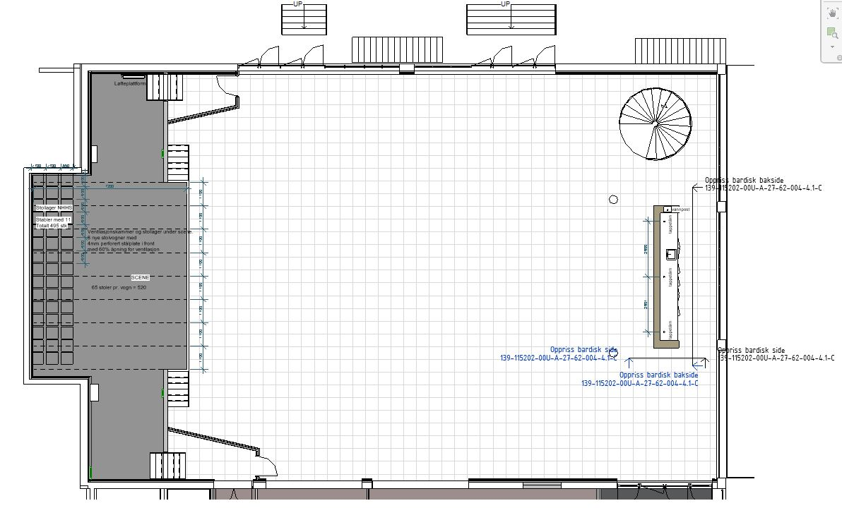
Aula – included in the project
Consequences:
Aula closes 1 April 2020.
End date project changes from
19 October to 11 December 2020
of the past

Slide 16
Objective: recreate the greatness of the past
new surfaces: floor, walls, ceiling, windows
new ventilation and heating systems
elevator from the basement
lifting platform to the stage
lowering the stage
new storage rooms
new and better bar
new aula entrance

Slide 17
Progress construction work
There have been some challenges along the way, but still nothing that breaks the framework of the project, neither financially or in time
80 000 production hours so far = an average of 55 shifts per day

Slide 18
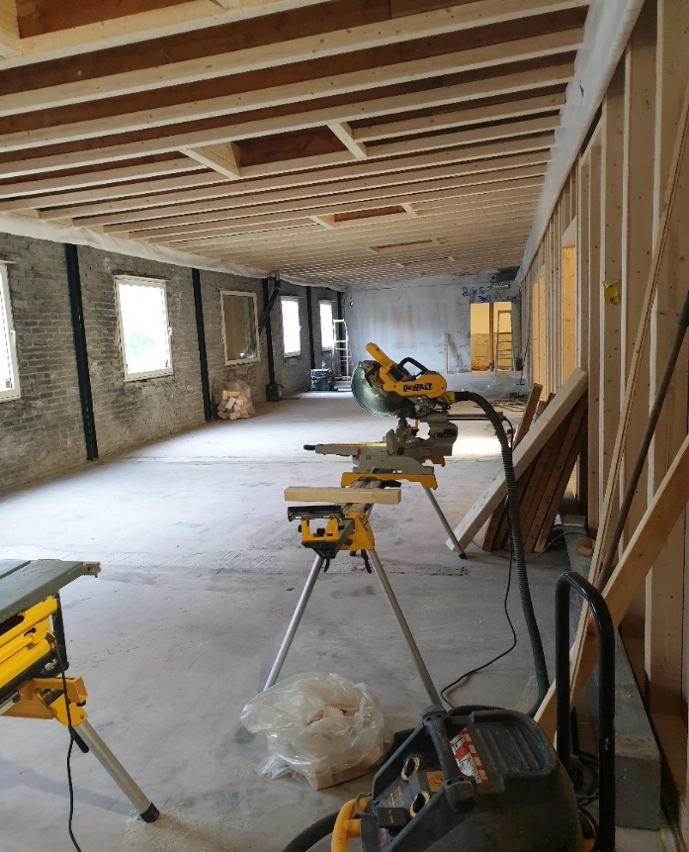
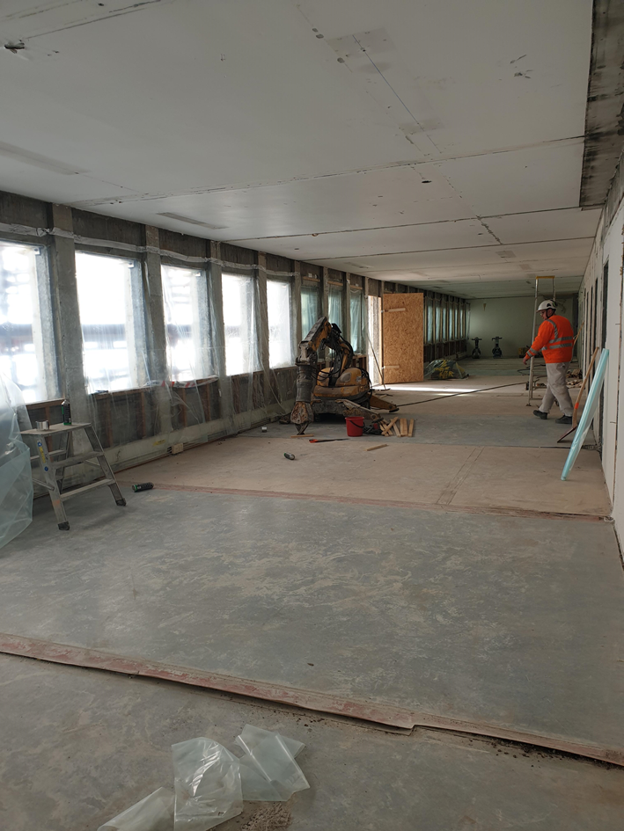
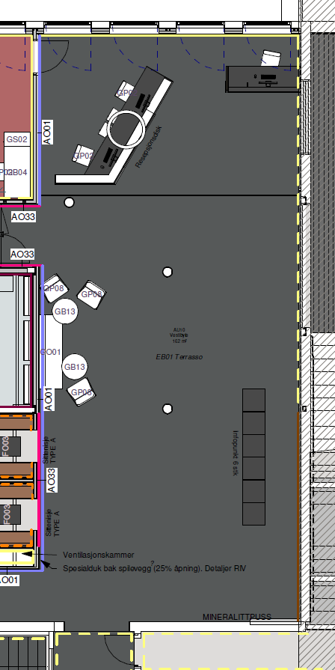
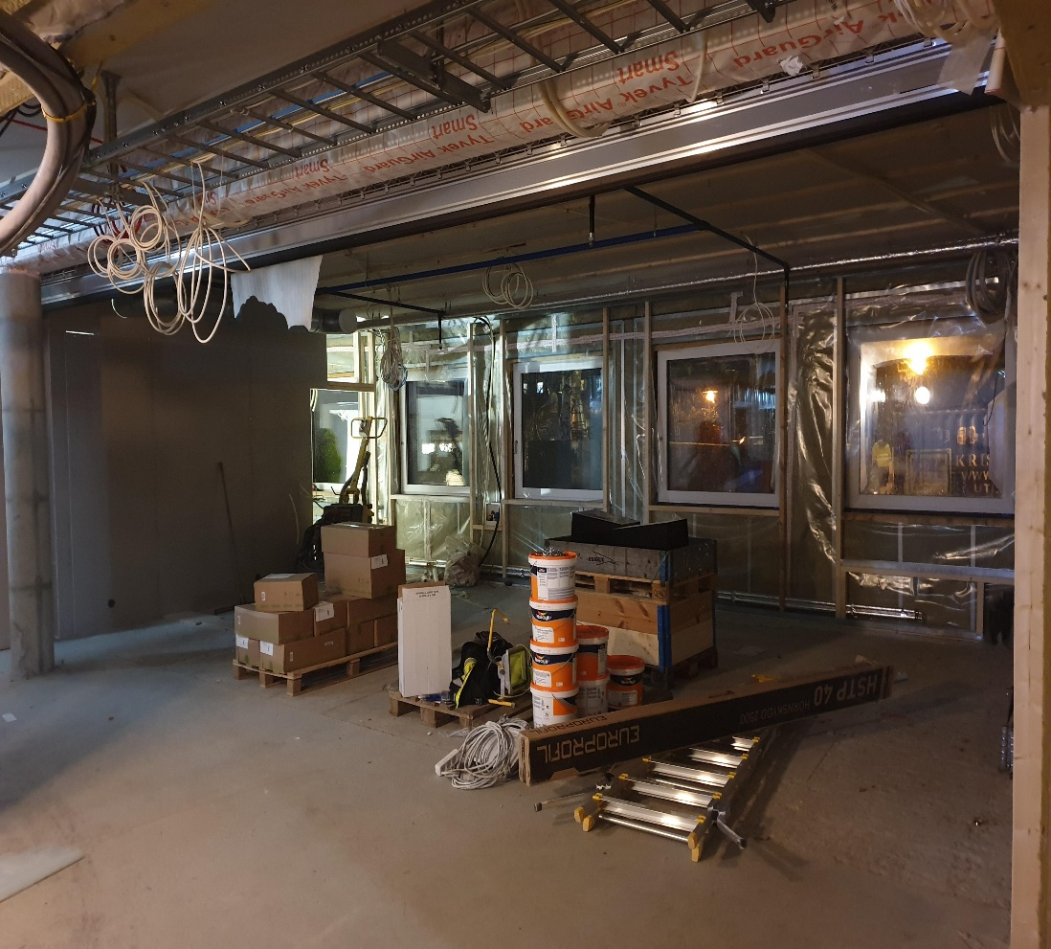
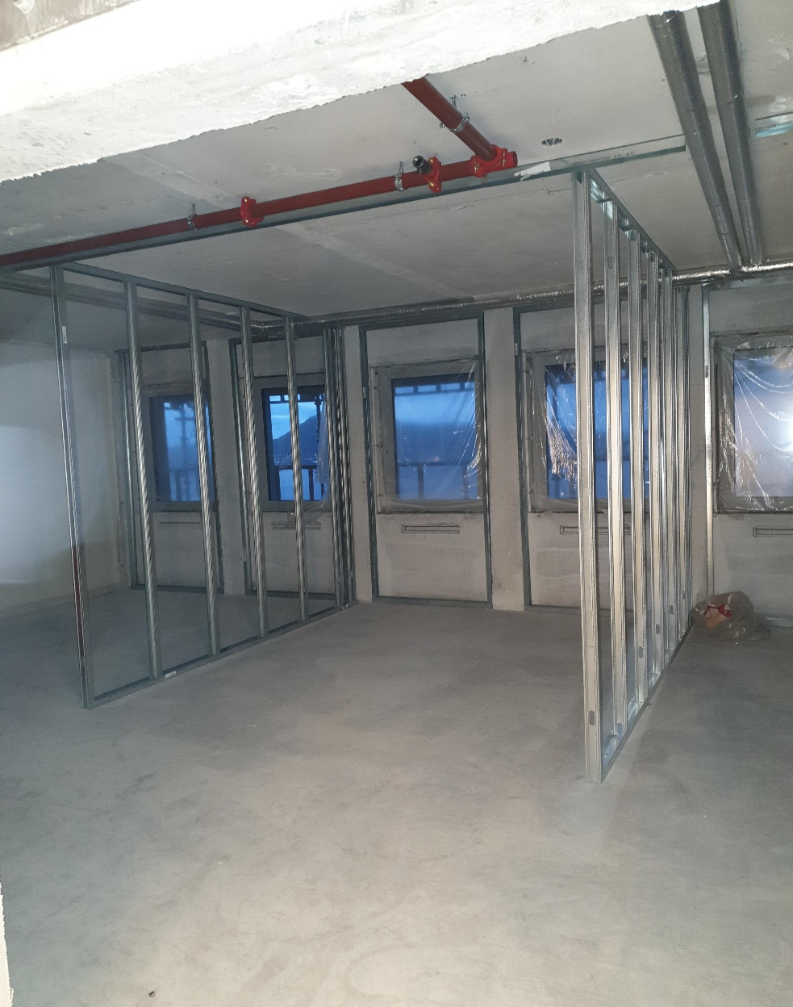
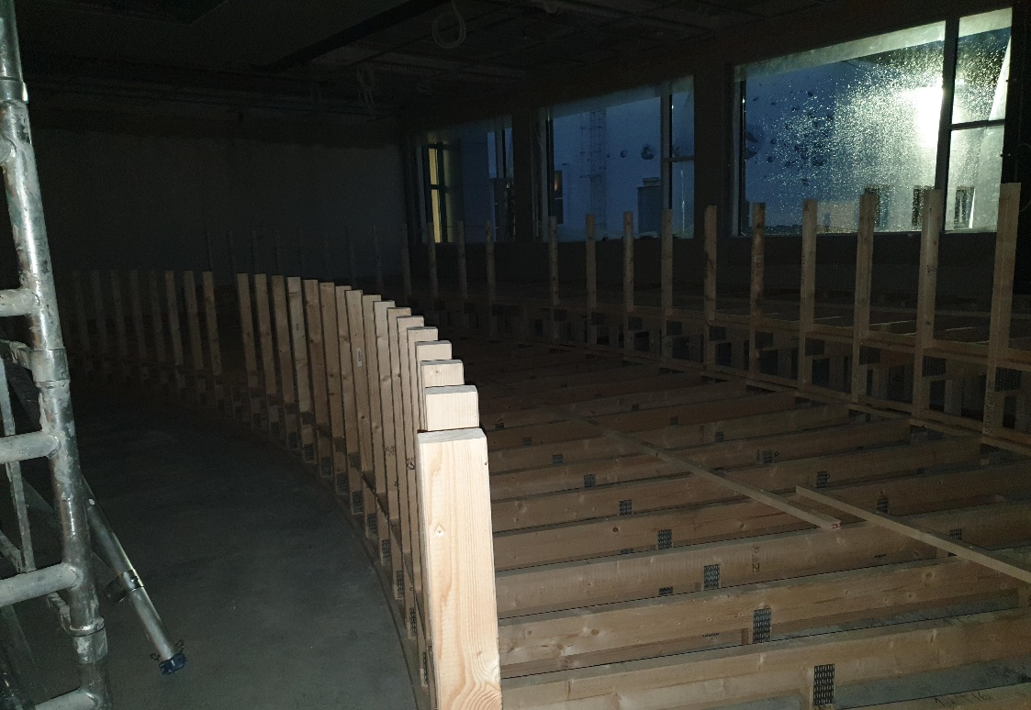
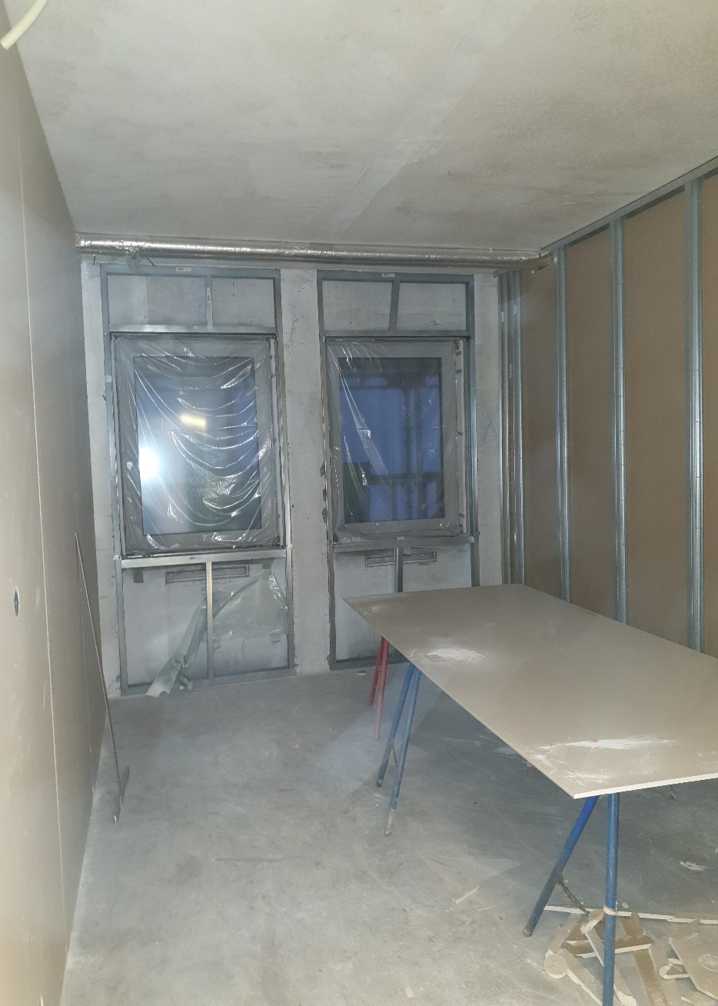
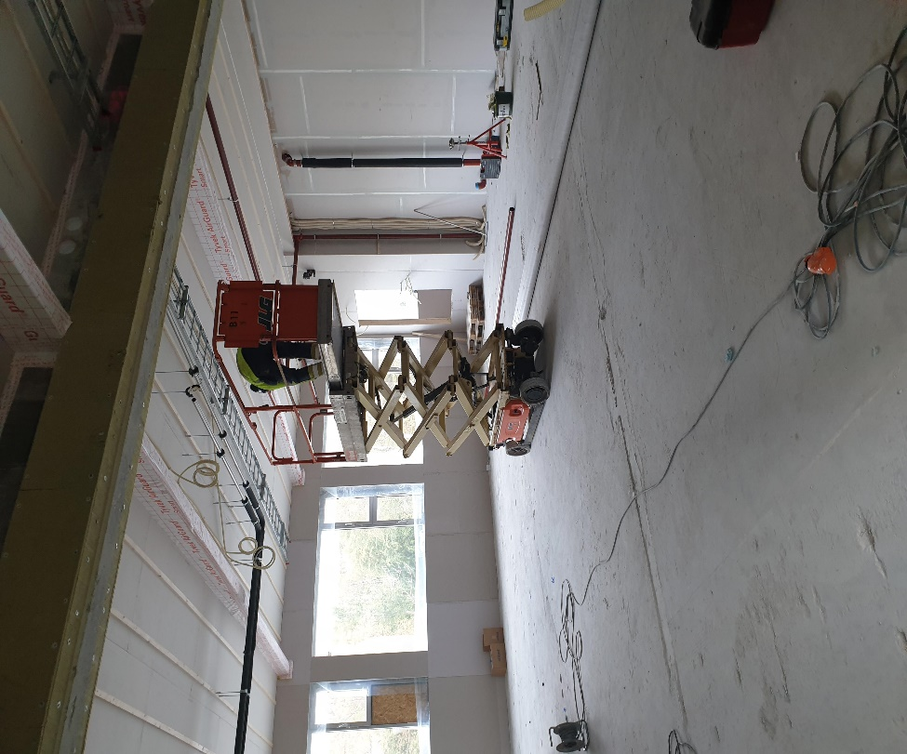

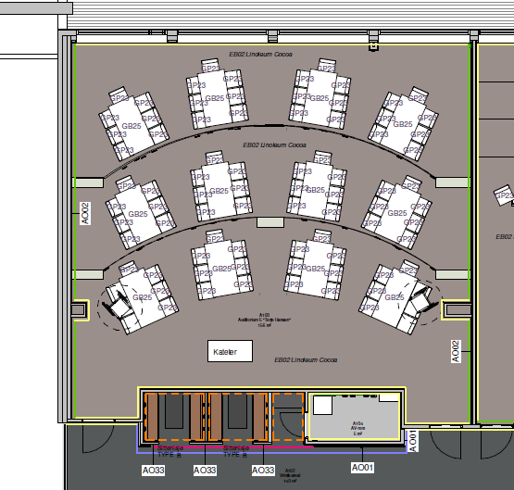
Progress construction work

Slide 19
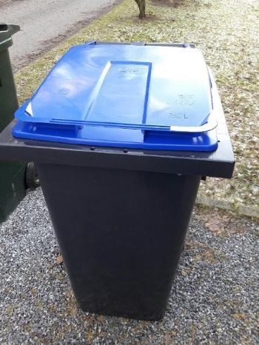
Moving back to Helleveien 2020
Units will move in the period 11 to 20 December
Merino building will be emptied and cleaned by 31 December
We are moving back to smaller office space - probably fewer shelves.
In other words, we have to get rid of shelf stuff
We start today, placing containers for paper on every floor
These are collected in week 2. If they are filled up
– please call 59881

Slide 20

Questions? Comments?
Merry Christmas!

Slide 21
Publication bonuses 2019

Slide 22
Publication Bonuses 2019
Name (NHH in bold) | Title | Journal | List
Rune Dahl Fitjar, Bram Timmermans | Relatedness and the Resource Curse: Is There a Liability of Relatedness? | Economic Geography | NHH
Ola Kvaløy, Trond E. Olsen | Relational Contracts, Multiple Agents, and Correlated Outputs | Management Science | NHH/FT
Sandra E. Black, Aline Bütikofer, Paul J. Devereux and Kjell G. Salvanes | This Is Only a Test? Long-Run and Intergenerational Impacts of Prenatal Exposure to Radioactive Fallout | The Review of Economics and Statistics | NHH
Aline Bütikofer, Katrine V. Løken and Kjell G. Salvanes | Infant Health Care and Long-Term Outcomes | The Review of Economics and Statistics | NHH
Niels Friewald, Florian Nagler | Over‐the‐Counter Market Frictions and Yield Spread Changes | The Journal of Finance | NHH/FT
Ingvild Almås, Alexander W. Cappelen, Bertil Tungodden | Cutthroat Capitalism versus Cuddly Socialism: Are Americans More Meritocratic and Efficiency-Seeking than Scandinavians? | Journal of Political Economy | NHH/FT
Bhuller, Manudeep; Mogstad, Magne; Dahl, Gordon Boyack; Løken, Katrine Vellesen | Incarceration, Recidivism, and Employment | Journal of Political Economy | NHH/FT
Ari Hyytinen, Frode Steen, Otto Toivanen | An Anatomy of Cartel Contracts | The Economic Journal | NHH
Kristina M Bott, Alexander W. Cappelen, Erik Ø. Sørensen, Bertil Tungodden | You’ve Got Mail: A Randomized Field Experiment on Tax Evasion | Management Science | NHH/FT
John A. List, Bertil Tungodden, Alexander W. Cappelen, and Anya Samek | The Effect of Early Childhood Education on Social Preferences | Journal of Political Economy | NHH/FT
Kjetil Bjorvatn, Alexander W. Cappelen, Linda Helgesson Sekei, Erik Ø. Sørensen, Bertil Tungodden | Teaching Through Television: Experimental Evidence on Entrepreneurship Education in Tanzania | Management Science | NHH/FT

Slide 23
Publication Bonuses 2019
Name (NHH in bold) | Title | Journal | List
Rune Dahl Fitjar, Bram Timmermans | Relatedness and the Resource Curse: Is There a Liability of Relatedness? | Economic Geography | NHH
Ola Kvaløy, Trond E. Olsen | Relational Contracts, Multiple Agents, and Correlated Outputs | Management Science | NHH/FT
Sandra E. Black, Aline Bütikofer, Paul J. Devereux and Kjell G. Salvanes | This Is Only a Test? Long-Run and Intergenerational Impacts of Prenatal Exposure to Radioactive Fallout | The Review of Economics and Statistics | NHH
Aline Bütikofer, Katrine V. Løken and Kjell G. Salvanes | Infant Health Care and Long-Term Outcomes | The Review of Economics and Statistics | NHH
Niels Friewald, Florian Nagler | Over‐the‐Counter Market Frictions and Yield Spread Changes | The Journal of Finance | NHH/FT

Slide 24
Publication Bonuses 2019
Name (NHH in bold) | Title | Journal | List
Ingvild Almås, Alexander W. Cappelen, Bertil Tungodden | Cutthroat Capitalism versus Cuddly Socialism: Are Americans More Meritocratic and Efficiency-Seeking than Scandinavians? | Journal of Political Economy | NHH/FT
Bhuller, Manudeep; Mogstad, Magne; Dahl, Gordon Boyack; Løken, Katrine Vellesen | Incarceration, Recidivism, and Employment | Journal of Political Economy | NHH/FT
Ari Hyytinen, Frode Steen, Otto Toivanen | An Anatomy of Cartel Contracts | The Economic Journal | NHH
Kristina M Bott, Alexander W. Cappelen, Erik Ø. Sørensen, Bertil Tungodden | You’ve Got Mail: A Randomized Field Experiment on Tax Evasion | Management Science | NHH/FT
John A. List, Bertil Tungodden, Alexander W. Cappelen, and Anya Samek | The Effect of Early Childhood Education on Social Preferences | Journal of Political Economy | NHH/FT
Kjetil Bjorvatn, Alexander W. Cappelen, Linda Helgesson Sekei, Erik Ø. Sørensen, Bertil Tungodden | Teaching Through Television: Experimental Evidence on Entrepreneurship Education in Tanzania | Management Science | NHH/FT

Slide 25
Students’ award to best lecturer in the bachelor programme

Slide 26


Christmas family party
Saturday 11 January at 11.30-14
Please register by 2 January
Santa Claus is coming to NHH – are you and your children coming?

