Slide 1
Welcome to

Slide 2
Get to know START SMART
Start Smart is a process tool that ensures an efficient start-up and development of teams and groups.
The process takes the team through a 3-hour workshop where you will explore and clarify topics that are important for teamwork.
During the workshop, you will develop a team contract that states what you will achieve as a team and how you will work together.
On the next slides, you’ll find:
A team guide for the Start Smart workshop
A facilitator guide for the Start Smart workshop
Illustration: Chance McGee

Slide 3
TEAM GUIDE

Slide 4
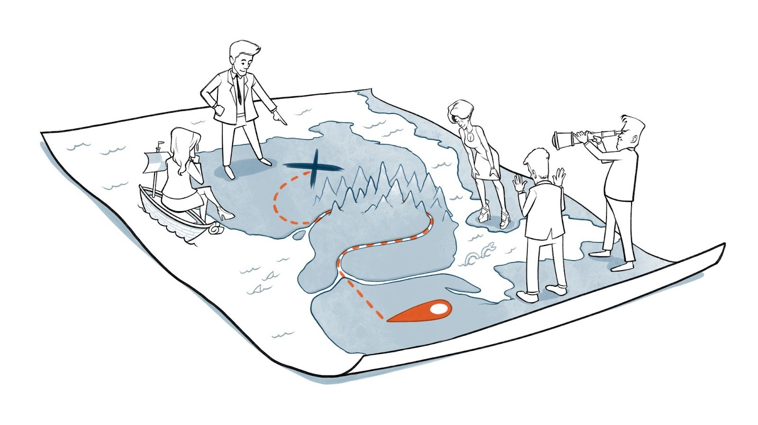
Preparations for the workshop
In the Start Smart workshop, we will work on creating a team contract that clarifies what we aim to achieve as a team and how we will work together.
To achieve good teamwork, it is important that you know each other well, which is something we will spend time on during the workshop.
To prepare, please think about how you cooperate with others by writing your personal user manual. Later on, you will present your personal user manual to the other team members in the Start Smart workshop.
You can copy the template on the next slide and fill in your personal information.
Illustration: Chance McGee

Slide 5
[….]’s personal user manual
My greatest strengths and contributions in teamwork:
I need this from the group to perform at my best:
My weaknesses in teamwork:
Role
What can frustrate me when working with others:
What motivates me for working in this team:
What people might misunderstand when working with me:
Key expertise
Notes:
Alternative questions:
Based on past experiences, what do I value the most when collaborating with others?
Based on past experiences, what irritates me or is challenging for me when collaborating with others?
What can be demanding for me? What should others know to work well with me?
I'm eager to improve in these areas and welcome feedback and support to become better at:

Slide 6
START SMART agenda and check-in
Intention
Desired outcome
Work method
Make important clarifications for our teamwork and get to know each other better to improve the chances of achieving our goals.
To have a proposed team contract that forms the basis for continuous team development.
We feel safer around each other and our tasks, and motivated for the teamwork ahead.
High intensity.
Think individually, write down on post-it notes and then share with the group.
Roles
Meeting guidelines
Check-in
Facilitator: Responsible for leading the team through the workshop and for keeping time.
Team members: Responsible for contributing with their perspectives.
Documentation: Choose a team member who will be responsible of creating a draft for a team contract based on the inputs given in this workshop.
Share and listen to each other, be curious and open-minded.
It is not required to have 100% agreement at all times.
Be attentive and present. Wait until the break to check your phone/laptop.
How are you today?
How do you feel now that we’re about to start this session?
Notes:
GO THROUGH THE AGENDA 10 mins
CHECK-IN 10 mins

Slide 7
[Template for printing]
Why are we a team?
What do we want to achieve?
Who are we?
1
2
3
Purpose
Goals
Our user manuals
15 mins
15 mins
5 mins per person
Why are we a team and what is our overall ambition?
What is the team’s specific goals?
To achieve the best possible teamwork, what should the other team members know about me?
4
How shall we work together?
Roles & Responsibilities
Work methods
15 mins
15 mins
Given our purpose, goals and who we are, which roles and responsibilities do we need to ensure for this team to succeed?
How can we best organize our work to succeed with our tasks and goals?
Collaboration norms
Team development
15 mins
15 mins
What mutual expectations should we have to optimize working together?
How can we follow up what we have agreed upon in this contract and ensure that we develop as a team?
Notes:
This version can be printed out and hung up on the workshop's wall

Slide 8
Our teamcontract
Why are we a team?
What do we want to achieve?
Who are we?
1
2
3
Purpose
Goals
Our user manuals
15 mins
15 mins
5 mins per person
Why are we a team and what is our overall ambition?
What is the team’s specific goals?
To achieve the best possible teamwork, what should the other team members know about me?
Insert here
Insert here
Insert here
How shall we work together?
4
Roles & responsibilities
Work methods
Collaboration norms
Team development
15 mins
15 mins
15 mins
15 mins
Given our purpose, goals and who we are, which roles and responsibilities do we need to ensure for this team to succeed.
How can we best organize our work to succeed with our tasks and goals?
Which mutual expectations should we have to optimize working together?
How can we follow up what we have agreed upon in this contract and ensure that we develop as a team?
Insert here
Insert here
Insert here
Insert here
Notes:
This is a team contract template where you can fill in what you have agreed upon after the workshop.
The boxes in this template can be adjusted and edited.
Your user manuals do not need to be included in this team contract, but we have kept the field to highlight what you have covered in the Start Smart workshop.

Slide 9
START SMART summary, follow-up and check-out
Summary
Follow-up
Check-out
Summarise what you agree upon, what remains unclear, and how this will be followed up. The facilitator writes down the points that need further clarification.
Agree on when a summarised team contract based on the input provided in the workshop should be ready. This includes the team’s purpose, goals, roles, work methods, collaboration norms and team development.
Set aside 5–10 minutes at the end of each meeting for a meta meeting (i.e. reflect on how you worked together today): What worked well and what could be improved?
If you're going to work together for a longer time period, we recommend doing a Start Smart Follow-up workshop after 2-3 months (see our website) to evaluate how the teamwork has gone so far.
How has working together in the team been for you today?
Notes:
SUMMARY, FOLLOW-UP AND CHECK-OUT 15 mins

Slide 10
Parking lot Everything that comes up during the workshop that can not be dealt with there, but should be discussed again in another relevant forum/meeting.

Slide 11
FACILITATOR GUIDE

Slide 12
Preparations by the facilitator
Familiarise yourself with the process by reading through the content of this file.
When needed, you can find useful additional resources on our website.
Prepare for the workshop by:
Aligning the process with the team leader (if that isn't you). Please note that Start Smart is just the beginning of the team's development, and the process should be followed up over time (check out Start Smart Follow-up). Additionally, Start Smart is a flexible tool that often needs to be customized for the group. See the last page in the facilitator's guide for examples of commonly used adjustments.
Send out a meeting invitation with a meeting time of 3 hours with information about what they are to take part in and what they should prepare (time estimate based on 6 team members, you might need more if you are more than 6).
Provide the participants with the personal user manual template in good time before the workshop.
If possible, conduct the workshop in person. Alternatively, the workshop can be conducted digitally. Hybrid is not recommended.
Prepare the equipment:
If the team meets in person:
Print the team contract in A0. Alternatively, write the headings from the team contract on a whiteboard/flip chart.
One pad of post-it notes for each participant in different colours.
Markers to write on the post-it notes.
A clock or a timer.
If the team meets digitally:
Use the MURAL - version of Start Smart or use a digital whiteboard where you enter the fields from the team contract.
Familiarise yourself with how the tool works, so that you can help the participants to use it.
Alternatively, you can also use a shared document (such as Word Online or Google Docs).

Slide 13
The workshop – 1/4
This workshop relies on good time management. Keep an eye on the clock and set aside a bit of buffer if you expect certain activities to take longer.
1. AGENDA AND CHECK-IN 20 mins
A. AGENDA 10 mins
Start the workshop on the agenda slide and continue in the suggested order.
Clarify if there are any questions or feedback on these points.
B. CHECK-IN 10 mins
Before any team meeting, whether it is Start Smart or something else - it is useful to have a ‘check-in’, which is a short round where everyone gets to say something. This has many purposes:
Getting focused on the task at hand.
Creating a connection between the participants.
Providing the others with practical information (e.g. limited time or focus because of X)
Examples of what can be included in a check-in include things that you are interested in, how you are doing, etc. In this process, we recommend that you start the check-in with the following two questions:
How are you today?
How do you feel now that we’re about to start this session?
Make sure that everyone talks for about the same amount of time.

Slide 14
The workshop – 2/4
2. PREPARING THE TEAM CONTRACT – approx. 2-2,5 hours including a break
For each of the topics in the team contract we recommend that the participants get 3 minutes to consider the question individually and note their thoughts on their post-it notes. Each participant in turn shares what they have written and places the post-it note on the dedicated area of the contract. There is time for a brief elaboration and, if necessary, questions from members of the team if something is unclear. Identical notes can be placed on top of each other. Alternate in who starts sharing their notes.
As a facilitator you might get questions as: ‘How should we answer this question?’, ‘What are we expected to say here?’, and etc. Here it is important to understand that Start Smart provides a method for the team, rather than the actual content of the team contract. Hence, all answers are valid.
It might be a good idea to ‘park’ conversations that seem to take too much time or are off-topic until a later occasion. These points can be noted down on the ‘parking lot’ (slide 10), and be discussed in another relevant forum/meeting.
On the last slide of this facilitator guide, you can find the whole team contract with several help questions. You can use these to elaborate on what might be important to talk about under each topic.
A. WHY are we a team? – PURPOSE 15 mins
Ask the question: Why are we a team and what is our overall ambition? Ask the team to take a superordinate perspective.
After everyone has shared their post-it notes, as the facilitator you summarises the input and remember to check with the team if they agree.
B. WHAT do we want to achieve? – GOALS 15 mins
Ask the question: What are the team’s specific goals? Underline that the team’s goals should be realistic, measurable and have a time limit.
There should be somewhat conformity between the answers in regards of the team’s goals, however the answers does not need to be identical. After everyone has shared their post-it notes, as the facilitator; summarise the input and check with the team if they agree.
If there is disagreement in the group, and it is not possible to resolve it immediately, you should come back to this topic as soon as possible after the workshop.

Slide 15
The workshop – 3/4
C. WHO are we? – PERSONAL USER MANUAL 5 mins per person
Participants prepare their ‘personal user manual’ before the session and bring the completed version. As you become familiar with Start Smart and the personal user manual, you can assess how many and which questions you want to bring into the various groups you facilitate.
Participants present their user manual one by one, spending about 5 minutes each.
After a participant has presented themselves, let some of the other participants give a brief response to what the participant has shared, 1-2 minutes, such as follow-up questions or comments.
Wrap up this session after everyone has presented by asking the group: How was this?
CONSIDER THE NEED FOR A BREAK HERE – 10-15 mins
D. HOW shall we work together? 60 mins
ROLES AND RESPONSIBILITIES 15 mins
Ask the question: Given our purpose, goals and who we are, which roles and responsibilities do we need to ensure that this team succeeds?
In this context, 'roles' refer to clarifying which roles/responsibilities are needed for the team to succeed in what the team is supposed to do. Sometimes, roles are quite clear from the outset, while other times, they are not. In the latter case, the distribution of roles and responsibilities may need to be determined after the workshop, as it often requires more time to assess who should do what based on skills, availability, and prerequisites.
After everyone has shared their post-its, the facilitator summarises the input and checks with the team if they agree.
If it is difficult to reach agreement within this topic, you can return to it when the whole team contract has been completed or at the next meeting.
WORK METHODS 15 mins
Ask the question: How can we best organise our work to succeed with our tasks and goals?
After everyone has shared their post-its, the facilitator summarises the input and checks with the team if they agree.

Slide 16
The workshop 4/4
COLLABORATION NORMS 15 mins
Ask the question: What mutual expectations should we have to optimize working together?
To help the team get started, you can ask them to think about the best and worst teams they've been a part of and produce suggestions based on these experiences.
After everyone has shared, check with the team if they agree. Do these norms support the goals and work methods?
TEAM DEVELOPMENT 15 mins
Ask the question: How can we follow up on what we have agreed upon in this contract and ensure that we develop as a team?
After everyone has shared their post-its, the facilitator summarises the input and checks with the team if they agree.
Agree on when you will conduct the Start Smart follow-up. We recommend a follow-up after approximately 2 months, but this depends on how closely the team will be working together. Please check out the dedicated tool called 'Start Smart Follow-up' on our website.
3. SUMMARY AND CHECK-OUT 15 mins
The facilitator or team leader summarises where there is agreement, what remains unclear, and how this will be followed up. Note down the points for clarification and a person responsible for following them up.
Agree on when a summarised team contract based on the input provided in the workshop should be ready. This includes the team’s purpose, goals, roles, work methods, collaboration norms and team development.
Do a quick check-out round where all participants have the chance to say something about how they found working together today.

Slide 17
Facilitator slide with sub-questions
1
Start: Explain Start Smart
2
Check-in
10 min
10 min
10 min
10 min
Intention– Desired outcome – Agenda – Roles – Guidelines - Time
Ask the question: How are you feeling today? What are you feeling as we're about to start this session?
Develop the teamcontract
3
145 min
Why are we a team?
What do we want to achieve?
Who are we?
1
2
3
Purpose
Goals
Our user manuals
15 mins
15 mins
5 mins per pers + 2 min response from others
Why are we a team and what is our overall ambition?
Relevant sub-questions:
What are the team’s specific goals?
Relevant sub-questions:
To achieve the best possible teamwork, what should the others know about, me?
Reflection after sharing: How was this?
What do we want to achieve in the short term?
What do we want to achieve in the long term?
How do our goals relate to those of the organization/client?
Why is this important?
What are we contributing to?
After this point you can have a break for 10-15 min
Hvordan skal vi jobbe sammen?
4
Roles and responsibilities
Work methods
Collaboration norms
Team development
15 mins
15 mins
15 mins
15 mins
Given our purpose, goals and who we are, which roles and responsibilities do we need to ensure this team’s success?
Relevant sub-questions:
How can we best organize our work to succeed with our tasks and goals?
Relevant sub-questions:
Which rules should we have to optimize working together as a team?
Relevant sub-questions:
How can we follow up what we have agreed in this contract and ensure that we develop as a team?
Relevant sub-questions:
How should we communicate with each other?
What kind of leadership does the team need?
How do we make decisions in the team? Leader, majority, unanimous? Which decisions must the whole team be involved in?
What is important for me to achieve good cooperation?
How can we ensure that we feel confident around each other?
How can we ensure that everyone dares to speak their mind?
How can we deal with disagreements?
In what way and how often should we evaluate our own functioning and work as a team along the way?
How do we ensure that everyone is motivated along the way?
How can we learn from our experience to become even better?
Who will be responsible for putting this on the agenda?
What formal roles/skills do we need?
What informal roles do we need?
4
Summary and check-out
Summarize what the team agrees on and what remains unclear, and how this will be followed up.
Check-out: How has it been working together today?
15 min
15 min

Slide 18
Common adjustments to Start Smart
TIME and NUMBER OF PARTICIPANTS
The time estimate for this workshop is based on teams with 6 participants and a strict time management. If you have more than 6 participants, you should allocate more time. To keep the time in check it is recommended to use a visible timer or limiting the number of notes each participants can write.
If your team consists of more than 8 people, we recommend adding an extra step. After individual thinking, participants can be divided into smaller groups, and then a representative from each group can share the group's inputs/notes with the whole group.
You can also take more time for a Start Smart, for example, over a 2-day leadership meeting or divide the workshop into several workshops to thoroughly discuss and concretize the inputs provided.
SEQUENCING of the topics
Start Smart is a flexible tool that you can conduct as it is described here, or it can be adjusted. You can change the order of topics or choose to spend more/less time on something if you know what the team needs to use most time on. However, don't skip elements for the sake of convenience, as the methodology includes elements that are essential for establishing effective teamwork.
PURPOSE
For some teams, it may be essential to understand how they fit into the overall organization/value chain. In such cases, it can be useful for the team to reflect on the team's purpose and how it fulfils a need/function in their context. How do they connect with the rest of the organization when discussing the team's purpose?
PERSONAL USER MANUAL
We have received feedback that teams appreciate spending more time on this part and/or conducting it as a separate session.
If the group is large (more than 8 participants), we recommend starting with the personal instruction manual because it will take a bit more time, and it fits well with a break after the session.
If the team already knows each other well and you are conducting Start Smart as a 'restart' of the team, we also recommend beginning with the personal instruction manual. In this case, we suggest taking the opportunity to provide feedback to each other. Check out the Start Smart Follow-up for guidance on how to do this.
It is possible to vary the questions asked in the personal instruction manual. For more alternatives, see the notes section in the personal instruction manual.
ROLES and RESPONSIBILITIES
If the workshop is being conducted with participants who are also members of other teams, it may be helpful in some cases to clarify how much time each participant can contribute to this team. If so, have a discussion about how much time each participant can contribute, for instance in percentage terms.
For some teams, it's important to clarify the boundaries with other teams. If this applies to your team, you can also discuss it here and follow up in a later meeting. It will be necessary to allocate more time if you make any of these adaptations.

