Slide 1
Welcome to
FOLLOW-UP

Slide 2
Get to know START SMART
Start Smart Follow-up is a further development of the team contract you created during your Start Smart workshop. The process is similar to last time but with a greater focus on what has worked well and what you want to adjust.
The process takes the team through a workshop of approximately 3,5 hours (depending on the team's size), where you explore and clarify essential topics for ongoing team collaboration.
During the workshop, you will update your team contract to align it with the experiences you have gained as a team up to this point and the current context you find yourselves in today.
On the following pages, you will find:
Team Guide for Start Smart follow-up
Facilitator Guide for Start Smart follow-up
Illustrasjon: Chance McGee

Slide 3
Teamguide
FOLLOW-UP

Slide 4
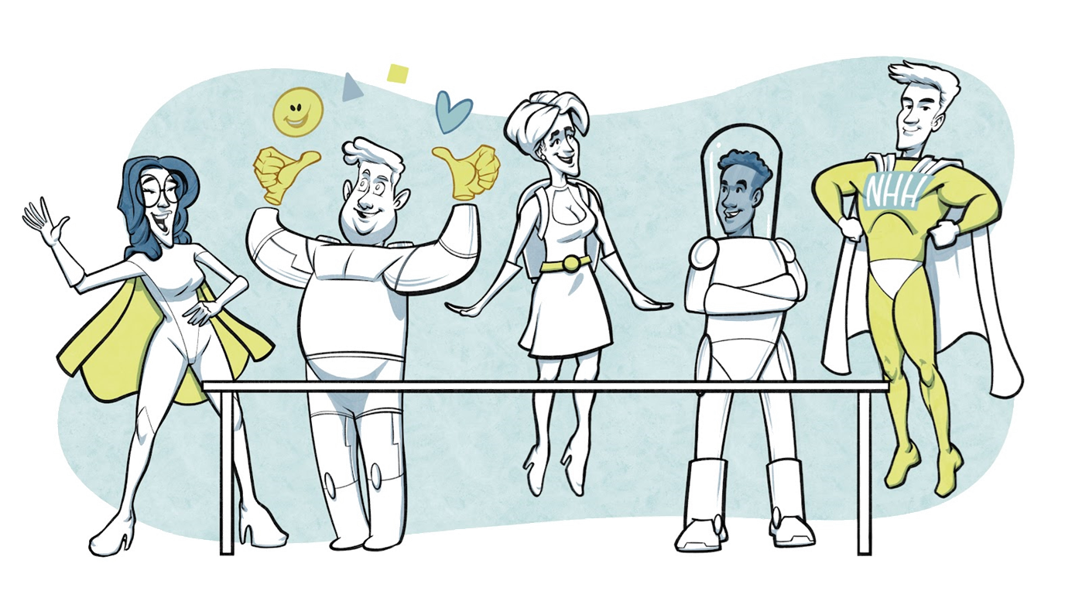
Preparations for the workshop
In this Follow-up workshop, you will be working on further developing your team contract. To facilitate effective teamwork, it is crucial to learn from your experiences as a team. Therefore, you will explore what you believe has worked well within the team and what should be adjusted.
As a preparation, we ask you to review your team contract to remember what you agreed upon during the previous Start Smart workshop.
We learn a lot about ourselves when working together in teams. During the last Start Smart workshop, we asked you to fill out a personal user manual.
As a part of your preparation, we also request you revisit your personal user manual to reflect on what new insights you have gained about yourself and your team members during the time you have worked together. This information will be used to provide feedback to each other during the workshop.
Illustrasjon: Chance McGee

Slide 5
START SMART agenda and check-in
Intention
Desired outcome
Work method
Make necessary adjustments to our team contract to increase the likelihood of achieving the goals we have set.
We have an updated team contract that serves as a foundation for our ongoing team development.
We are more confident in each other and our roles, and we are motivated for future collaboration.
High intensity
Individual reflection, note-taking, and then share with the group
Providing feedback to each other
Roles
Meeting guidelines
Check-in
Facilitator: Responsible for leading the team through the workshop and managing the time.
Team Members: Responsible for sharing their perspectives.
Documentation: One team member is responsible for processing the information and finalizing the team contract after the workshop.
Share and actively listen to each other, show curiosity and openness.
It's not necessary to reach 100% agreement.
Maintain attention and presence and obtain from using mobile phones or computers until the break.
How are you today?
What are you feeling as we're about to start our session?
Notes:
GO THROUGH THE AGENDA 5 mins
CHECK-IN 10 mins

Slide 6
Recap
FOLLOW-UP
Each participant reads through the team contract from the previous Start Smart to refresh their memory about what the group agreed upon at that time.
Notes:
5 minutes

Slide 7
[Template for printing]
Why are we a team?
What do we want to achieve?
Who are we in this team now?
1
2
3
Purpose
Goals
New insight about ourselves and our team members
15 mins
15 mins
7 min preparation
8 min per pers.
Does our purpose still make sense? Or should we adjust it?
What are NOW our most important goals?
Each participant shares:
How have I contributed to the team?
How do I wish to develop myself and what would I like feedback on going forward?
4
How shall we work together going forward?
Roles & Responsibilities
Work methods
15 mins
15 mins
What has worked well?
What do we wish to adjust?
What has worked well?
What do we wish to adjust?
Each participant gives feedback to the others:
What have I appreciated when working with you.
Collaboration norms
Team development
15 mins
15 mins
What has worked well?
What do we wish to adjust?
What has worked well?
What do we wish to adjust?
Notes:
This version can be printed out and hung up on the workshop's wall

Slide 8
Our teamcontract
Why are we a team?
What do we want to achieve?
Who are we in this team now?
1
2
3
Purpose
Goals
New insight about ourselves and our team members
15 mins
15 mins
7 min preparation
8 min per pers.
Does our purpose still make sense? Or should we adjust it?
What are NOW our most important goals?
Each participant shares:
How have I contributed to the team?
How do I wish to develop myself and what would I like feedback on going forward?
Insert here
Insert here
Each participant gives feedback to the others:
What have I appreciated when working with you.
How shall we work together going forward?
4
Roles & responsibilities
Work methods
Collaboration norms
Team development
15 mins
15 mins
15 mins
15 mins
Given our purpose, goals and who we are, which roles and responsibilities do we need to ensure for this team to succeed.
What has worked well?
What do we wish to adjust?
How can we best organize our work to succeed with our tasks and goals?
What has worked well?
What do we wish to adjust?
Which mutual expectations should we have to optimize working together?
What has worked well?
What do we wish to adjust?
How can we follow up what we have agreed upon in this contract and ensure that we develop as a team?
What has worked well?
What do we wish to adjust?
Insert here
Insert here
Insert here
Insert here
Notes:
This is a team contract template where you can fill in what you have agreed upon after the workshop.
The boxes in this template can be adjusted and edited.
Your user manuals do not need to be included in this team contract, but we have kept the field to highlight what you have covered in the Start Smart workshop.

Slide 9
START SMART summary, follow-up and check-out
Summary
Follow-up
Check-out
Summarize what there is consensus on, what may still be unclear, and how this will be followed up. Any points requiring further clarification will be noted by the facilitator.
Agree on when a revised team contract based on the input provided in the workshop should be ready. This includes the teams purpose, goals, roles, work methods, collaboration norms and team development.
Allocate 5-10 minutes at the end of each meeting for a meta-meeting (i.e., reflect on how you worked together today): What worked well, and what can we possibly adjust?
If you're going to work together for an extended period, we recommend conducting another follow-up session after some time to explore how team collaboration continues to function
How was it to work together as a team today?
Notes:
SUMMARY, FOLLOW-UP AND CHECK-OUT 15 mins

Slide 10
Parking lot Anything that arises during the workshop that cannot be addressed there but should be discussed in another relevant forum or meeting

Slide 11
Facilitator guide
FOLLOW-UP

Slide 12
Preparations for the facilitator
Start Smart Follow-up is quite similar to Start Smart. Familiarize yourself with the differences in the Follow-up by reading the content of this guide.
Prepare for the workshop by:
Aligning the process with the team leader, if you are not the leader.
Sending a meeting invitation, allocating approximately 2 hours (time estimate based on a team of 6 people; if you have more, consider additional time).
Informing everyone to prepare in advance by reflecting on their contributions to the team and what they appreciate about their colleagues.
If possible, conduct the workshop in person. Alternatively, the workshop can be conducted digitally. Hybrid is not recommended.
Prepare equipment:
If the team meets physically:
Print the team contract in A0. Alternatively, write the headings from the team contract on a whiteboard/flip chart.
One pad of post-it notes for each participant in different colours.
Markers to write on the post-it notes.
A clock or a timer.
If the team meets digitally:
Use the MURAL - version of Start Smart or use a digital whiteboard where you enter the fields from the team contract.
Familiarise yourself with how the tool works, so that you can help the participants to use it.
Alternatively, you can also use a shared document (such as Word Online or Google Docs).

Slide 13
The workshop - 1/4
This workshop relies on good time management. Keep an eye on the clock, and set aside a bit of buffer if you expect certain activities to take longer.
1. AGENDA, CHECK-IN AND RECAP 20 mins
A. AGENDA 5 mins
Start the workshop in the suggested order on the agenda slide.
Clarify any questions or feedback on these points.
B. CHECK-IN 10 mins
In this process, we recommend that you start the check-in with the following two questions:
How are you today?
How do you feel now that we’re about to start this session?
Make sure that everyone talks for about the same amount of time.
C. RECAP 5 min
Let each participant read through the team contract from the previous Start Smart to refresh their memory about what the group agreed upon at that time.

Slide 14
The workshop – 2/4
2. ADJUSTING THE TEAM CONTRACT – approx. 2,5-3 hours including break
For each of the topics in the team contract we recommend that the participants get 2-3 minutes to consider the question individually and note their thoughts on their post-its. Each participant in turn shares what they have written and places the post-it(s) on the dedicated area of the contract. There is time for a brief elaboration and, if necessary, questions from members of the team if something is unclear. Identical notes can be placed on top of each other. Alternate in who starts sharing their notes.
As a facilitator you might be asked: ‘How should we answer this question?’, ‘What are we expected to say here?’, and alike. Here it is important to understand that Start Smart provides a method for the team, rather than the actual content of the team contract. Hence, all answers are valid.
It might be a good idea to ‘park’ conversations that seem to take too much time or are off-topic until a later occasion. These points can be noted down on the ‘parking space’ (slide 10), and be discussed in another relevant forum/meeting.
A. WHY are we a team? - PURPOSE 15 min
Ask the question: Does our purpose still make sense, or should it be adjusted? If so, how? Encourage the team to take a superordinate perspective.
After everyone has shared their post-it notes, as the facilitator you summarises the input and remember to check with the team if they agree.
B. WHAT do we want to achieve? – GOALS 15 mins
Ask the question: What are NOW our most important goals? Underline that the team’s goals should be realistic, measurable and have a time limit.
There should be somewhat conformity between the answers in regards of the team’s goals, however the answers does not need to be identical. After everyone has shared their post-it notes, as the facilitator; summarise the input and check with the team if they agree.
If there is disagreement in the group, and it is not possible to resolve it immediately, you should come back to this topic as soon as possible after the workshop.

Slide 15
The workshop – 3/4
C. WHO are we in this team now? New insights about ourselves and each other. 60 mins 7 minutes individual preparation + 8 minutes per person + 5 minutes of collective reflection. One participant in focus at a time.
Ask each participant to reflect individually on the following:
What do I perceive to have contributed to the team, and what do I wish to adjust going forward?
What have I appreciated when working with each colleague in the team?
Start with one participant and let him share his answer to the first question, then let the others in the group share what they have appreciated in working with the participant. Continue the round until everyone has been through. If the group is large, not everyone needs to give feedback to each individual.
When everyone has presented and received feedback, the facilitator can ask the group: How was this?
Note: it is easy to exceed the time here, so feel free to use a timer set for 8 minutes per person.
CONSIDER THE NEED FOR A BREAK HERE - 15 minutes
D. HOW will we work together going forward?
Under each of the following points, you will ask the group what has worked well since last Start Smart workshop and what they want to adjust going forward. Let participants both think individually and share their answers to these questions simultaneously.
ROLES AND RESPONSIBILITIES 15 minutes.
Refer back to the question posed in the first Start Smart Given our purpose, goals, and who we are, what roles and responsibilities do we need to ensure in this team to succeed? and invite the participants to evaluate individually What has worked well? and What do we want to adjust?
After everyone has posted their notes and given their input, summarize what has been contributed and check with the group if it looks okay.

Slide 16
The workshop 4/4
WORK METHODS 15 minutes.
Refer back to the question posed in the first Start Smart How can we best organize our work to succeed in our tasks and goals? and invite the participants to evaluate individually What has worked well? and What do we want to adjust?
After everyone has posted their notes and given their input, summarize what has been contributed and check with the group if it looks okay.
COLLABORATION NORMS 15 minutes.
Refer back to the question posed in the first Start Smart What mutual expectations should we have to optimize working together? and invite the participants to evaluate individually What has worked well? and What do we want to adjust?
After everyone has posted their notes and given their input, summarize what has been contributed and check with the group if it looks okay.
TEAM DEVELOPMENT 15 minutes.
Refer back to the question posed in the first Start Smart How can we follow up on what we have agreed upon in this contract and ensure that we develop as a team? and invite the participants to evaluate individually What has worked well? and What do we want to adjust?
After everyone has posted their notes and given their input, summarize what has been contributed and check with the group if it looks okay.
3. SUMMARY AND CHECK-OUT 15 mins
The facilitator or team leader summarises where there is agreement, what remains unclear, and how this will be followed up. Note down the points for clarification and a person responsible for following them up.
Agree on when a summarised team contract based on the input provided in the workshop should be ready. This includes the team’s purpose, goals, roles, work methods, collaboration norms and team development.
Do a quick check-out round where all participants have the chance to say something about how they found working together today.

Slide 17
Facilitator slide with sub-questions
1
3
Recap
Start: Explain Start Smart
2
5 mins
Check-in around the table
5 mins
10 min
10 mins
Intention– Desired outcome – Agenda – Roles – Guidelines - Time
How are you feeling today? What are you feeling as we're about to start this session?
Look through existing team contract
Develop the teamcontract
4
155 mins
Why are we a team?
What do we want to achieve?
Who are we in this team now?
1
2
3
Purpose
Goals
New insights
15 mins
15 mins
7 mins preparation + 8 mins per person incl. responses from others
Does our purpose still make sense, or should it be adjusted? If so, how? Relevant sub-questions:
What are NOW our most important goals?
Relevant sub-questions:
Each participant shares:
How have I contributed to the team?
What do I wish to develop myself on and am gladly taking feedback on
The team gives feedback to the person:
What have I appreciated when working with you
Reflection after sharing: How was this?
Which goals should we keep?
What new goals should we set for the short/long term?
How do our new goals align with the organization's/client's goals?
Why is this important?
What are we contributing to?
Have a break for 15 min
How shall we work together going forward?
4
Roles and responsibilities
Work methods
Collaboration norms
Team development
15 mins
15 mins
15 mins
15 mins
Given our purpose, goals and who we are, which roles and responsibilities do we need to ensure this team’s success?
What has worked well?
What do we wish to adjust?
Relevant sub-questions:
How can we best organize our work to succeed with our tasks and goals?
What has worked well?
What do we wish to adjust?
Relevant sub-questions:
Which rules should we have to optimize working together as a team?
What has worked well?
What do we wish to adjust?
Relevant sub-questions:
How can we follow up what we have agreed in this contract and ensure that we develop as a team?
What has worked well?
What do we wish to adjust?
Relevant sub-questions:
How should we communicate with each other?
What kind of leadership does the team need?
How do we make decisions in the team? Leader, majority, unanimous? Which decisions must the whole team be involved in?
What is important for me to achieve good cooperation?
How can we ensure that we feel confident around each other?
How can we ensure that everyone dares to speak their mind?
How can we deal with disagreements?
The facilitator refers to what is already stated in the team contract.
Are there any roles/responsibilities that needs to be added/are not needed?
In what way and how often should we evaluate our own functioning and work as a team along the way?
How do we ensure that everyone is motivated along the way?
How can we learn from our experience to become even better?
5
Summary and check-out
Summarize what the team agrees on and what remains unclear, and how this will be followed up.
Check-out: How has it been working together today?
15 min
15 min

