Slide 1
Welcome to

Slide 2
Get to know START SMART
Start Smart is a process tool that ensures efficient start-up and development of teams and groups.
The process takes the team through a 3-hour workshop where you'll explore and clarify topics that are important for teamwork.
In the workshop, you'll develop a team contract that states what you'll achieve as a team and how you'll work together.
On the next slides, you’ll find:
A team guide for the Start Smart workshop
A facilitator guide for the Start Smart workshop
Illustration: Chance McGee

Slide 3
TEAM GUIDE

Slide 4
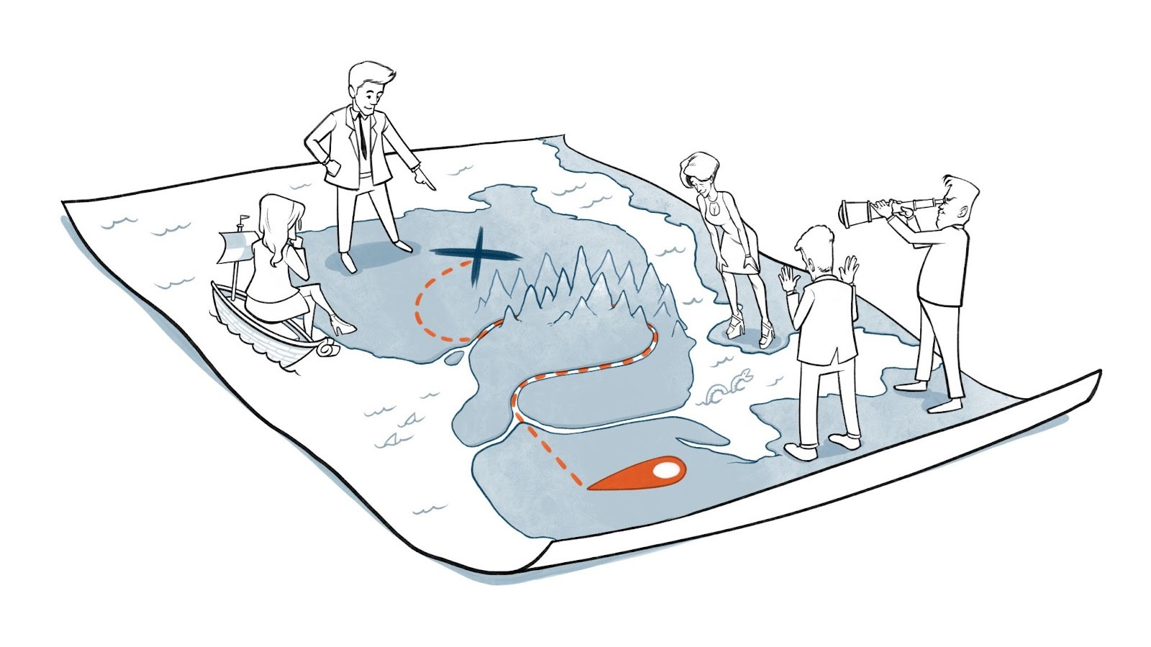
Preparations for the workshop
To achieve good teamwork, it is important that you know each other well, which is something we’ll spend time on in the workshop.
To prepare, please think about how you cooperate with others by writing your personal user manual. You'll present your user manual to the other team members in the Start Smart workshop.
You can copy the template on the next slide and enter your personal information.
Illustration: Chance McGee

Slide 5
Notes:
PREFERABLY CARRIED OUT BEFORE THE WORKSHOP, BUT TIME CAN ALSO BE ALLOCATED IN THE WORKSHOP ITSELF FOR THIS TASK.

Slide 6
START SMART agenda and check-in
Intention
Desired outcome
Work method
Make important clarifications for our teamwork and get to know each other better to improve the chances of achieving our goals.
We have a proposal for a team contract that forms the basis for continuous team development.
We feel more confident with each other and our tasks, and motivated for the teamwork ahead.
In total, a 3-hour workshop.
High intensity.
Think individually, write down on post-its and then share with the group.
Roles
Meeting guidelines
Check-in
Facilitator: Responsible for leading the team through the workshop and for keeping time.
Team members: Responsible for contributing with their perspectives.
Share and listen to each other, be curious and open-minded.
You don’t have to agree with each other entirely.
Be attentive and present. Wait until the break to check your phone/laptop.
How are you today?
How do you feel now that we’re about to start this session?
Notes:
GO THROUGH THE AGENDA 10 mins
CHECK-IN 10 mins

Slide 7
15 mins
15 mins
5 mins per person
15 mins
15 mins
15 mins
15 mins
Notes:
PREPARE THE TEAM CONTRACT ca. 2 hours – 2,5 hours incl. a break

Slide 8
START SMART summary, follow-up and check-out
Summary
Follow-up
Check-out
Summarise what you agree upon, what remains unclear, and how this will be followed up. The facilitator writes down the points that need further clarification.
Clarify who will prepare a summarised team contract based on the input provided in the workshop. This includes the team’s purpose, goals, roles, work methods, collaboration norms and team development.
Set aside 5–10 minutes at the end of each meeting for a meta meeting (i.e. reflect on how you worked together today): What worked well and what could be improved?
If you're going to work together for a longer time period, we recommend taking a new Start Smart workshop after two months to evaluate how the teamwork has gone so far.
How has working together in the team been for you today?
Notes:
SUMMARY, FOLLOW-UP AND CHECK-OUT 15 mins

Slide 9
Parking lot Everything that comes up during the workshop that can not be dealt with there, but should be discussed again in another relevant forum/meeting.

Slide 10
FACILITATOR GUIDE

Slide 11
Preparations by the facilitator
Familiarise yourself with the process by reading through the content of this file.
Prepare for the workshop by:
Aligning the process with the team leader (if that isn't you).
Sending a meeting invitation for ca. 3 hours (estimate based on 6 team-members, you might need more if you are more than 6).
Instructing participants about the workshop’s rationale.
Providing participants with the personal user manual template in good time before the workshop.
If possible, meet in person. Alternatively, the workshop can be conducted digitally. Hybrid is not recommended.
Prepare the equipment: If the team meets in person:
Print the team contract in A1/A0. Alternatively, write the headings from the team contract on a whiteboard/flip chart.
One pad of post-its for each participant in different colours.
Markers to write on the post-its.
A clock or timer.
If the team meets digitally:
Use the MURAL - version of Start Smart or use a digital whiteboard where you enter the fields from the team contract.
Familiarise yourself with how the tool works so that you can help the participants to use it.
Alternatively, you can also use a shared document (such as Word Online or Google Docs).

Slide 12
The workshop – 1/4
This workshop relies on good time management. Keep an eye on the clock, and set aside a bit of buffer if you expect certain activities to take longer.
1. AGENDA AND CHECK-IN 20 mins
A. AGENDA 10 mins
Start the workshop in the suggested order on the agenda slide.
Clarify any questions or feedback on these points.
B. CHECK-IN 10 mins
Before any team meeting – be it Start Smart or something else - it is useful to have a ‘check-in’, which is a short round where everyone gets to say something. This has many purposes:
Getting focused on the task at hand
Creating a connection between the participants
Providing the others with practical information (e.g. limited time or focus because of X)
Examples of what can be included in a check-in comprise things that you are interested in, how you are doing at the moment, or alike. In this process, we recommend that you start the check-in with the following two questions:
How are you today?
How do you feel now that we’re about to start this session?
Make sure that everyone talks for about the same amount of time.

Slide 13
The workshop – 2/4
2. PREPARING THE TEAM CONTRACT – approx. 2-2,5 hours including a break
For each of the topics in the team contract we recommend that the participants get 3 minutes to consider the question individually and note their thoughts on their post-its. Each participant in turn shares what they have written and places the post-it(s) on the dedicated area of the contract. There is time for a brief elaboration and, if necessary, questions from members of the team if something is unclear. Identical notes can be placed on top of each other.
As a facilitator you might be asked: ‘How should we answer this question?’, ‘What are we expected to say here?’, and alike. Here it is important to understand that Start Smart provides a method for the team, rather than the actual content of the team contract. Hence, all answers are valid.
It might be a good idea to ‘park’ conversations that seem to take too much time or are off-topic until a later occasion. These points can be noted down on the ‘parking lot’ (slide 9), and be discussed in another relevant forum/meeting.
On the last slide of this facilitator guide, you can find the whole team contract with several help questions. You can use these to elaborate on what might be important to talk about under each topic.
A) WHY are we a team? – PURPOSE 15 mins
Ask the question: Why are we a team and what is our overall ambition? Ask the team to take a superordinate perspective.
After everyone has shared their post-its, the facilitator summarises the input and checks with the team if they agree.
B) WHAT do we want to achieve? – GOALS 15 mins
Ask the question: What are the team’s specific goals? Underline that the team’s goals should be realistic, measurable and have a time limit.
After everyone has shared their post-its, the facilitator summarises the input and checks with the team if they agree.
If there is disagreement in the group, come back to this topic as soon as possible after the workshop.

Slide 14
The workshop – 3/4
C) WHO are we? – PERSONAL USER MANUAL 5 mins per person + 10 minute reflection together
Participants prepare their ‘personal user manual’ before the session and bring the completed version.
Participants present their user manual one by one, spending about five minutes each, and add them to the dedicated space.
When everyone has had their turn, the facilitator can ask the team: How did you find this task? How was it to present yourself? How was it to listen to the others? What can we learn from this round?
CONSIDER THE NEED FOR A BREAK HERE – 15 mins
D) HOW shall we work together?
ROLES AND RESPONSIBILITIES 15 mins
Ask the question: Given our purpose, goals and who we are, which roles and responsibilities do we need to ensure that this team succeeds?
After everyone has shared their post-its, the facilitator summarises the input and checks with the team if they agree.
If it is difficult to reach agreement within this topic, you can return to it when the whole team contract has been completed or at the next meeting.
WORK METHODS 15 mins
Ask the question: How can we best organise our work to succeed with our tasks and goals?
After everyone has shared their post-its, the facilitator summarises the input and checks with the team if they agree.
If it is difficult to reach agreement within this topic, you can return to it when the whole team contract has been completed or at the next meeting

Slide 15
The workshop 4/4
COLLABORATION NORMS 15 mins
Ask the question: Which mutual expectations should we have to optimise working together as a team?
After everyone has shared, check with the team if they agree. Do these norms support the goals and work methods? Are they inter-related?
TEAM DEVELOPMENT 15 mins
Ask the question: How can we follow up on what we have agreed upon in this contract and ensure that we develop as a team?
After everyone has shared their post-its, the facilitator summarises the input and checks with the team if they agree.
3. SUMMARY AND CHECK-OUT 15 mins
The facilitator or team-leader summarises where there is agreement, what remains unclear, and how this will be followed up. Note down the points for clarification and a responsible for following them up.
Clarify who will summarise and document the work in a written team contract. Goals, roles, work methods, collaboration norms and further team development are the most important elements of the contract.
Do a quick check-out round where all participants receive equally much time to say something about how they found working together today.

Slide 16
15 mins
15 mins
5 mins per person + 10 minute reflection
Why is this important?
What are we contributing to?
What do we want to achieve in the short term?
What do we want to achieve in the long term?
How do our goals relate to those of the organization/client?
15 mins
15 mins
15 mins
15 mins
How should we communicate with each other?
What kind of leadership does the team need?
How do we make decisions in the team? Leader, majority, unanimous? Which decisions must the whole team be involved in?
How frequent and where shall we meet as a team?
What formal roles/skills do we need?
What informal roles do we need?
What is important for me to achieve good cooperation?
How can we ensure that we feel confident around each other?
How can we ensure that everyone dares to speak their mind?
How can we deal with disagreements?
In what way and how often should we evaluate our own functioning and work as a team along the way?
How do we ensure that everyone is motivated along the way?
How can we learn from our experience to become even better?
Who will be responsible for putting this on the agenda?

