Slide 1
Town hall meeting & summer lunch
18 june 2019

Slide 2

agenda
The 60-year anniversary for NHH Executive: Status and prospects
The ARK working environment survey, some experiences
EdTech at NHH
Information from the June board meeting

Slide 3
NHH Executive 60 year anniversary
Status and prospects
Tore I. Hellebø

Slide 4
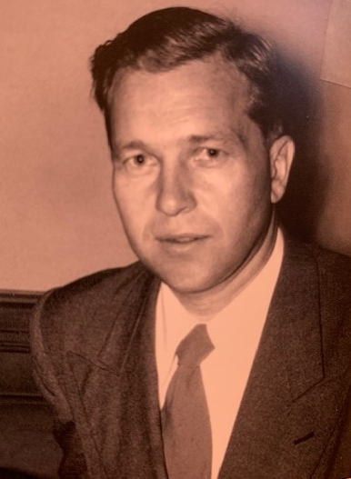
Arne Fostvedt (1915-1991) – the founding father of NHH executive education («kursvirksomhetens far»)
The first director of NHH executive education (1959-1985)
Inaugural courses in the Spring semester of 1959
Organised as a trust (“Norges Handelshøyskoles kursvirksomhet”)
Photo/source: Book on NHH 75-year anniversary

Slide 5
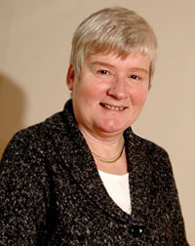
Elisabeth Løvenholm (1947) – the first director of (new) “NHH Executive”
Oversaw the transition from trust to integrated department of NHH under the new name “NHH Executive” (1998)
Other key contributors of this integration were Carl Julius Norstrøm (rector), Kurt Petersen (head of studies) and Erik Lundberg (head of section)
At the helm for 15 years until 2012
Photo/source: “Paraplyen” / interview NHH staff

Slide 6
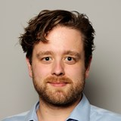
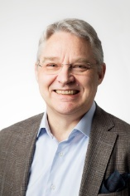
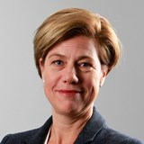
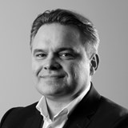
NHH Executive directors since 2012
Kjetil Sudmann Larsen
Sven-Åge Dahl
Birthe Kåfjord Lange
Tore Hillestad
Photo/source: NHH, SNF

Slide 7
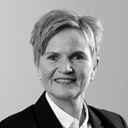
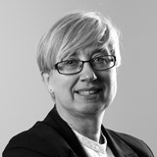
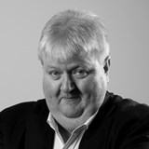
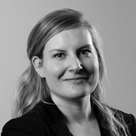
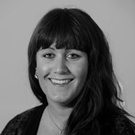
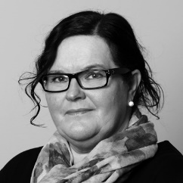
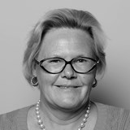
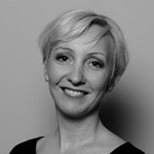
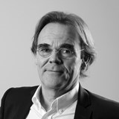
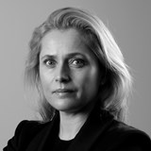
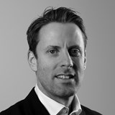
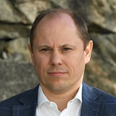
NHH Executive team today
Administration
Temp admin staff
Gro Tufte
Lone Haugsvær
Ove Løvik
Lena Marie Vestli
Hanne Refvik
Marianne Vårdal Minde
Kari Kristiansen
Programme development, management and marketing
Director
Monica Rydland
Tore Hillestad
Tor Øyvind Baardsen
Kristin Stave
Carl Chr Christensen
Tore I. Hellebø
Photo/source: NHH Executive

Slide 8
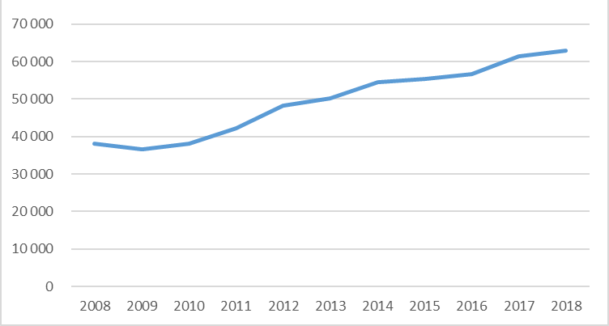
Steady positive development in revenues
Y-o-Y growth seems the rule!
Growth historically driven by EMBA and AFA
Recent growth driven by new open enrolment and custom programmes
Projections 2019 vs 2018: similar revenues (MNOK 64), but more balanced split between “established” vs “new” programmes
Source: Finance department, NHH

Slide 9
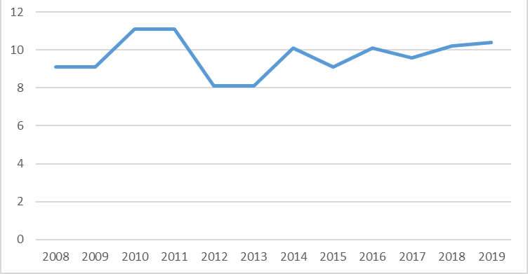
Headcount at NHH Executive has been stable
The increase in revenues has not resulted in increased headcount
Source: NHH Executive

Slide 10
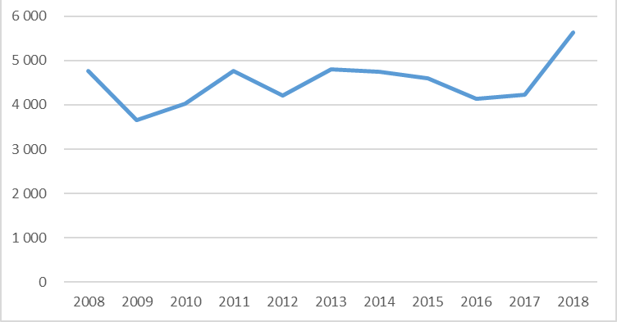
Steady positive returns to the Departments
Net profit / earnings transferred to the various Departments in excess of NOK 4 million annually
Spike in 2018: courtesy of Linda’s EMBA in Seafood Management
Source: Finance department, NHH

Slide 11
Our programme portfolio at a glance
Main categories
Type of programmes
Degree (ECTS)
Executive MBA (6 specialisations / 2-year duration)
Executive Master in Management
Open enrolment (incl. “AFA”, “Brytningstid”, “Design Thinking”)
Trend /our impression:
…demand for modularisation / flexibility
Trend / our impression:
…the winning combination is “hard” + “soft” skills...
…shorter / flexible programmes, more digitalised
Non-degree (no ECTS)
Custom programmes (incl. “Gjensidige”, “BKK”, “Uniconsult”)
Open enrolment (incl. “Business Upgrade”, “Styreprogrammet”)
Source: NHH Executive

Slide 12
Ongoing exciting challenges..
Dip in applications to traditional “flagship” programmes
Continuous renewal and innovation to meet market demand for flexibility and relevance
Build even closer ties with key interfaces internally at NHH, particularly with the Departments, applied research communities, alumni and international relations
Ensure a healthy balance of dependencies with our key partners
Establish a structured approach to FT ranking
Quality assurance, incl. “Assurance of Learning” (AoL) as part of the ACSB accreditation

Slide 13
You are always welcome to our offices
– we have plenty of coffee and are always keen on a good conversation.
Happy 60-year anniversary to NHH Executive!

Slide 14
The ARK working environment survey
some experiences
Gunnar E. Christensen, Jarle Møen

Slide 15


ARK-NHH 2018-2019
Survey period
15 Oct - 5 Nov 2018
Jan
Jun
Jul
Oct
Nov
Feb
Mar
Apr
May
Aug
Sep
Dec
Follow-up
process
Survey
Annual cycle
ARK
Information
Commitment
Implemen-
tation
Action plan and processes
- what to be preserved?
- what to be improved?
Notes:
OPPSUMMERING: Gå gjennom årshjulet for undersøkelsen. Poengter at arbeidsmiljøundersøkelsen vil bli foretatt jevnlig fremover, med et par års mellomrom mellom hver gang.
Fortell at dere skal ha oppfølgingsmøtet i desember-januar (sett av 2-3 timer på et møte eller som del av et internseminar). Møtet avtales med HR og verneombud.
Påminnelse til leder mht. involvering av verneombud:
Avtal møte med verneombud til utfylling av FaktaARK I, dvs. organisatoriske forhold som kan påvirke arbeidsmiljøet på enheten (24. september-8. oktober)
Verneombudet har deltatt på hverdagsledelse 12.09.18 og deltar i forberedelse av oppfølgingsmøtet på enheten.
Avtale møte med verneombud til utfylling av FaktaARK II, dvs rapportering av tiltak og evaluering (dato kommer).

Slide 16
Motto:
«your participation counts»
Some response rates:
84 % total at NHH (67 % in the HEI-sector)
Female 91 % Male 79 %
Faculty 80 % PhDs 75 %
Admin staff 90 % Leaders 100 %
Notes:
Se merknad på neste lysark om oppfølgingsmøtet og på Paraplyen om arbeidsmiljøundersøkelsen.

Slide 17
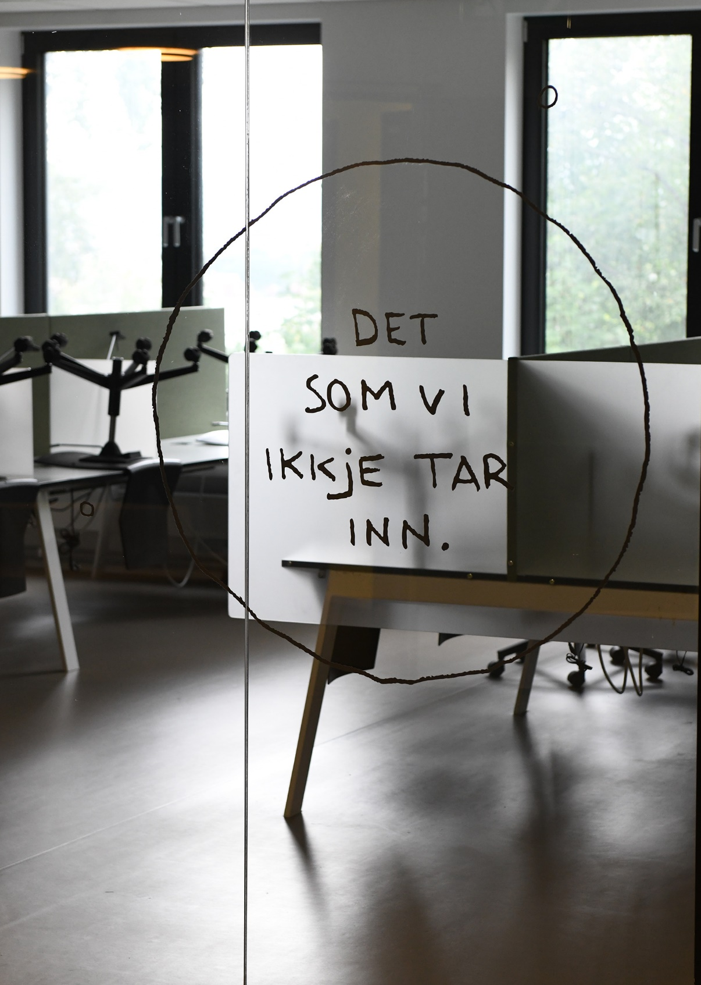
Ark process challenges
Some leaders had problems giving priority to the ARK follow-up process
Some of the survey questions were relatively unclear and therefore not easy to answer
Some units needed a lot of «motivational push» to get started with the follow-up process
Demanding to keep the process «warm and alive» from October to April
Notes:
Se merknad på neste lysark om oppfølgingsmøtet og på Paraplyen om arbeidsmiljøundersøkelsen.

Slide 18
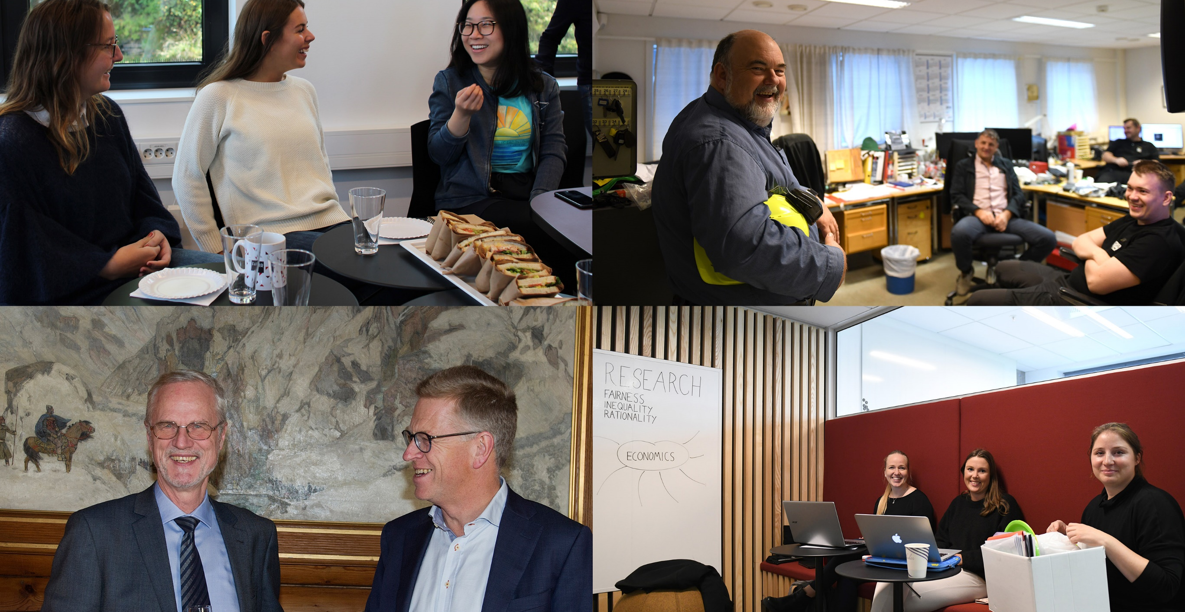
NHH Working environment survey 2018
Lessons FROM the department of Business and Management science

Slide 19
THE WORKING ENVIRONMENT PROCESS 2018-2019
Follow-up meeting:
Presentation of results
Development areas
Jan
Jun
Jul
Oct
Nov
Feb
Mar
Apr
Mai
Aug
Sep
Des
Survey
15 October - 5. November 2018
Survey
Follow-up
Action Plan before Easter
Annual cycle of work environment survey
What have we learned about the process at this stage?
Information
Implementation
Information meeting for management, safety deputies, union representatives

Slide 20


1. Make it useful
It is never the right time, but
It has little value unless you go “all in”
The work environment is important!

Slide 21
2. High response rate is key
Information through email and lunch meeting
Explained what it is
Stressed that we sincerely wanted everybodys opinion
Fired up the competitive instincts: 100% response rate
      Not just the most dedicated!
      Not just the most dissatisfied!

Slide 22
3. Do not postpone the follow-up meeting
Give feed-back and discuss follow up actions while it is fresh in mind
I.e. before Christmas, not before Easter!!

Slide 23
4. Follow-up meeting take-aways
Three hour mandatory breakfast meeting at NHH
Presented the results
Group work – not mixed groups
Plenary discussion based on the group work
Document the input

Slide 24
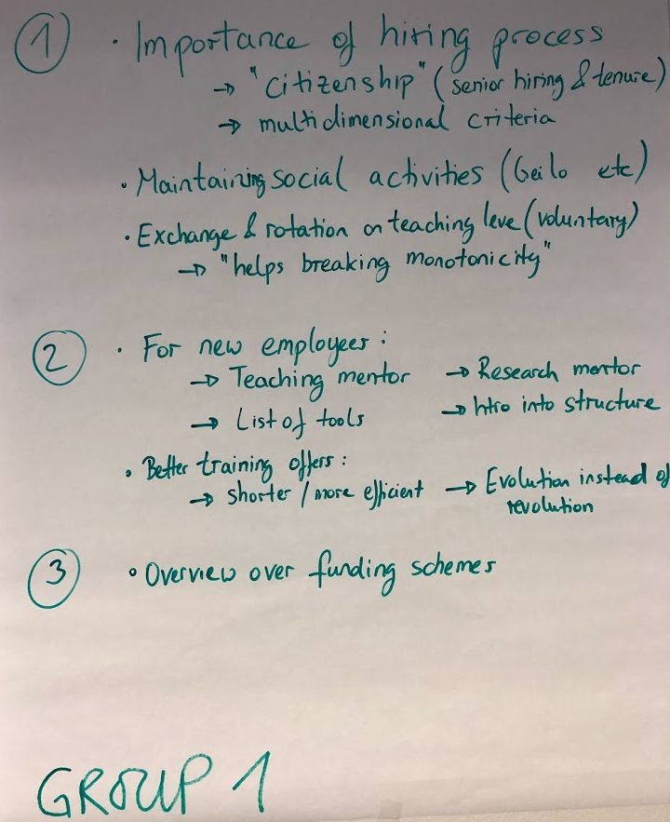
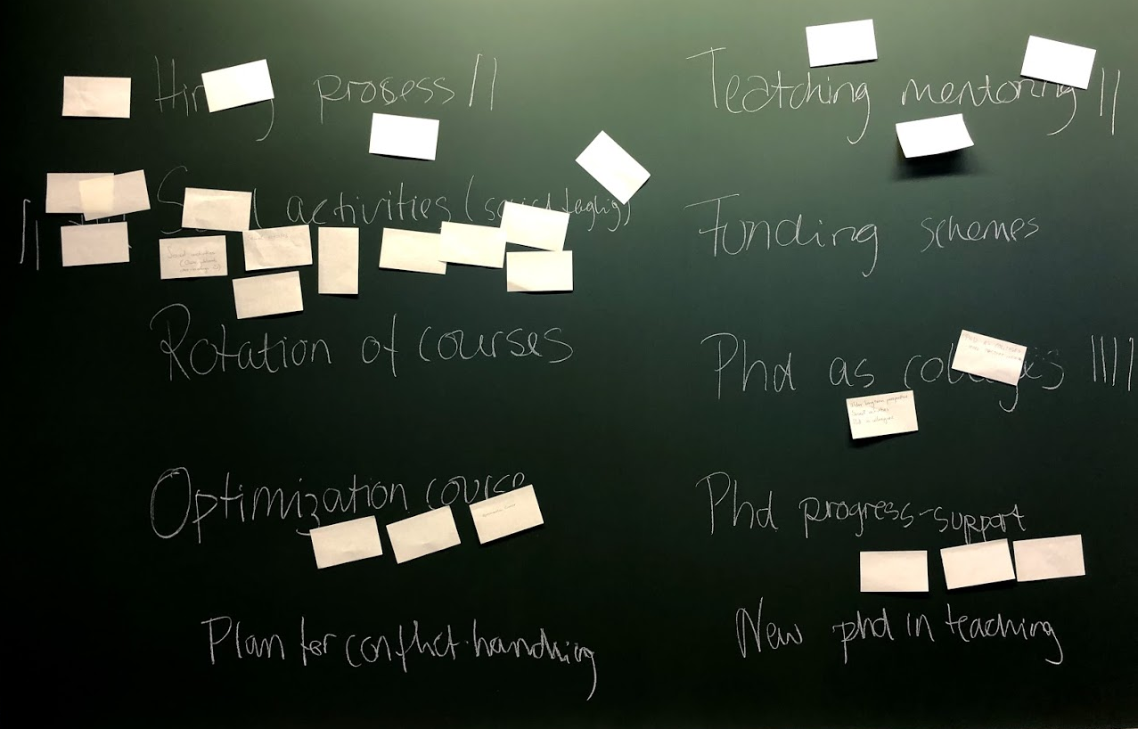
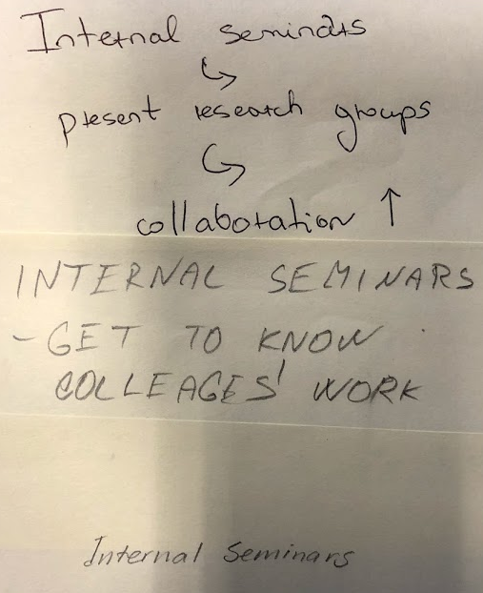

Slide 25
5. Following up the follow-up meeting …
Discussion about priorities in the management group
Gave feedback at the department seminar at Geilo
Action plan formally decided by the department board
Kept it simple: Five specific points
Remember to implement!

Slide 26
Why has it been useful?
Knowing rather than assuming
Always scope for improvement
Forced creativity and a push
“All in” → Not too often!

Slide 27
EdTech at NHH
status
Arild Schanke

Slide 28
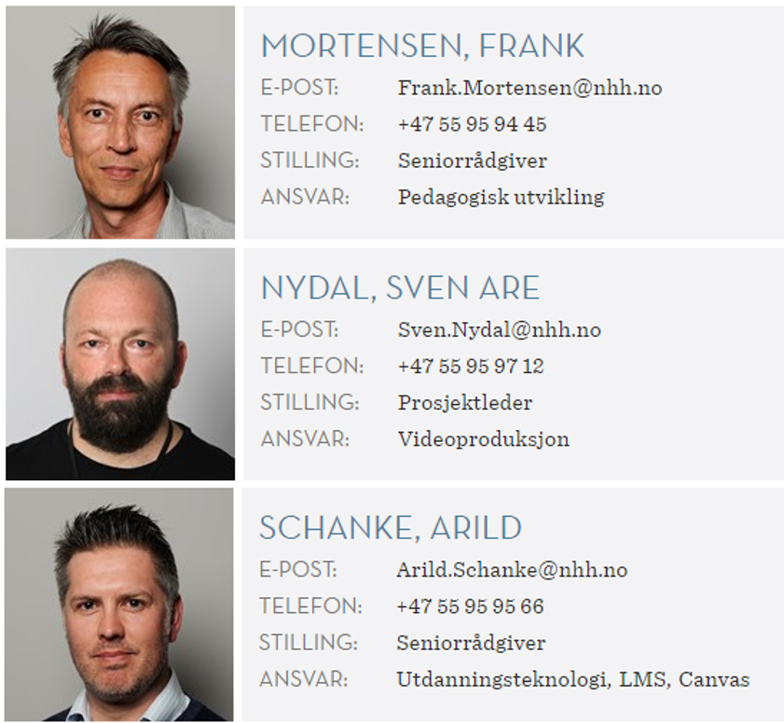
Who are we?
Frank: educational development
Arild: educational technology
Sven: video
…and a film crew of 8 NHH students

Slide 29

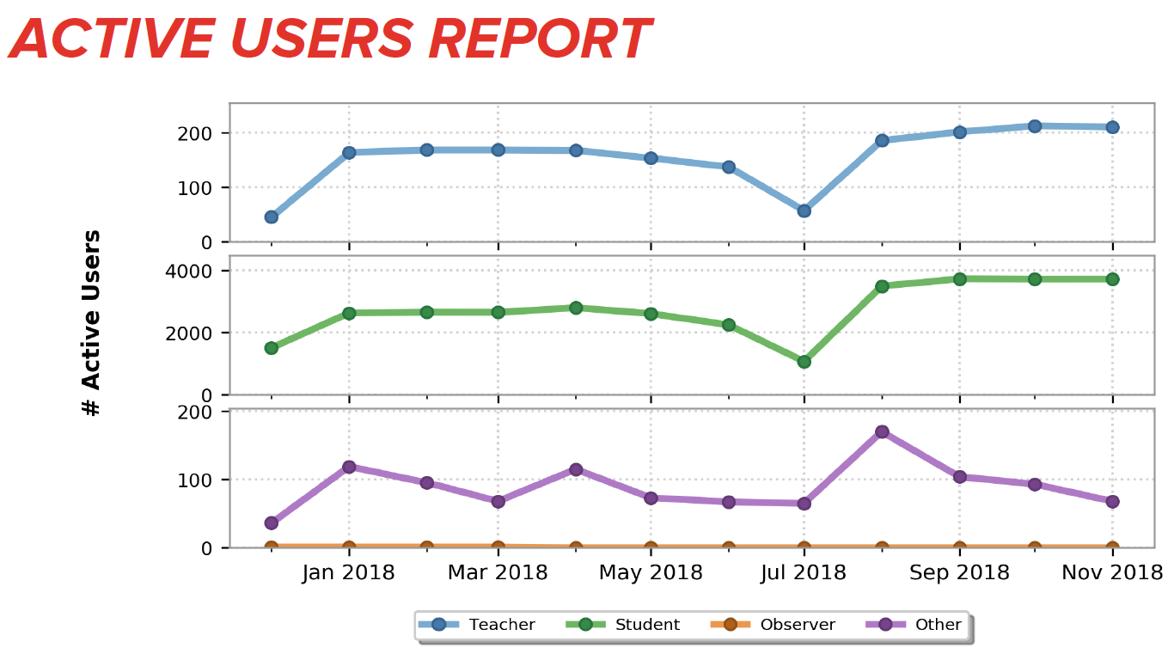
Students’ top 3:
CANVAS

Slide 30
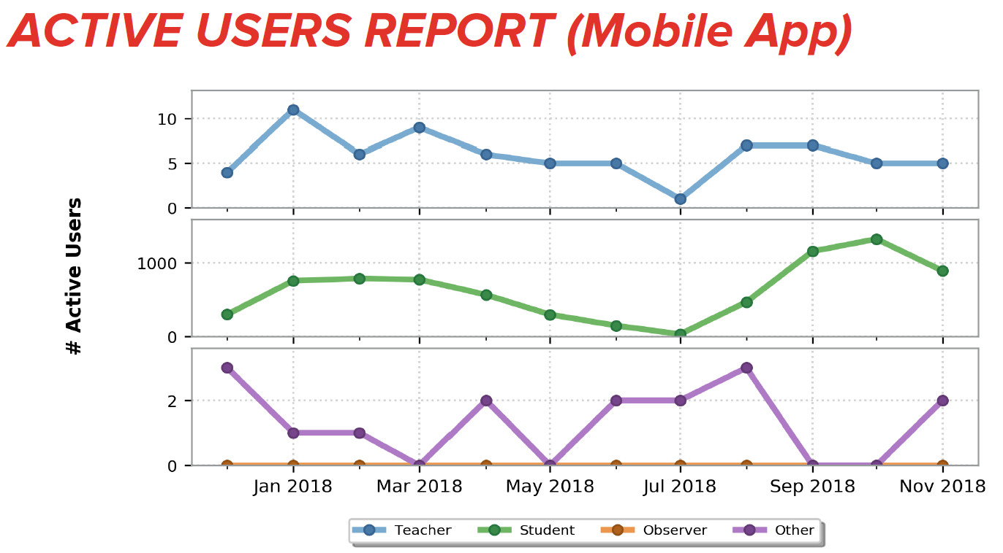
Students’ top 3:
CANVAS

Slide 31
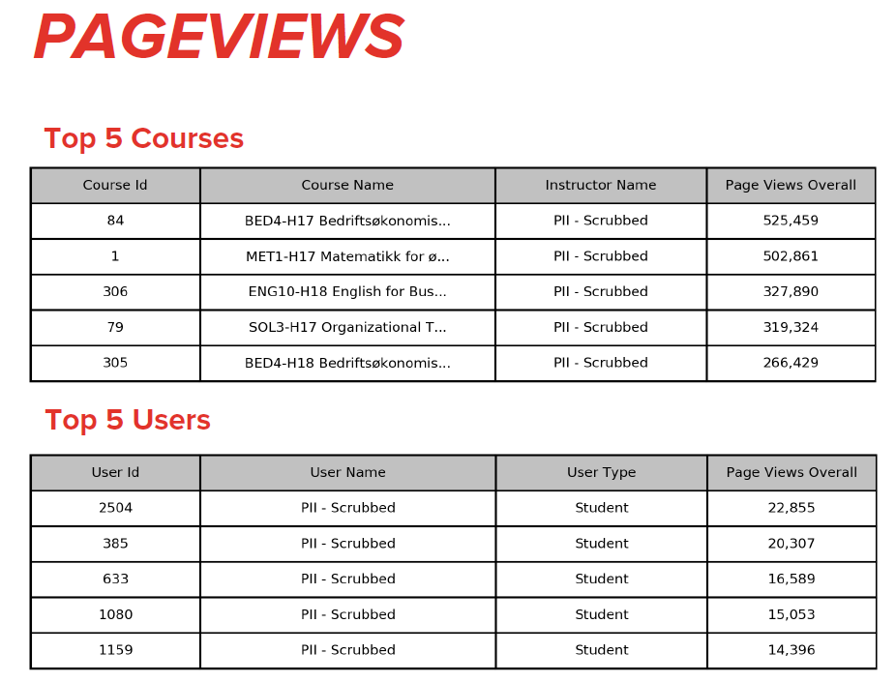
Students’ top 3:
CANVAS

Slide 32
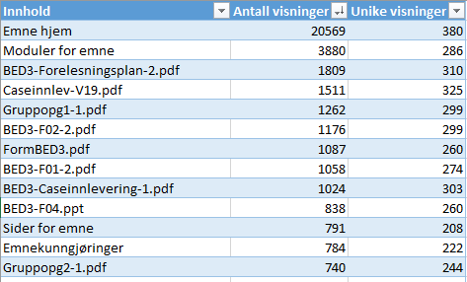

Students’ top 3:
CANVAS
  What are the students saying?
    We use «everything» course related, but mainly lecture notes and video (if available)
    Challenge: Courses are structured in different ways – some in a very orderly fashion, some not
  Which content is used in my course?
    On your home page, click:
    It’s also possible to extract details about the use of
    content. Example from BED3:

Slide 33



Students’ top 3:
VIDEO
  Mainly lecture captures (video.nhh.no / microsoft stream / adobe connect)
  …but increasingly also shorter videos / screen recordings (Canvas Arc, youtube, vimeo)
  How / why are the students using videos?
    Flexibility – if you are unable to attend (classes that «collide», illness, etc.)
    Repetition – recapitulate the difficult parts
    Preparation – revisit content before the next meeting

Slide 34
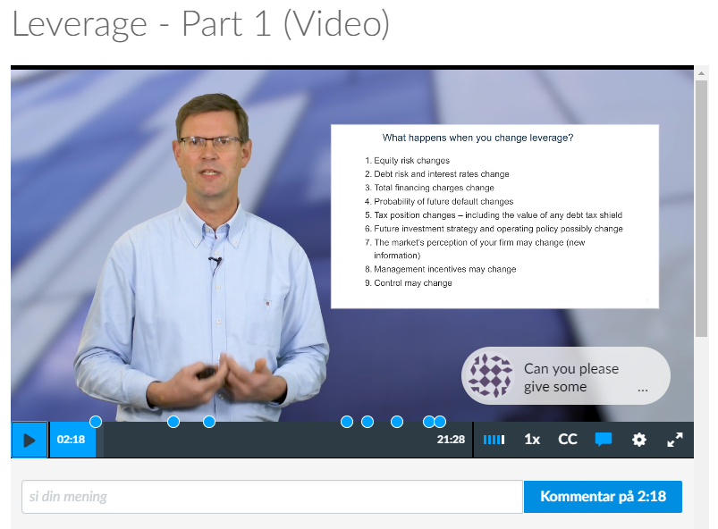
Flipped Classroom Example: FIE428
Recorded in our studio with prompter
and green screen
Published in Canvas using Arc
Aksel published the videos before he
met with the students
…and discussed feedback / comments
on the video timeline in class

Slide 35
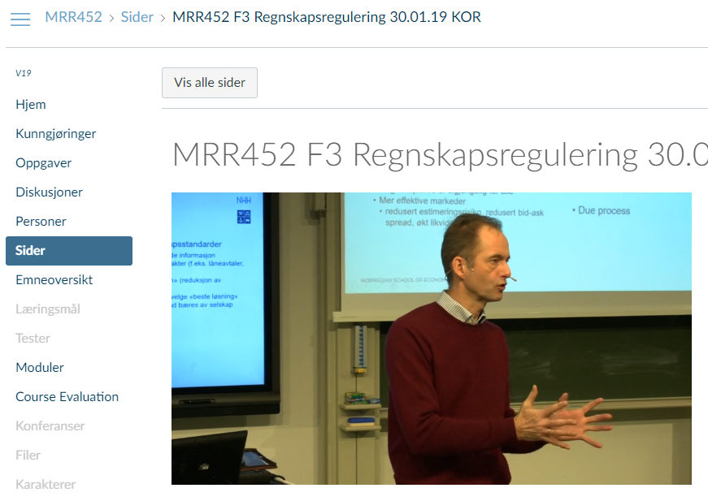
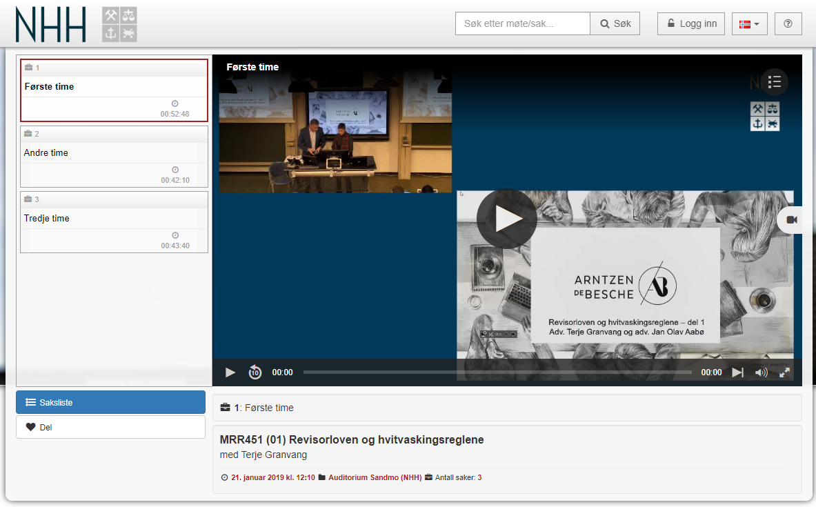
Live Stream: MRR Oslo
Using Vimeo and/or stream.nhh.no
Embedded in Canvas
Produced ‘live’ with a 3-camera setup,
and a digital source
Available for playback immediately:

Slide 36
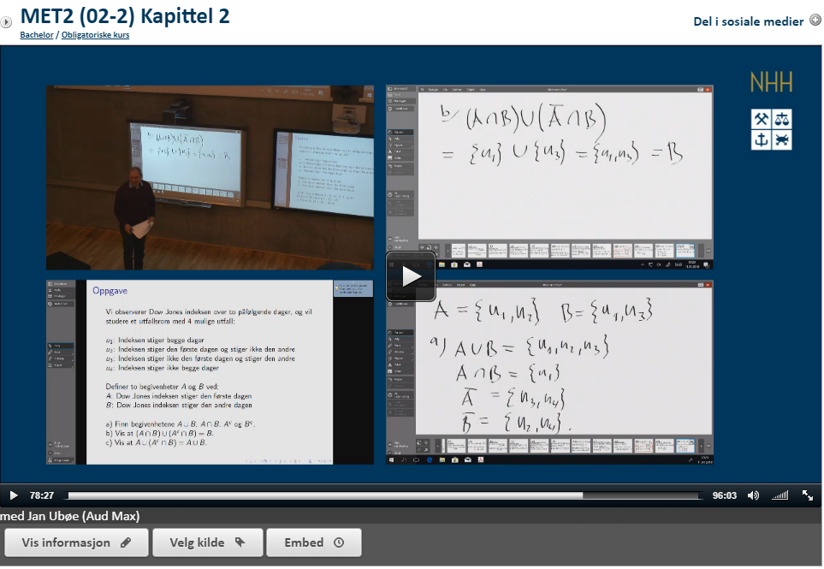
Lecture Captures
Approx. 30 courses this semester
Embedded in Canvas
..but also searchable at video.nhh.no
User statistics limited – clicks only
Old solution (Flash based)
Currently testing new solution
(MediaSite)

Slide 37

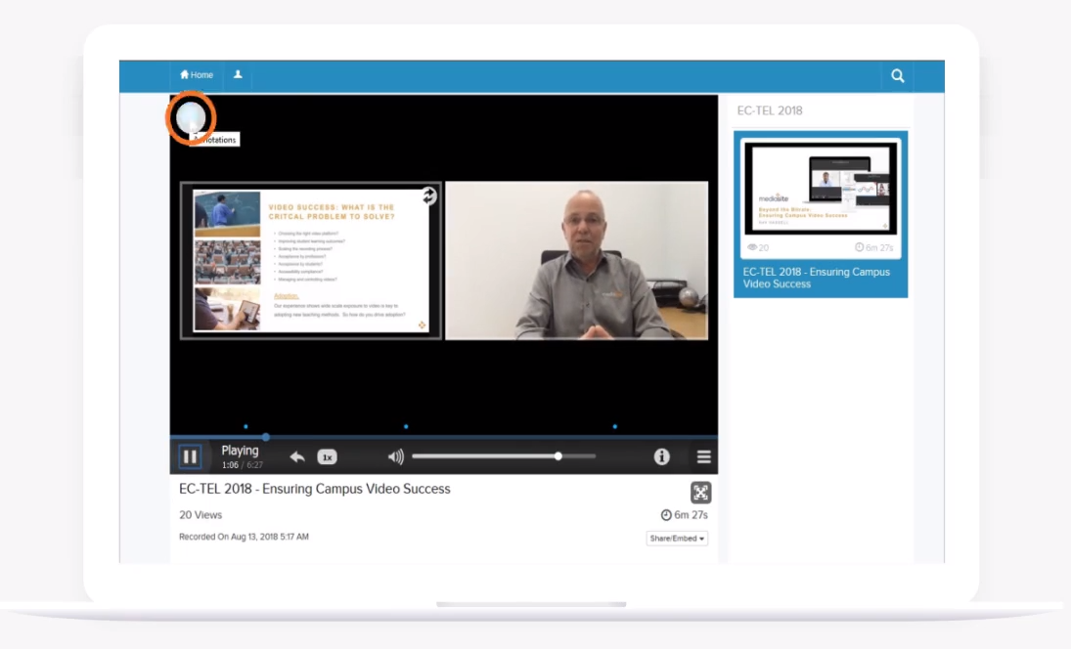
Mediasite
Cloud-based service provided by UNIT
Plugged into Canvas (MyMediasite)
Possible to integrate with TimeEdit,
our scheduling system
You own your recordings and decide
when and how to publish
Possible to add quizzes and
comments (similar to Arc)

Slide 38
Students’ top 3:
Other tools – most used:
  YouTube (videos where basic concepts are explained, e.g. Khan Academy)
  Google Docs (for co-writing)
  Office 365 (Word, Excel, Powerpoint, OneDrive)
  E-mail
What do the students miss?
  Videos where elementary concepts, models and/or methods are explained
  Improved video player for lecture captures (playback, functionality)
  Better use of Canvas – similar structure throughout, «easy to find» content
  Progress bar in Canvas – what is my progress?
  Possibility to ask questions digitally – anonymous if possible
  A podcast or blog where current events are related to course topics
  More – and different forms of – digital assessment, e.g. cases

Slide 39
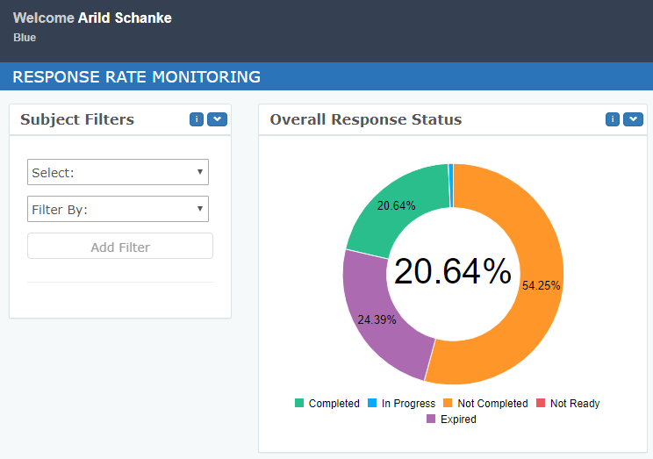
CANVAS – WHICH PLUGINS DO WE USE?
URKUND (Plagiarism)
TimeEdit (Synchronizing courses and
course schedules)
ARC (Video module)
BLUE (Course evaluations)
…and some course specific tools

Slide 40






CANVAS – What’s on the horizon?
Plug-ins:
  EdWord (Feedback on assignments)
  Leganto (Curriculum)
  Zoom (Video Conferencing)
  Blackboard Ally (Universal design)
  Portfolium (ePortfolios)
  Badgr (Gamification/Progress)
Other relevant concepts:
  Autotexting video (Universal design)
  Canvas to FS two-way synchronization – including registration of course requirements

Slide 41
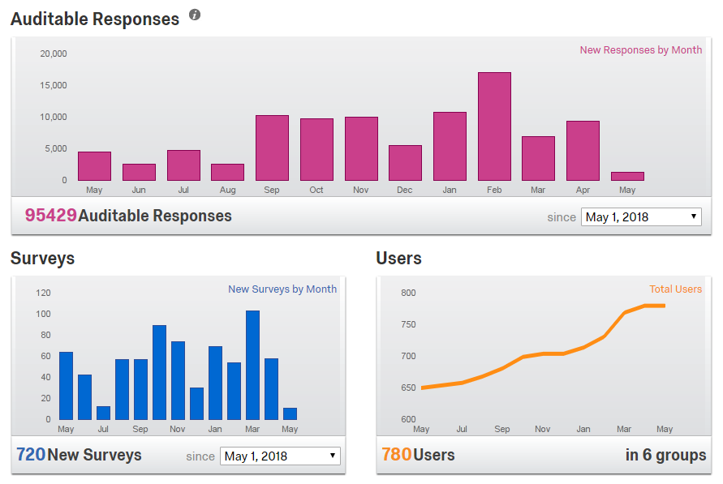
OTHER SYSTEMS IN USE
Polling / Quizzing:
  Kahoot!
  Socrative
  Padlet
Surveys
  Qualtrics

Slide 42
Questions?
Curious about any of this?
Want to know more?
Contact us!

Slide 43
Information from June board meeting

Slide 44
June NHH Board meeting – highlights
Financial report Q1 & long term budget
NHH language policy
Research report 2018
Report on media coverage and ‘expert commissions’ in 2018
NHH funds

Slide 45
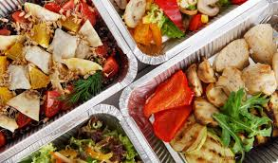
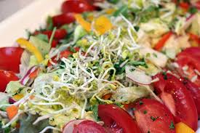
LET’S DO LUNCH!
Now (13-15 o’clock)
In the student canteen

