Slide 1
Town hall meeting
7 november 2019

Slide 2

agenda
The new NHH mission – Together for sustainable value creation: Capitalizing from the mission statement, the way forward
Information from the November board meeting
NHH students in international case competitions: Mentoring and performance
Q&A

Slide 3
Capitalizing from the mission statement

Slide 4
What is NHH’s new mission statement?
Part 1
Part 3

Slide 5
The process of revising NHHs mission statement
      Broad process involving all parts of the organization
      Townhall meeting in November 2018
      Mission workshop with students and employees in February 2019
      Written input from all parts of the organization
      Mission workshop as part of the NHH board’s annual seminar in March 2019
      In the September meeting, the board decided on four short-listed candidates for our new mission statement:
English | Norsk
Together for sustainable value creation | Saman for berekraftig verdiskaping
A driving force for sustainable value creation | Ei drivkraft for berekraftig verdiskaping
Shaping knowledge for sustainable value creation | Forme kunnskap for berekraftig verdiskaping
A driving force for responsible value creation in business and society | Ei drivkraft for ansvarleg verdiskaping i næringsliv og samfunn
Notes:
Working group: Sigrid Folkestad, Astri Kamsvåg, James Hocea + Linda N.

Slide 6
New NHH Mission
Vote:
  Together for sustainable value creation, 41,5%
  Shaping knowledge for sustainable value creation, 32,9%
  A driving force for sustainable value creation, 13,8%
  A driving force for responsible value creation in business and society, 11,8%

Slide 7
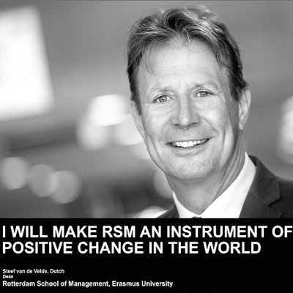
Inspiration – Rotterdam School of Management (RSM)
RSM mission statement:
«To be a force for positive change in the world»
The «I will» initiative:
Starting today think of yourself as a leader of tomorrow’s world. Living, thinking and acting in the future tense. What will you do?
That is the essence of I WILL: a manifesto that expresses the spirit of the people of Rotterdam School of Management, Erasmus University.
A community of individuals who are making a commitment – saying I WILL – to the future we want to create.

Slide 8
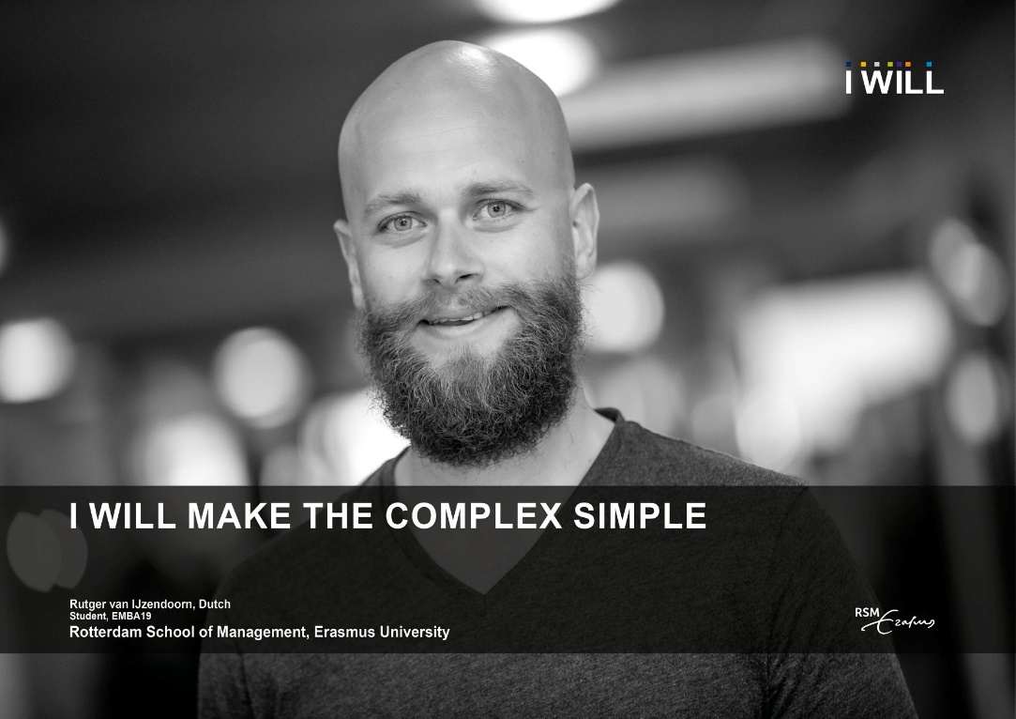
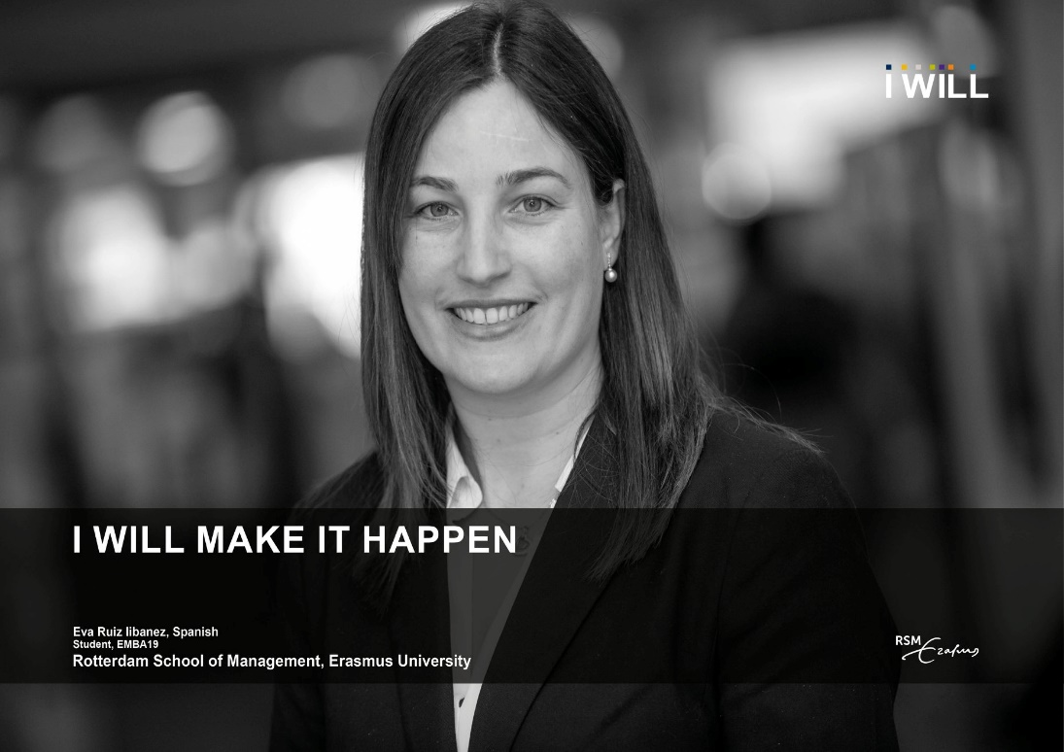
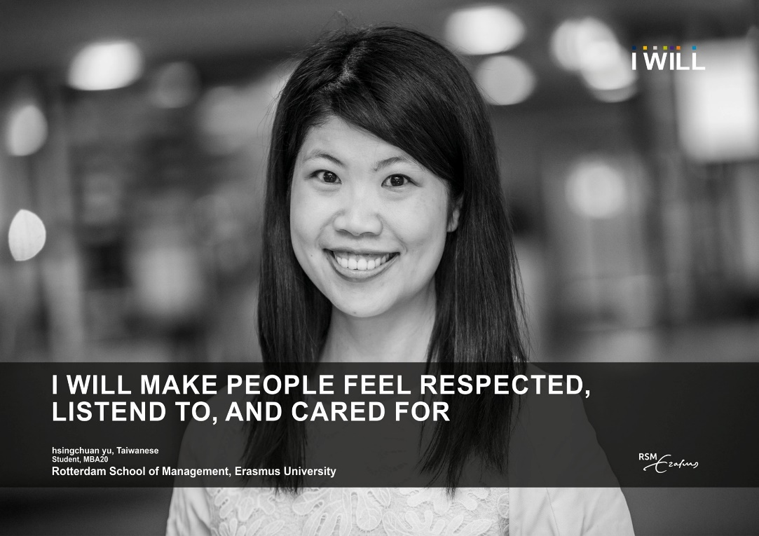
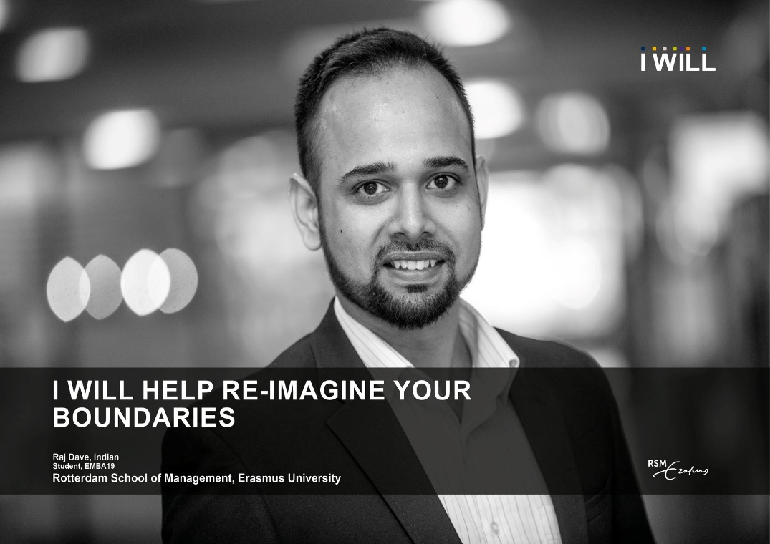

Slide 9
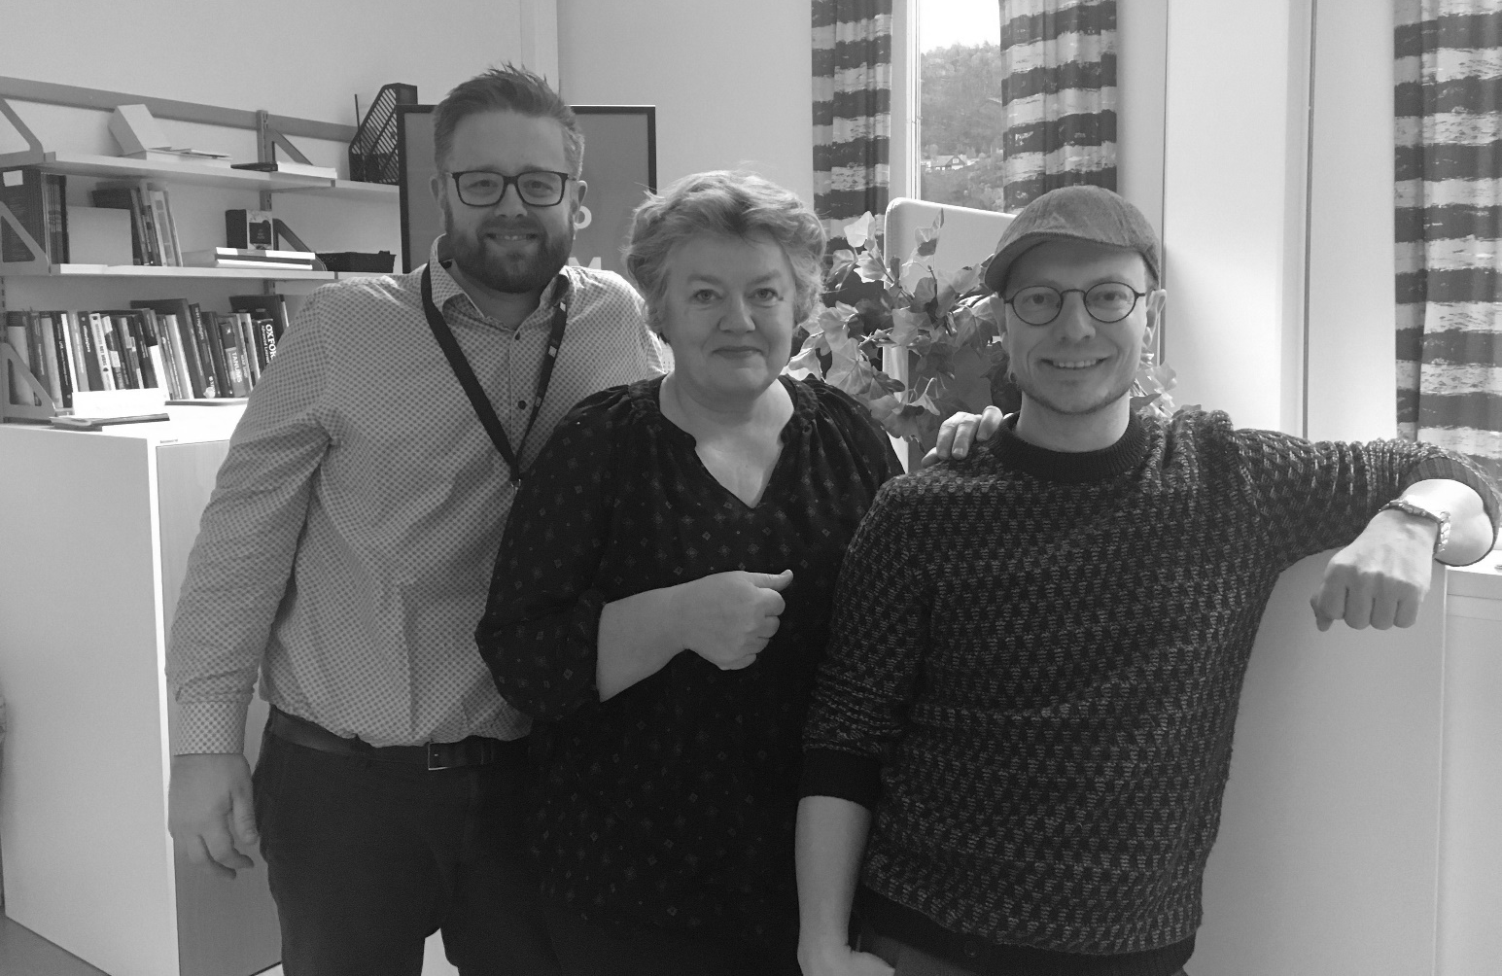
Together we will… // Sammen vil vi….
3 minutes buzzing with the person sitting next to you
Come up with your own sentence
Send us your sentence using slido.com
Enter slido with the code: K194
https://app.sli.do/event/wmwqdf9u
TOGETHER WE WILL CONTRIBUTE TO NHH ACHIEVING AACSB ACCREDITATION
Kjetil Sudmann Larssen, Merete Ræstad and Brigt Ove Vaage

Slide 10
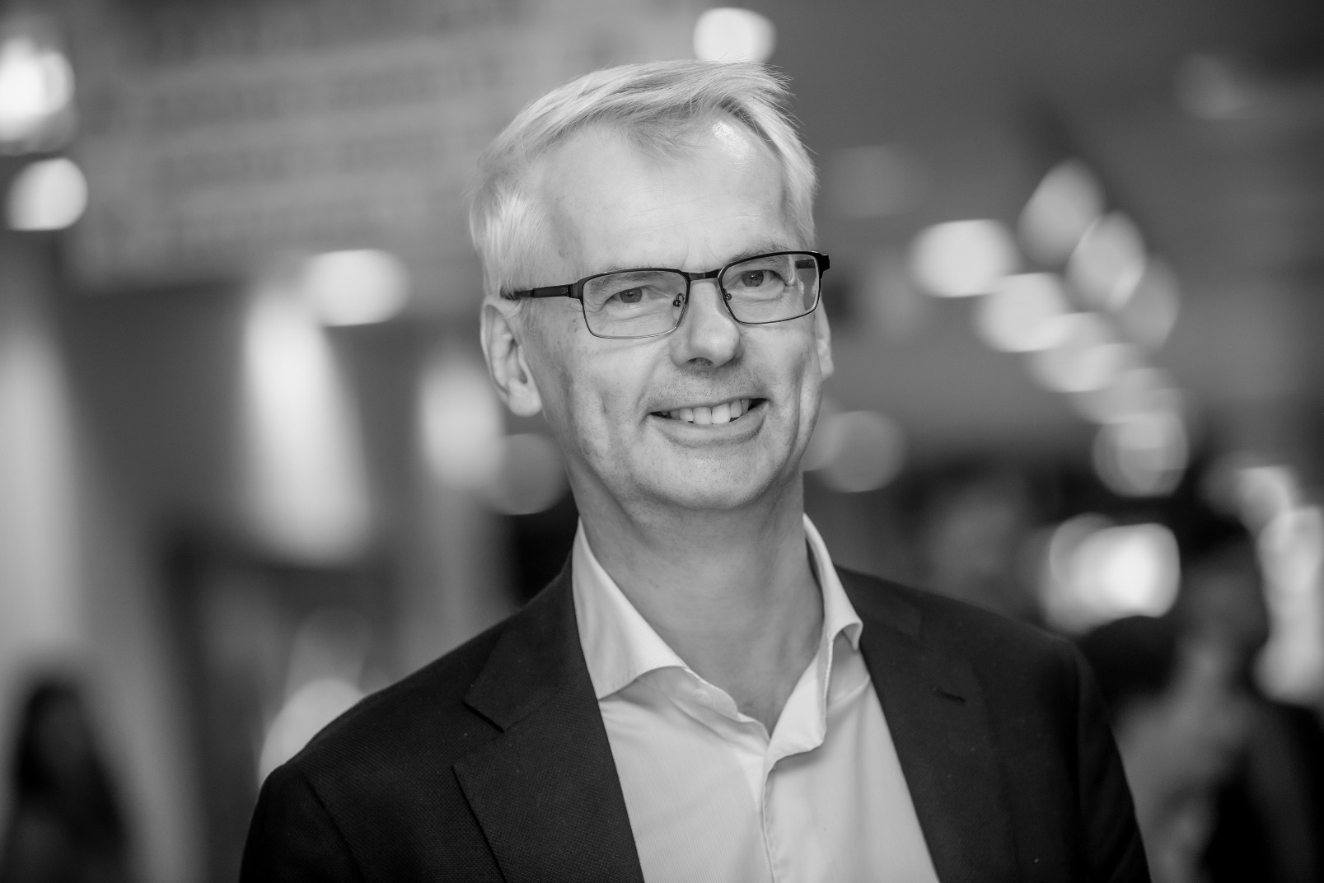
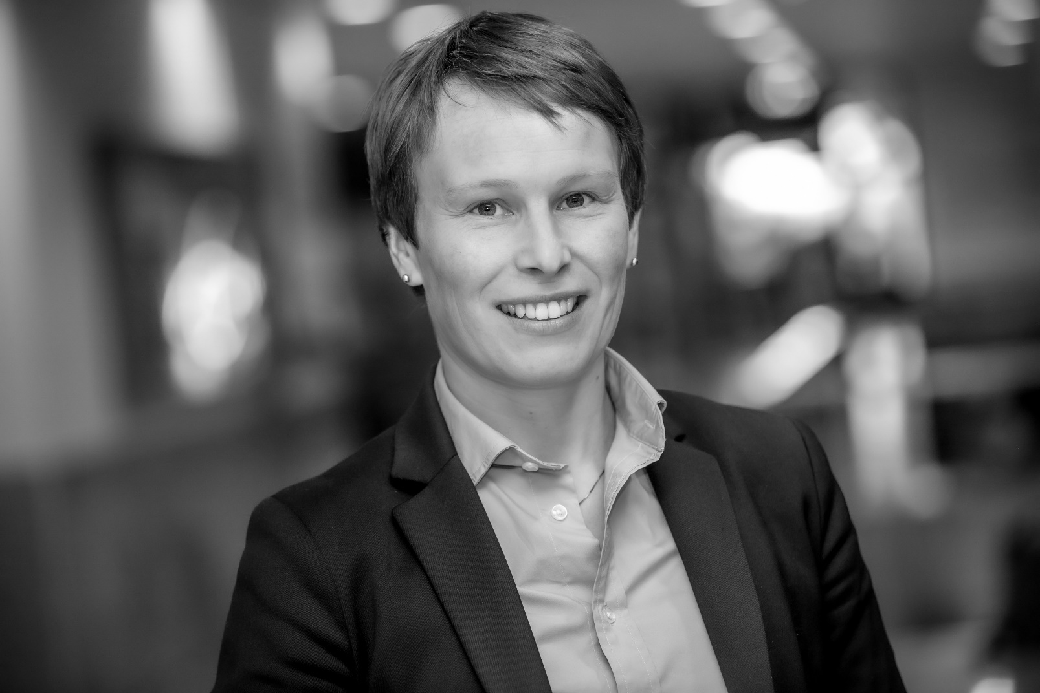
TOGETHER WE WILL… BRING NHH TO NEW HEIGHTS
TOGETHER WE WILL…… BRING NHH TO NEW HEIGHTS

Slide 11
Information from the November board meeting

Slide 12
November NHH Board meeting – some highlights
NHH in the process to be certified as a «Miljøfyrtårn» (a public certification scheme for an environmental approach to our operations)
The annual report on this year’s student enrollment
The annual report from the «Learning Environment Committee»
This semester’s progressreport on strategic priority areas – performance and risks
First round – the NHH budget for 2020

Slide 13
NHH students in international case competitions

Slide 14
Case Club
Club founded in the Spring of 2016
Currently has around 35 members
Activities:
  Weekly training sessions
  Participation in national competitions
  Participation in international competitions
Initial goal: to participate in the Champion’s Trophy.

Slide 15
International Case Competitions - Format
12-20 teams compete.
Schools from:
  Europe: BI, Aalto, CBS, Maastricht, Belgrade, Münster…
  North America: USC, Penn State, Florida University, HEC Montreal, Alberta, UCLA,…
  Oceania: UNSW, Melbourne, Queensland, Auckland, Monarch…
  Asia: NUS, HKUST, U. of Hong-Kong, Thammasat, Nanyang, Tsinghua
24-hour case.
4-5 teams in a semi-final; one advances to the final.
15-minute presentation followed by a 15-min Q&A.

Slide 16
My role: coach/mentor
I was brought in as the coach in the beginning of 2018.
Reasons for a coach:
  The team was not reaching the finals.
  They felt they were lacking skills in the financials.
Role:
  Help the “Financials” person.
  Occasional workshops for the entire club.
  Interviews for the international competitions.
  4-6 week training prior to an international competition.
  I attend the international competitions.

Slide 17
Mountain to Climb
Small club
3-year bachelor
Teaching in the bachelor is not case based
2-3 competitions per year
Informal structure backing the club
English is not our students’ first language
But, we have driven, motivated, smart and hard-working students!

Slide 18
International Competitions in the Last Two Years
2018 – Scotiabank ICC
2018 – NHH ICC
2018 – GBCC at Ritsumeikan
2019 – Heavener ICC
2019 – NHH ICC
2019 – Thammasat UBC

Slide 19
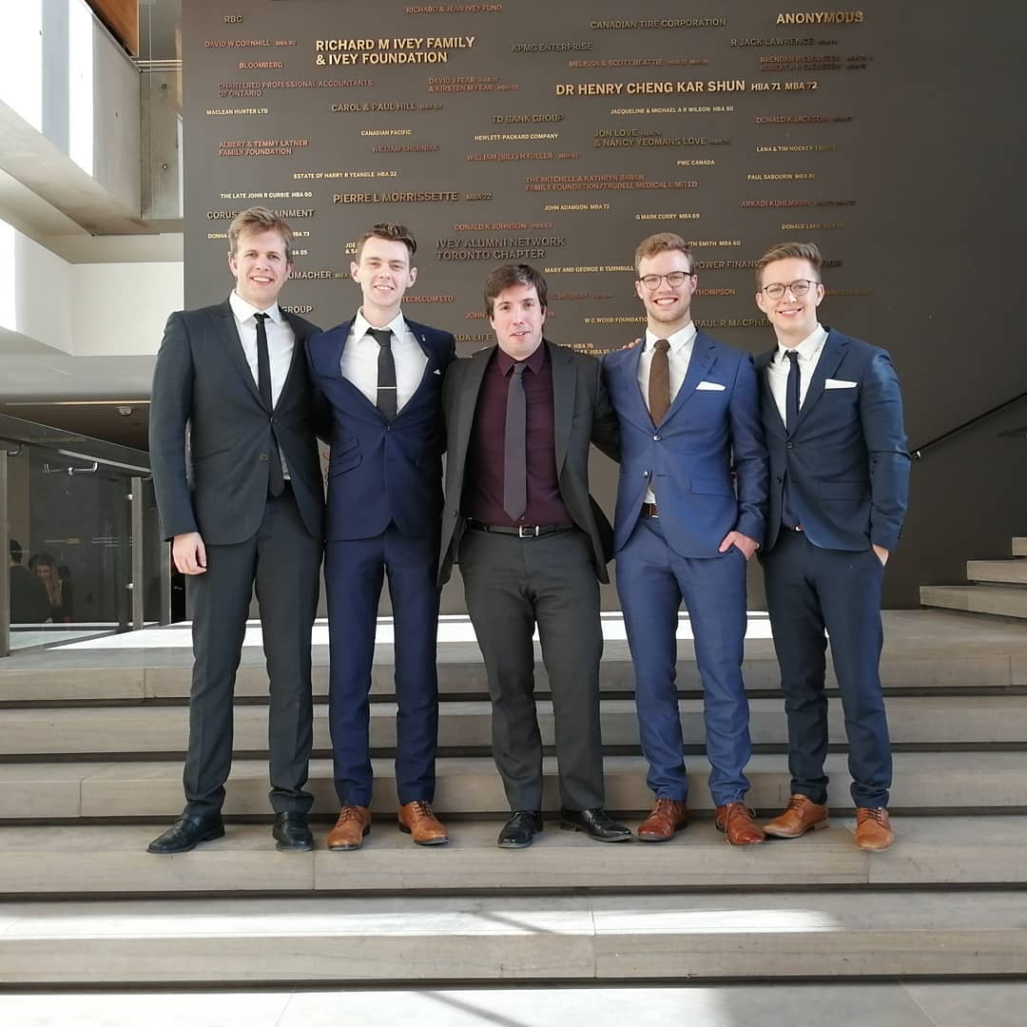
Scotiabank ICC

Slide 20
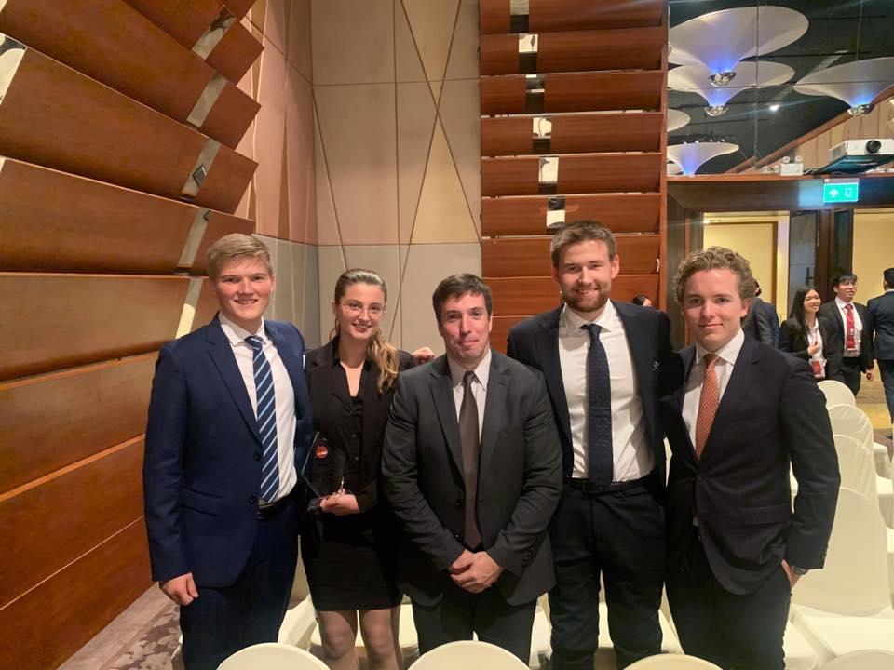
Thammasat UBC
Initial goal achieved: we are in the Champion’s Trophy.

Slide 21
Moving Forward
Grow the club
Tentative idea of going to the bachelor’s program with a case course
Attend more competitions – constraints:
  Budget
  Students willing to participate
  Coach availability
Continue with the learning and achieve the same success.

Slide 22
Q&A

Slide 23
20 December: town hall meeting and Christmas lunch

