Slide 1
TOWN HALL MEETING
2 may 2019

Slide 2

AGENDA
Internal communication at NHH
– objectives and mechanisms
Processing personal data and NSD requirements
National survey – harassment
Social events at NHH
Q&A

Slide 3
Internal communication at NHH
– objectives and mechanisms

Slide 4
INTERNAL COMMUNICATION AT NHH
– OBJECTIVES AND MECHANISMS
Objectives: Provide relevant information to all members of our organisation
      Timely information
      Efficient channels and mechanisms
      Accurate information
Why?
      Direction and reason
      Relevant and accurate information is a pre-requisite for doing a good job – individually as well as collectively
      Efficiency of our organisation, quality of internal communication impacts quality of external communication
Mechanisms and channels
      Management responsibility – at all levels, but also an individual responsibility
      Meetings of many types
      «Paraplyen», minutes from meetings, newsletters, various other types of written material
      NHH web pages

Slide 5
Internal communication
Department of economics, Eilif Fjon

Slide 6
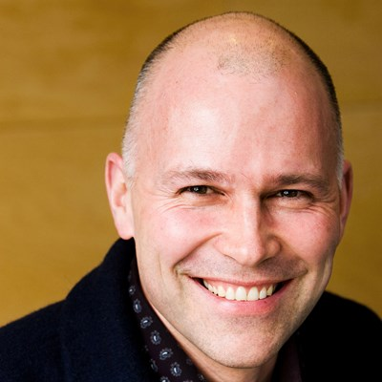
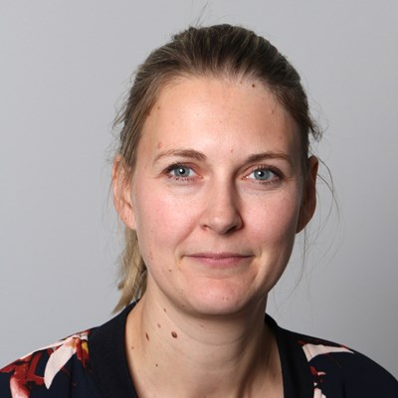

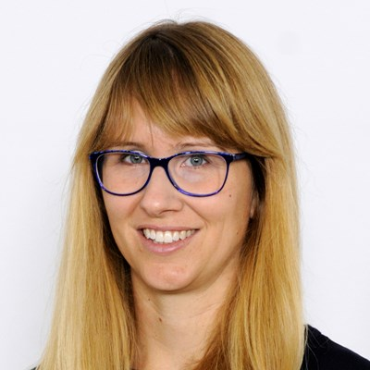




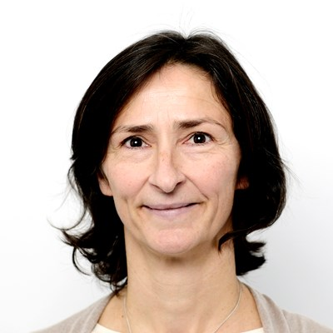


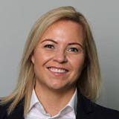
PRIORITIES AND OBJETCTIVES
Responsibility
Need for information
Involvement and engagement
Openness
Quality and quantity
Fewer channels
Culture

Slide 7
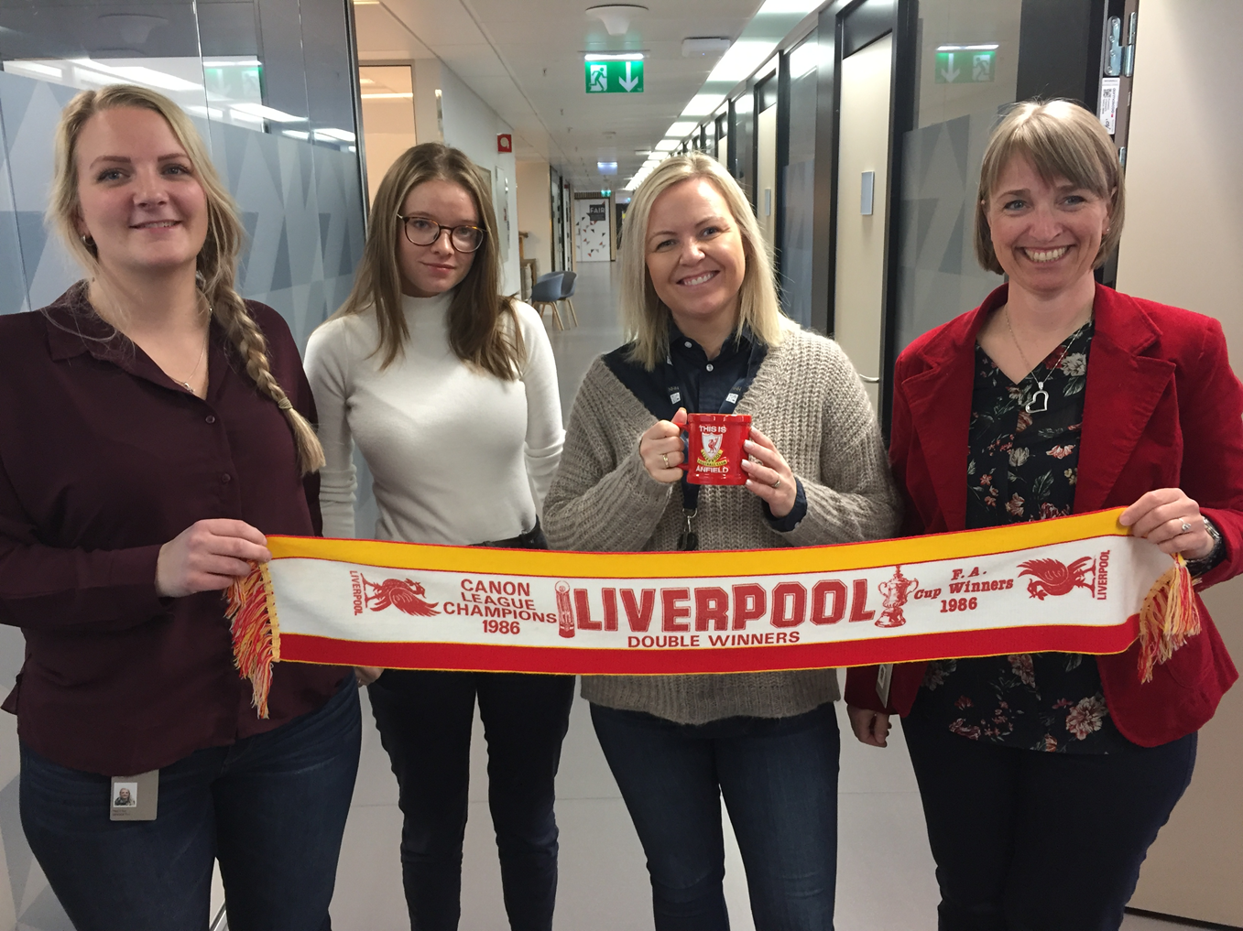
COMMON AND UNIFIED CULTURE

Slide 8
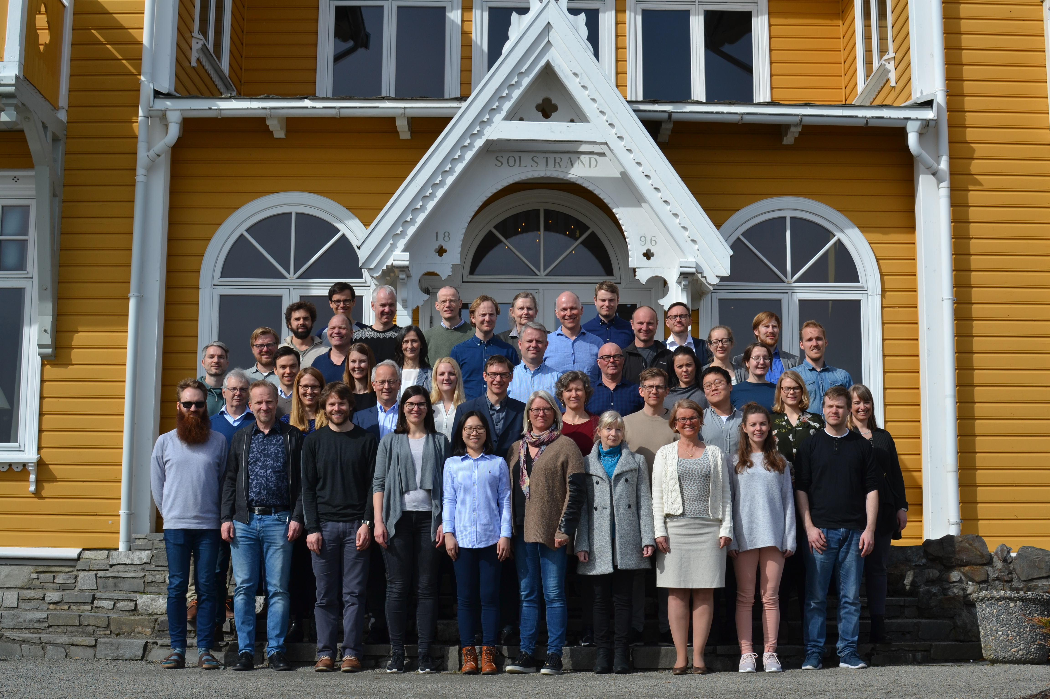
COMMUNICATION CHANNELS AT THE DEPARTMENT OF ECONOMICS
Meetings, email, employee appraisal interviews, conversations etc.
Faculty & staff meetings: Once a month
Strategy seminar –
once a year
Kick off every autumn
Newsletter

Slide 9



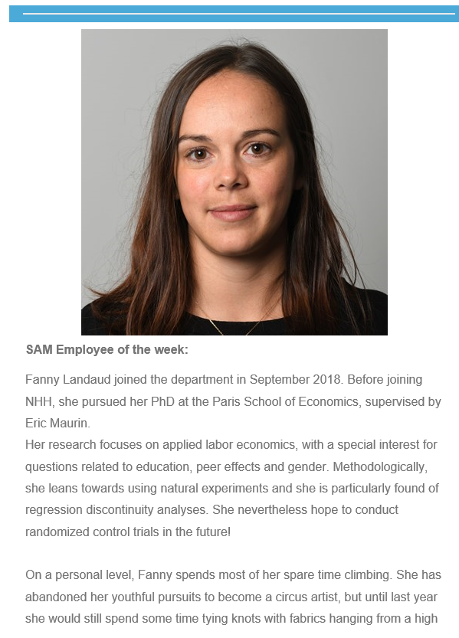
NEWSLETTER
Results
  Read by many
  Positive feedback
Recourses
  Published every week (except holidays and feasts)
  A designated staff member produce and publish
  Time consume:
  Approximately 6 hrs. pr. week
Content
  Regular columns
  Low threshold

Slide 10

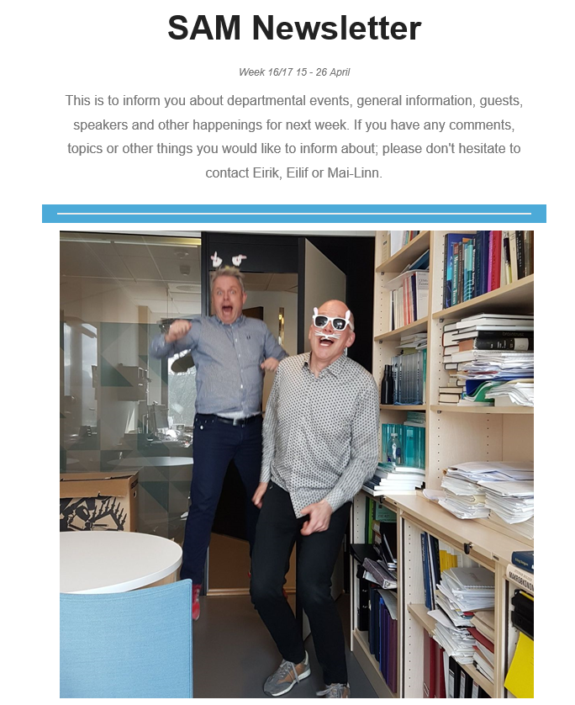

Slide 11
Paraplyen and other channels for Internal communication
Office of communcations and marketing, astri kamsvåg

Slide 12
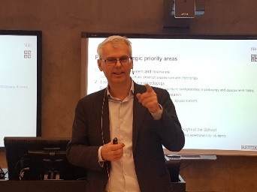
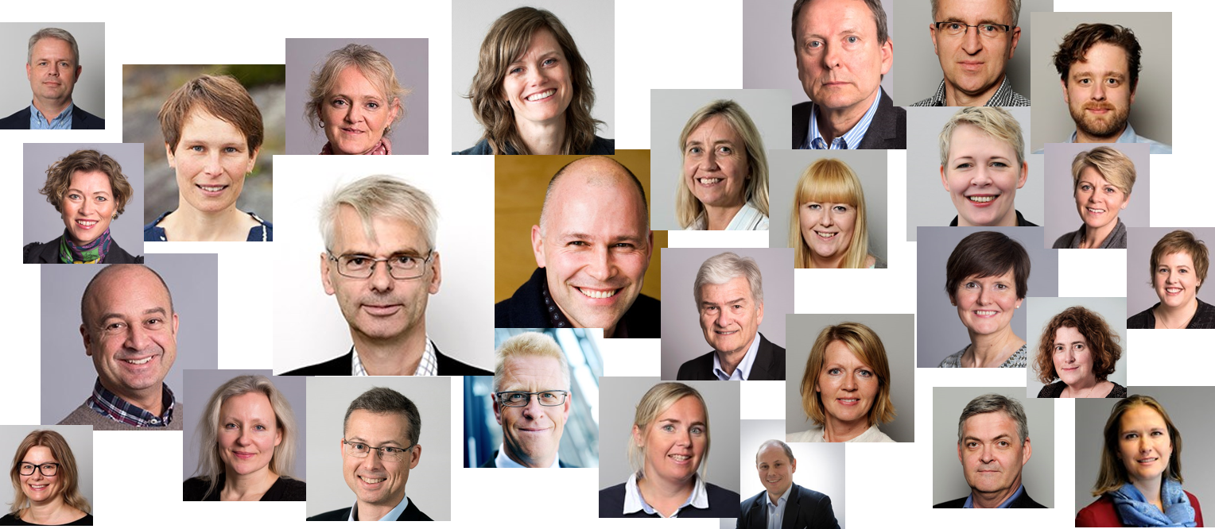

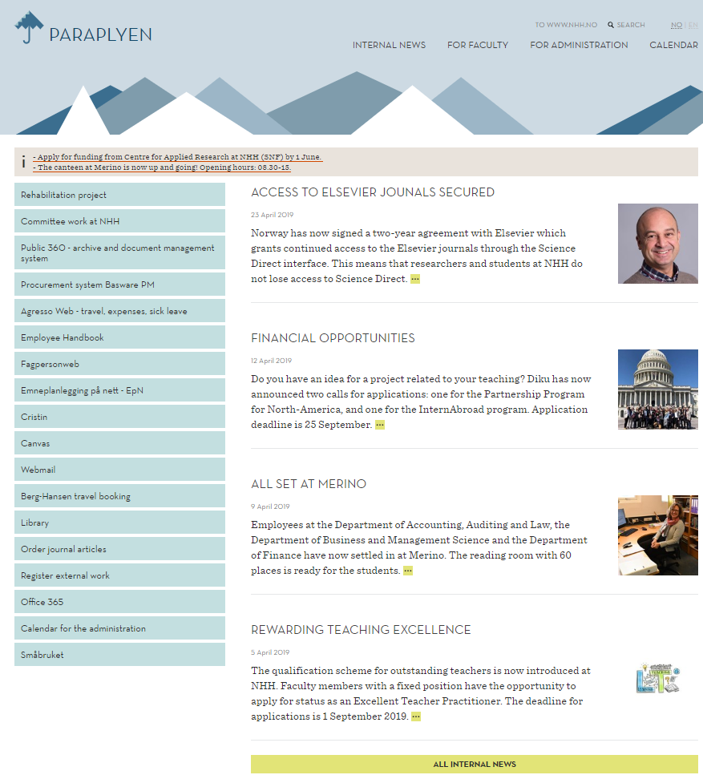
INTERNAL COMMUNICATION CHANNELS AT NHH
Town hall meetings
Leaders and managers
Email and newsletters
Paraplyen

Slide 13
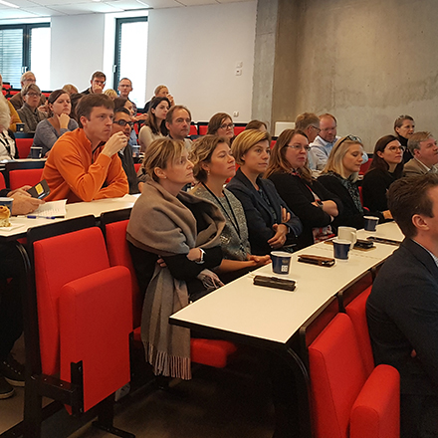

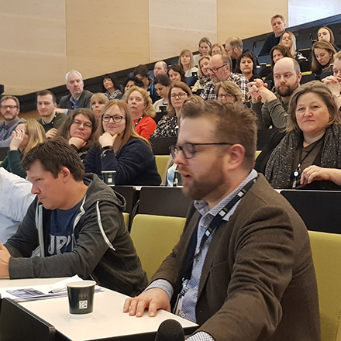
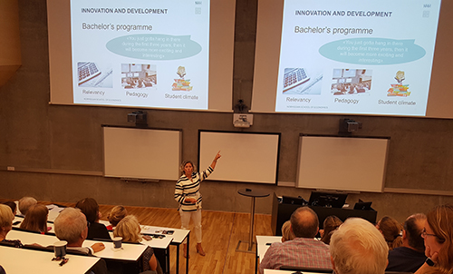
1. TOWN HALL MEETINGS
Rector’s information meetings + Q&A
Fresh news from the Board
Survey autumn 2017
Strengthen internal culture across units
Everyone gets the same information from the same source at the same time
Goal:
give employees increased insight into strategically important matters

Slide 14

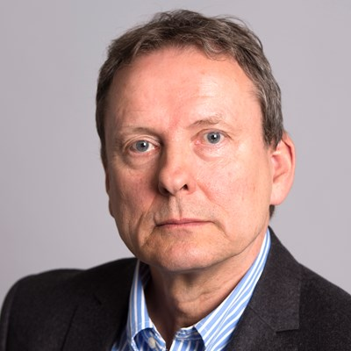



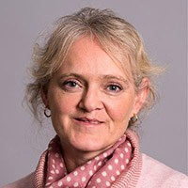
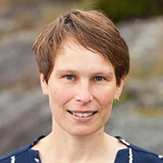
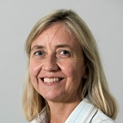
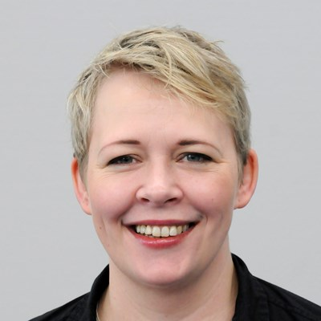

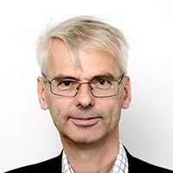

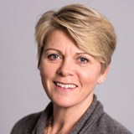
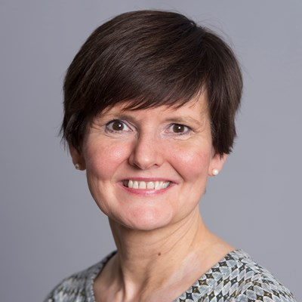

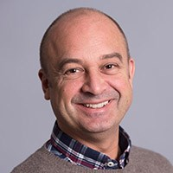
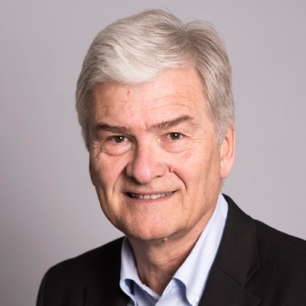
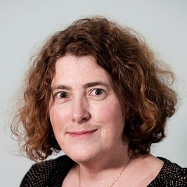

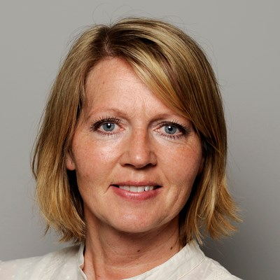


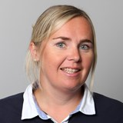
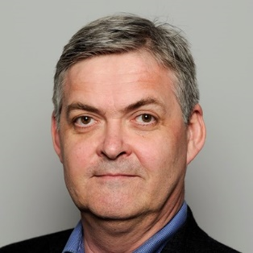
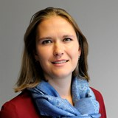

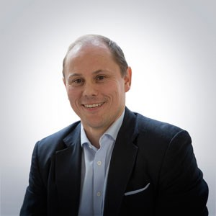
2. LEADERS AND MANAGERS

Slide 15
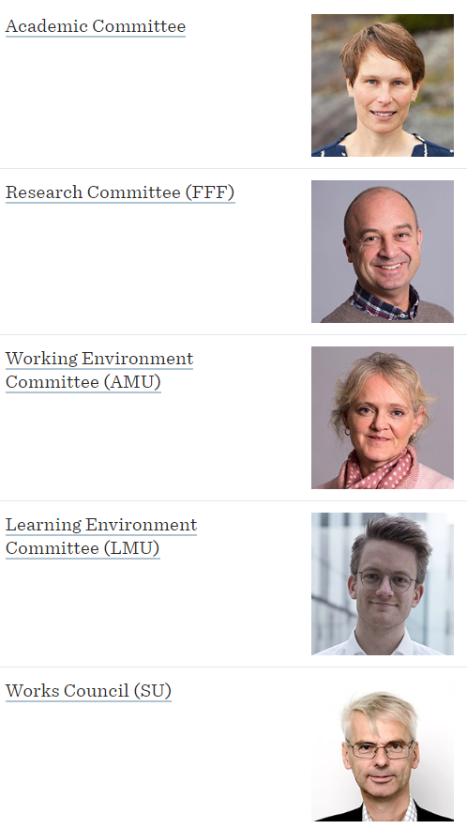
MANAGEMENT MEETINGS AND COMMITTEES
Management meetings
Heads of Department Forum (ILF)
Heads of Office Forum (ALF)
Extended Management Forum (ULF)
Goal:
- inform about decisions and background for decisions
- strategic priorities
Committees

Slide 16
3. EMAIL AND NEWSLETTERS
a supplement to other channels
links to other sources (Paraplyen, nhh.no etc)
- quite efficient: direct access to the recipients’ attention in their private mailbox
- more targeted than town hall meetings
Goal:
- information
- call to action

Slide 17
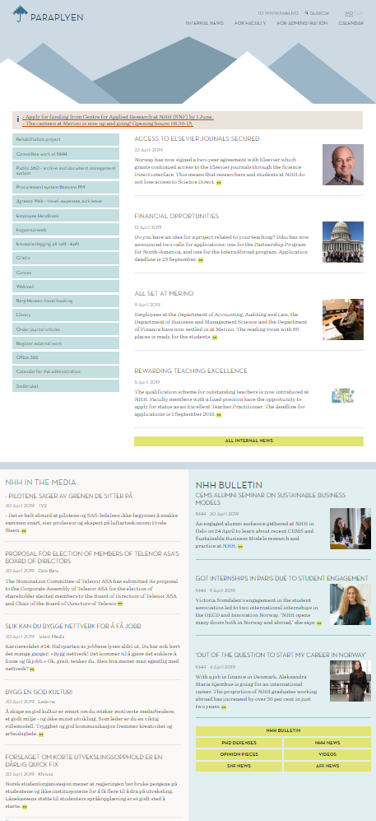
4. PARAPLYEN
Internal news
Static information pages
Links to digital tools
Feeds:
- external NHH news
  press cuttings
  calendar events
All this in one page!
(use the scroller to get it all)

Slide 18
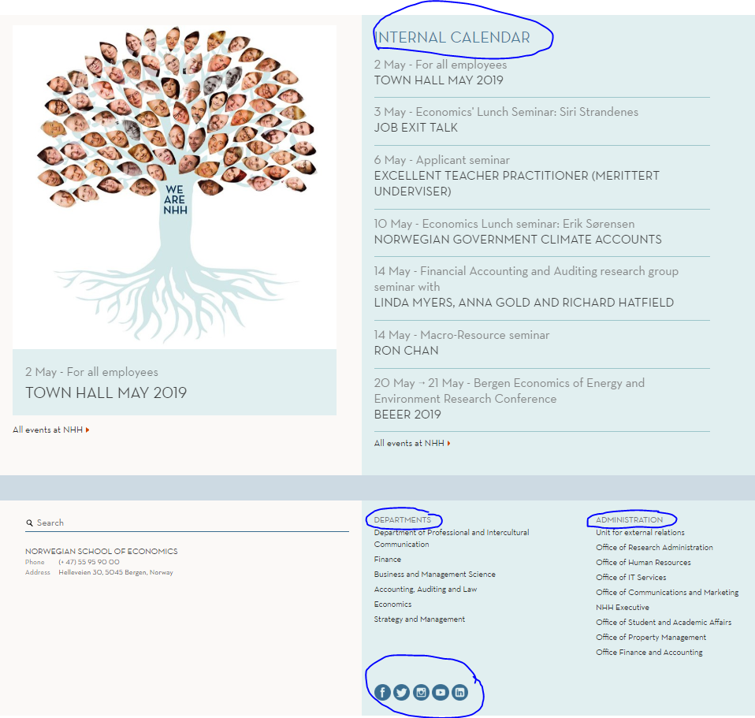

Slide 19
HARD FACTS PARAPLYEN
Category | 2019 1 JAN-30 April | 2018 | 2017
News articles per week No | 4.9 | 3.3 | 2.8
News articles per week Eng | 2 | 1.7 | 1.4
Page views Eng-No | 53,000 ->211,000? | 174,000 | 173,000
Searches Eng-No Jan-Apr | 8,300 | 4,200 | -

Slide 20
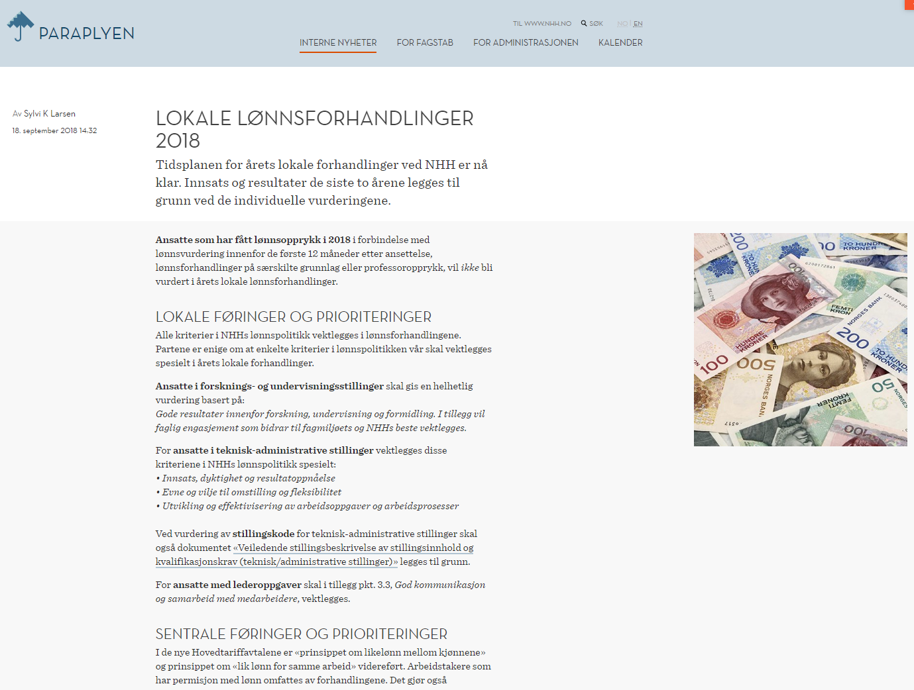
MOST POPULAR ARTICLE JAN 2018-APR 2019

Slide 21
WHAT NOW?
Are we happy with the channels we have?
How can we all contribute to communicating better?
How can we use internal communication as an even better strategic tool to reach NHH’s ambitious goals?
How can we improve the flow of information to relevant stakeholders?
How can we integrate internal communication in all our activities?
Plans for 2019-2020 include:
  involving you more through survey(s)
  measuring the effect of our internal communication
  measuring NHH’s internal communication maturity

Slide 22
Processing of personal data in master’s theses and research projects – a Quick overview
Data protection officer Monica nielsen øen

Slide 23
THE OVERALL PICTURE
GDPR (General Data Protection Regulation) was introduced July 2018 in Norway (EEA)
NHH must follow the rules (reputation and sanctions (max. 20 mill. euro)
Part of research ethics
Need of assistance in navigation – effectiveness – must be improved
Important collaborators:
  NSD (Norsk senter for forskningsdata) – NHH has an agreement that covers privacy consulting
  SSB (Mikrodata/Microdata)
  REK (Health Research/Health Research Act)

Slide 24

THE DATA PROTECTION OFFICERer (DPO)
New role related to the introduction of GDPR – required within the Public Sector
Independent role
Tasks (example)
  Give advice regarding the processing of personal data within NHH (law and obligations)
  Provide an overview of the activities related to processing of personal data (both research and admin)
  Check if these activities are in compliance with the law
  Inform and train employees within the area of processing personal data

Slide 25
MASTER’S THESIS
Will you be processing personal data? (NB! personal data also includes sound recording)
  Register/notify the project with NSD - required
  If use of SSB data
    (Mikrodata – make sure you have a good description of your project,
    Microdata – outside GDPR/easier process/No need of registration at NSD) - limited
  If health research – also contact REK for ethical assessment (application)
  Make sure you have good information security related to the personal data you process (IT)
  The student cannot start the processing of personal data before NSD has “approved” the registration/notification
  The supervisors role

Slide 26
RESEARCH PROJECTS
Will you be processing personal data within your project?
  Register/notify the project with NSD – required
  If use of SSB data – follow the application routine towards SSB (the better quality in the documentation, the easier process towards SSB)
  If health Research – also contact REK for ethical assessment (application)
  Make sure you have good information security related to the personal data you process (IT)
  You cannot start the processing of personal data before NSD has “approved” the registration/notification

Slide 27
ADMINISTRAITVE PROCESSING
Contact DPO for registration and advice before starting the processing of personal data within your project

Slide 28
MORE INFORMATION/CONTACTS
https://www.nhh.no/om-nhh/personvern/ (only in Norwegian at the moment – will be translated and updated soon)
https://www.nhh.no/en/paraplyen/work-support/research-support/open-access-data-protection-and-ethics/ (Here you will find information on how to handle, store and protect research data. You also have access to NHH guidelines and requirements regarding privacy policy and other relevant ethical guidelines for the social sciences – under construction)
https://nsd.no/personvernombud/
https://www.datatilsynet.no/
https://www.sikresiden.no/forebyggende/behandlepersonopplysninger
https://www.ssb.no/omssb/tjenester-og-verktoy/data-til-forskning#Kriterier_for_lne_data
https://helseforskning.etikkom.no/
Please give us feedback – personvernombud@nhh.no
If you have questions – please contact either Bjarte Grønner (FAA) or Monica N. Øen (DPO)

Slide 29
National survey - harassment

Slide 30
NATIONAL SURVEY OF BULLYING AND HARASSMENT AMONG STAFF IN HIGHER EDUCATION INSTITUTIONS
Survey period from 20 May to 31 May
    Survey conducted for 26 institutions across the country, representing some 40,000 staff/employees
About a dozen “easy-to-answer” questions
    Questions related to (i) bullying/harassment in general, (ii) sexual harassment, and (iii) reporting routines
Not a whistleblowing system – reporting through the survey is not possible
    If you have experienced bullying/harassment, you should report it following the NHH reporting procedures
Survey, collected data and subsequent analyses managed by Ipsos Norway
    Data handled in a way that ensures anonymity in compliance with personal data protection legislation
National-level report presented (by Ipsos) in June
    Participating institutions can order a report at institutional level
→ More information and instructions will be provided before 17 May

Slide 31
Social events at nhh

Slide 32
Social events at NHH
The new annual get-together – scheduled for October
Summer-lunch after summer town hall
Christmas-lunch after christmas town hall
--
Christmas parties locally

Slide 33
Q&a

