Slide 1
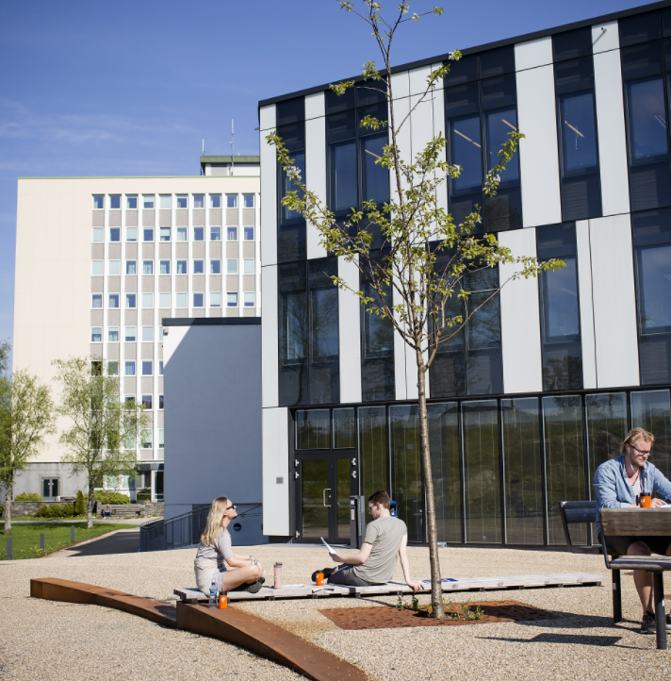
Exams
Rules and regulations
Practical details
Electronic exam in WISEflow
Tips and advice
Hilde Hognaland
Section for exams
Tatiana Pozolotina
Section for exams
Welcome to the information meeting about exams!

Slide 2
Important information
It is your own responsiblility to familiarize yourself with NHH’s examination information and regulations.
General information for students
Regulations about examinations for full-time study programmes at NHH
Course descriptions
Informational videos:
  Home exams
  School exams

Slide 3

Withdrawal deadline
Deadline for withdrawal – three weeks before the first exam/ or exam part in the course (details in Studentweb)
Withdraw before withdrawal deadline!
A no-show at an exam counts as an examination attempt, but does not appear on your transcript

Slide 4

Examination attempts
Two examination attempts per course
If you want to leave the examination room during a school exam without submitting your paper you have to sign a withdrawal form before you leave your desk
This will count as an examination attempt unless you provide a medical certificate.

Slide 5

Illness before the exam
Doctor's notice must be submitted the first business day after the exam at the latest.
Send it to exams@nhh.no (if you don't have a Bank-ID)
The medical certificate must be dated before or on the exam date, and be signed and stamped
With valid documentation you will not use an exam attempt

Slide 6
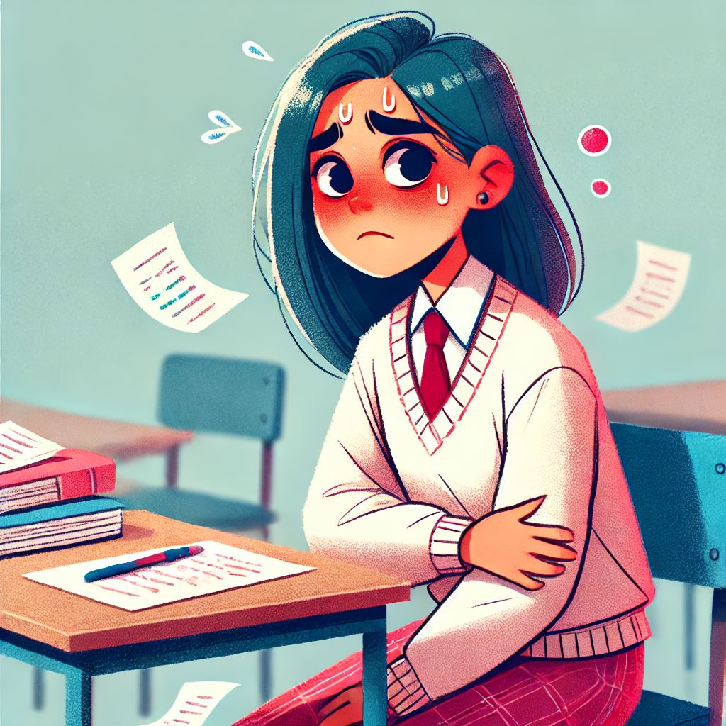
Illness during the exam
Contact the invigilator to withdraw from the examination.
  NB! The withdrawal form must be filled in.
You must then immediately see a doctor.
If you get sick during home exam, do not submit your paper/ blank paper in WISEflow, everything submitted in WISEflow will be send for assessment regardless of the doctor’s notice.

Slide 7

Failed a course, or part of a course?
All parts of a course have to be passed, to pass the course as a total and receive credits for it.
There is no possibility to hand in alternative work/do presentations/etc., if you fail an exam
You can however re-sit an exam

Slide 8

Re-sit exam
Exams are generally held only in the semester the course is taught
Prerequisite: passed compulsory activity (course approval)
Compulsory activities (course approval):
can only be passed in the semester the course is taught.
valid in the following semesters unless otherwise specified in the course description or until the requirements for passing are changed.

Slide 9
Re-sit exam
You will be tested in accordance with the most recent curriculum taught, and changes may be made to the content, curriculum and form of assessment, and course requirement.
The best result will appear in your transcript
You can still re-sit an exam after your exchange has ended, if you still have valid attempts left in the course.
You will need help signing up for it, so please send an e-mail to: incoming@nhh.no
- Before 1. September/1. February

Slide 10
Cheating
Cheating is a violation of the regulations and the University and University Colleges Act.
It may result in you being banned from NHH and all Norwegian universities and university colleges for up to two years, in addition to having your grade annulled.
It is your responsibility as a student to familiarize yourself with the regulations regarding cheating. Ignorance of the regulations is no excuse.
More information about cheating

Slide 11

Cheating at home exams, compulsory activities and other written submissions
The following will be treated as an attempt to cheat:
All citing without referencing, including your own previously submitted work
Cooperating with other participants/groups
Putting your name on a group paper if you did not contribute
All submitted papers are checked for plagiarism in Canvas and WISEflow.
Make sure you reference your paper properly
Ask the Library
PhD on Track – a useful resource for master students
For referencing: sokogskriv.no/en/

Slide 12

Cheating at school exams
Illegal support materials:
Syllabus or other academic literature if not specified by course responsible
Calculator types that are not allowed
«Cheat notes»: notes in the books that are not allowed
«Cheat sheets»
Cell phones, watches or other support materials not specified
On exams with Device monitoring: opening files, programs and accessing internet sites other than the ones allowed by the course responsible
Turing off the Device monitor during the exam
All communication with other participants during the exam will be regarded as an attempt to cheat.

Slide 13

Permitted support materials for school exams
You can only have food, drinks, ID and permitted support materials on your desk
The information about permitted support materials is
a) Provided by the lecturer on
Canvas/course description
b) Stated on the front page of
the examination question
paper
Copies and loose sheets are not permitted unless otherwise stated
Permitted support materials cannot be borrowed from other participants
Remember to turn off your cell phone
NB! Watches are not allowed

Slide 14

Calculator
If a calculator is permitted, any calculator, with the exception of calculators with wireless communication options may be used.
  You must be able to show that the memory is empty before the exam start
  User manuals are not permitted

Slide 15

Dictionary
One bilingual dictionary may be used, unless the course description states otherwise.
Electronic devices are not permitted.
Economic or legal dictionaries are not permitted.
For examination in language and law, own rules may apply - see course description.
No references are permitted in dictionaries.

Slide 16
Special examination arrangements
A student with medical conditions that give disadvantages in an exam setting may apply for special examination arrangements
Both acute and chronic conditions. Application due to seasonal allergies are only assessed as an acute illness.
For more information and application form, please refer to: Link – Documents must be attached
Application deadlines
Autumn semester: September 1
Spring semester: February 1
Acute applications are processed continuously
Notes:
If you have some condition that may give you a disadvantage you may request special arrangements. Dyslexia, severe allergies, tendinosis or similar
If something occurs right before the examination we may also accommodate. Extra time, writing on PC, standing desk. Contact us, we will guide you.
Must be documented by a doctors note.

Slide 17
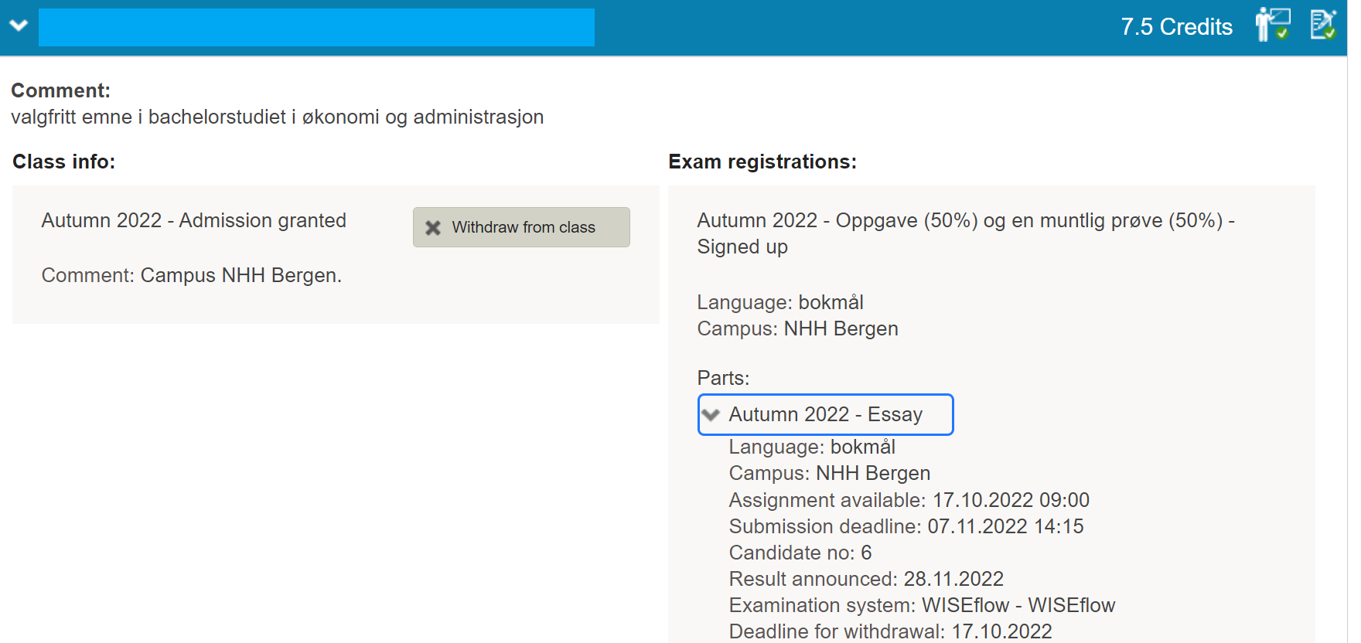
Before the exams
Exam dates can be found here: Timetables
Studentweb: Information about electronic exams, dates, examination rooms, candidate number (different for every exam) : Upcoming events

Slide 18

The day of the exam
You must meet at least 30 minutes before the examination starts (normally 8:30)
You can only have your own laptop, charger, ID, food and drink, and permitted support materials on your desk
Electronic exam: You must log in to WISEflow and open the correct flow at least 15 minutes before the exam starts
Invigilator will check your ID and get your signature after the exam start
Breaks: Get in touch with the invigilator
  You cannot leave the examination room before 1 hour after the exam start
NB! In case of late arrival at the exam you may be denied participation

Slide 19

ID
  Valid ID with a photo must be on your desk during the exam (ex. passport, driver's license).
  ID on a mobile phone is not valid!

Slide 20


Show consideration for others!
  Do not eat crispbread / strong smelling food (like mackerel in tomato and salami)
  Do not use perfume / aftershave
  Show consideration when leaving the examination room, there can be students with extra time still working

Slide 21
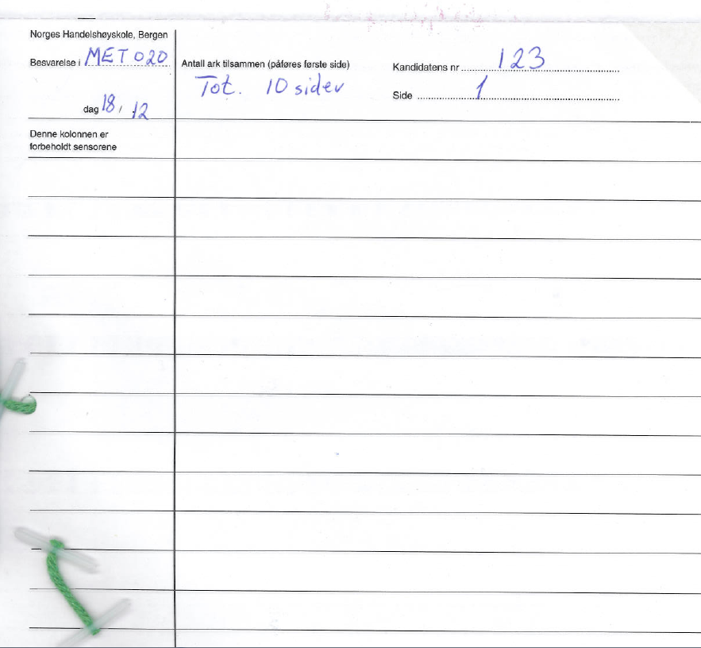
School exam on paper

Slide 22

Grades
Announced on StudentWeb and Wiseflow
Published 3 weeks after the exam. Some courses have a prolonged assessment deadline.
Grade statistics are published on StudentWeb for all exams
Grading scale: A-F (pass/ fail in some courses).
Grades cannot be converted to a different scale
If the assessment form consists of several parts: sub-grades are combined into aggregate grades (normally part grades are provided as well)

Slide 23

Grade explanation
NB! Check the assessor guide/solution guide published in Canvas before asking for a grade explanation or sending a grade appeal!
Grade explanation
Grade explanation request is sent in WISEflow.
Only one group member should ask for an explanation and then forward the explanation to the other group members.
The examiner can choose to give an explanation orally or in writing.
Deadline to request a grade explanation: One week from when the grades are published.
Deadline to give a grade explanation is two weeks from the date the explanation request is sent.

Slide 24

Grade appeal
IF you have a Norwegian BANK-ID
Fill in and submit the form here
IF you do not have a Norwegian BANK-ID:
Fill in the form
Sign the form and send to exams@nhh.no
The deadline for appeal is three weeks from the date the results are published, or the grade explanation received.
NB! Group-based assessment form: Must appeal individually.
If several in a group wish to appeal, they must fill in an appeal form individually
Oral exams cannot be appealed.

Slide 25
Grade appeal
Answer papers are sent to the appeal committee six weeks from the original grade publication date - the grading deadline for the new committee is three weeks after receiving the answer papers.
We cannot speed up the process to accommodate individual needs
Blind appeal grading
NB! The new grade can stay the same, be lower or higher than the original grade
The new grade after the appeal is final and cannot be further appealed.

Slide 26

WISEflow for participants
Introduction course

Slide 27


Types of FLOWs
School exam
  FLOWlock – with a WORD-like text editor
  FLOWmulti – an interactive school exam

Slide 28


Types of FLOWs
Home exam
  FLOWassign – uploading of a PDF-file and appendices if allowed
  FLOWhandin – uploading of different types of files

Slide 29

Types of FLOWs
Assessment and grade explanation flow
  FLOWattend – assessment registration for handwritten and
  oral exams, portfolio grades

Slide 30
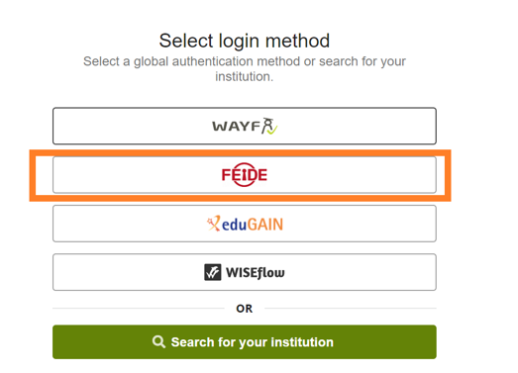
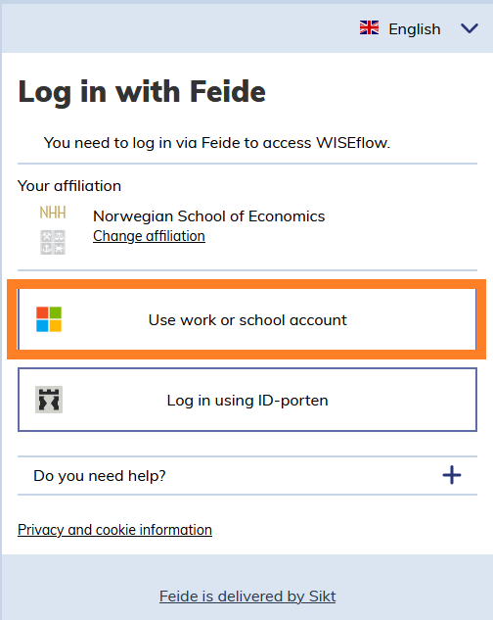
Logging in with FEIDE
https://europe.wiseflow.net – click on log in.
Select FEIDE as an authentification method
Click on Use work or school account
Make sure that NHH is set as your
affiliation

Slide 31
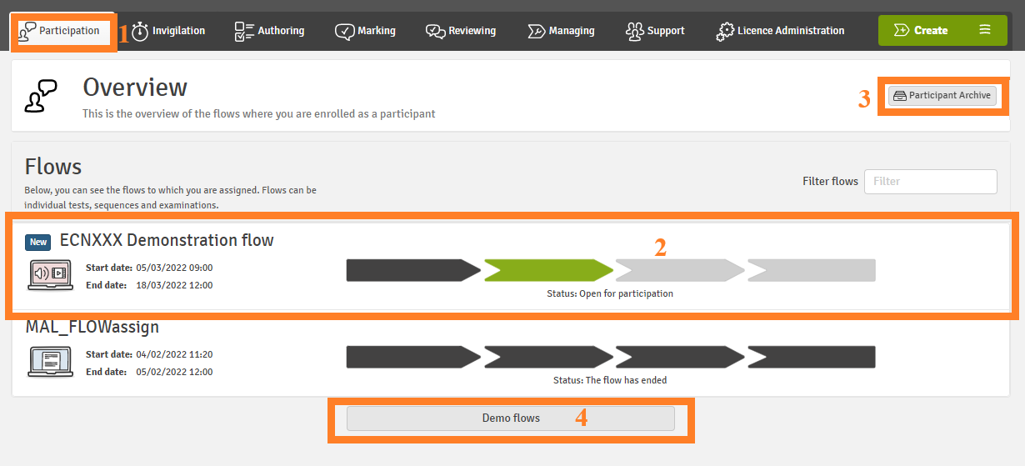
Participant

Slide 32

Home exam
Requirements on the maximum length of answers must be followed
The answer paper must be uploaded in PDF format on WISEflow, unless stated otherwise by the course responsible.
The candidate number(s) should be provided on the title page.
Find your candidate number on StudentWeb
The deadline is final

Slide 33
Home exam
Most of home exams are in FLOWassign: you should convert your main document into a PDF. Practice to convert files into a PDF format before the exam!
Appendices, if allowed, can be submitted in
various formats.
15 minutes extra for uploading the paper.
NB! Larger files (e.g., videos) can take longer to upload.

Slide 34
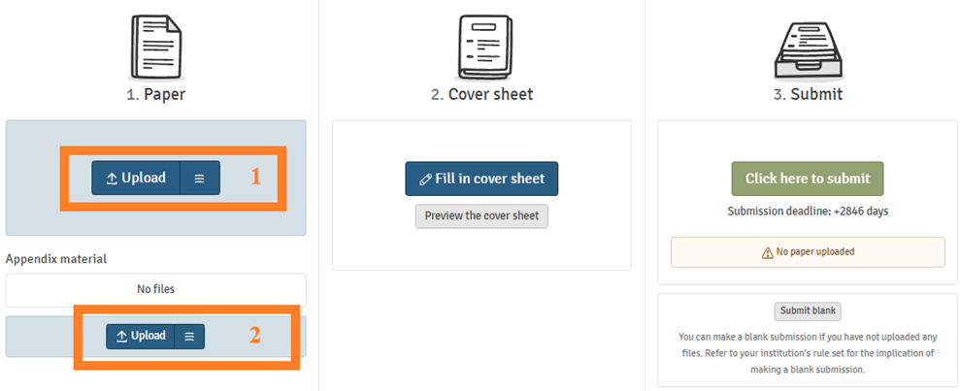
Uploading and submitting your answer paper
Uploading main file in a PDF format (1) and appendices (if allowed) in any formats (2)

Slide 35
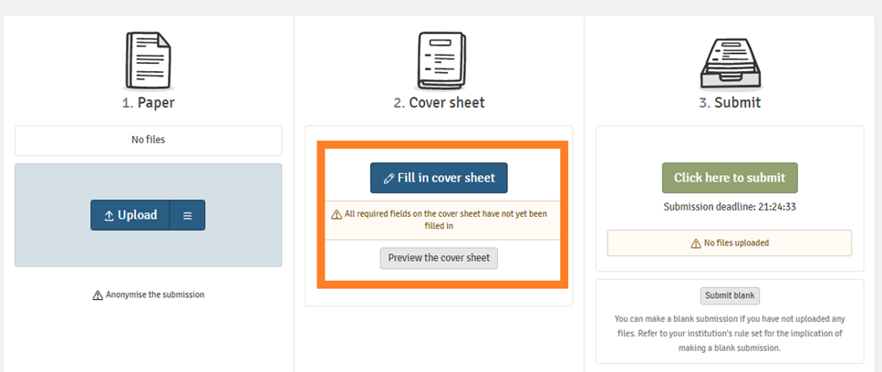
Uploading and submitting your answer paper
If you are required to fill in the cover sheet, you will not be able to proceed to submitting your paper before filling it in.

Slide 36
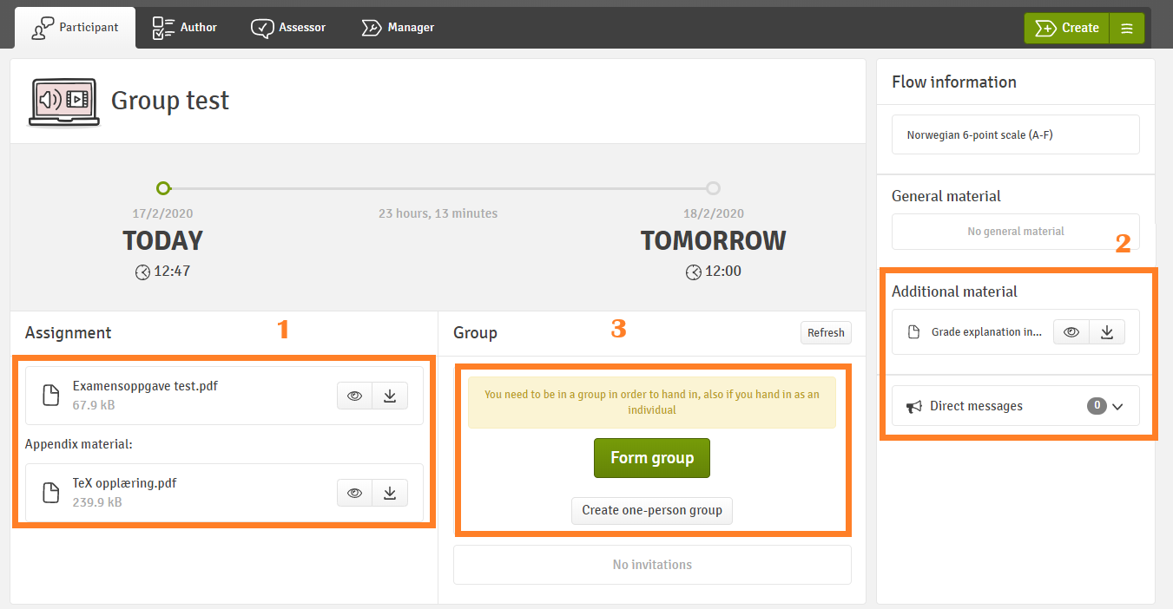
Group exam
NB! You must create a group before you can upload the paper
If you are submitting individually, create a one-person group

Slide 37
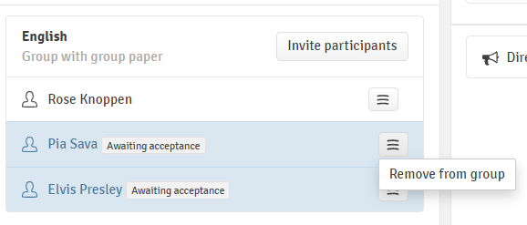
Group exam
NB! All the invited group members must accept/ reject the group invitation before you can submit the paper. Make sure you create groups well in advance of the submission deadline.
You can also remove the members from the group.
After you have accepted the invitation, you have the same rights as the person who created the group.
One group member submits the paper for the whole group. Each group member can see the submitted paper.

Slide 38
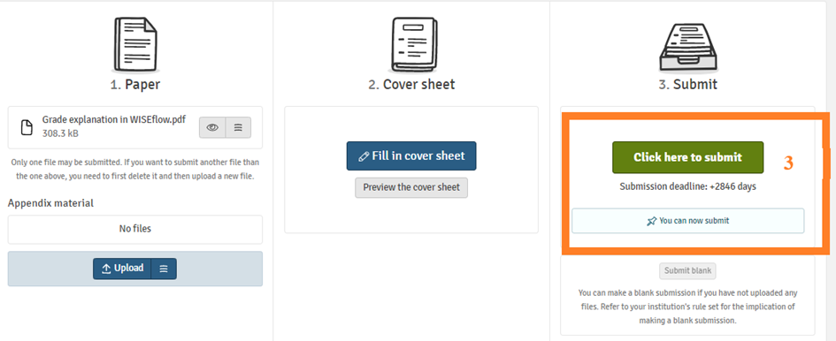
Uploading and submitting your answer paper
Press Click here to submit (3) button to submit your paper.

Slide 39
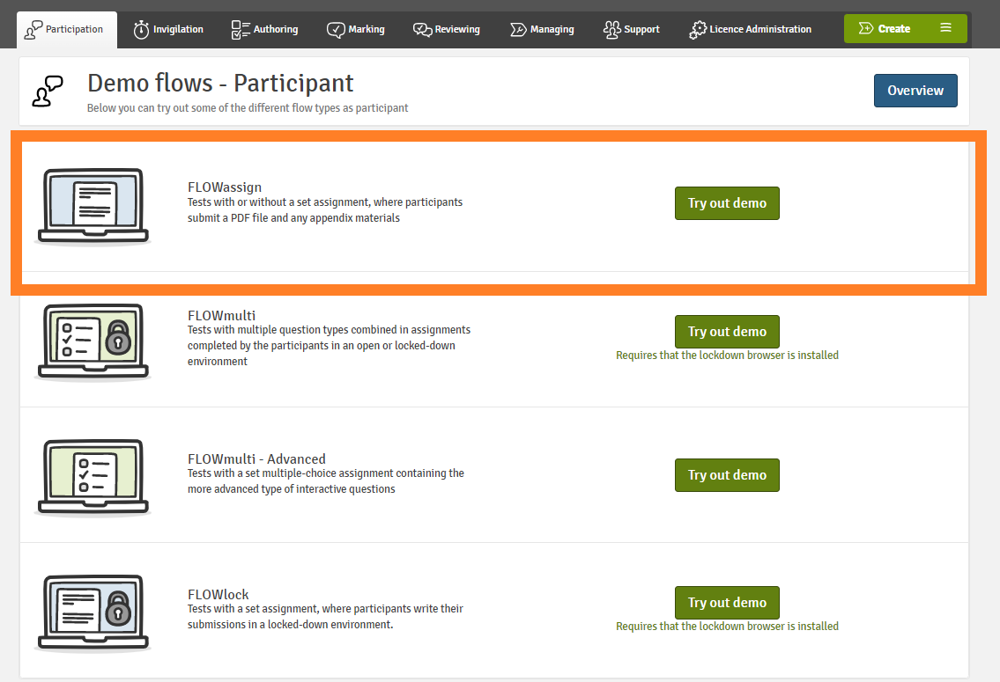
Home exam
Try FLOWassign demo flow

Slide 40

If you experience technical problems with submission
Send your paper to the Exam Office (exams@nhh.no) before the deadline.
If the file is too large to be sent by email, use File sender: https://filesender.sikt.no/(FEIDE login).
NB! The links to cloud storage are not accepted.
NB! Submissions are not accepted after the deadline.

Slide 41
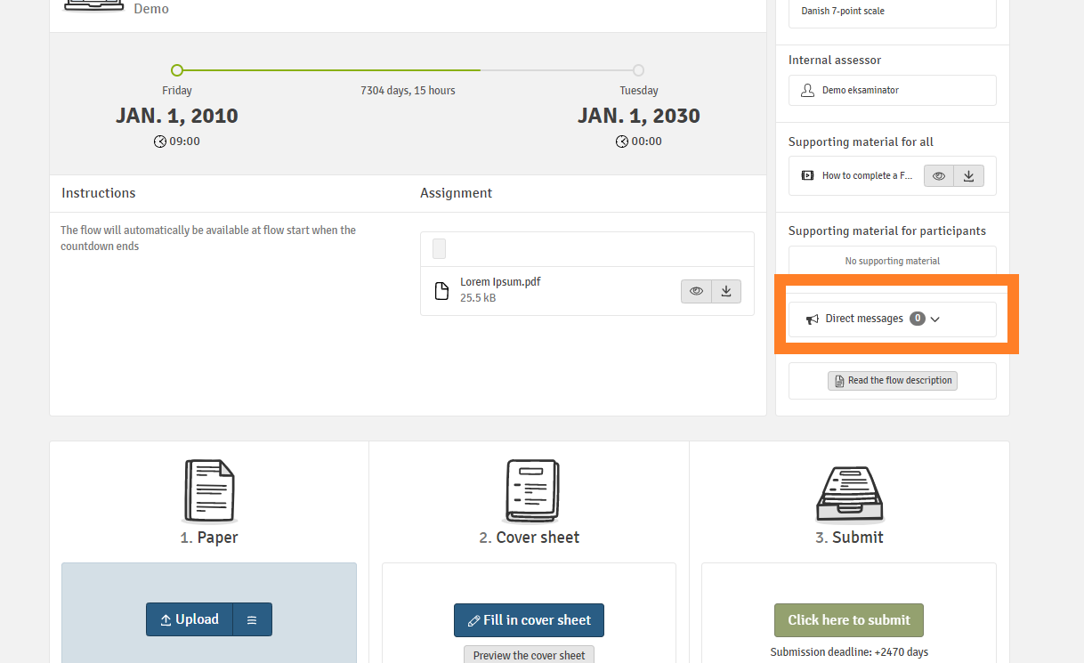
If you experience technical problems with submission
The link to Filesender and other important information about problems with submission will appear in a direct message

Slide 42

If you experience technical problems with submission
NB! Problems with internet connection is not a valid excuse for late submission
Use a stable internet connection when submitting your exam.
Have an alternative Internet connection available in case there is a problem with your network.
A good alternative is to use your phone as a WIFI hotspot.

Slide 43
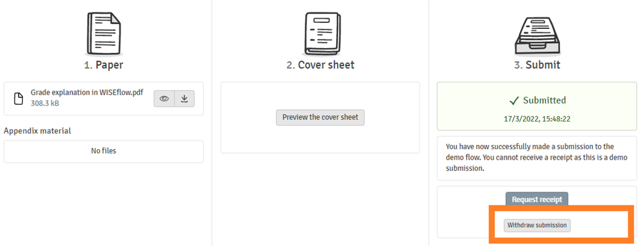







Home exam
You can withdraw your paper before the deadline and submit another paper

Slide 44
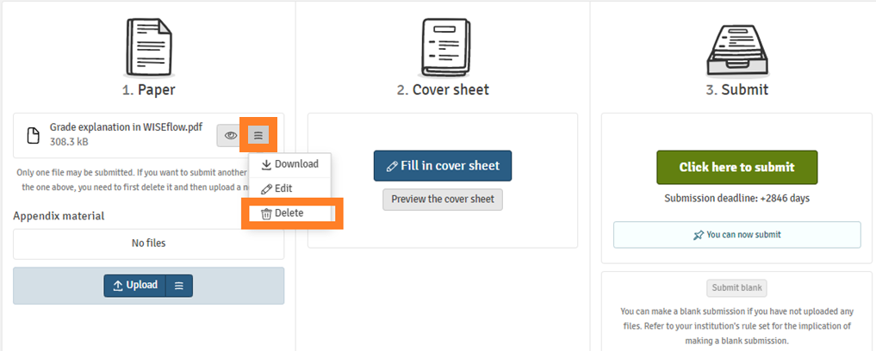
Home exam
NB! Remember to delete old files before uploading new files that will replace them and then press submit. When you press Click here to submit, everything that is uploaded in the flow will be sent for grading.

Slide 45

Types of electronic school exams
Exams with lockdown browser
FLOWlock
FLOWmulti (interactive exam)
Exams with Device monitor

Slide 46
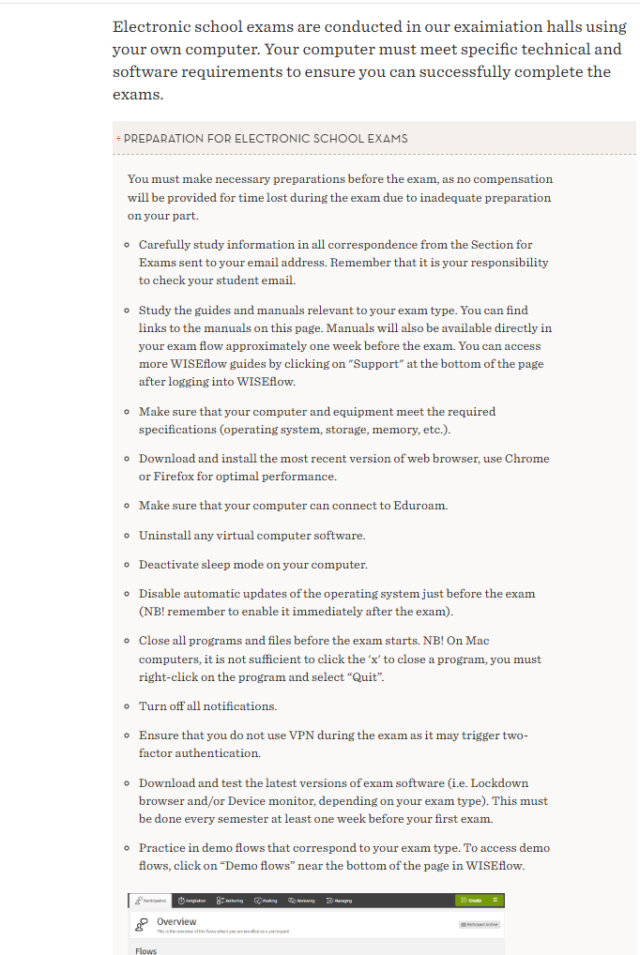
Before the exam
You must make all necessary preparations before the exam, as no compensation will be given for any time lost due to inadequate preparation.
You can find information about the preparations here

Slide 47
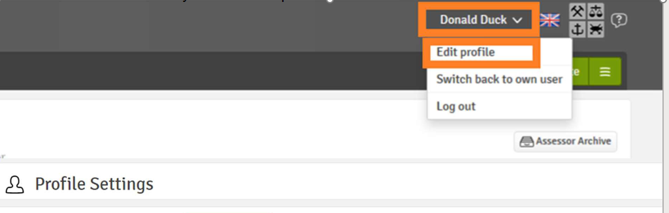
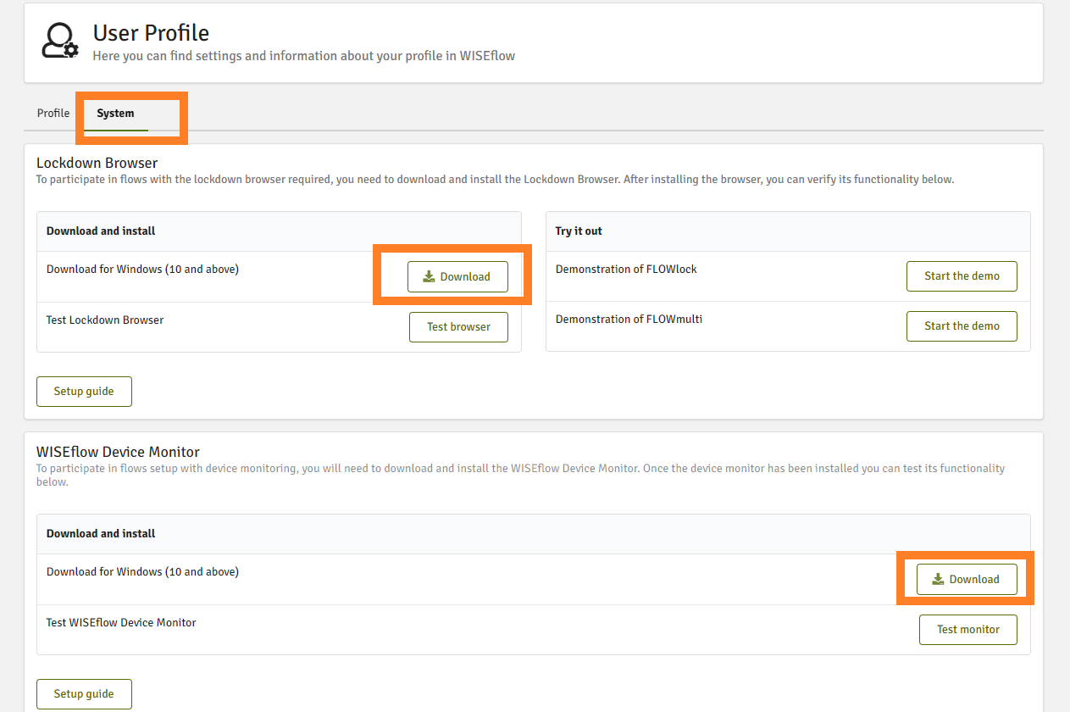
Download lockdown browser and Device monitor for school exams
You must download the latest version of lockdown browser and Device monitor before every examination period:
Click on your name in the upper right corner and select Edit profile.
Click on System .
Click on Download.
You can also test the browser and the monitor
You can also download from the exam flow (available 1 week before the exam).
NB! You won't be compensated for the time used to download and install lockdown browser or Device monitor on the exam day. Technical invigilators will prioritize other issues.
Notes:
As usual, you have access to the web cam and drawing tool in the appendix manager on FLOWlock exams. It is now possible to crop, rotate and adjust brightness of the images. From this semester you also have access to the code editor in the appendix manager which enables you to write mathematical formulas with the help of LaTeX. We advise you to test out the tools in the appendix manager in the demo flows in WISEflow before your exams.

Slide 48
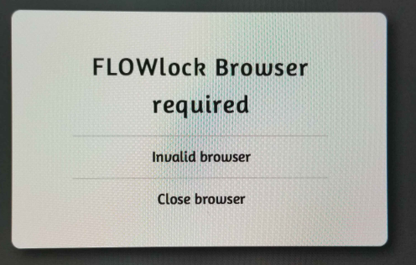
Download lockdown browser and/or Device monitor for school exams

Slide 49
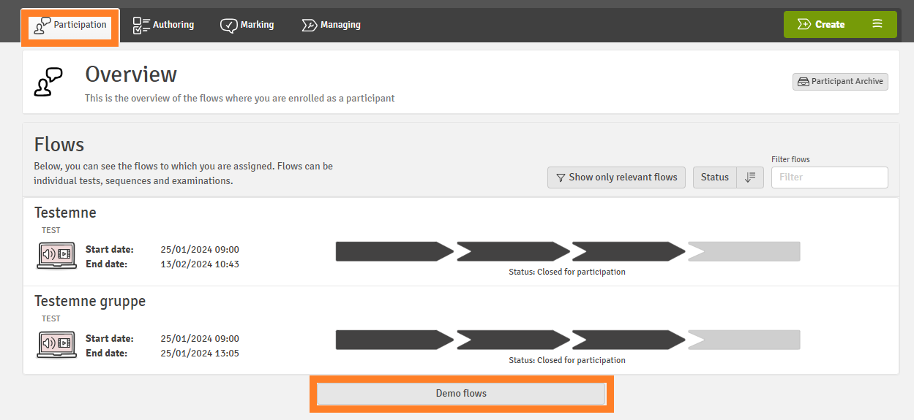
Practice in demo flows
Practice in demo flows

Slide 50
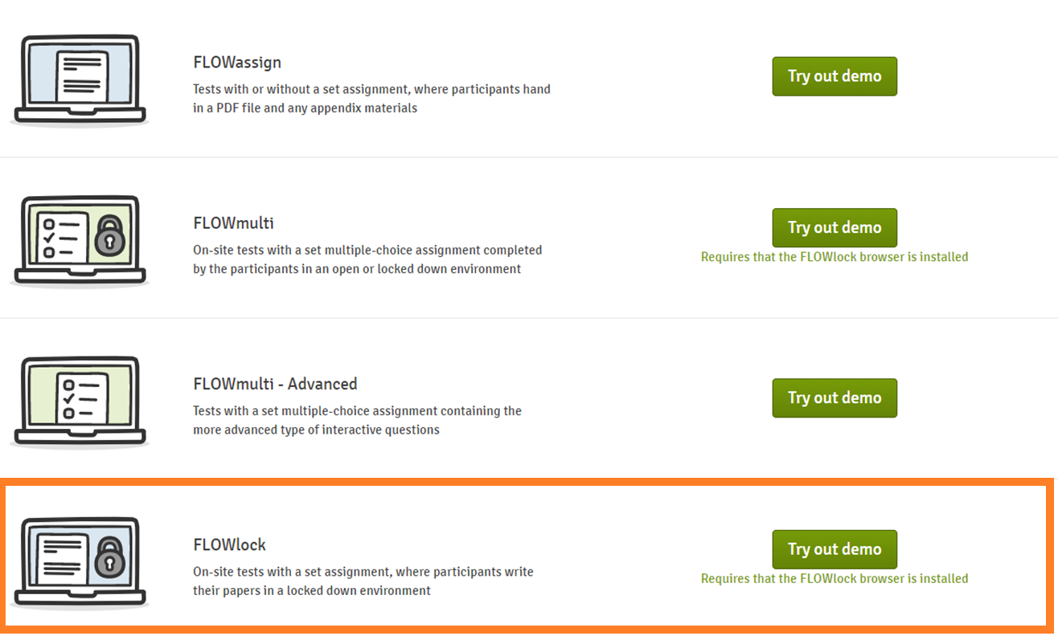

Slide 51
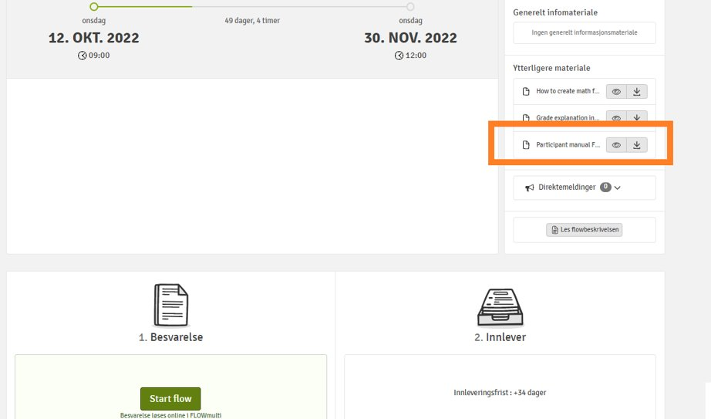
3. Where can I find manuals for exams?
Detailed manual is available in the exam flow (activated approx. 1 week before the exam)

Slide 52
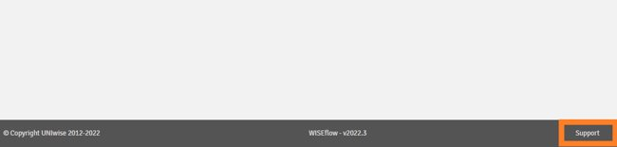
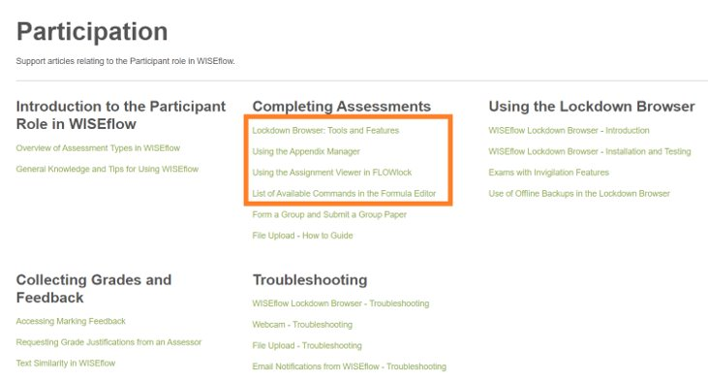
3. Where can I find manuals for exams?
2. Manuals from the WISEflow supplier UNIwise can be found under Support

Slide 53
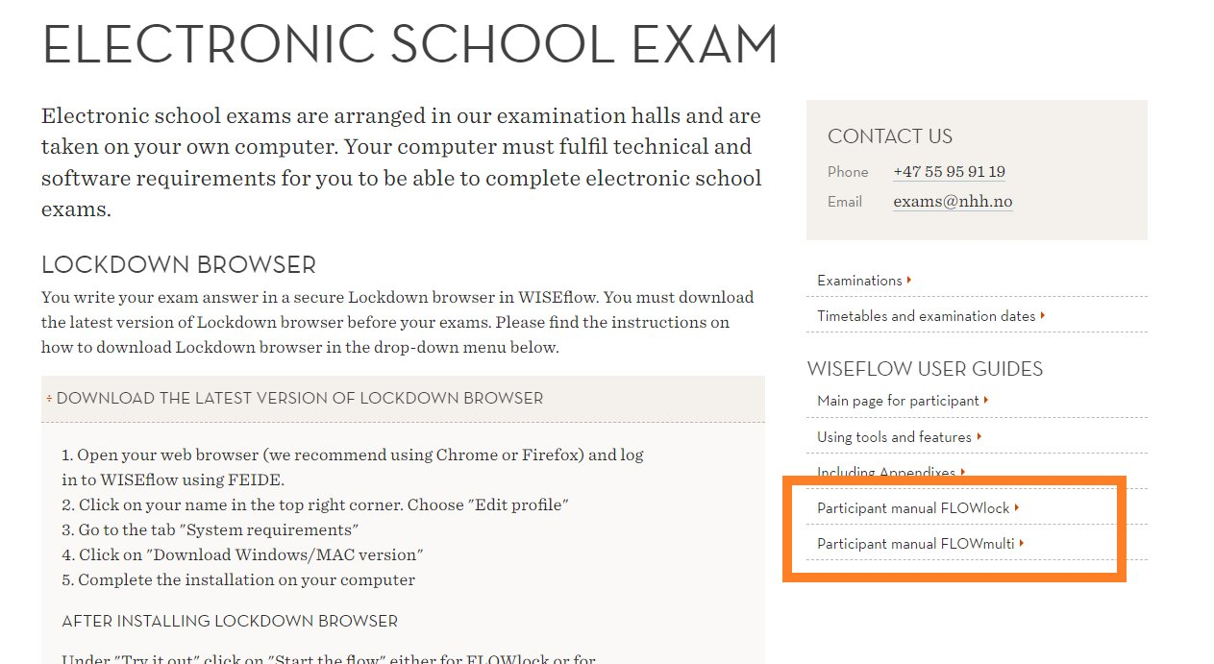
3. Where can I find information/ manuals for exams?
3. Information on NHH website
School exam
Home exam

Slide 54
Laptop requirements
We have a limited number of laptops for emergency needs only. These are reserved for those who experience problems with their own PC on the day of the exam.
REGULATIONS FOR FULL-TIME STUDY PROGRAMMES AT THE NORWEGIAN SCHOOL OF ECONOMICS (NHH), Section 1-7 Laptop computers:
Students at NHH must have access to their own laptop computers in connection with teaching and assessment. Requirements apply in relation to equipment and software
Test your webcam in the demoflows

Slide 55
4. Check the PC, mouse, keyboard, WEB camera
PC: lockdown browser installed, you have administrator access to your PC, deactivate automatic Windows updates, deactivate VPN, uninstall virtual computers.
Test in the demo flow that the WEB camera takes legible pictures
Allowed to use a wired mouse, keyboard, external web camera
No cordless equipment is allowed
External monitor is not allowed

Slide 56
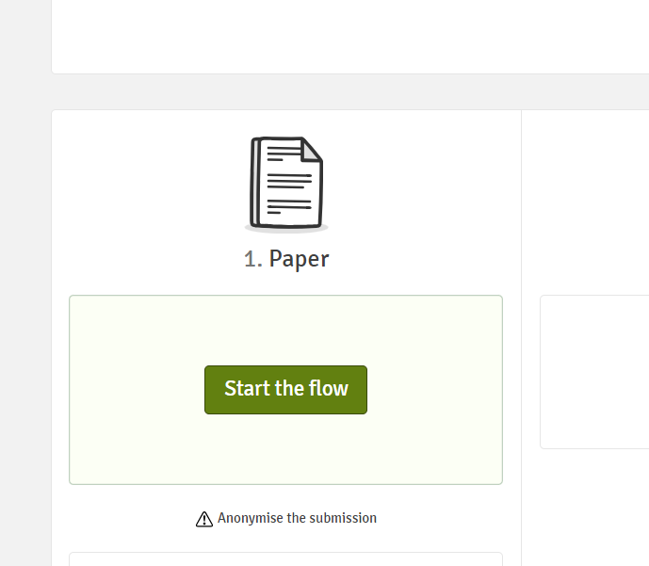
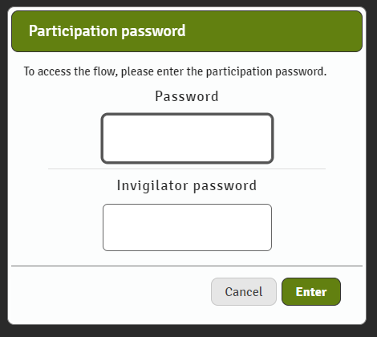
On the exam day
Start the flow at 8:45. If you start the flow after 9:00, you will have to wait for the invigilator to write the password
NB! The time lost while waiting for the invigilator will not be compensated for

Slide 57
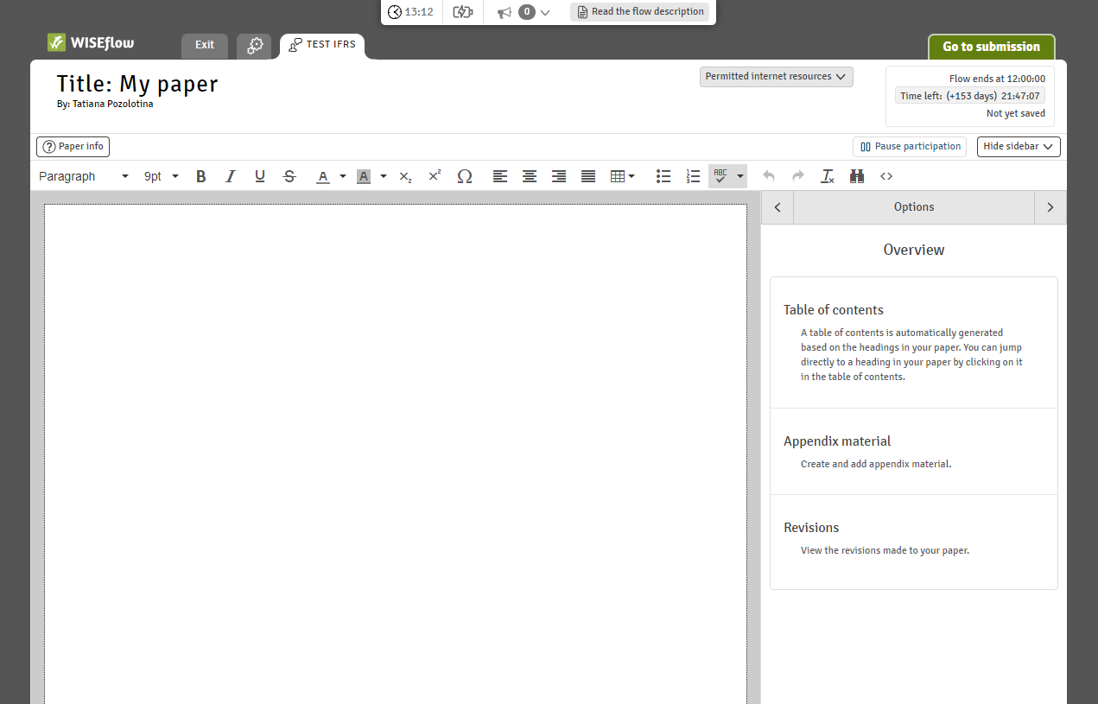
FLOWlock
A WORD-like text editor
NB! Your answer paper will be converted to a PDF-file, there can be margin width
discrepancies, thus some words can be moved to a new line.
If the alignment is important (e.g., accounting), create a table!

Slide 58
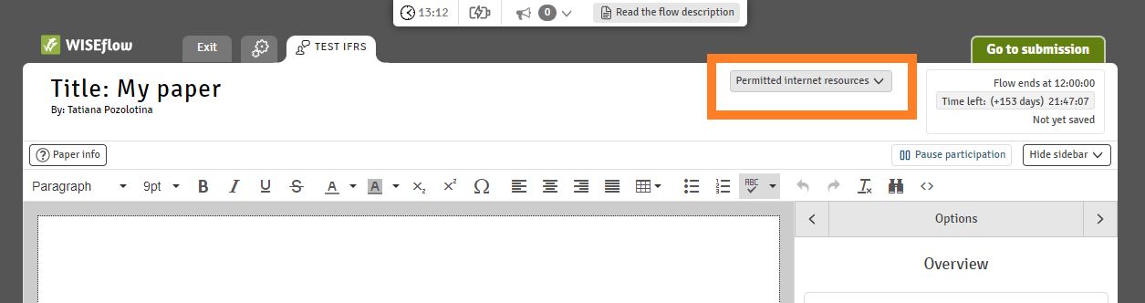
FLOWlock
Permitted internet resources and attachments to download (ex., formula sheets, Excel files)

Slide 59
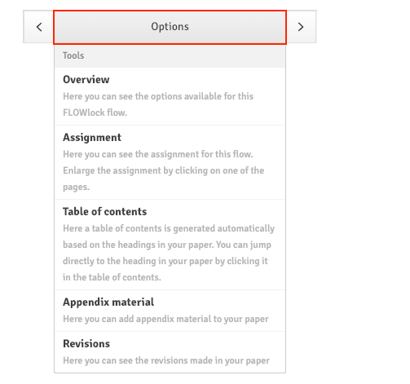
Navigation

Slide 60
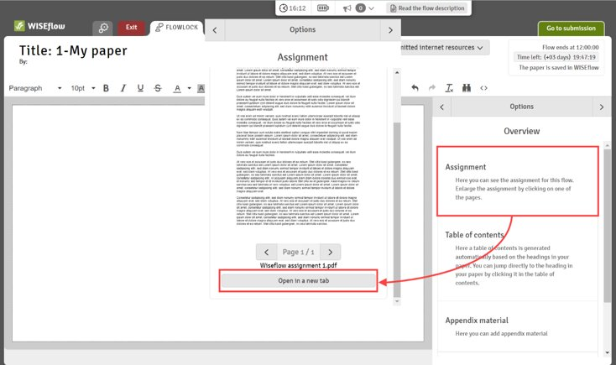
Navigation: Assignment
You can open the exam assignment in its own tab

Slide 61
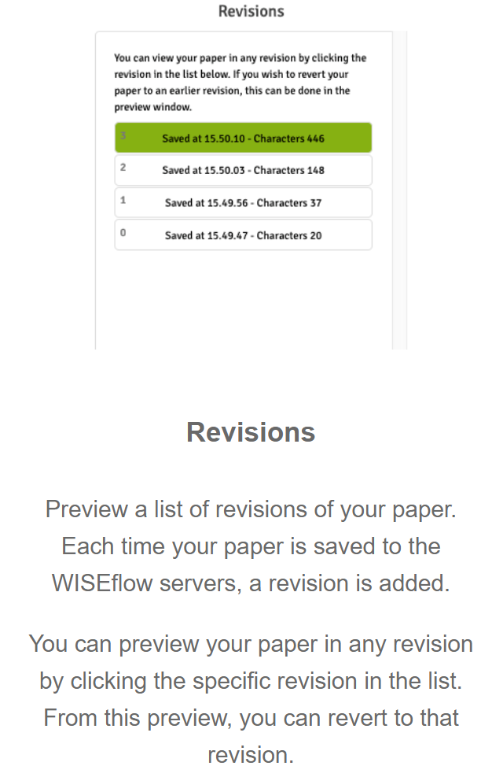
Revisions

Slide 62
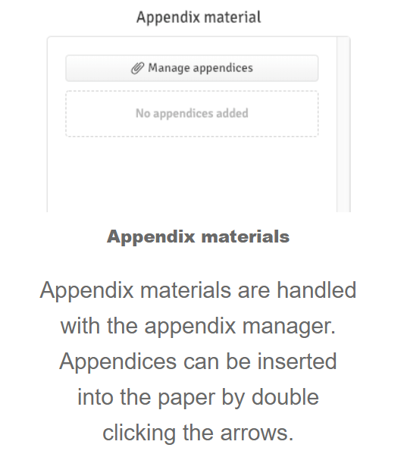
Appendix manager

Slide 63
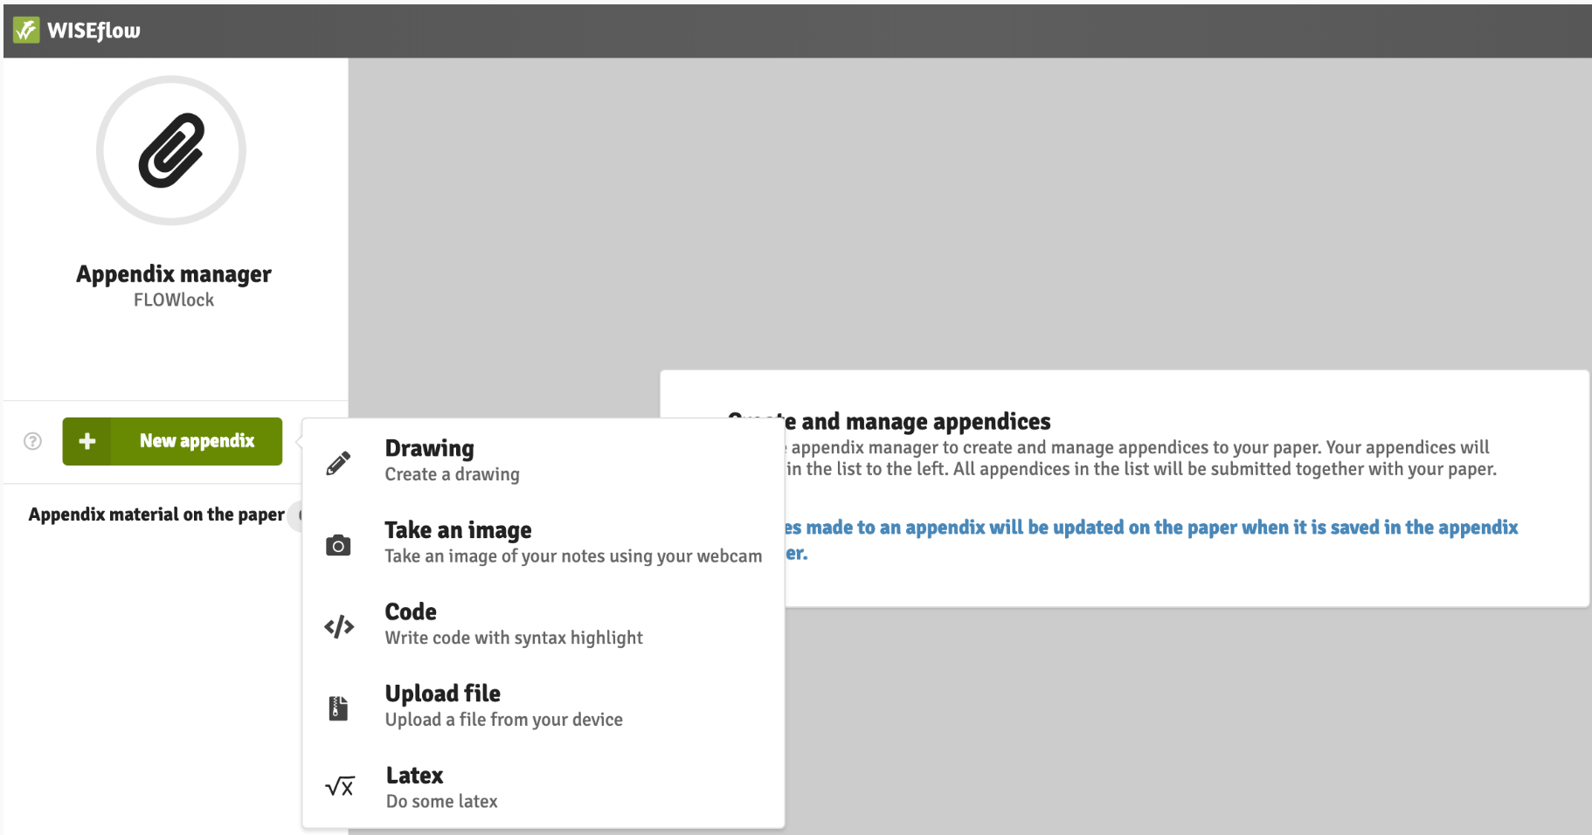
Appendix manager

Slide 64
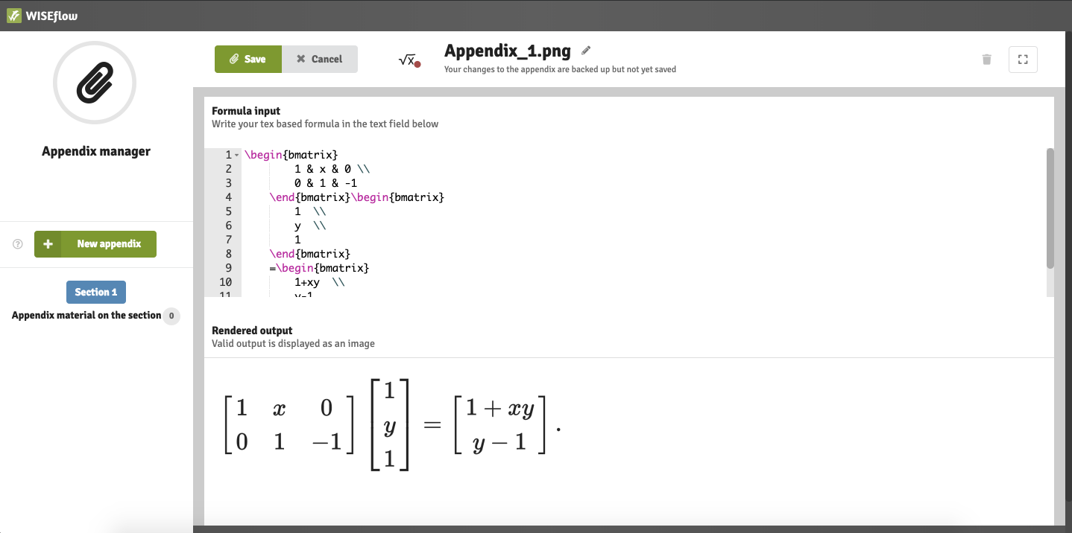
Formula editor

Slide 65
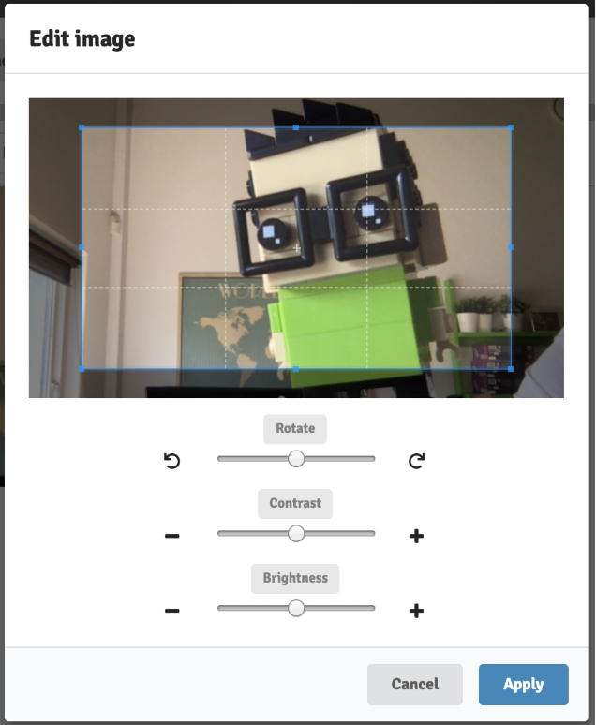
WEBCAM
Use a special sheet for taking pictures handed out by invigilators
You can edit Webcam pictures.

Slide 66
You must insert pictures into your answer paper

Slide 67
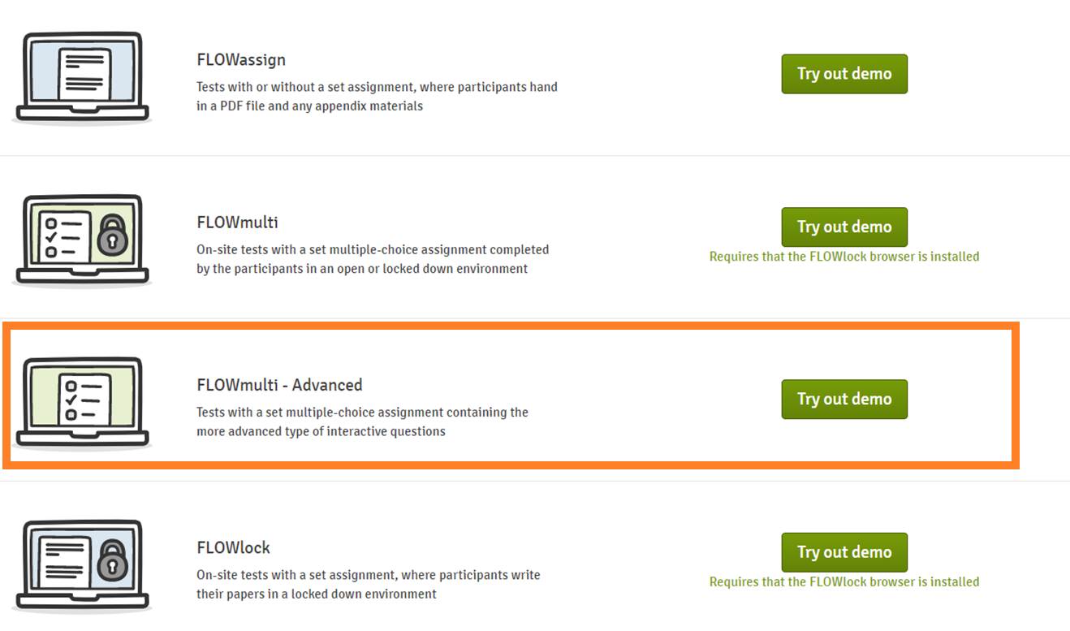
FLOWmulti: the interactive exam

Slide 68
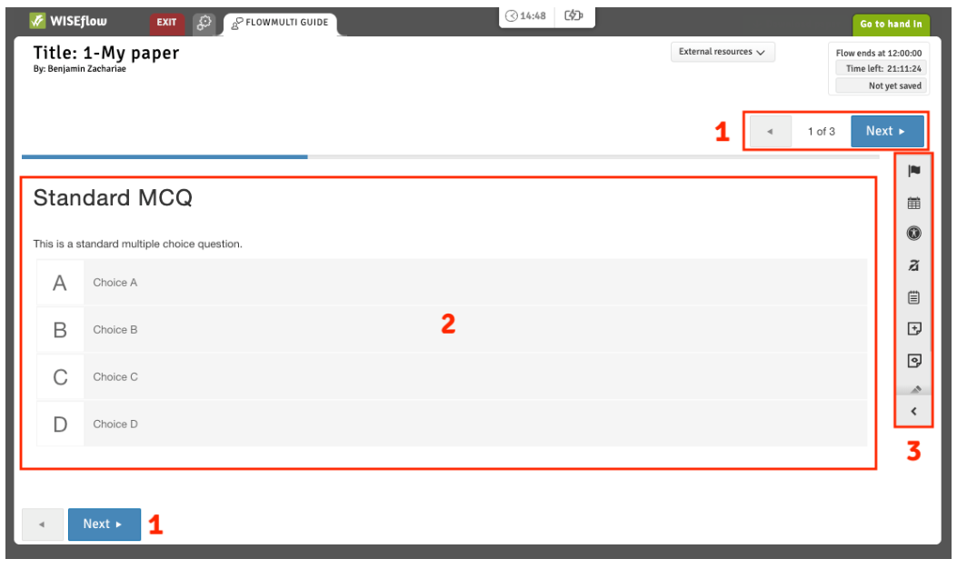
FLOWmulti: the interactive exam
1. Navigate between sections of the questionnaire.
2. The current section is situated here. A section can have multiple questions.
3. Annotation and overview tools for FLOWmulti.

Slide 69
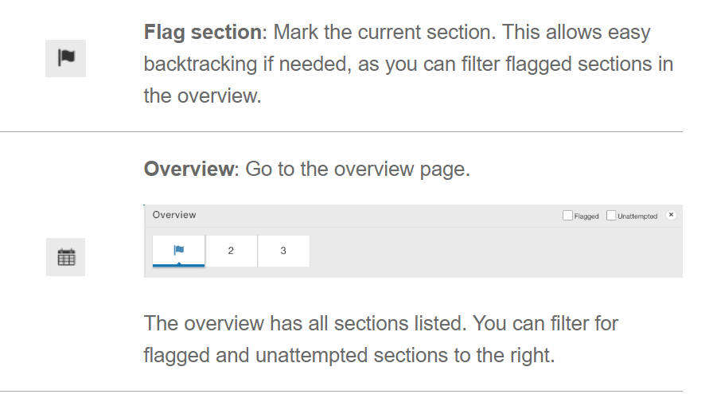
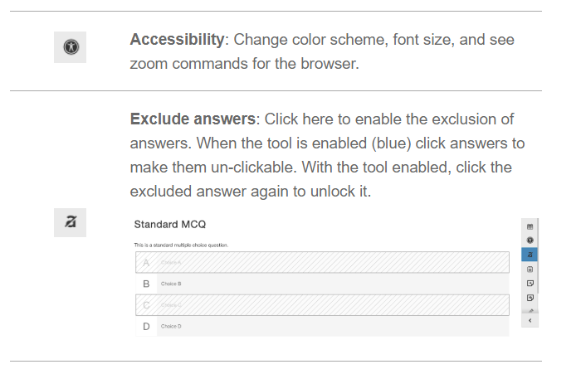
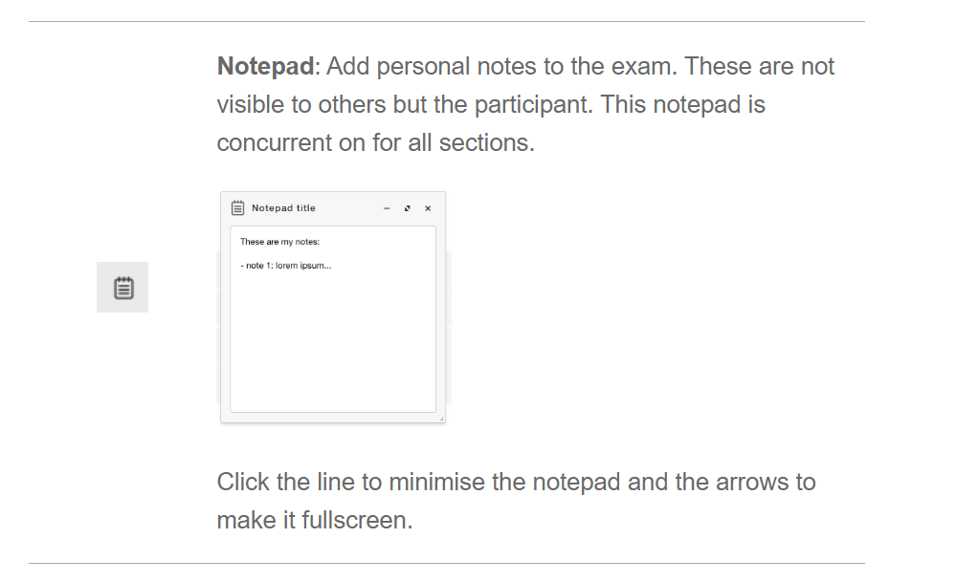
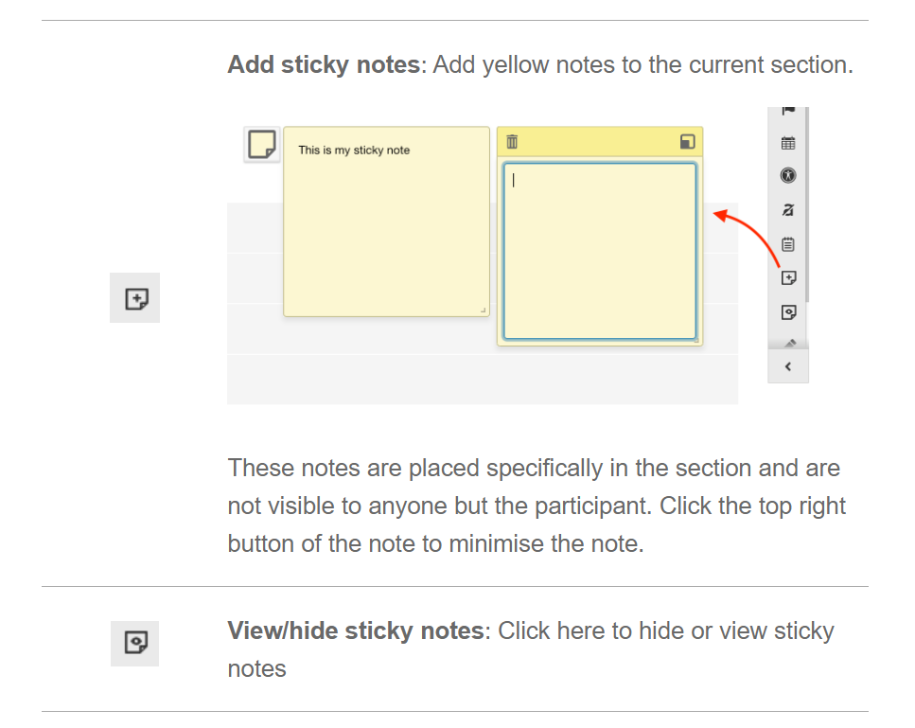
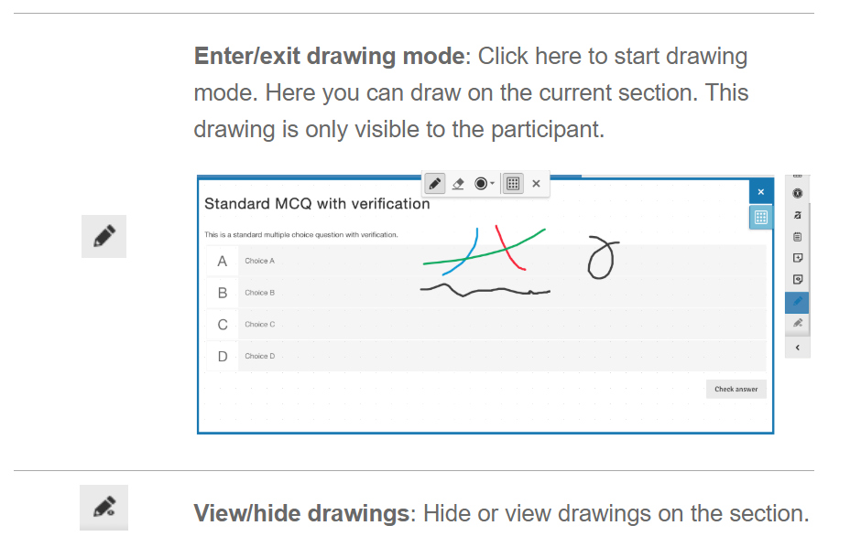
Annotation tools: changes visible only to you

Slide 70
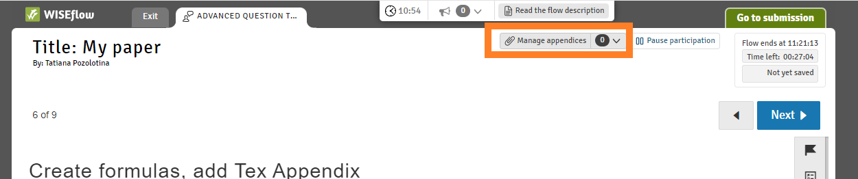
Appendix manager
For specific question types you can add appendices to the section. Click the "Manage appendices" to open the Appendix manager in a new tab.

Slide 71
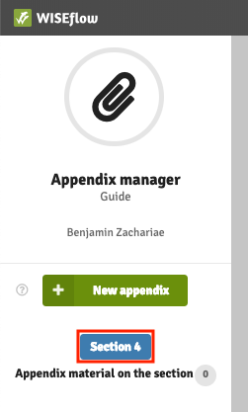
Appendix manager
The appendix manager shows you which section is open.

Slide 72
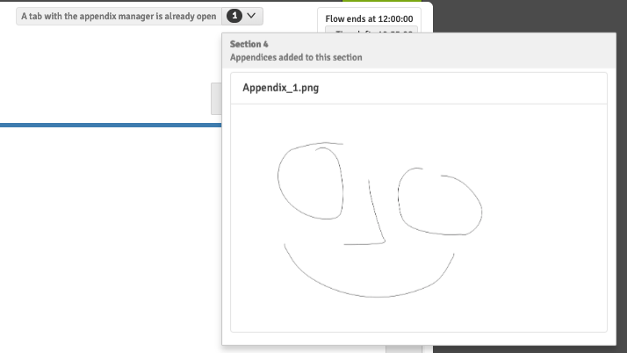
Appendix manager
You can preview appendices for the section in the dropdown to the right of the manage appendices button.

Slide 73
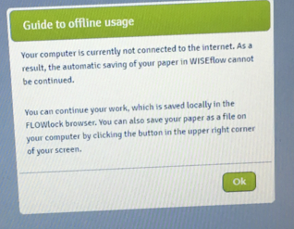
School exam
Do not be worried if you get this message during the exam: press Ok and continue working

Slide 74
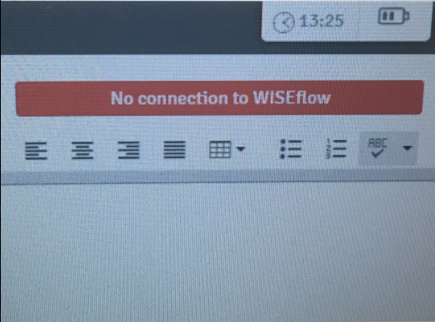
School exam
You can monitor your connection status on the top of the browser: if you are not connected to the internet for over 5 minutes, please, contact a technical invigilator. NB! Do not refresh the browser while offline.

Slide 75
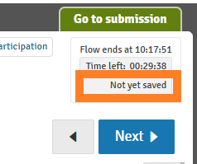

School exam
If you are experiencing other issues, for example, the extra time is not showing, spell check does not work, etc. Follow the steps:
Make sure you are online
Save the progress manually by clicking “Not yet saved” or the time it was last saved
3. Refresh the page
4. If the issue persists, contact technical invigilator

Slide 76

Direct messages
Important information and instructions
Pop up automatically
Can be found on the top of the page

Slide 77

Submitting and exiting lockdown browser
You can hand (press "Go to submission") in or exit without handing in (an invigilator will have to enter the password)
Do not just close your laptop and go, lockdown browser will still be locking your computer when you open it again

Slide 78
Exams with Device monitor
Section for exams sends an email with information about your exam in Device monitor
Read the e-mail carefully!
  States what is allowed during exam and what is considered cheating
  Tells you how to prepare for the exam
PC is not locked but invigilators look though the print screens and background processes
The print screens are also available for exam administration after the exam.

Slide 79

Exams with Device monitor

Slide 80

Practical assignments
Download and install the lockdown browser
Open the demo FLOWlock
  Create a table
  Take a picture with your webcam, crop it and insert it in the paper

Slide 81
Key takeaways from today
It is the student's responsibility to familiarize themselves with NHH's exam information and regulations.
The deadlines are final
No cheating!
Come prepared to your exams – download the latest versions of all required programmes (Wiseflow)

Slide 82
Thank you for attention
Questions?

