Slide 1
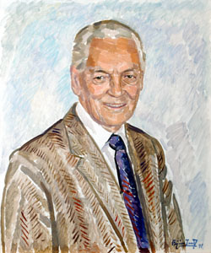
Karl Borch
Lecture
Norwegian School of Economics

Slide 2
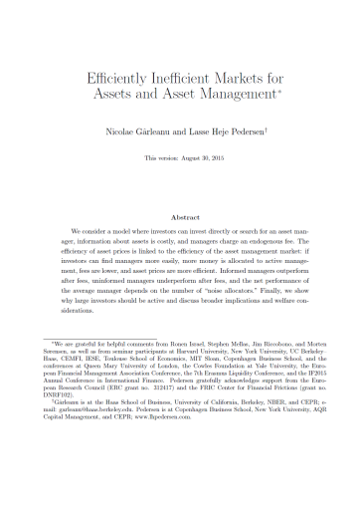
Overview of talk
Efficiently inefficient
How smart money invests & market prices are determined
Book by Princeton University Press, as Borch (1968)
Equilibrium model
New paper on
asset market efficiency $↔$ asset management efficiency

Slide 3
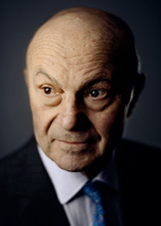
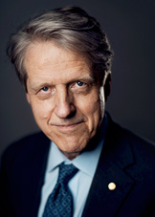
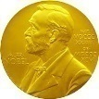
Market efficiency
Market efficiency: at the heart of financial economics
Nobel Prize 2013 awarded to Eugene Fama, Lars Hansen, and Robert Shiller
Efficient!
Inefficient!

Slide 4
Brief literature review
Security markets
Asset management markets
Fully efficient
Efficiently inefficient
Highly inefficient
Fama (1970)
Berk and Green (2004)
Grossman and Stiglitz (1980)
This book/paper
This book/paper
Shiller (1980)
Fama (1970)
, Gennaioli, Shleifer, and Vishny (2015)
Berk and Green (2004)

Slide 5
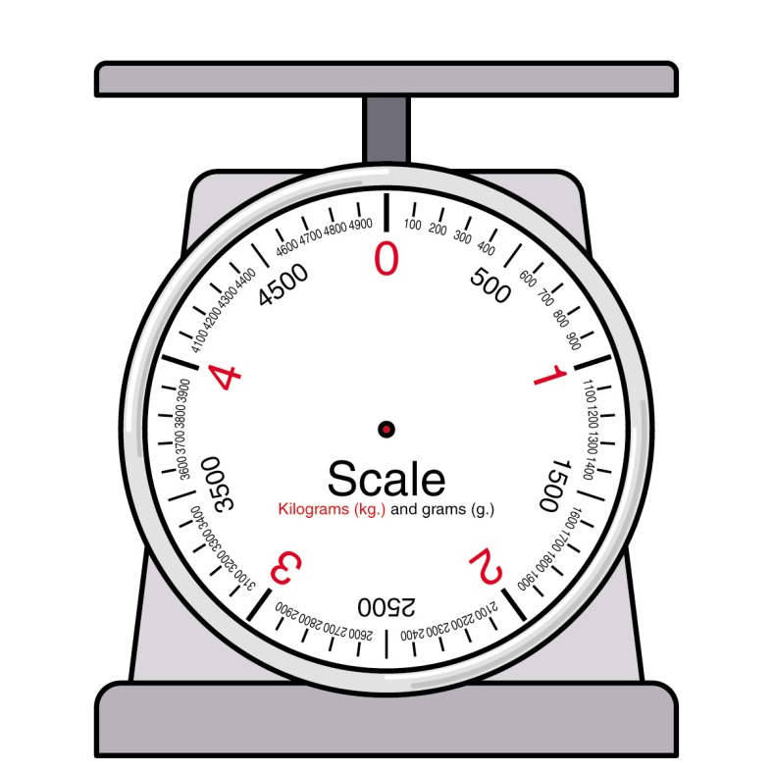
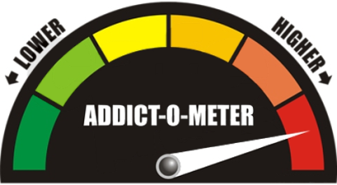
Efficient Markets?
Markets cannot be fully efficient
If they were, no one would have an incentive to collect information (Grossman-Stiglitz, 1980)
Logically impossible that both market for asset management and asset markets fully efficient
Asset market efficient → no one should pay for active management
Clear evidence against market efficiency
Failure of the Law of One Price, e.g.
Asset management: Closed-end fund discount, ETFs
Stocks: Siamese twin stock spreads
Bonds: Off-the-run vs. on-the-run bond spreads
FX: Covered interest-rate parity violations
Credit: CDS-bond basis
Not subject to “joint hypothesis problem”
Completely
Inefficient
Perfectly
Efficient
Efficiency-o-meter

Slide 6
Inefficient Markets?
Market prices cannot be completely divorced from fundamentals
Money managers compete to buy low and sell high
Free entry of managers and capital
If markets were completely divorced from fundamentals
Making money should be very easy
But, professional managers hardly beat the market on average
Completely
Inefficient
Perfectly
Efficient
Efficiency-o-meter
6

Slide 7
Efficiently Inefficient Markets
Markets are efficiently inefficient
Markets must be
inefficient enough that active investors are compensated for their costs
efficient enough to discourage additional active investing
Efficiently
Inefficient
Completely
Inefficient
Perfectly
Efficient
Efficiency-o-meter
7

Slide 8
How Do You Beat the Market?
Conceptually, how do you beat the market?
But, how do you do it in practice?

Slide 9
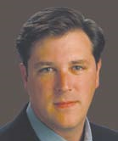
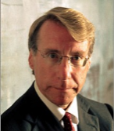
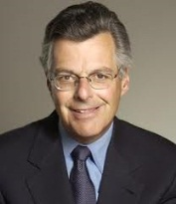
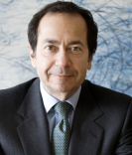
How Do You Beat the Market?
Investment Strategies
Ainslie
Chanos
Asness
Soros
Harding
Scholes
Griffin
Paulson

Slide 10
How Do You Beat the Market? Liquidity and information
Ainslie
Chanos
Asness
Soros
Harding
Scholes
Griffin
Paulson
shorting
over-bought
stocks
information
on policy
changes and
macro
imbalances
information on
trends
vs. hedgers
information
about illiquid
convertible
bonds
information on
out-of-favor
stocks
information
on flows due
to institutional
frictions in
fixed income
information on
how to provide
liquidity to sellers
of merger target
systematic
use of information
and supply/demand
imbalances

Slide 11
Overview of talk
Efficiently inefficient
How smart money invests & market prices are determined
Equilibrium model
Asset management efficiency $↔$ asset market efficiency

Slide 12
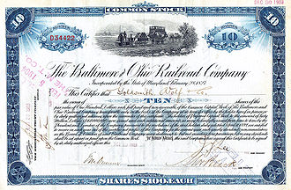
Model
asset
price $p$
buy $x_{i}(p,s)$
buy $x_{u}(p)$
Signal $s=v+ε$
$$ε\sim N\left(0,σ_{ε}\right)$$
s at costs k
M informed
assets
fee f
managers
search c(M,I)
I active
N-I passive
N investors
CARA utility $−\frac{1}{γ}\text{log}\left(E\left({−e}^{−γ\tilde{W}}\right)\right)$

Slide 13
Model: market structure
Profit Sources
Information
Liquidity
asset
price $p$
Payoff $v\sim N(m,σ_{v})$
Supply $q\sim N(Q,σ_{q})$
noise traders
buy Q-q shares
signal $s=v+ε$
$$ε\sim N\left(0,σ_{ε}\right)$$
noise allocators
invest with A random managers
assets
managers

Slide 14
Model: Equilibrium Concept
General equilibrium for assets and asset management (p, I ,M, f )
(p) Asset price is an asset-market equilibrium
q = I x_{i} (p, s) + (N − I ) x_{u} (p)
(I) Investors’ active/passive decision is optimal
(M) Managers optimally enter/exit
(f) Asset management fee outcome of Nash bargaining
asset
price $p$
$x_{i}(p,s)$
$x_{u}(p)$
M informed
assets managers
fee f
I active
N-I passive

Slide 15
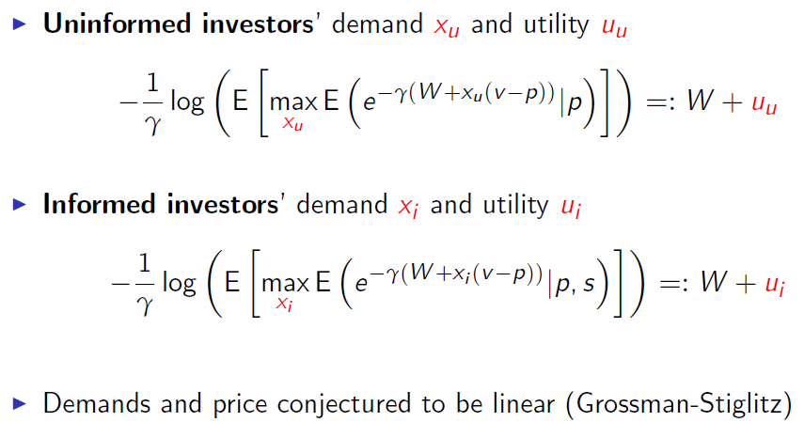
Solving the Model: Utility, Demand, and Asset Price

Slide 16
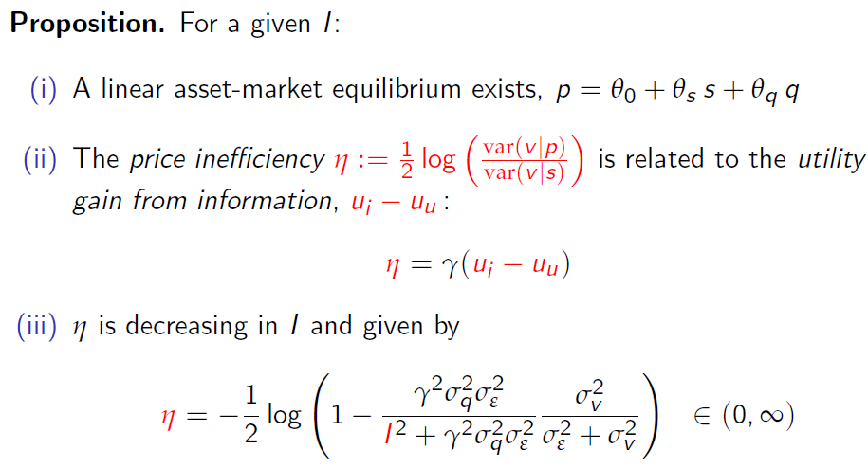
Asset-Market Equilibrium: Grossman-Stiglitz (1980)

Slide 17
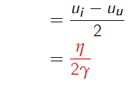
Asset Management Fee

Slide 18
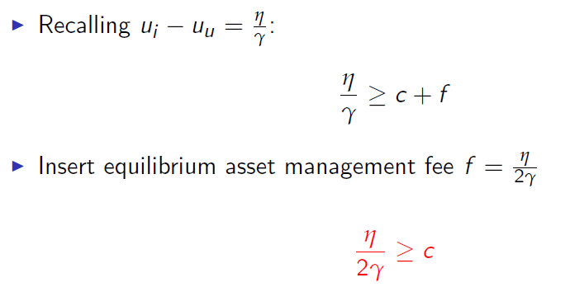
Investors’ Decision to Search for Asset Managers

Slide 19
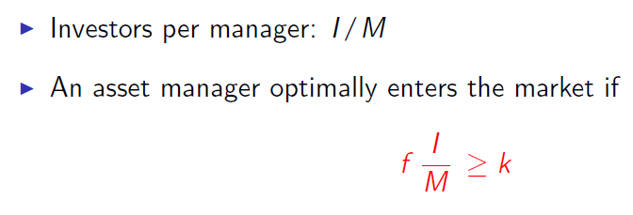
Entry of Asset Managers

Slide 20
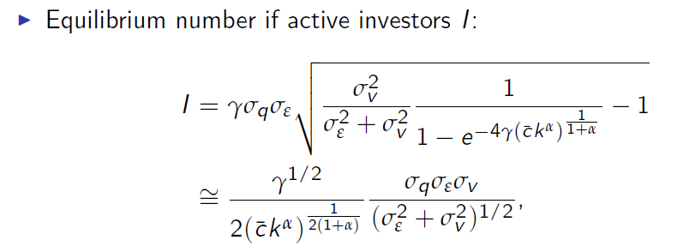
Closed-form Solution for specific search function (results hold generally)

Slide 21
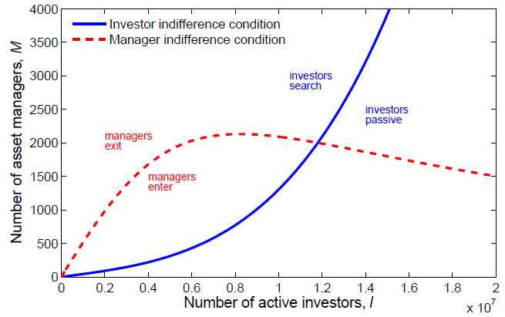
General Equilibrium for Assets and Asset Management

Slide 22
Performance of asset managers
Proposition
Informed asset managers: outperform passive investing before and after fees
Uninformed managers: underperform after fees
Searching investors:
outperform net of fees, i.e. “return predictability”
outperformance just compensates their search costs in an interior equilibrium
larger search frictions means higher net outperformance, i.e., more predictability
Noise allocators: underperform after fees
Average manager (= average investor), value-weighted
outperforms after fees if the number of noise allocators is small, $A<$ I
underperforms if $A>I$
+ = +

Slide 23
Empirical evidence on performance
“Old consensus” in the academic literature:
Mutual funds have no skill: Jensen (1968), Fama (1970), Carhart (1997)
“New consensus” in the academic literature
The average mutual fund underperforms slightly after fees, not before fees, but the average hides significant cross-sectional variation across good/bad managers
Skill exists among mutual funds and can be predicted: Kacperczyk, Sialm, and Zheng (2008), Fama and French (2010), Kosowski, Timmermann, Wermers, White (2006):
“we find that a sizable minority of managers pick stocks well enough to more than cover their costs. Moreover, the superior alphas of these managers persist”
Skill exists among hedge funds: Fung, Hsieh, Naik, and Ramadorai (2008), Jagannathan, Malakhov, and Novikov (2010), Kosowski, Naik, and Teo (2007):
“top hedge fund performance cannot be explained by luck, and hedge fund performance persists at annual horizons… Our results are robust and relevant to investors as they are neither confined to small funds, nor driven by incubation bias, backfill bias, or serial correlation.”
Skill exists in private equity and VC: Kaplan and Schoar (2005)
“we document substantial persistence in LBO and VC fund performance”

Slide 24
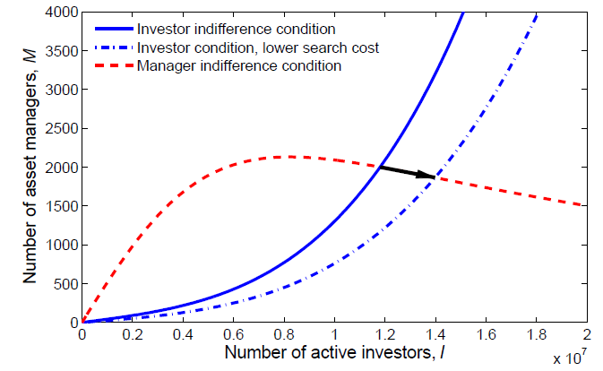
Asset Management Frictions and Asset Prices

Slide 25
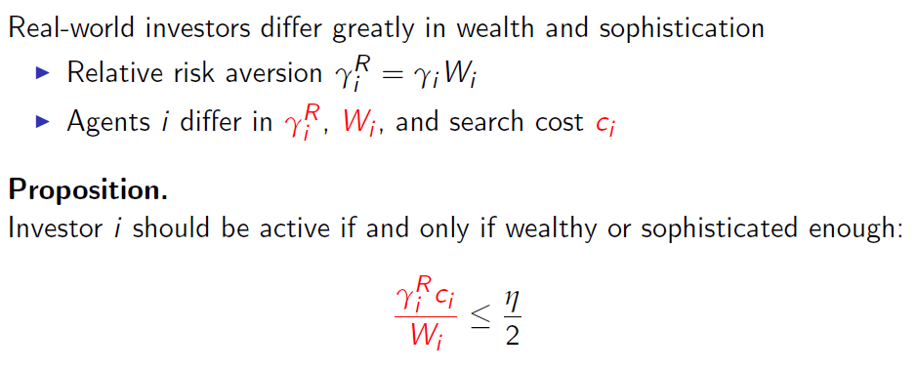
Small and large investors

Slide 26
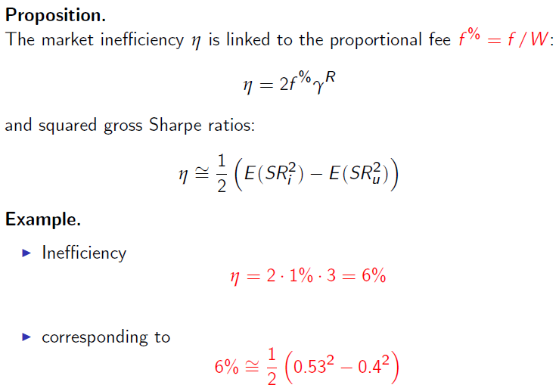
Economic Magnitude

Slide 27
Welfare and Market Liquidity

Slide 28
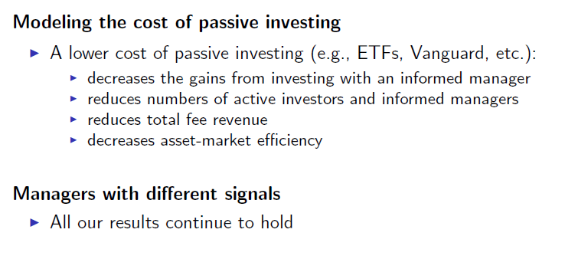
Further Extensions

Slide 29
Empirical Implications
Efficiently inefficient markets
Anomalies more likely to arise with higher c or k
Asset managers performance
managers can outperform before fees: Grinblatt and Titman (89), Wermers (00), Kacperczyk, Sialm, and Zheng (08), Kosowski, Timmermann, Wermers, and White (06)
average mutual fund may underperform after fees due to noise allocators: Carhart (97), Berk and Binsbergen (12)
but the best mutual funds outperform even after fees: Kosowski et al (06), Fama and French (10)
hedge funds may outperform after fees: Kosowski, Naik, and Teo (07), Fung, Hsieh, Naik, and Ramadorai (08), Jagannathan, Malakhov, and Novikov (10) – fewer noise allocators?
private equity and venture capital performance persistence: Kaplan and Schoar (05); Raise money contingent on reaching a total amount
performance slightly predictable, especially in HF/PE markets where search costs are larger
Lower search frictions, flows to asset managers
Sirri and Tufano (98), Jain and Wu (00), and Hortacsu and Syverson (04)
Growth of asset management industry: French (08)

Slide 30
Empirical Implications, continued
Asset management fees
should be larger for more inefficient assets due to larger information or search costs
HFs vs. mutual funds, equity funds vs. bond funds, global equity vs. domestic equity
Size and organization of asset-management industry
total size grows when c or k diminish: Pastor, Stambaugh, and Taylor (14)
industry consolidates when c goes down
good managers attract more investors (Berk and Binsbergen 12)
Investment consultants, investment advisors, funds of funds
Fund of Funds (non-noise allocators) should be able to predict manager perf.: Ang, Rhodes-Kropf, and Zhao (08)

Slide 31
Broader Implications: efficiently inefficient EconomicS
Markets are efficiently inefficient
not perfectly efficient
nor completely inefficient
Neoclassical Finance and Economics | Efficiently Inefficient Markets
Modigliani-Miller | Capital structure matters
Two Fund Separation | Investors choose different portfolios
Capital Asset Pricing Model | Liquidity risk and funding constraints
Law of One Price and Black-Scholes | Arbitrage opportunities
Merton’s Rule | Optimal early exercise and conversion
Real Business Cycles, Ricardian Equivalence | Credit cycles and liquidity spirals
Taylor Rule | Two monetary tools

Slide 32
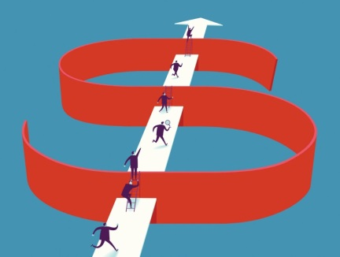
Even Broader Implications: Is the world Efficiently Inefficient ?
Competition + frictions = dynamics
Efficiently ineff icient traffic dynamics
Efficiently inefficient political process
Efficiently inefficient nature: evolution not converged yet yet

Slide 33
Conclusion
Markets are efficiently inefficient
Frictions and liquidity are important for economics
Asset market linked to asset management market
Many testable implications
Faculty using the book for teaching:
Cool free problem sets
Solutions
Slides
Exams
Efficiently
Inefficient

Slide 34
appendix

Slide 35
How Do You Beat the Market? Investment styles
1000s of hedge funds and active mutual funds
across different markets, continents, asset classes, …
But, can we summarize the main trading strategies through a few investment styles?
method that can be applied across markets
based on economics
broad long-term evidence
Value investing
Trend-following
Liquidity provision
Low-risk investing
Quality investing
Investment styles
Carry trading
Buffett’s performance

Slide 36
Investment styles: Value and Momentum everywhere
Asness: we’re looking for cheap stocks that are getting better, the academic ideas of value and momentum
Ainsley: sustainable free cash flows in comparison to enterprise value… it’s certainly important to be attuned to short-term expectations as well
Chanos: we to try short overvalued firms… if a position is going against us, we’ll trim it back
Soros: I look for boom-bust cycles
Harding: trends are what you’re looking for
Scholes: most of the fixed income business is a negative-feedback-type business unless you're directional, which is positive feedback, or trend following
Griffin: view markets through the lens of relative value trading
Paulson: the target stock runs up close to the offer price but trades at a discount to the offer price because of the risks of deal completion
Source: Value and Momentum Everywhere, Asness, Moskowitz, and Pedersen (2013, Journal of Finance)

